Slide 1

BUSINESS SYSTEMS ENGINEERING
EAGLE INNOVATIONS
High-Performance CRMs, Active Dashboards, and Process Automations for Growing Teams.

Slide 2
The Core Challenge: Software That Doesn't Fit
Rigid Off-The-Shelf Solutions: Buying standardized portals or CRMs forces your operational teams to change how they work, creating inefficiencies.
Spreadsheet & Manual Chaos: Growing teams often default to copy-pasting customer data across scattered spreadsheets, causing human errors and data silos.
Fragmented Vision: Without a single, central operational layer, leadership loses visibility into real-time metrics, pipeline bottlenecks, and team performance.
Our Solution: Eagle Innovations engineers custom business software designed specifically around your exact processes, database models, and executive workflows.

Slide 3

Core Capabilities: Digital Systems Studio
1. Custom CRMs & Client Portals
We build centralized hubs to manage customer communication, leads, ticket flows, and operations in a unified workspace.
2. Executive BI Dashboards
Consolidate multiple data streams into real-time analytical command centers, allowing leadership to spot performance trends and operational risks.
3. Workflow & AI Automation
Connect forms, approvals, cloud storage, notifications, and reports to save your staff 10+ hours per week per employee by automating repetitive work.

Slide 4
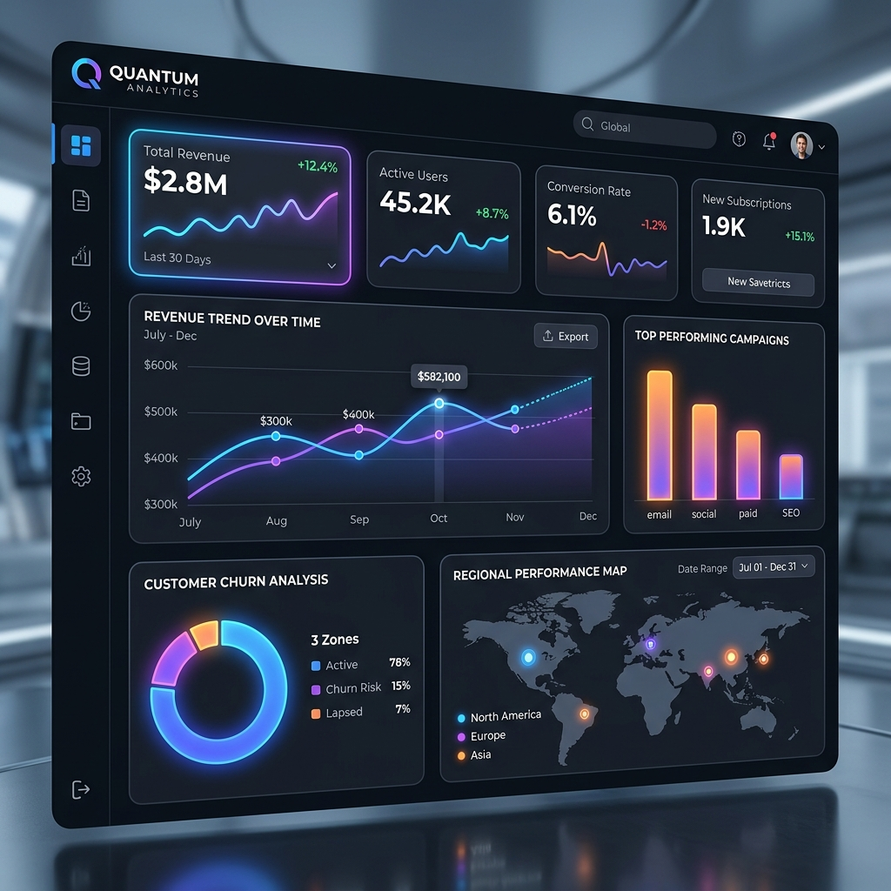
Product Foundations: Ready Systems, Faster Delivery
AppGenius Logistics CRM & Automation:
Tailored portal integrating inventory, shipping alerts, and ticket systems directly into a clean backend workflow.
DataViz Analytics Dashboard:
An executive-ready dashboard engine offering rapid charts, data consolidation, and drill-down metrics capabilities.
VisionPro Object Detection Platform:
A computer vision platform transforming camera feeds and snapshots into audit-ready operations metrics and zone compliance alerts.
Enterprise Systems Manager (ESM):
Central command center monitoring cloud health, logs, and database metrics in real-time.

Slide 5
Proven In Production: Our Active Live Systems
We maintain fully operational digital platforms running under active workloads. You can explore these live systems on our website:
Eagle Business AI Workspace: A secure, authenticated corporate workspace providing integrated AI-assisted tools and secure internal intelligence access.
TN Election Insights: A responsive, high-performance feedback and constituency voter survey analytics dashboard.
Aayus Naturals Devotional E-Commerce: A robust, full-featured retail platform showcasing catalog search, cart architecture, and rapid WhatsApp touchpoint sync.
Lakshmi Jewellery Storefront: A highly aesthetic, fluid media storefront focused on premium branding, smooth CSS grids, and high-fidelity mobile browsing.
PV School Parent Portal: A structured education portal managing academic information, admissions queries, and centralized parent communication.

Slide 6
Client Success Stories: Real Outcomes
Case Study 1: Logistics CRM & Workflow Automation
- The Problem: A logistics team spent 14 hours/week copy-pasting tracking data.
- The Solution: Custom Python synchronization scripts that automated the entire dispatch and customer notifications pipeline.
- The Result: Reduced manual workflow effort by 95% and achieved 100% data integrity.
Case Study 2: OpenSearch Energy Analytics Command Center
- The Problem: A scaling energy provider had fragmented analytics across multiple servers, making real-time KPI analysis impossible.
- The Solution: A centralized OpenSearch metrics connector generating sub-second grid health analysis and interactive trend forecasts.
- The Result: Eliminated reporting latency and reduced operational response times.

Slide 7
Transparent Pricing & High-ROI Packages
Basic Business Website (Starting from INR 5,000)
- Responsive showcase, custom contact forms, essential SEO, and 1 year maintenance.
Professional Platform Storefront (Starting from INR 8,999)
- Custom visual layouts, lead conversion paths, high-fidelity galleries, and support.
Custom B2B CRM & Dashboard (Starting from INR 12,000)
- Full lead/customer database, secure follow-up tracking, dynamic reports, and 1 year support.
AI & Intelligent Custom App (Starting from INR 25,000)
- AI-assisted workflow modules, advanced automation tasks, database scaling, and maintenance.
*Note: Every system we build includes 1 full year of dedicated maintenance and live deployment support.

Slide 8
Robust & Scalable Technology Stack
Backend & Web Foundations: Python, Flask, Node.js, and secure RESTful API architectures.
Deep Learning & Advanced Modeling: TensorFlow, Keras (LSTM forecasting models), and PyTorch ( biosignal convolutional neural networks).
Databases & Search Engines: PostgreSQL, SQLite, and OpenSearch / Elasticsearch clustering.
Modern Interface & Aesthetics: Responsive front-end layouts, glassmorphism UI components, fluid CSS transitions, and unified, solid-color brand blend layouts.
Centralized Scalability: Single-file config system (site-config.js) dynamically updating external integrations, WhatsApp gateways, and booking endpoints across all website sub-pages instantly.

Slide 9
PARTNER WITH EAGLE INNOVATIONS
Let's build your next digital system.
Tell us what is slowing your team down or what you want to launch next. We will respond with a practical, high-ROI workflow design.
🟢 Direct WhatsApp / Call: +91 82204 88716
✉️ Email Us: eaglegroupit@gmail.com
🌐 Active Digital Workspace: https://eagleinnovations.in

