Slide 1
IBM project Phase 3: development (part 1) Topic: media streaming with IBM cloud video streaming

Slide 2
Introduction to media streaming:
Streaming media is a method of delivering multimedia content, such as video or audio, to a user’s device over the internet. The content is delivered in a continuous manner, with little or no intermediate storage in network elements. The user can play back the content in real time, without actually downloading the media files.
Common forms of streaming content include: Podcasts, Webcasts, Movies, TV shows, Music videos.
Streaming media can be played back using an offline or online media player. For example, streaming TV is video content delivered over the internet instead of a cable or dish. You can watch streaming TV on a TV, tablet, phone, or laptop, if you have a decent internet connection.

Slide 3
Introduction to IBM cloud video streaming:
IBM Cloud Video, now known as IBM Watson Media, is a cloud streaming platform that offers a range of features for live and on-demand video content. It’s powered by Watson AI and offers enterprise video solutions for creating, storing, managing, and broadcasting.
IBM Watson Media’s video streaming solutions include: •Video hosting •Transcoding •Multi-platform playout •Analytics

Slide 4
IBM acquired Ustream in 2016 for up to $150 million and combined it with Aspera, Clear leap, and Clever safe to form IBM’s Cloud Video unit. Ustream was founded in 2007 by John Ham, Brad Hun stable, and Gyula Fehr. Its clientele and partners include Cisco, Sony, Discovery Communications, Georgetown University, and Samsung.
You can download a video from an IBM Video Streaming account by selecting the video and choosing download from the more menu at the top or the drop down at the end of the video entry row. IBM Video Streaming accounts will automatically have an mp4 version of their video transcoded. If the video is not yet available, an flv version will be available for download.

Slide 5
Given dataset:
Time # Log Message -0.0s 1 /bin/bash: /opt/conda/lib/libtinfo.so.6: no version information available (required by /bin/bash) 11.8s 2 {‘years’: [2011, 2012, 2013, 2014, 2015, 2016, 2017, 2018, 2019, 2020], ‘durations’: [103, 101, 99, 100, 100, 95, 95, 96, 93, 90]} 11.9s 3 {‘years’: [2011, 2012, 2013, 2014, 2015, 2016, 2017, 2018, 2019, 2020], ‘durations’: [103, 101, 99, 100, 100, 95, 95, 96, 93, 90]} 12.4s 4 show_id type title director \ 12.4s 5 0 s1 TV Show 3% NaN 12.4s 6 1 s2 Movie 7:19 Jorge Michel Grau 12.4s 7 2 s3 Movie 23:59 Gilbert Chan 12.4s 8 3 s4 Movie 9 Shane Acker 12.4s 9 4 s5 Movie 21 Robert Luketic 12.4s 10 12.4s 11 cast country \ 12.4s 12 0 João Miguel, Bianca Comparato, Michel Gomes, R... Brazil 12.4s 13 1 Demián Bichir, Héctor Bonilla, Oscar Serrano, ... Mexico 12.4s 14 2 Tedd Chan, Stella Chung, Henley Hii, Lawrence ... Singapore 12.4s 15 3 Elijah Wood, John C. Reilly, Jennifer Connelly... United States 12.4s 16 4 Jim Sturgess, Kevin Spacey, Kate Bosworth, Aar... United States 12.4s 17
12.4s 18 date_added release_year duration \

Slide 6
12.4s 18 date_added release_year duration \ 12.4s 19 0 August 14, 2020 2020 4 12.4s 20 1 December 23, 2016 2016 93 12.4s 21 2 December 20, 2018 2011 78 12.4s 22 3 November 16, 2017 2009 80 12.4s 23 4 January 1, 2020 2008 123 12.4s 24 12.4s 25 description genre 12.4s 26 0 In a future where the elite inhabit an island ... International TV 12.4s 27 1 After a devastating earthquake hits Mexico Cit... Dramas 12.4s 28 2 When an army recruit is found dead, his fellow... Horror Movies 12.4s 29 3 In a postapocalyptic world, rag-doll robots hi... Action 12.4s 30 4 A brilliant group of students become card-count.. Dramas 12.4s 31 title country genre release_year duration 12.4s 32 1 7:19 Mexico Dramas 2016 93 12.4s 33 2 23:59 Singapore Horror Movies 2011 78 12.4s 34 3 9 United States Action 2009 80 12.4s 35 4 21 United States Dramas 2008 123 12.4s 36 6 122 Egypt Horror Movies 2019 95 12.9s 37 title country \ 12.9s 38 35 #Rucker50 United States

Slide 7
12.4s 12.9s 39 55 100 Things to do Before High School United States 12.9s 40 67 13TH: A Conversation with Oprah Winfrey & Ava ... NaN 12.9s 41 101 3 Seconds Divorce Canada 12.9s 42 146 A 3 Minute Hug Mexico 12.9s 43 162 A Christmas Special: Miraculous: Tales of Lady... France 12.9s 44 171 A Family Reunion Christmas United States 12.9s 45 177 A Go! Go! Cory Carson Christmas United States 12.9s 46 178 A Go! Go! Cory Carson Halloween NaN 12.9s 47 179 A Go! Go! Cory Carson Summer Camp NaN 12.9s 48 181 A Grand Night In: The Story of Aardman United Kingdom 12.9s 49 200 A Love Song for Latasha United States 12.9s 50 220 A Russell Peters Christmas Canada 12.9s 51 233 A StoryBots Christmas United States 12.9s 52 237 A Tale of Two Kitchens United States 12.9s 53 242 A Trash Truck Christmas NaN 12.9s 54 247 A Very Murray Christmas United States 12.9s 55 285 Abominable Christmas United States 12.9s 56 295 Across Grace Alley United States 12.9s 57 305 Adam Devine: Best Time of Our Lives United States 12.9s 58

Slide 8
12.9s 57 305 Adam Devine: Best Time of Our Lives United States 12.9s 58 12.9s 59 genre release_year duration 12.9s 60 35 Documentaries 2016 56 12.9s 61 55 Uncategorized 2014 44 12.9s 62 67 Uncategorized 2017 37 12.9s 63 101 Documentaries 2018 53 12.9s 64 146 Documentaries 2019 28 12.9s 65 162 Uncategorized 2016 22 12.9s 66 171 Uncategorized 2019 29 12.9s 67 177 Children 2020 22 12.9s 68 178 Children 2020 22 12.9s 69 179 Children 2020 21 12.9s 70 181 Documentaries 2015 59 12.9s 71 200 Documentaries 2020 20 12.9s 72 220 Stand-Up 2011 44 12.9s 73 233 Children 2017 26 12.9s 74 237 Documentaries 2019 30 12.9s 75 242 Children 2020 28 12.9s 76 247 Comedies 2015 57 12.9s 77 285 Children 2012 44 12.9s 78 295 Dramas 2013 24 12.9s 79 305 Stand-Up 2019

Slide 9
Necessary steps to follow: 1.import Libraries:
Start by uploading the necessary libraries program : # Python program using Pandas for # arranging a given set of data # into a table # importing pandas as pd import pandas as pd data = {“country”: [“Brazil”, “Russia”, “India”, “China”, “South Africa”], “capital”: [“Brasilia”, “Moscow”, “New Delhi”, “Beijing”, “Pretoria”], “area”: [8.516, 17.10, 3.286, 9.597, 1.221], “population”: [200.4, 143.5, 1252, 1357, 52.98] data_table = pd.DataFrame(data) print(data_table)

Slide 10
2.Load the dataset:
To load a dataset into a Pandas Data frame, you can use the read_csv() function. For example, you can use the following code to load a media streaming dataset.
Program:
Import pandas as pd df = pd.read_csv(“data.csv”)

Slide 11
3.Exploratory data analysis:
Perform EDA to understand your data better. This includes checking for missing values ,exploring the Device’s statistics And visualising it to Identify Patterns. Program: #checking for missing values Print (df.isnull()sum()) #explore statistics Print (df.described()) #visualize the data(eg.Histograms,scatter plots etc.)

Slide 12
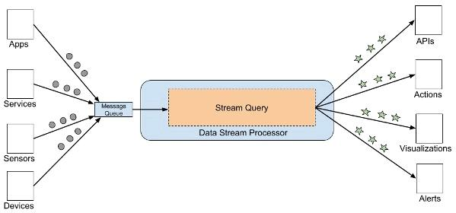
4.Feature engineering:
Depending on your dataset you may need to create new features or Transforming existing one. This can involve one-hot encoding categorical variables, handling date/time data, or scaling numerical features.
Diagram:

Slide 13
5.Split the data:
Split your dataset into training and testing sets. This helps you evaluate your model’s performance later. Program:
# Importing the turicreate Library import turicreate as tc # Now Loading the data data=tc.Sframe(“data.csv”) # Turicreate has a library named as random # split that will the data randomly among the train,test # Dev will be part of test set and we will split that data later. Train_data_set,test_data=data.random_split(.8,

Slide 14
6.Feature scaling:
Apply feature scaling to normalise your data, ensuring that all features have similar scales, standardization ( scaling to mean=0 and Std=1) is a common choice. Program: From sklearn.preprocessing import MinMaxScaler scaler = MinMaxScaler() scaled_data = scaler.fit_transform(df) scaled_df = pd.DataFrame(scaled_data, columns=df.columns scaled_df.head()

Slide 15
Importance of loading and pre-processing the dataset:
Loading a dataset is important for fast access and analysis. It can also improve data accuracy and speed up time to insights. In machine learning, loading a dataset is a significant preliminary step to build any deep learning model. You have to load and pre-process the data that you want to train your model using. Data pre-processing is essential before its actual use. Data pre-processing is the concept of changing the raw data into a clean data set. The dataset is pre-processed in order to check missing values, noisy data, and other inconsistencies before executing it to the algorithm. Data must be in a format appropriate for ML.

Slide 16
Challenges involving loading and pre-processing the dataset:
Missing data: Datasets often have missing values, which can adversely affect the performance of machine learning models. Categorical Data: Machine learning algorithms typically work with numerical data, so categorical variables need to be transformed into a numerical format. Scaling and Normalization: Features in the dataset may have different scales, which can affect the performance of algorithms like k-nearest neighbours or gradient descent-based methods. Feature Engineering: Determining which features are relevant and how to create new meaningful features from the existing ones can be complex.

Slide 17
Solutions to overcome the challenges involving loading and pre-processing the dataset:
Missing Data: Techniques such as imputation (filling missing values using statistical methods), removing rows or columns with missing values, or using advanced imputation algorithms can address this challenge. Categorical Data: Techniques like one-hot encoding (for nominal data) or label encoding (for ordinal data) can be applied to convert categorical variables into a suitable numerical format. Scaling and normalisation: Scaling methods like Min-Max scaling or standardization (z-score normalization) can be applied to bring features to a similar scale, ensuring fair comparison between t Feature engineering: domain knowledge and experimentation play a significant role in feature engineering. Techniques like PCA (Principal Component Analysis) or domain-specific transformations can help create relevant features.

Slide 18
1.Loading the dataset:
Input:
This code is for the server # Lets import the libraries import socket, cv2, pickle,struct,imutils # Socket Create server_socket = socket.socket(socket.AF_INET,socket.SOCK_STREAM) host_name = socket.gethostname() host_ip = socket.gethostbyname(host_name) print(‘HOST IP:’,host_ip) port = 9999 socket_address = (host_ip,port) # Socket Bind server_socket.bind(socket_address) # Socket Listen server_socket.listen(5) print(“LISTENING AT:”,socket_address) # Socket Accept while True: client_socket,addr = server_socket.accept()

Slide 19
print(‘GOT CONNECTION FROM:’,addr) if client_socket: vid = cv2.VideoCapture(0) while(vid.isOpened()):
img,frame = vid.read() frame = imutils.resize(frame,width=320) a = pickle.dumps(frame) message = struct.pack(“Q”,len(a))+a client_socket.sendall(message) cv2.imshow(‘TRANSMITTING VIDEO’,frame) if cv2.waitKey(1) == ‘13’: client_socket.close() Client-side Python Code: First, we will create the socket by specifying the address family and address type to the socket.socket() function. Server_socket = socket.socket(socket.AF_INET,socket.SOCK_STREAM) Now I will use the connect function to connect to the server socket. The host IP address and the port number will be the same as the serve

Slide 20
Client_socket.connect((host_ip,port)) Now we can send and receive the information using send() and recv() function. Here we will use 1024 as buffer size as TCP is a streaming protocol which means there are no message boundaries it is just the stream of message bytes. It is like FIFO and when the server will send 1024 bytes then 1024 bytes will be received by the client. Packet = client_socket.recv(1024) client_socket.send(packet) The socket can be close the socket with the close function. Client_socket.close() Here at the client-side first, we will unpack the received packet data using struct module and then will load the frame using pickle, and finally, we will display the received video. Here is the complete code for client-server.py import socket,cv2, pickle,struct # create socket client_socket = socket.socket(socket.AF_INET,socket.SOCK_STREAM) host_ip = ‘192.168.1.20’ # paste your server ip address here port = 9999 client_socket.connect((host_ip,port)) # a tuple data = b”” payload_size = struct.calcsize(“Q”) while True:

Slide 21
while len(data) < payload_size: packet = client_socket.recv(4*1024) # 4K if not packet: break data+=packet packed_msg_size = data[:payload_size] data = data[payload_size:] msg_size = struct.unpack(“Q”,packed_msg_size)[0] while len(data) < msg_size: data += client_socket.recv(4*1024) frame_data = data[:msg_size] data = data[msg_size:] frame = pickle.loads(frame_data) cv2.imshow(“RECEIVING VIDEO”,frame) if cv2.waitKey(1) == ‘13’: break client_socket.close()

Slide 22
Output:
12.9s 60 35 Documentaries 2016 56 12.9s 61 55 Uncategorized 2014 44 12.9s 62 67 Uncategorized 2017 37 12.9s 63 101 Documentaries 2018 53 12.9s 64 146 Documentaries 2019 28 12.9s 65 162 Uncategorized 2016 22 12.9s 66 171 Uncategorized 2019 29 12.9s 67 177 Children 2020 22 12.9s 68 178 Children 2020 22 12.9s 69 179 Children 2020 21 12.9s 70 181 Documentaries 2015 59 12.9s 71 200 Documentaries 2020 20 12.9s 72 220 Stand-Up 2011 44 12.9s 73 233 Children 2017 26 12.9s 74 237 Documentaries 2019 30 12.9s 75 242 Children 2020 28 12.9s 76 247 Comedies 2015 57 12.9s 77 285 Children 2012 44 12.9s 78 295 Dramas 2013 24 12.9s 79 305 Stand-Up 2019

Slide 23
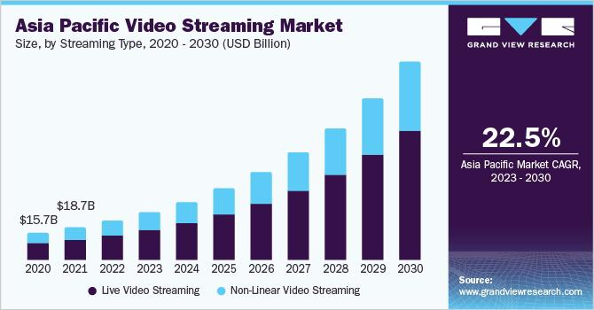
Example graph:(Asia Pacific video streaming market)

Slide 24
2.pre-processing the dataset:
Data preprocessing is the process of cleaning and transforming data to make it suitable for analysis. The goal is to make the data accurate, consistent, and suitable for analysis. It helps to improve the quality and efficiency of the data mining process.
Data preprocessing is a fundamental stage in data mining to improve data efficiency. It is the first and crucial step while creating a machine learning model.

Slide 25
Visualization and pre-processing the dataset:
Import pandas import matplotlib.pyplot as plt data = ‘iris_df.csv’ names = [‘sepal-length’, ‘sepal-width’, ‘petal-length’, ‘petal-width’, ‘class’] dataset = pandas.read_csv(data, names=names) dataset.plot(kind=‘box’, subplots=True, layout=(2,2), sharex=False, sharey=False) plt.show()

Slide 26
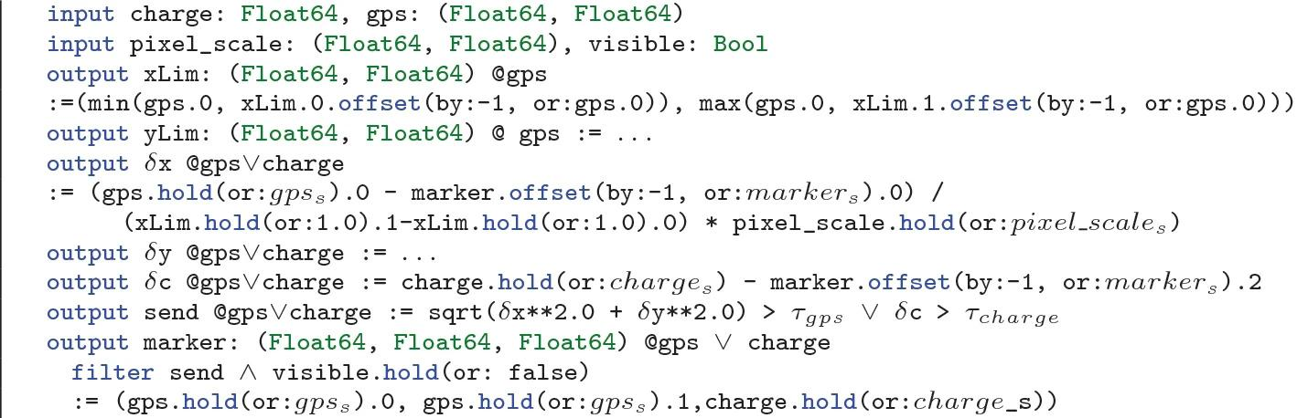
Program:

Slide 27
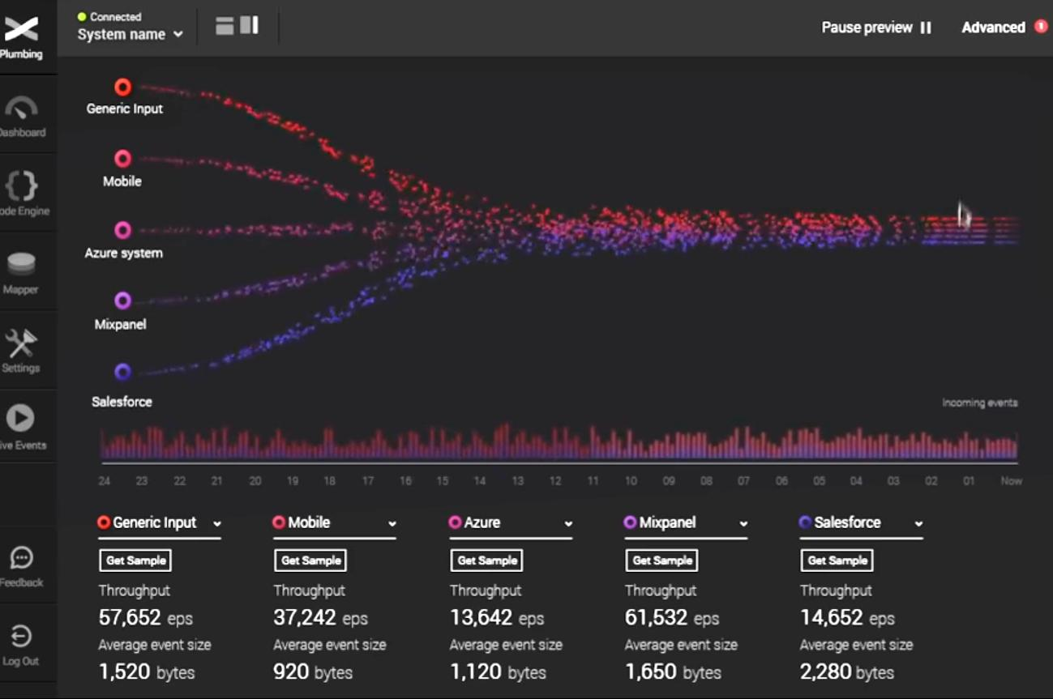

Slide 28
VISUALIZATION CORRELATION :
# Chronogram in R # including the required packages library(corrplot) head(mtcars)
Head(mtcars)
mpg cyl disp hp drat wt qsec vs am gear carb
Mazda RX4 21.0 6 160 110 3.90 2.620 16.46 0 1 4 4
Mazda RX4 Wag 21.0 6 160 110 3.90 2.875 17.02 0 1 4 4 Datsun 710 22.8 4 108 93 3.85 2.320 18.61 1 1 4 1 Hornet 4 Drive 21.4 6 258 110 3.08 3.215 19.44 1 0 3 1 Hornet Sportabout 18.7 8 360 175 3.15 3.440 17.02 0 0 3 2 Valiant 18.1 6 225 105 2.76 3.460 20.22 1 0 3 1

Slide 29
Input:
# Correlogram in R # required packages library(corrplot)
head(mtcars) #correlation matrix M<-cor(mtcars) head(round(M,2)) #visualizing correlogram
#as circle corrplot(M, method=“circle”) #as pie
corrplot(M, method=“pie”) # as colour corrplot(M, method=“color”) # as number
correlate(M, method=“number”)

Slide 30
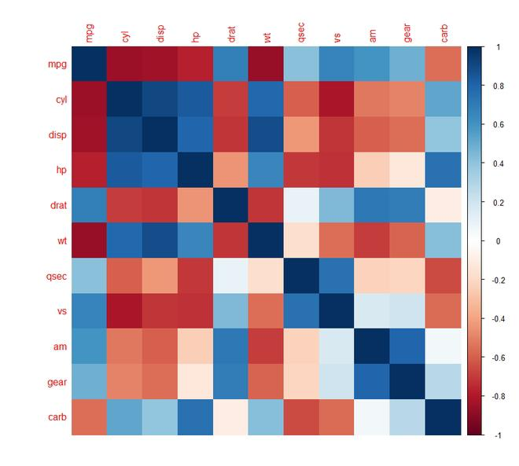
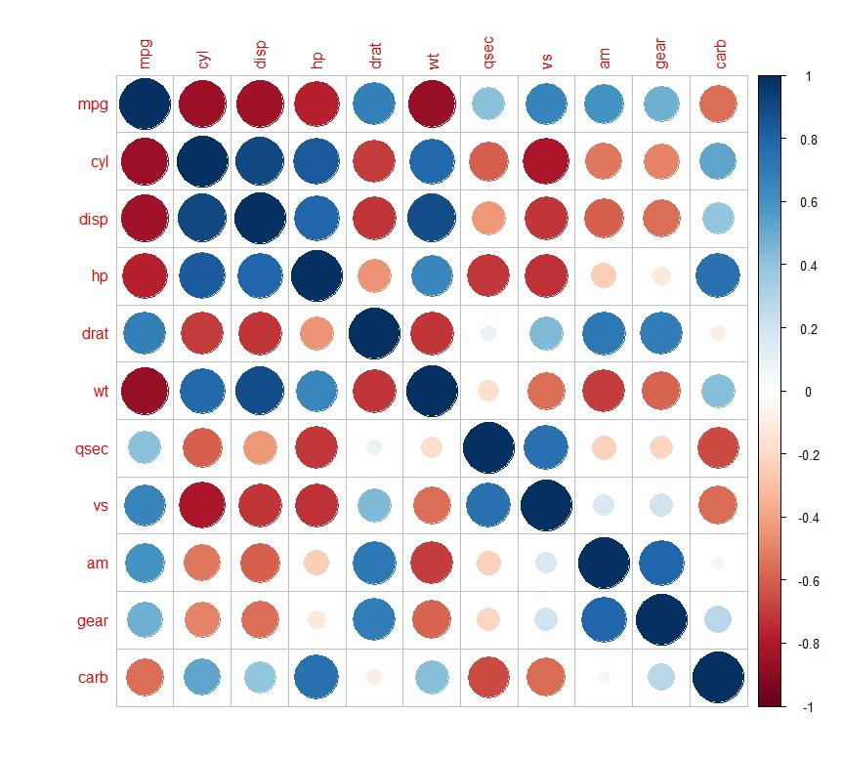
Output:

Slide 31
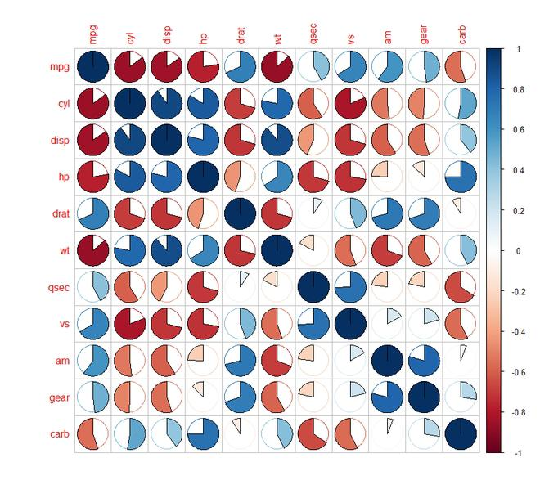
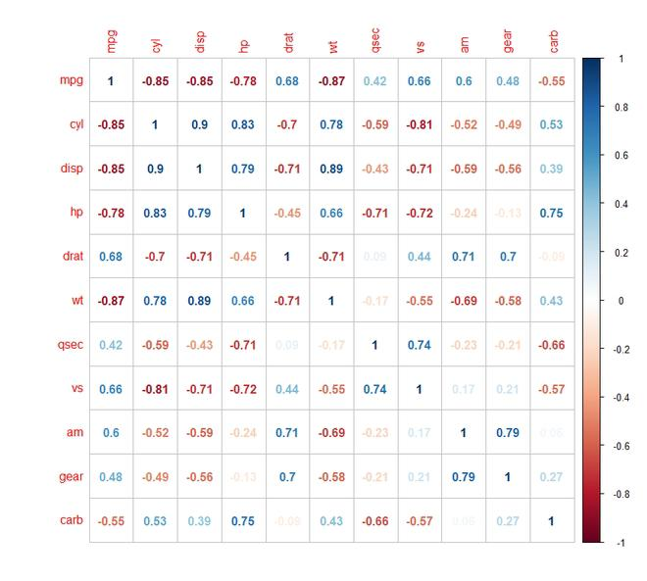

Slide 32
Some common pre-processing task include:
Data profiling:
Data profiling is the process of examining, analysing and reviewing data to collect statistics about
its quality. It starts with a survey of existing data and its characteristics. Data scientists identify
data sets that are pertinent to the problem at hand, inventory its significant attributes, and form a
hypothesis of features that might be relevant for the proposed analytics or machine learning task.
Data cleansing: The aim here is to find the easiest way to rectify quality issues, such as eliminating bad data, filling in missing data or otherwise ensuring the raw data is suitable for feature engineering

Slide 33
Data reduction:
Raw data sets often include redundant data that arise from characterizing phenomena in different ways or
data that is not relevant to a particular ML, AI or analytics task. Data reduction uses techniques like
principal component analysis to transform the raw data into a simpler form suitable for particular use
cases.
Data transformation:
Here, data scientists think about how different aspects of the data need to be organized to make the most sense for the goal. This could include things like structuring unstructured data, combining salient variables when it makes sense or identifying important ranges to focus.

Slide 34
Data enrichment:
In this step, data scientists apply the various feature engineering libraries to the data to effect the desired transformations. The result should be a data set organized to achieve the optimal balance between the training time for a new model and the required compute.
Data validation:
At this stage, the data is split into two sets. The first set is used to train a machine learning or deep learning model. The second set is the testing data that is used to gauge the accuracy and robustness of the resulting model. This second step helps identify any problems in the hypothesis used in the cleaning and feature engineering of the data. If the data scientists are satisfied with the results, they can push the preprocessing task to a data engineer who figures out how to scale it for production. If not, the data scientists can go back and make changes to the way they implemented the data cleansing and feature engineer

Slide 35
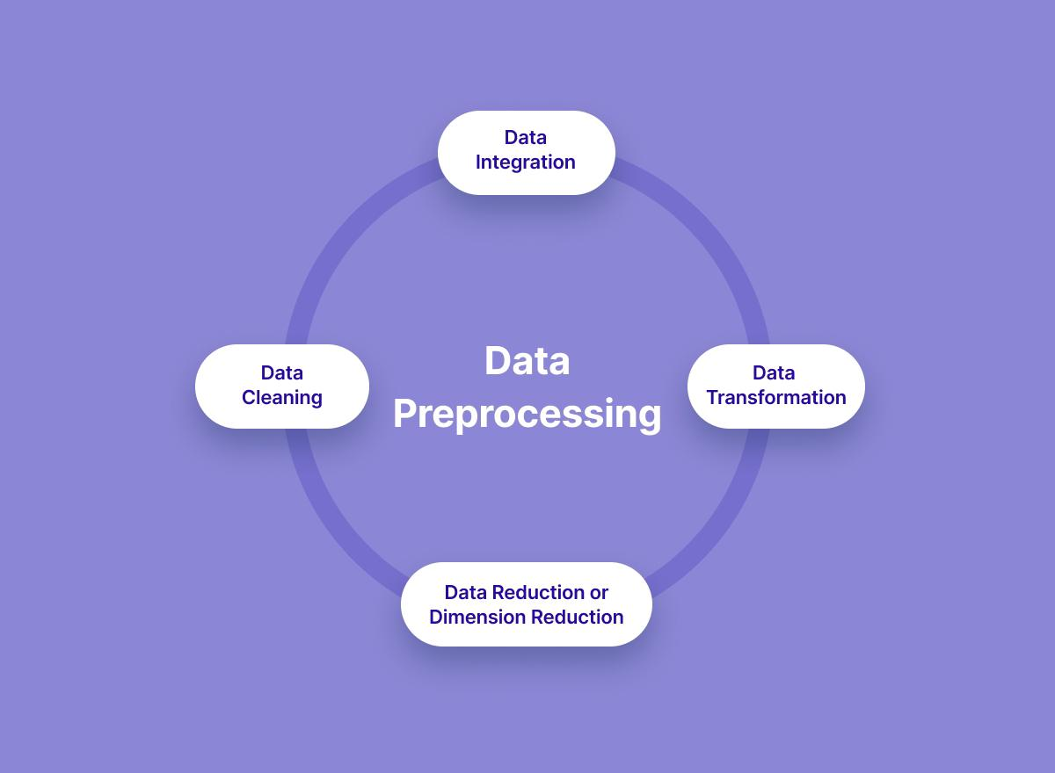

Slide 36
CODE FOR PRE-PROCESSING A DATASET IN PYTHON:
Import libraries: import pandas as pd from sklearn.pre-processing import Imputer Read the dataset: dataset = pd.read_csv(‘Data.csv’) Pre-process the data: X = dataset.iloc[:, :-1].values
imputer = imputer.fit(X[:, 1:3])

