Slide 1
Food Delivery & Sales Insights Across Multiple Restaurants
Prem Kumar Thummala
MSBA 305: Business Intelligence & Decision Support
December 5, 2024

Slide 2
Business Problem
Objective:
Analyze food delivery and sales performance across 10 restaurants.
Business Need:
Improve delivery efficiency
Identify top-performing restaurants
Improve delivery efficiency
Understand customer behavior
Optimize pricing and promotions

Slide 3

Dataset Overview
Dataset:
The dataset incorporates approximately 100,000 created simulated records which replicate actual food delivery data gathered during 2016 to 2024
Key Fields:
Restaurant, Dish, OrderDate, DeliveryTime, Status
Customer Demographics (Age, Gender, City) Pricing, Discounts, FeedbackScore

Slide 4
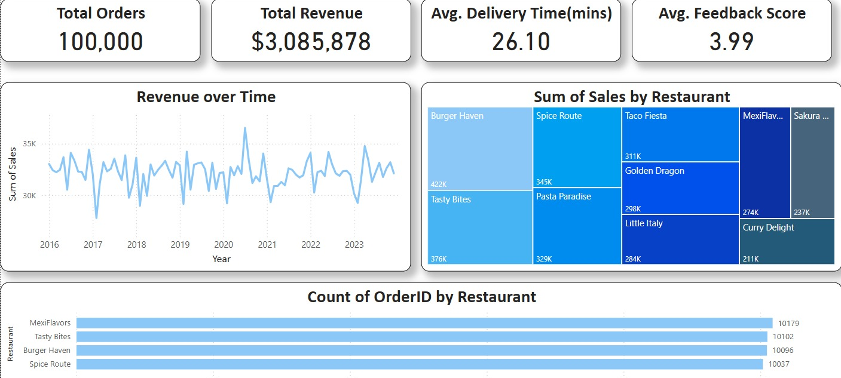
Visualizations & Key Insights
Page 1: Executive Overview
KPIs: Total Orders, Revenue, Avg Feedback, Delivery Duration
Visuals: Bar Chart (Top Restaurants), Treemap (Revenue)

Slide 5
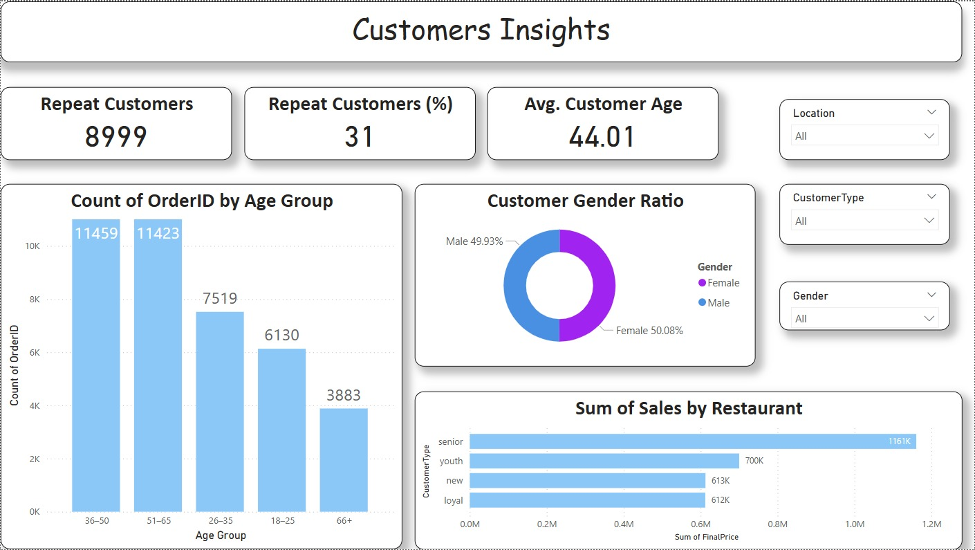
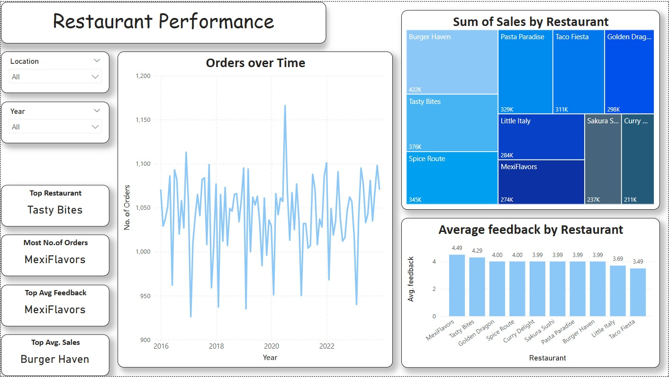
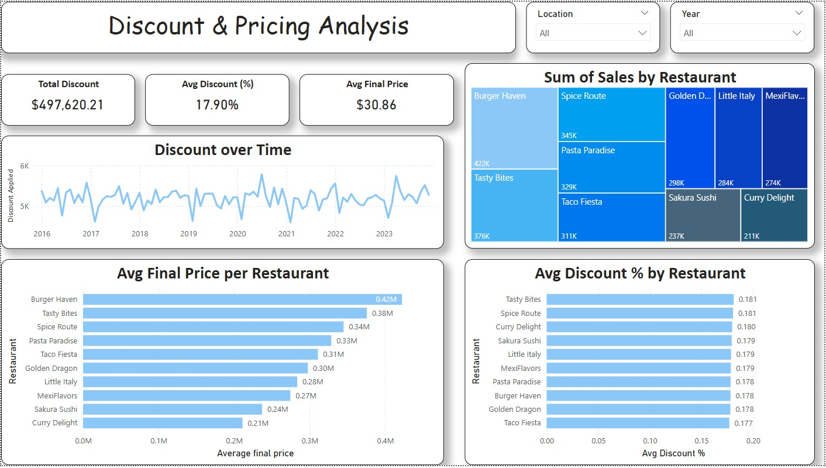
Visualizations & Key Insights
Page 2: Customer Insights
Age Group Breakdown, Gender Split, Spending by Type
Page 3-4: Restaurant Performance
Avg Revenue per Restaurant, Feedback Score Trends, Delivery Issues

Slide 6
Analytical Insights
Top Performer: “Golden Dragon” with highest revenue
Customer Base: Mostly aged 25–34; higher spending on weekends
Delivery Issues: Slight increase in delayed orders post-8 PM
Actionable Suggestion: Incentivize early deliveries, expand menu for youth

Slide 7
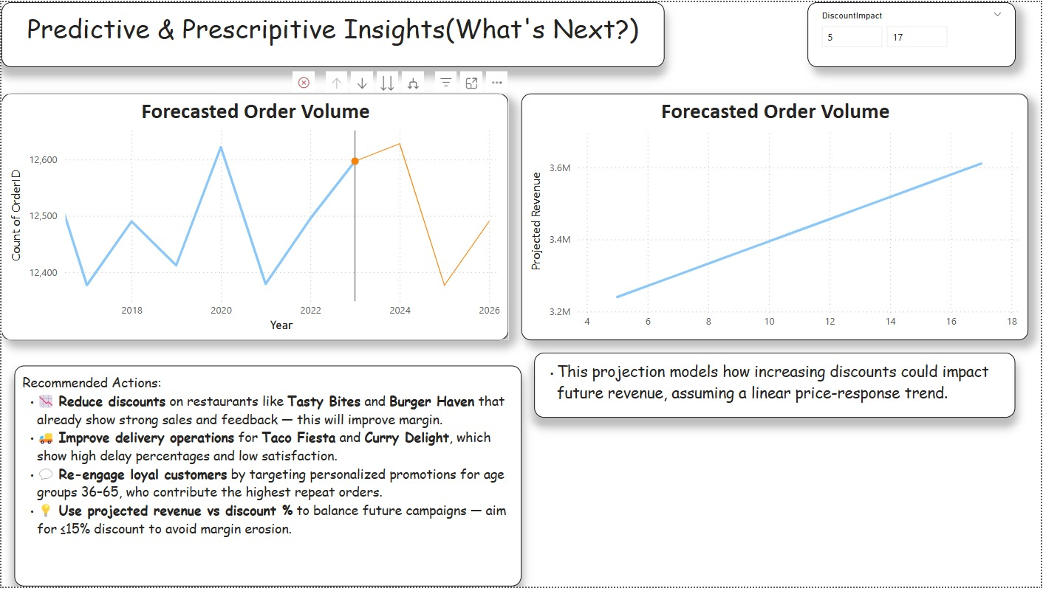
Predictive & Prescriptive Insights
Key Points on Discount Impact(slicer):
Dynamic Revenue Forecasting: The Discount Impact slicer allows users to adjust discount percentages and observe how projected revenue responds. As discounts increase, the line chart updates in real-time, illustrating a linear growth in projected revenue under the assumption that higher discounts attract more orders.
Strategic Trade-Off Visualization: This feature helps visualize the trade-off between discount size and profit margin. While revenue may increase with higher discounts (as shown by the upward slope in the chart), it also warns that excessive discounting could erode profitability if not managed against cost structures.

Slide 8

References & Sources
Kimball, R., & Ross, M. (2013). The Data Warehouse Toolkit: The Definitive Guide to Dimensional Modeling. Wiley.
Marr, B. (2016). Big Data in Practice: How 45 Successful Companies Used Big Data Analytics to Deliver Extraordinary Results. Wiley.
McKinsey & Company. (2020). The future of food delivery. Retrieved from https://www.mckinsey.com/
Tableau Software. (2021). Data visualization best practices. Retrieved from https://www.tableau.com/learn/articles/data-visualization
Harvard Business Review. (2018). Why Companies Should Invest in Predictive Analytics. Retrieved from https://hbr.org/
Kaggle. (n.d.). Datasets for business intelligence projects. Retrieved from https://www.kaggle.com/
Gandomi, A., & Haider, M. (2015). Beyond the hype: Big data concepts, methods, and analytics. International Journal of Information Management, 35(2), 137–144.
Sicular, S. (2013). Gartner’s Big Data Definition Consists of Three Parts, Not to Be Confused with Three “V”s. Gartner Blog Network.
Chen, M., Mao, S., & Liu, Y. (2014). Big Data: A Survey. Mobile Networks and Applications, 19(2), 171–209. https://doi.org/10.1007/s11036-013-0489-0
Davenport, T. H., & Harris, J. G. (2007). Competing on Analytics: The New Science of Winning. Harvard Business Press.
Cheng, Y., & Koehler, J. (2020). Optimizing discount strategies using machine learning: A case study on online food delivery platforms. Journal of Business Analytics, 5(2), 113–129.
Grewal, D., Hulland, J., Kopalle, P. K., & Karahanna, E. (2020). The future of technology and marketing: A multidisciplinary perspective. Journal of Marketing, 84(1), 1–28.

