Slide 1
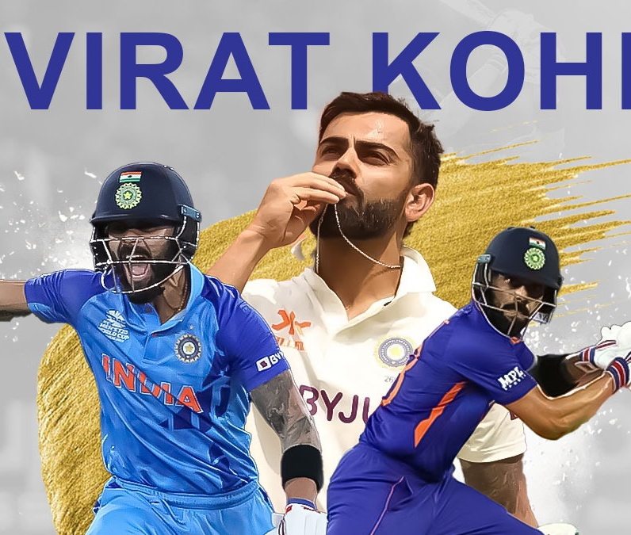
Descriptive and Regression Analysis of Virat Kohli's ODI Batting Performance
Exploring Key Metrics, Trends, and Predictive Insights from 2008–2024
Presented by: Prem kumar Thummala Sai Praneeth Adusumalli Naga Mukesh Chandra Naidu Rudravaram

Slide 2
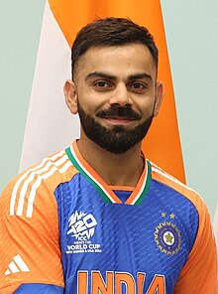
Introduction
Kohli is undoubtedly one among the greatest ODI batsmen, with more than 12000 runs and a healthy batting average.
“Chase Master” and “Run Machine” have been the other names due to his consistency in the track field.
Cricket is a game of dimensions and the performance of the players depends for matters of fact upon the number of runs made by the player, the rate at which they scored, the time which the player spent during his innings and so on.
Using Kohli’s data assists in revealing patterns that present the opportunity to explain his performances and his need for development.

Slide 3


Data Collection:
Source of data was – ESPNcricinfo Statsguru of the period between 2008 till 2024. The dataset is made of 295 matches, of which 283 innings involve run, batting average, strike rate, boundary and other performance parameters.
Such measures also exist as balls faced converted to minutes faced while using strike rate for the missing values, which makes the dataset complete for analysis.

Slide 4

Objectives
Primary Objectives:
To find out correlations important in explaining Kohli’s batting average and strike-rate such as time taken on the crease.
So that he could know whether boundary percentage, minutes faced or strike rate impacts him in a particular manner. .
Secondary Objective:
To construct an inference mechanism in view of significant attributes with a view to making precise prediction concerning the position of Kohli as a batsman.

Slide 5
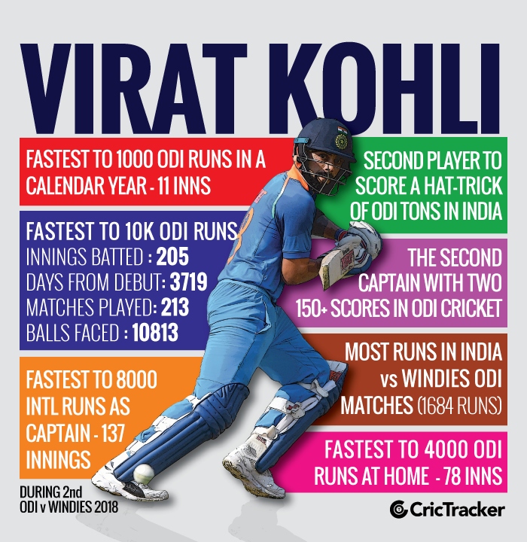
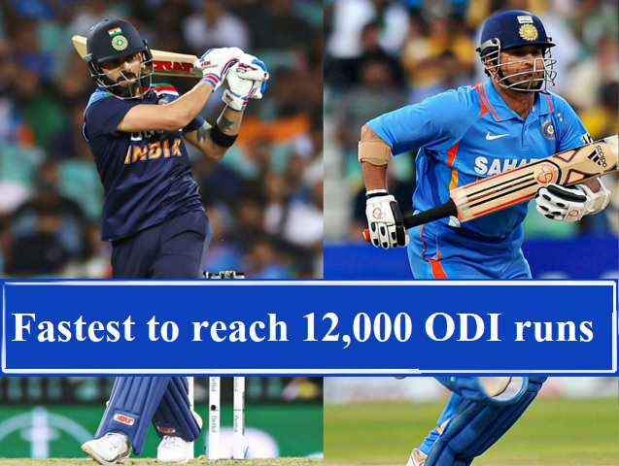
Data Overview
Source: ESPNcricinfo Statsguru.
Time Span: 2008–2024.
Key Statistics: Runs (total runs scored), Batting Average (mean = 58.18), Strike Rate (mean = 93.54), Minutes Faced, Balls Faced, Boundaries (4s and 6s).
This dataset represents Virat Kohli's ODI career between 2008 to 2024, showing his consistency and impact as a batsman.
Span | Mat | Inns | Runs | HS | Ave | BF | SR | 100 | 50 | 4s | 6s
2008–2024 | 295 | 283 | 13,906 | 183 | 58.18 | 14,866 | 93.54 | 50 | 72 | 1,302 | 151

Slide 6

Data Cleaning
Data Cleaning:
Due to the nature of the data collected, some cleaning was done on the data set to remove a number of issues including missing values or even duplication..
Handling Missing Values:
36 missing values in the minutes faced column were estimated using the formula:
Minutes=(Balls Faced/Strike Rate)×60
This imputation was useful in providing estimates that were relevant to cricket analysis and more importantly consistent with other statistical measures.

Slide 7
Descriptive Statistics of Key Performance Metrics
The mean for runs per innings (49.1) indicates consistency, though the standard deviation (43.01) suggests some variability.
The median of 37 is also low due to odd low scoring values skewing the scores slightly.
For someone who is an aggressive batsman, Kohlis, 80.92 is a good strike rate indeed.
Metric | Mean | Median | Standard Deviation
Runs per Innings | 49.1 | 37 | 43.01
Balls Faced | 52.53 | 47 | 39.15
Strike Rate | 80.92 | 82.64 | 36.06
Minutes Faced | 38.89 | 42 | 22.48

Slide 8
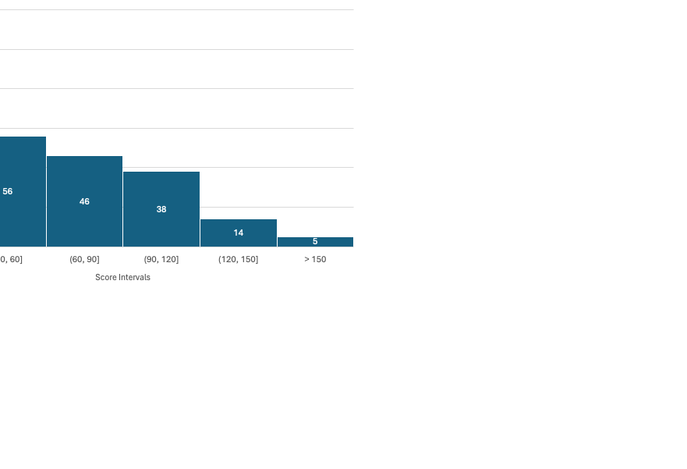
Exploratory Data Analysis (EDA)
Runs Distribution (Histogram)
The highest individual score belongs to Virat Kohli with 183 runs, which exactly lies in the 150+ range, however, maximum number of matches he scored between 0-30 runs with 127.

Slide 9
Dismissal Types (Pie Chart)
Caught has occurred the most often in the cases of Virat Kohli’s dismissal, close to it in frequency Bowled and Not Out.
The least frequent dismissals are Hit Wicket and Stumped.

Slide 10
Batting Position and Performance Analysis
Batting Positions | Average of SR | Sum of Runs | Avg batting average
1 | 75 | 115 | 28.8
2 | 43 | 51 | 12.8
3 | 80 | 11785 | 61.4
4 | 81 | 1767 | 58.9
5 | 105 | 127 | 25.4
6 | 209 | 23 | 0.00
7 | 109 | 38 | 12.7
The total number of runs at each of the top Positions is given by: Kohli clearly performs best at Position 3, with a large decline in the number of runs at lower Positions.
That is why the places 5, 6, and 7 are significantly lower than in Runs; it is less effective at the bottom of the list.

Slide 11
Batting Performance Across Different Positions
Position 3 Shows Consistent High Performance: Position 3 has been Kohli’s most successful and consistent batting position given that he has one of the higher batting averages and striking rate of 61.4 and 80 respectively.
Significant Decline in Lower Batting Positions: Kohli is very inconsistent in Positions 5, 6, and 7, and this can be seen in Positions 6 which has a strike rate of 209, but an average bat of 0.

Slide 12
Opposition Analysis
Consistency Against Strong Opponents: Despite challenging opposition, Kohli maintains impressive averages against Australia (Avg: 50.4) and New Zealand (Avg: 53.1), highlighting his reliability in high-pressure matches.
Dominant Performance Against Specific Teams: Kohli exceptional strike rates and averages against teams like Afghanistan (SR: 102.3), West Indies (SR: 86.4), and Bangladesh (SR: 85.7), reflecting his ability to capitalize on weaker bowling attacks.

Slide 13
Venue Analysis (Home vs. Away Performance)
Kohli’s higher Strike Rate of 96.70 at Home suggests more aggressive batting in familiar conditions, while his Away Strike Rate of 90.81 reflects his ability to anchor innings when needed.
While Kohli scores more Runs Away (7638) than at Home (6268), his Strike Rate remains consistently high, with 90.81 Away and 96.70 at Home.
This indicates his adaptability to varying playing conditions.

Slide 14
Key Insights and Findings from the Analysis
Highlight the Batting Trends
Kohli excels at Position 3 with the highest Batting Average (61.4) and significant Runs (11,785).
His performance across batting positions shows remarkable consistency and adaptability.
Strike Rate Insights
Strike Rates vary across batting positions and against opponents, indicating situational awareness and his ability to adapt the playing style.
Higher strike rates are recorded at Home (96.7) compared to Away matches (90.81).
Key Observations from Opposition Analysis
Strong performances against Bangladesh (SR: 85.7), West Indies (SR: 86.4), and Afghanistan (SR: 102.3)highlight his dominance over particular teams.
Comparatively lower averages and strike rates against England and South Africa can indicate areas for further focus.
Descriptive Statistics Summary
Across all matches, Kohli’s Mean Runs per Innings = 49.1, showcasing remarkable consistency.

Slide 15
Regression Analysis of Kohli’s ODI Performance
Objectives:
To analyze the impact of Batting Position (Pos), Balls Faced (BF), and Strike Rate (SR) on Runs (Y).
To understand how each variable influences Kohli's batting performance.
Variables Used:
Y (Dependent Variable): Runs scored in the match.
X1 (Independent Variable 1): Batting Position (Pos).
X2 (Independent Variable 2): Balls Faced (BF).
X3 (Independent Variable 3): Strike Rate (SR).
Model Overview:
Multiple Linear Regression was used for the purpose of finding a relationship between Runs with respect to the predictors Pos, BF and SR.
R-Square value itself is 94.15% which shows that whatever variance is there in the data has largely explained by the model.

Slide 16
SUMMARY OUTPUT
Regression Statistics
Multiple R | 0.970345984
R Square | 0.941571329
Adjusted R Square | 0.940943063
Standard Error | 10.45410652
Observations | 283
ANOVA
 | df | SS | MS | F | Significance F
Regression | 3 | 491366.1777 | 163788.726 | 1498.68432 | 1.141E-171
Residual | 279 | 30491.44772 | 109.288343
Total | 282 | 521857.6254
 | Coefficients | Standard Error | t Stat | P-value | Lower 95% | Upper 95% | Lower 95.0% | Upper 95.0%
Intercept | -14.77308887 | 3.174081537 | -4.6542878 | 5.031E-06 | -21.021278 | -8.5248994 | -21.021278 | -8.5248994
X Variable 1 | -1.143864851 | 0.933671225 | -1.225126 | 0.22156104 | -2.9817996 | 0.69406988 | -2.9817996 | 0.69406988
X Variable 2 | 0.951283861 | 0.018550386 | 51.2810826 | 4.734E-144 | 0.91476737 | 0.98780035 | 0.91476737 | 0.98780035
X Variable 3 | 0.218182635 | 0.02016013 | 10.8224814 | 5.0553E-23 | 0.17849736 | 0.25786791 | 0.17849736 | 0.25786791

Slide 17
Key Insights from Regression Model
Strong Model Fit:
R-Square = 94.15%, meaning 94.15% of the variance in Runs can be explained by the model.
Impact of Variables:
Balls Faced (BF):
Strong positive relationship with Runs, highly significant with a p-value of 4.73E-144.
Strike Rate (SR):
Positive effect on Runs, with a p-value of 5.05E-23, indicating morr statistical significance.
Batting Position (Pos):
No significant relationship with Runs (p-value = 0.221).
Model Coefficients:
Intercept: -14.77 (baseline Runs when all variables are zero).
Pos (Position): -1.14 (indicating a slight, but insignificant negative impact).
BF (Balls Faced): 0.95 (strong positive relationship).
SR (Strike Rate): 0.22 (moderate positive effect).

Slide 18
Model Diagnostics: Analyzing Residuals for Fit and Accuracy
Large Residuals as Outliers: Observations 21, 79, 113, 183, and 259 show large residuals can be considered as potentially influential observations which can impact the performance of the current model.
Residual Variability: The other residuals stand between overprediction and underprediction, which means that the model is a good fit most of the time.

Slide 19
Performance: Yearly Trends and Key Insights
Consistent Growth in Runs: Kohli’s total runs show steady growth, particularly in the mid-2010s, reflecting his development as a top ODI batsman.
Stable and Aggressive Strike Rate: There is barely any change in Kohli’s strike rate showing that he has been aggressive throughout the series.

Slide 20
Centuries Over the Years
Consistent Centuries Against Key Teams: Kohli has scored the most centuries against Sri Lanka (10) and West Indies (9), showcasing dominance over these teams throughout his career.
Peak Century Years: Kohli reached his peak form in 2017, 2018, and 2023, with 6 centuries in each of these years, indicating consistent high performance during these periods.

Slide 21
Limitations and Assumptions
Data Limitations:
It refers only to Kohli’s performance up to ODI matches until his year 2024; it is not equal to all matches, he sometimes gets injured or need a break.
The analysis focuses primarily on Kohli's centuries and does not include a comprehensive review of all his performances across various formats or situations.
Simplified Assumptions:
Taken for granted that Kohli’s batting performances in the last few years as a batsman are the same no matter the playing style (ODI, Test, or T20).
Some other factors such as the venue characteristics (turf type, weather conditions) were kept constant over the years to make the analysis smooth.
Match Context Not Considered:
Did not take into account some contextual parameters such as; match pressure, the strength of the opposition, or certain match conditions like playing World cup or a bilateral series.
Performance Variables:
Other potential influential factors, for example, players’ injuries, team interrelationships, and weather conditions are not incorporated into the model.

Slide 22

Insights from Historical Data & Future Predictions
Historical Insights: Kohli’s That falls in part to Kohli’s 50 ODI centuries, most of which were achieved against the top teams including Australia. He has improved his performance starting 2018-2019 academic year.
Future Predictions: With this, the data makes it easier to forecast future performances, which may be useful in devising match strategies. Suppose, employing complicated models and machine learning, it would be possible to hone an ability to make a prediction depend on match conditions and opposition.

Slide 23
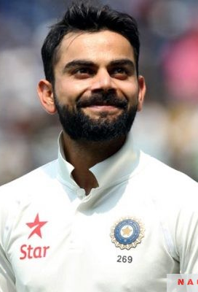
Conclusion – Performance Consistency & Key Predictors
Consistency in Batting: Kohli's consistent performance, especially at position 3, has been a key to his success. His adaptability across teams, conditions, and formats has sustained his excellence.
Key Predictors: Regression From the model that has been done using regression analysis, the variable that has been most influential in Kohli’s run-scoring are the balls faced and the strike rate. This explains why he has been very useful for his target team by offering stout resistance irrespective of the venue and the opponent.
Kohli’s innings especially during pressure circumstances demonstrates his tactical an imperative asset as ODI batsman.

Slide 24
Final Observations and Key Takeaways
The analysis of Kohli’s career data highlights key trends, such as his consistency in performance and the factors influencing his success, like balls faced and strike rate.
By applying regression analysis and trend identification, the study successfully demonstrated how specific factors correlate with Kohli's performance.
The analysis can serve as a foundation for further predictive models, which can be used for strategic match planning and player developent.
Closing Thought: This data-driven approach can inform predictive models for match strategy and player development, with potential applications for other players.

Slide 25
Acknowledgments & References
Acknowledgments:
Data sourced from ESPN Cricinfo for Kohli's career statistics.
Tools used: Excel (including Analysis ToolPak) for data processing and PowerPoint for visualization.
Gratitude to cricket analysts and statisticians for their insights into performance analysis.
References:
ESPN Cricinfo: Kohli's ODI Stats

