Slide 1

Process Mining Virtual Internship
by
S.Premnath reddy
Roll No. 214G1A3280
Department of Computer Science and Engineering(Data Science)
Srinivasa Ramanujan Institute of Technology
Autonomous
Rotarypuram Village, BKS Mandal, Ananthapuram – 515701.
2023-2024

Slide 2
Contents
Introduction
Steps
Technology
Modules
Applications of Process Mining
Conclusion
References

Slide 3
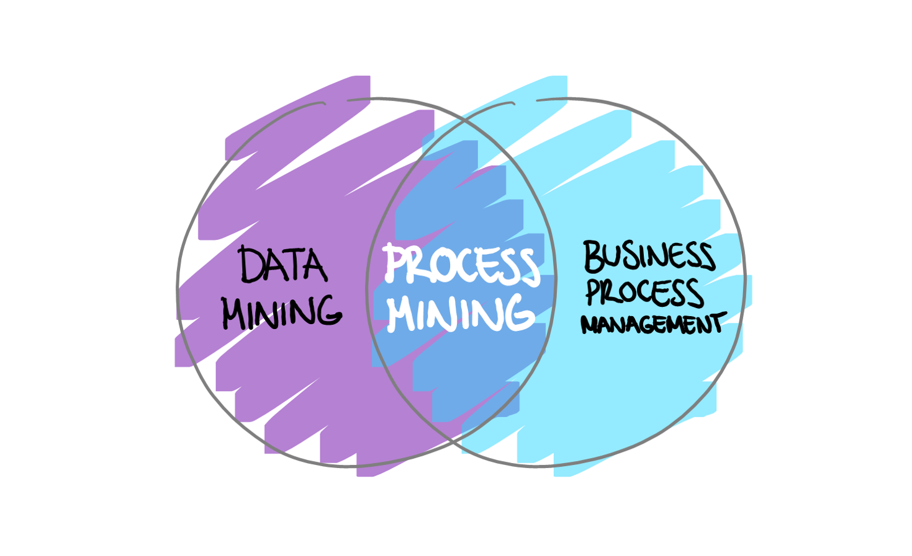
Introduction
Process mining is a technique designed to discover, monitor and improve real processes (i.e., not assumed processes) by extracting readily available knowledge from the event logs of information systems.

Slide 4
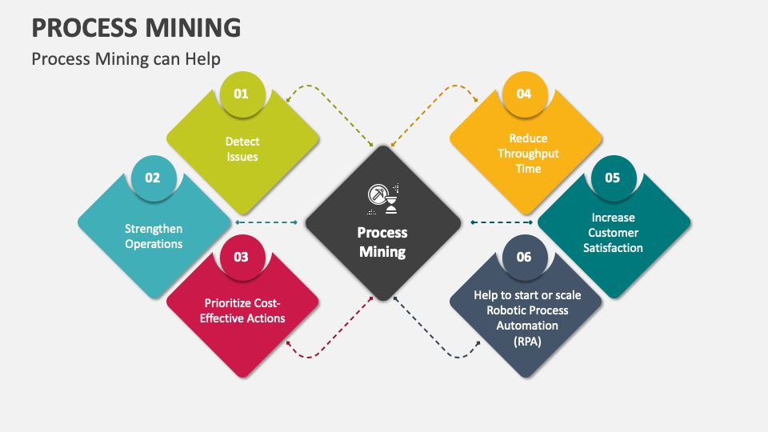
Intro..

Slide 5
Celonis Process Mining Steps
Data Extraction:
Extract event log data from various sources such as ERP systems, databases, or application logs.
Data Preparation:
Clean and preprocess the data to ensure accuracy and consistency.
Process Discovery:
Use Celonis algorithms to automatically generate a visual process model.
Conformance Analysis:
Compare the discovered process model with actual event data to identify discrepancies.

Slide 6
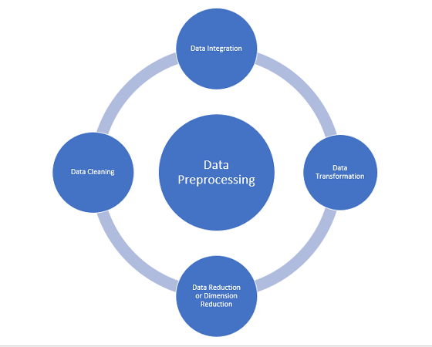
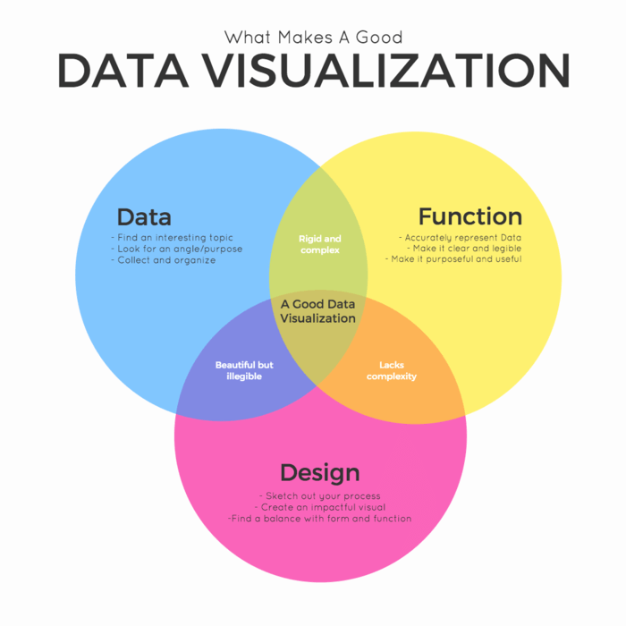
TECHNOLOGY
Data Preprocessing: Before analysis can begin, event logs often need to be cleaned and preprocessed. This might involve removing duplicates, handling missing data, and transforming raw data into a more suitable format for analysis.
Data Visualization: Interactive visualizations play a crucial role in process mining. They help stakeholders understand complex process behaviors, bottlenecks, and other patterns.

Slide 7
MODULES
STEPS INVOLVED IN PROCESS MINING:
DATA COLLECTION:
Data collection is a foundational step in the process mining methodology. It involves gathering event data from various sources within an organization's information systems, databases.
DATA UNDERSTANDING:
Data understanding in process mining refers to the process of gaining a comprehensive understanding of the data that will be used for analysis. This step is essential to ensure that the data is suitable, relevant, and of high quality for conducting effective process mining analyses.

Slide 8
contd…
Data preparation:
It is a crucial step in the process mining workflow. It involves transforming and structuring the raw event data into a suitable format for analysis.
Data modeling:
Data modeling in process mining refers to the creation of graphical representations or mathematical models that capture the behavior, structure, and characteristics of business processes using the event data collected.
Data evaluating:
In the context of process mining, data evaluation involves assessing the quality, relevance, and appropriateness of the data before and during the analysis.

Slide 9
Applications of Process Mining
Customer Journey Analysis:
Identify pain points and areas for improvement in customer journeys.
Risk Management:
Identify and mitigate risks by analyzing deviations and potential issues in processes.
Human Resources:
Analyze HR processes such as recruitment, onboarding, and performance management.
Healthcare Process Analysis:
Analyze patient treatment pathways, hospital operations.

Slide 10
Conclusion
Process mining stands as a powerful methodology that bridges the gap between theoretical process models and real-world business operations.
Process mining also plays a pivotal role in compliance monitoring and risk management, ensuring that organizations adhere to regulations and internal policies.
It involves not only data analysis and technical expertise but also a thorough understanding of the business context and its objectives.
As technology continues to evolve,process mining is likely to become even more sophisticated and integrated into various industries.
In a world where data-driven insights drive success, process mining stands as a beacon of opportunity.

Slide 11
References
[1] Ref website: https://academy.celonis.com/learning-paths/execution-management.
[2] Execution management link : https://tinyurl.com/2pvuuzmd.
[3] Login page : https://academy-login.celonis.com/s/login/.

Slide 12


