Slide 1


Segmentation of images
Vitor Souza Premoli Pinto de Oliveira¹
¹Federal University of Espírito Santo
Artificial Intelligence Applied to Images
Federal University of Espírito Santo
Artificial Intelligence Applied to Images
Segmentation of images

Slide 2


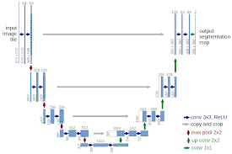
Intoduction
Objectives
Introduction;
Rats’ tibias segmentation;
Fully Convolutional Network (FCN);
U-Net: Convolutional Networks;
Skip connection;
Biomedical images;
Kaggle applications with Keras;
Conclusion
Others neural networks;
Federal University of Espírito Santo
Artificial Intelligence Applied to Images
Segmentation of images

Slide 3
SEGMENTATION OF IMAGES
Introduction
Federal University of Espírito Santo
Artificial Intelligence Applied to Images
Segmentation of images

Slide 4
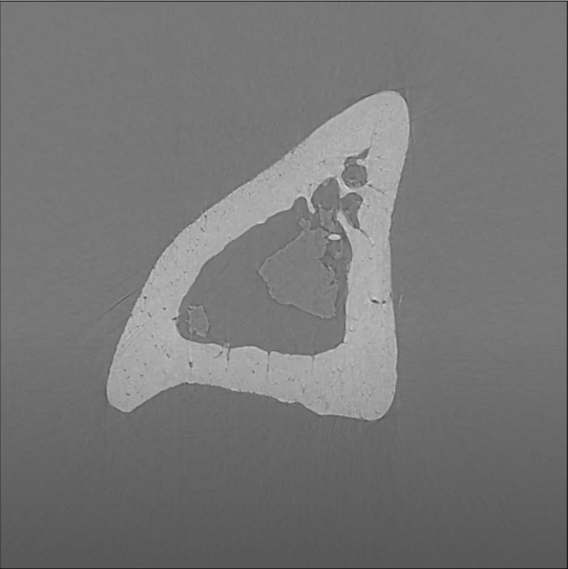
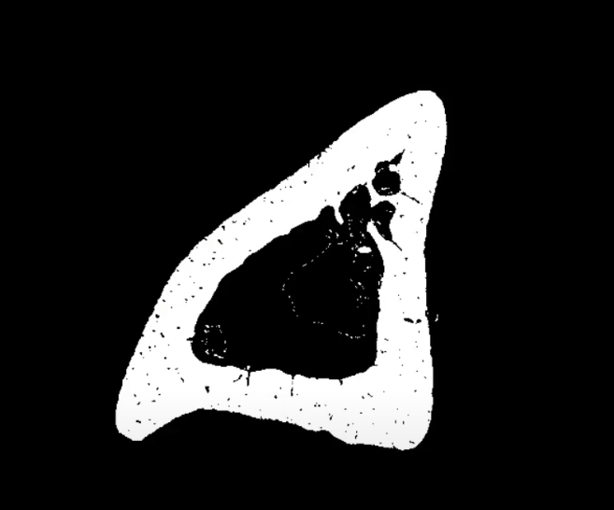
Segmentation of images
Introduction
Rats’ tibias segmentation
Federal University of Espírito Santo
Artificial Intelligence Applied to Images
Segmentation of images

Slide 5
Segmentation of images
Introduction
Rats’ tibias segmentation
is it possible to segment the mouse tibia image by neural networks?
Federal University of Espírito Santo
Artificial Intelligence Applied to Images
Segmentation of images

Slide 6
Segmentation of images
Introduction
Rats’ tibias segmentation
Manual segmentation methods can be very tedious, time-consuming and subject to inter and intraindividual variability (TINGELHOF, 2008).
Automatic segmentation methods can overcome these problems, nevertheless their performance is in many cases adversely affected by low tissue contrast and image artifacts. Traditional segmentation methods are often based on conventional computer vision and machine learning approaches(GONZALEZ & WOODS, 2018)(SÁNCHEZ, 2020).
Recently, methods based on deep learning have demonstrated a potential to notably outperform the traditional methods in medical image analysis (SÁNCHEZ, 2020).
Federal University of Espírito Santo
Artificial Intelligence Applied to Images
Segmentation of images

Slide 7
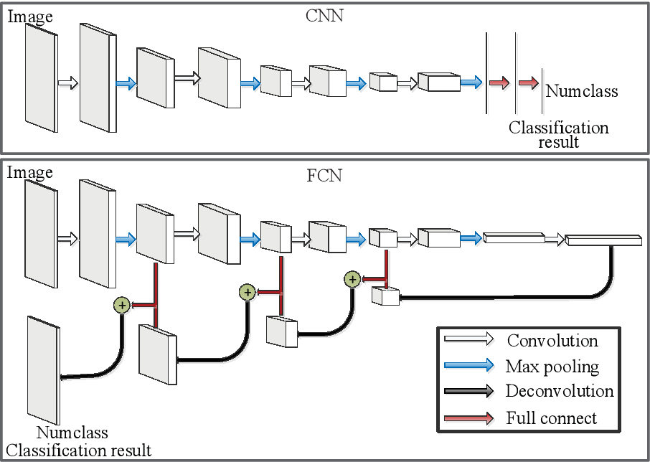
Segmentation of images
Introduction
Fully Convolutional Network (FCN)
Fully Convolutional Networks (FCN) emerged from a structural change in the composition of conventional classification CNNs. Its history is recent, and its purpose is different: instead of classifying the image as a whole, its purpose is to segment it into different classes.
LI, CHEN, LIU, JIAO (2018)
Federal University of Espírito Santo
Artificial Intelligence Applied to Images
Segmentation of images

Slide 8
SEGMENTATION OF IMAGES
U-Net: Convolutional Networks
Federal University of Espírito Santo
Artificial Intelligence Applied to Images
Segmentation of images

Slide 9
Segmentation of images
U-Net: Convolutional Networks
Skip connection
A convolutional layer consists of a set of learnable filters (kernels) that can detect specific features in the input image. The resulting feature maps represent abstractions of the input image; the deeper the CNN network is the more abstract information the feature maps contain. One or more subsequent fully connected layers combined with a softmax layer can be used for classification tasks. For image segmentation, however, the encoded abstract information has to be decoded to form the segmented image.
This approach was first applied in the fully convolutional network (FCN) by Shelhamer (2017). Better segmentation results were achieved when the encoder and decoder parts were organized in levels and connected with skip connections. This design known as the U-Net was first implemented by Ronneberger et al (2015), in 2D and later extended to 3D by Çiçek (2016).
LI, CHEN, LIU, JIAO (2018)
Federal University of Espírito Santo
Artificial Intelligence Applied to Images
Segmentation of images

Slide 10
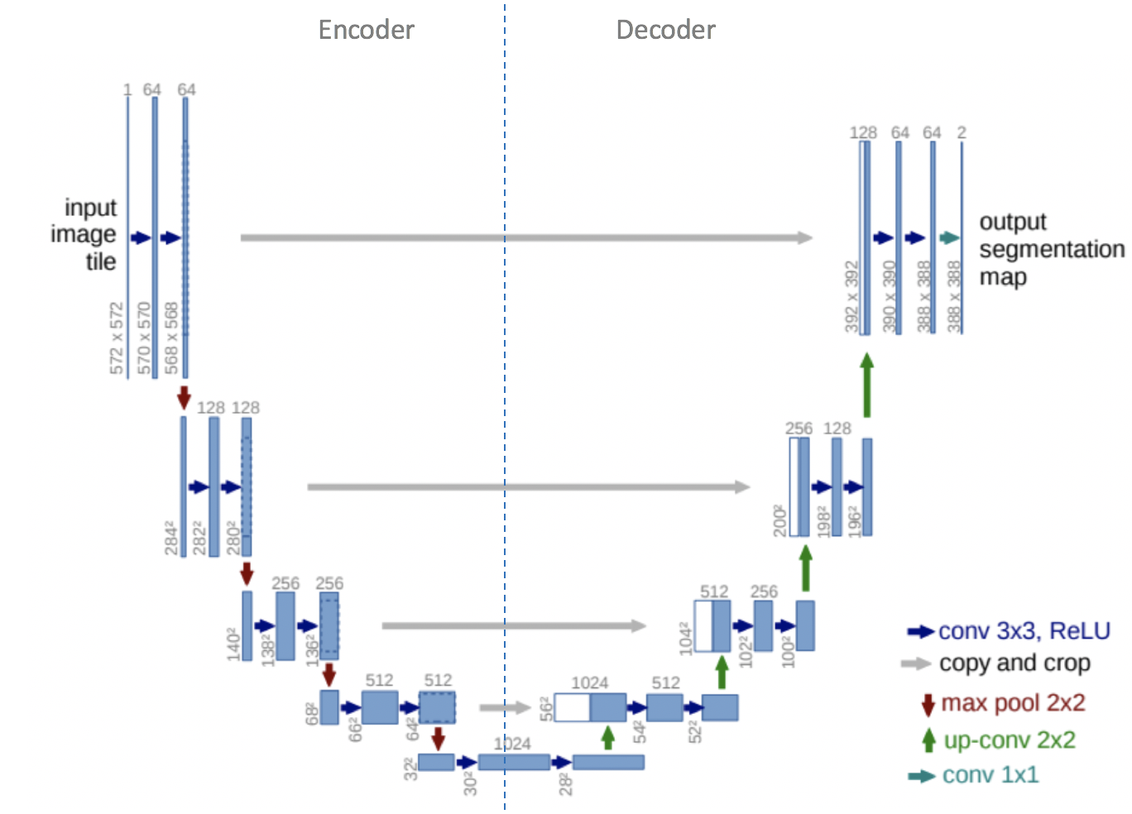
Segmentation of images
U-Net: Convolutional Networks
Biomedical images
UNet, evolved from the traditional convolutional neural network, was first designed and applied in 2015 to process biomedical images(ZHANG, 2022).
As a general convolutional neural network focuses its task on image classification, where input is an image and output is one label, but in biomedical cases, it requires us not only to distinguish whether there is a disease, but also to localise the area of abnormality
U-net architecture. Blue boxes represent multi-channel feature maps, while while boxes represent copied feature maps. The arrows of different colors represent different operations
Federal University of Espírito Santo
Artificial Intelligence Applied to Images
Segmentation of images

Slide 11
SEGMENTATION OF IMAGES
Kaggle applications with Keras
Federal University of Espírito Santo
Artificial Intelligence Applied to Images
Segmentation of images

Slide 12
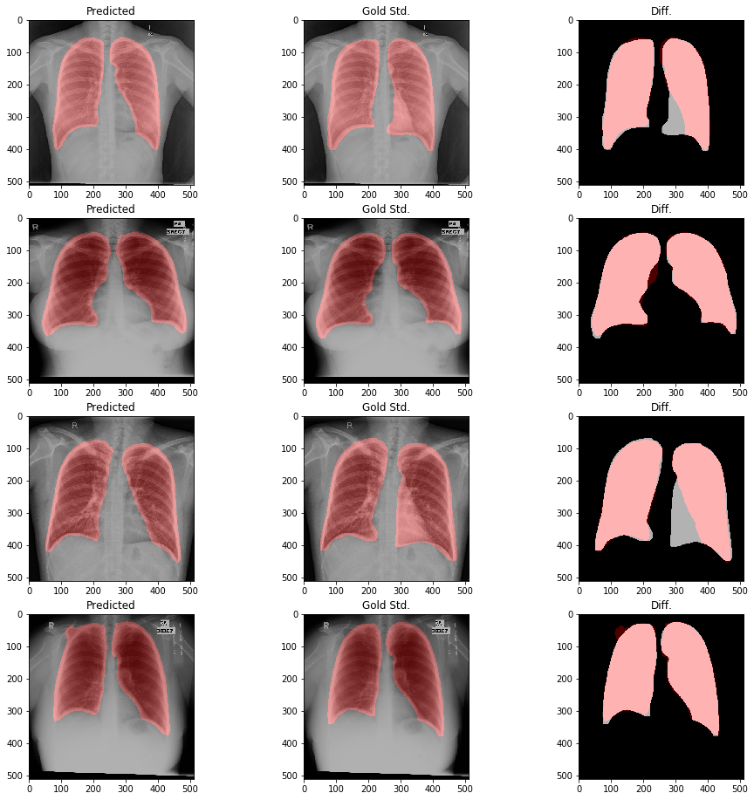
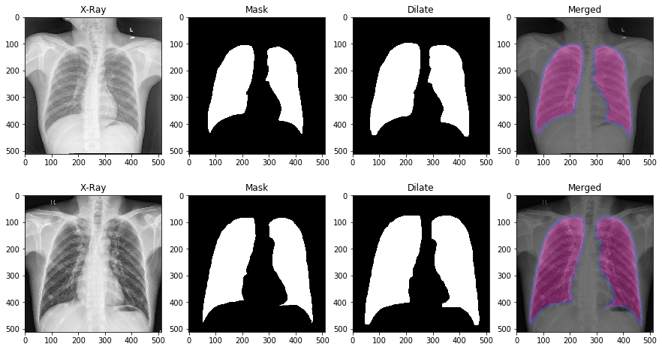
Segmentation of images
Kaggle applications with Keras
Biomedical images
U-Net lung segmentation (Montgomery + Shenzhen)
https://www.kaggle.com/eduardomineo/u-net-lung-segmentation-montgomery-shenzhen/notebook
Federal University of Espírito Santo
Artificial Intelligence Applied to Images
Segmentation of images

Slide 13
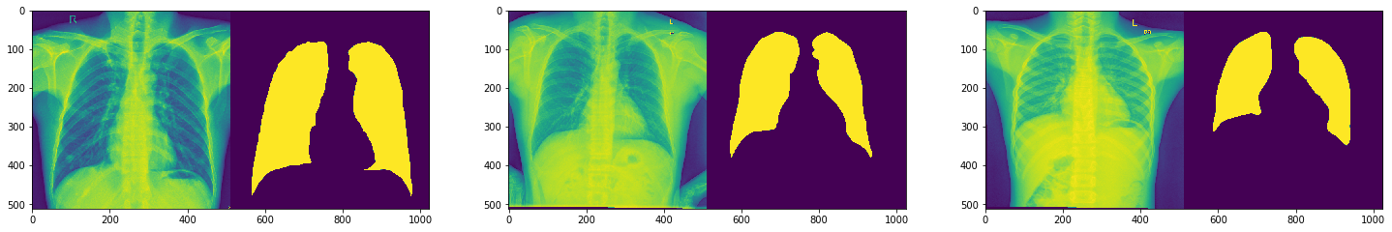
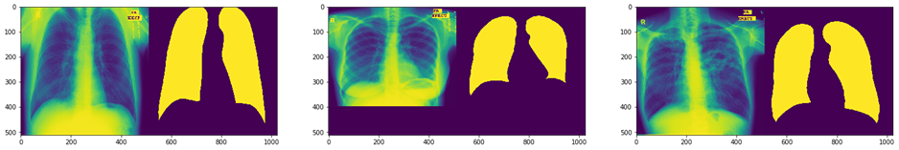
Segmentation of images
Kaggle applications with Keras
Biomedical images
Training set
Testing set
Lung segmentation from Chest X-Ray dataset
https://www.kaggle.com/nikhilpandey360/lung-segmentation-from-chest-x-ray-dataset/notebook
Federal University of Espírito Santo
Artificial Intelligence Applied to Images
Segmentation of images

Slide 14
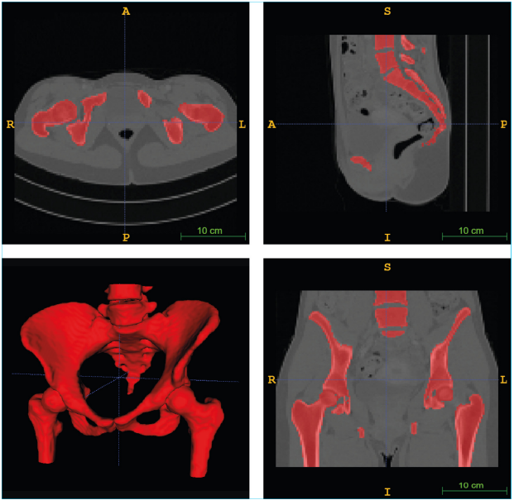
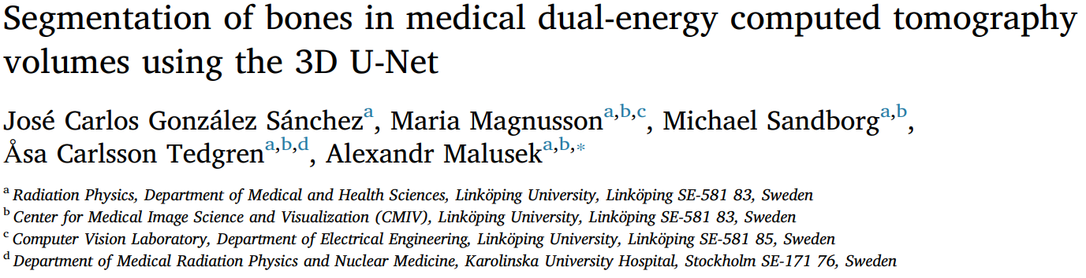
Segmentation of images
Kaggle applications with Keras
Biomedical images
Federal University of Espírito Santo
Artificial Intelligence Applied to Images
Segmentation of images

Slide 15
SEGMENTATION OF IMAGES
Conclusion
Federal University of Espírito Santo
Artificial Intelligence Applied to Images
Segmentation of images

Slide 16

Segmentation of images
Conclusion
Others neural networks
Metrics:
“The network performed well on all the data sets; the mean Dice coefficient for the test data was larger than 0.963[…] he corresponding increase in the Dice coefficient from 0.965 to 0.966 was small since the enhancements were mainly at the edges of the bones (SÁNCHEZ, 2020).
“We match the performance of UNet, for which predictions are averaged over seven rotations of the input images, while using less parameters and without sophisticated class weighting. Note that among other FCN available on the leader board, CUMedVision is using postprocessing in order to boost performance” (Bibliographic review by DROZDZAL, 2016).
Many examples using U-net and easy availability of the code either through Kaggle or Github.
Federal University of Espírito Santo
Artificial Intelligence Applied to Images
Segmentation of images

Slide 17
REFERENCES
Tingelhoff K, Eichhorn KWG, Wagner I, Kunkel ME, Moral AI, Rilk ME, et al. Analysis of manual segmentation in paranasal CT images. Eur Arch Otorhinolaryngol 2008;265(9):1061–70. https://doi.org/10.1007/s00405-008-0594-z.
Gonzalez RC, Woods RE. Digital Image Processing. 4th ed. New York, NY: Pearson; 2018.
SÁNCHEZ, José Carlos González et al. Segmentation of bones in medical dual-energy computed tomography volumes using the 3D U-Net. Physica Medica, v. 69, p. 241-247, 2020.
Shelhamer E, Long J, Darrell T. Fully convolutional networks for semantic segmentation. IEEE Trans Pattern Anal Mach Intell 2017;39(04):640–51. https://doi. org/10.1109/TPAMI.2016.2572683.
Ronneberger O, Fischer P, Brox T. U-net: Convolutional networks for biomedical image segmentation. In: Medical Image Computing and Computer-Assisted Intervention (MICCAI); vol. 9351 of LNCS. Springer; 2015, p. 234–241. (available on arXiv:1505.04597 [cs.CV]).
Çiçek Ö, Abdulkadir A, Lienkamp SS, Brox T, Ronneberger O. 3D U-net: Learning dense volumetric segmentation from sparse annotation. In: Ourselin S, Joskowicz L, Sabuncu MR, Unal G, Wells W, editors. Medical Image Computing and ComputerAssisted Intervention – MICCAI 2016. Cham: Springer International Publishing; 2016, p. 424–432.https://doi.org/10.1007/978-3-319-46723-8_49.
ZHANG, Jeremy. UNet — Line by Line Explanation: Example UNet Implementation. Available in: https://towardsdatascience.com/unet-line-by-line-explanation-9b191c76baf5 . Access in: 08 FEB. 2022
DROZDZAL, Michal et al. The importance of skip connections in biomedical image segmentation. In: Deep learning and data labeling for medical applications. Springer, Cham, 2016. p. 179-187.
EXTRA
RONNEBERGER, Olaf; FISCHER, Philipp; BROX, Thomas. U-net: Convolutional networks for biomedical image segmentation. In: International Conference on Medical image computing and computer-assisted intervention. Springer, Cham, 2015. p. 234-241.
Segmentation of images
Vitor Souza Premoli Pinto de Oliveira¹
¹Federal University of Espírito Santo
Artificial Intelligence Applied to Images
Federal University of Espírito Santo
Artificial Intelligence Applied to Images
Segmentation of images

