Slide 1


ANN: ConvNet with Keras
Vitor Souza Premoli Pinto de Oliveira¹
¹Federal University of Espírito Santo
Artificial Intelligence Applied to Images
Federal University of Espírito Santo
Artificial Intelligence Applied to Images
Deep ANNs applied to images

Slide 2


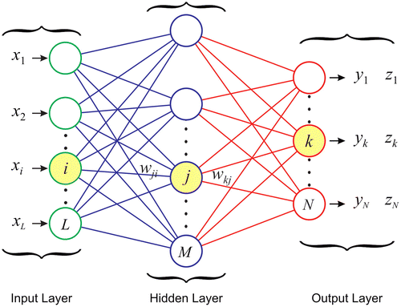
Intoduction
Objectives
Importing dataset and making Exploratory Data Analysis;
Show the mathematical logic behind CNN;
Choose hyperparameters through Grid Search CV;
After made the evaluation, verify if models with best hyperparameters have statistic differences.
Make data augmentation
Make predictions
Federal University of Espírito Santo
Artificial Intelligence Applied to Images
Deep ANNs applied to images

Slide 3
MNIST
Exploratory Data Analysis
Federal University of Espírito Santo
Artificial Intelligence Applied to Images
Deep ANNs applied to images

Slide 4
MNIST
Exploratory Data Analysis
Extracting the dataset
#dataset
from tensorflow.keras.datasets import mnist
(X_train1, y_train1), (X_test1, y_test1) = mnist.load_data()
X1 = np.concatenate((X_train1, X_test1))
y = np.concatenate((y_train1, y_test1))
img_size = 28
X = X1.reshape(-1, img_size, img_size, 1)
.npz (NumPy Zipped Data)
Channels first means that in a specific tensor (consider a photo), you would have (Number_Of_Channels, Height , Width).
Channels last means channels are on the last position in a tensor(n-dimensional array).(Height , Width, Number_Of_Channels)
TensorFlow: Channels last order.
Federal University of Espírito Santo
Artificial Intelligence Applied to Images
Deep ANNs applied to images

Slide 5
MNIST
Exploratory Data Analysis
Extracting the dataset
# Random seed
key_random = random.SystemRandom()
seed = key_random.randint(0,30)
X_training, X_testing, y_training, y_testing = train_test_split(X, y, test_size=0.2, random_state = seed)
Shapes
X_training:(56000, 28, 28, 1)
X_testing:(14000, 28, 28, 1)
y_training:(56000,)
y_testing:(14000,)
Federal University of Espírito Santo
Artificial Intelligence Applied to Images
Deep ANNs applied to images

Slide 6
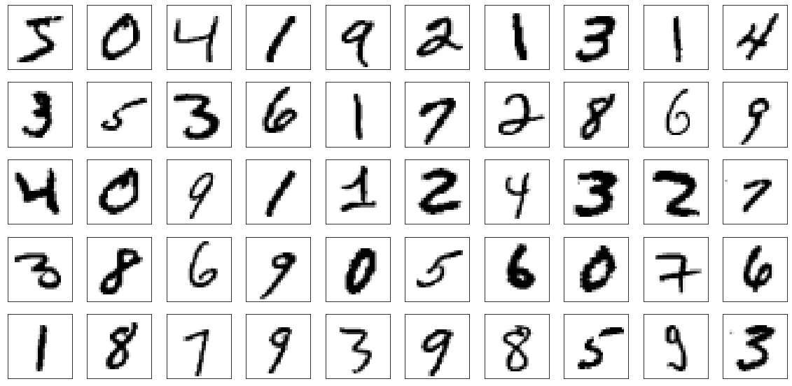
MNIST
Exploratory Data Analysis
Extracting the dataset
Federal University of Espírito Santo
Artificial Intelligence Applied to Images
Deep ANNs applied to images

Slide 7
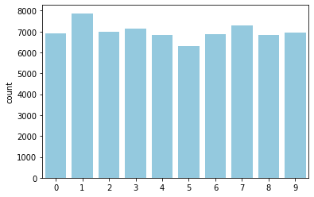
MNIST
Exploratory Data Analysis
Extracting the dataset
Federal University of Espírito Santo
Artificial Intelligence Applied to Images
Deep ANNs applied to images

Slide 8
DEEP LEARNING MODEL
CONVOLutional neural network
Federal University of Espírito Santo
Artificial Intelligence Applied to Images
Deep ANNs applied to images

Slide 9
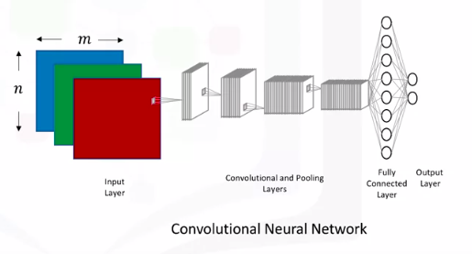
DEEP LEARNING MODEL
CONVOLutional neural network
Architecture
CONVOLutional neural network (CVN)
It’s a stack of Conv2D and MaxPooling2D layers. Convnet takes as input tensors of shape (image_height, image_width, image_channels), not including the batch dimension (CHOLLET, 2021).
The patterns they learn are translation-invariant. After learning a certain pattern in the lower-right corner of a picture, a convnet can recognize it anywhere: for example, in the upper-left corner. A densely connected model would have to learn the pattern anew if it appeared at a new location (CHOLLET, 2021).
Federal University of Espírito Santo
Artificial Intelligence Applied to Images
Deep ANNs applied to images

Slide 10
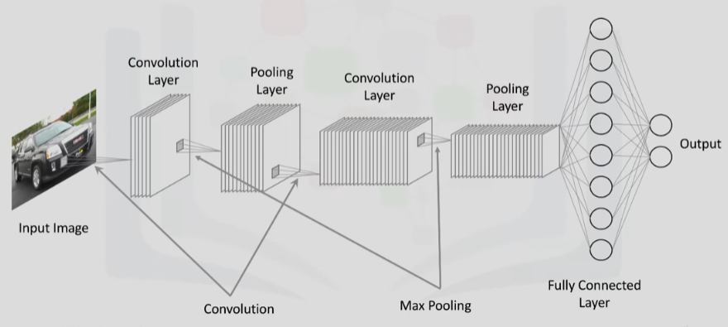
DEEP LEARNING MODEL
CONVOLutional neural network
Architecture
Federal University of Espírito Santo
Artificial Intelligence Applied to Images
Deep ANNs applied to images

Slide 11
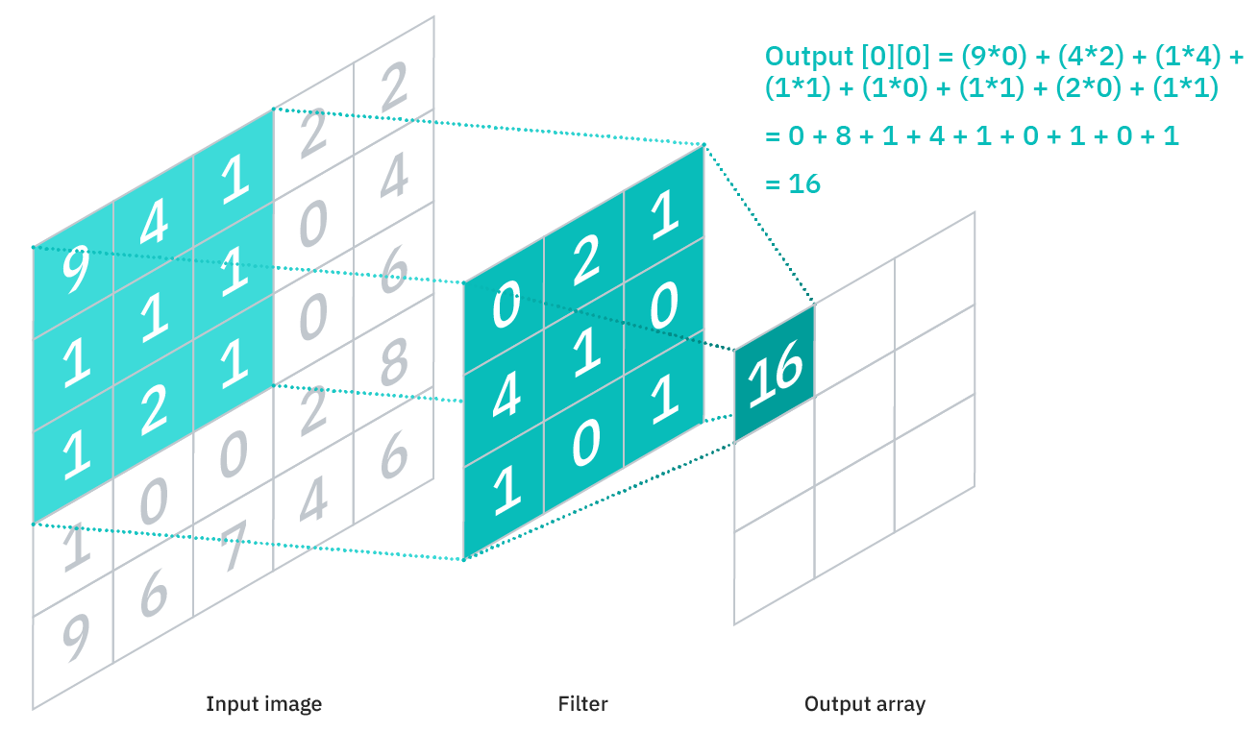
DEEP LEARNING MODEL
CONVOLutional neural network
Architecture
Federal University of Espírito Santo
Artificial Intelligence Applied to Images
Deep ANNs applied to images

Slide 12
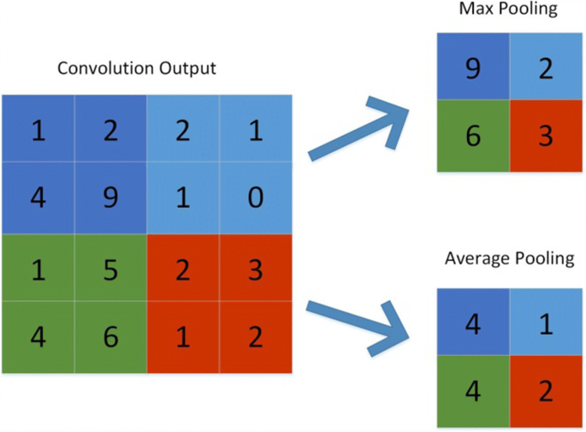
DEEP LEARNING MODEL
CONVOLutional neural network
Architecture
Federal University of Espírito Santo
Artificial Intelligence Applied to Images
Deep ANNs applied to images

Slide 13
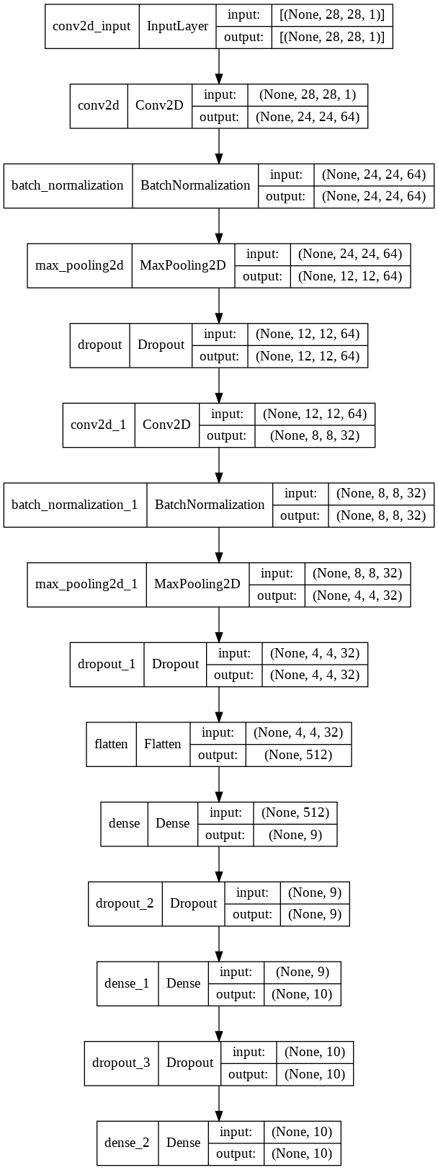
DEEP LEARNING MODEL
CONVOLutional neural network
Final model
MLP
Federal University of Espírito Santo
Artificial Intelligence Applied to Images
Deep ANNs applied to images

Slide 14
HYPERPARAMETERS
Grid Search CV
Federal University of Espírito Santo
Artificial Intelligence Applied to Images
Deep ANNs applied to images

Slide 15
HYPERPARAMETERS
Grid Search CV
Parameters
# fourth layer: max or average pooling 2d + dropout
if pool_type == 'max':
CNNkeras.add(MaxPooling2D(pool_size=(2, 2)))
if pool_type == 'average':
CNNkeras.add(AveragePooling2D(pool_size=(2, 2)))
if dropout_rate != 0:
CNNkeras.add(Dropout(rate=dropout_rate))
# final layer - MLP
CNNkeras.add(Flatten())
#Transforming matrix in vector by Flatten command, therefore use a simple mlp for classification
for i, nodes in enumerate(layers):
if i==0:
CNNkeras.add(Dense(nodes, activation=activation))
if dropout_rate != 0:
CNNkeras.add(Dropout(rate=dropout_rate))
else:
CNNkeras.add(Dense(nodes, activation=activation))
if dropout_rate != 0:
CNNkeras.add(Dropout(rate=dropout_rate))
#output
CNNkeras.add(Dense(10, activation='softmax'))
# Compile model
CNNkeras.compile(
optimizer='adam',
loss='sparse_categorical_crossentropy',
metrics=['accuracy'])
return CNNkeras
def CNN_model(input_kernel_size,
second_kernel_size,
third_kernel_size,
layers,
input_filter,
pool_type,
activation,
optimizer,
dropout_rate):
CNNkeras = Sequential()
# first layer: convolution
CNNkeras.add(Conv2D(input_filter,
kernel_size=input_kernel_size,
activation='relu', input_shape=(28, 28, 1)))
CNNkeras.add(BatchNormalization())
#second layer: max or average pooling 2d + dropout
if pool_type == 'max':
CNNkeras.add(MaxPooling2D(pool_size=(2, 2)))
if pool_type == 'average':
CNNkeras.add(AveragePooling2D(pool_size=(2, 2)))
if dropout_rate != 0:
CNNkeras.add(Dropout(rate=dropout_rate))
#third layer: convolution
CNNkeras.add(Conv2D(64, kernel_size=third_kernel_size,
activation=activation))
CNNkeras.add(BatchNormalization())
Federal University of Espírito Santo
Artificial Intelligence Applied to Images
Deep ANNs applied to images

Slide 16
HYPERPARAMETERS
Grid Search CV
What’s Grid Search?
early_stop = EarlyStopping(monitor = 'val_accuracy',
mode = 'max',
patience=5, restore_best_weights=True)
#My scores
scores = {'accuracy' :make_scorer(accuracy_score),
'f1' :make_scorer(fbeta_score, beta = 1, average='micro')}
#Grid
param_grid = dict(epochs = (10, 20),
batch_size=[1000],
input_filter = [64],
input_kernel_size = [(5,5), (10,10)],
second_kernel_size = [(5,5), (10,10)],
third_kernel_size = [(3,3), (5,5)],
#final_kernel_size = [(5,5),(4,4),(3,3),(1,1)],
activation = ['relu', 'tanh'],
optimizer = ['Adam'],
dropout_rate=[0.2,0.6],
layers = [[9,10]],
pool_type = ['max', 'average'])
kfold = StratifiedKFold(n_splits=10, shuffle=True)#, random_state=seed)
Kmodel = KerasClassifier(build_fn=CNN_model, verbose=1)
grid = GridSearchCV(estimator=Kmodel,
param_grid=param_grid,
cv=kfold,
scoring=scores,
refit='accuracy')
grid_result = grid.fit(X_train/255.0, y_training,
validation_data=(X_test/255.0, y_testing),
callbacks = [early_stop])
Hyper-parameters are parameters that are not directly learnt within estimators. In scikit-learn they are passed as arguments to the constructor of the estimator classes.(SCIKIT-LEARN, 2021)
GridSearchCV is a module in Scikit Learn and is used extensively to automate much of the tuning process. The primary purpose of GridSearchCV is to create combinations of parameters and then evaluate them.
Based on a "list"" of parameters, GridSearchCV will create the combinations and then evaluate them
from sklearn.model_selection import GridSearchCV
from keras.callbacks import EarlyStopping
Federal University of Espírito Santo
Artificial Intelligence Applied to Images
Deep ANNs applied to images

Slide 17
HYPERPARAMETERS
Grid Search CV
What’s Grid Search?
early_stop = EarlyStopping(monitor = 'val_accuracy',
mode = 'max',
patience=5, restore_best_weights=True)
#My scores
scores = {'accuracy' :make_scorer(accuracy_score),
'f1' :make_scorer(fbeta_score, beta = 1, average='micro')}
#Grid
param_grid = dict(epochs = (10, 20),
batch_size=[1000],
input_filter = [64],
input_kernel_size = [(5,5), (10,10)],
second_kernel_size = [(5,5), (10,10)],
third_kernel_size = [(3,3), (5,5)],
#final_kernel_size = [(5,5),(4,4),(3,3),(1,1)],
activation = ['relu', 'tanh'],
optimizer = ['Adam'],
dropout_rate=[0.2,0.6],
layers = [[9,10]],
pool_type = ['max', 'average'])
kfold = StratifiedKFold(n_splits=10, shuffle=True)#, random_state=seed)
Kmodel = KerasClassifier(build_fn=CNN_model, verbose=1)
grid = GridSearchCV(estimator=Kmodel,
param_grid=param_grid,
cv=kfold,
scoring=scores,
refit='accuracy')
grid_result = grid.fit(X_train/255.0, y_training,
validation_data=(X_test/255.0, y_testing),
callbacks = [early_stop])
Test the accuracy of the network on a test data set. If the accuracy is less than optimal, change one or more parameters of the network topology and start over (ROIGER, 2017).
from sklearn.model_selection import GridSearchCV
from keras.callbacks import EarlyStopping
Federal University of Espírito Santo
Artificial Intelligence Applied to Images
Deep ANNs applied to images

Slide 18
HYPERPARAMETERS
Grid Search CV
What’s Grid Search?
early_stop = EarlyStopping(monitor = 'val_accuracy',
mode = 'max',
patience=5, restore_best_weights=True)
#My scores
scores = {'accuracy' :make_scorer(accuracy_score),
'f1' :make_scorer(fbeta_score, beta = 1, average='micro')}
#Grid
param_grid = dict(epochs = (10, 20),
batch_size=[1000],
input_filter = [64],
input_kernel_size = [(5,5), (10,10)],
second_kernel_size = [(5,5), (10,10)],
third_kernel_size = [(3,3), (5,5)],
#final_kernel_size = [(5,5),(4,4),(3,3),(1,1)],
activation = ['relu', 'tanh'],
optimizer = ['Adam'],
dropout_rate=[0.2,0.6],
layers = [[9,10]],
pool_type = ['max', 'average'])
kfold = StratifiedKFold(n_splits=10, shuffle=True)#, random_state=seed)
Kmodel = KerasClassifier(build_fn=CNN_model, verbose=1)
grid = GridSearchCV(estimator=Kmodel,
param_grid=param_grid,
cv=kfold,
scoring=scores,
refit='accuracy')
grid_result = grid.fit(X_train/255.0, y_training,
validation_data=(X_test/255.0, y_testing),
callbacks = [early_stop])
Test the accuracy of the network on a test data set. If the accuracy is less than optimal, change one or more parameters of the network topology and start over (ROIGER, 2017).
from sklearn.model_selection import GridSearchCV
from keras.callbacks import EarlyStopping
Federal University of Espírito Santo
Artificial Intelligence Applied to Images
Deep ANNs applied to images

Slide 19
HYPERPARAMETERS
Grid Search CV
What’s Grid Search?
grid_result.best_params_
{'activation': 'tanh’,
'batch_size': 1000,
'dropout_rate': 0.2,
'epochs': 20,
'input_filter': 64, 'input_kernel_size': (5, 5),
'layers': [9, 10],
'optimizer': 'Adam’,
'pool_type': 'max', 'second_kernel_size': (5, 5), 'third_kernel_size': (3, 3)}
mean_test_accuracy = 0.982714
std_test_accuracy = 0.003501
mean_test_f1 = 0.982714
std_test_f1 = 0.003501
Federal University of Espírito Santo
Artificial Intelligence Applied to Images
Deep ANNs applied to images

Slide 20
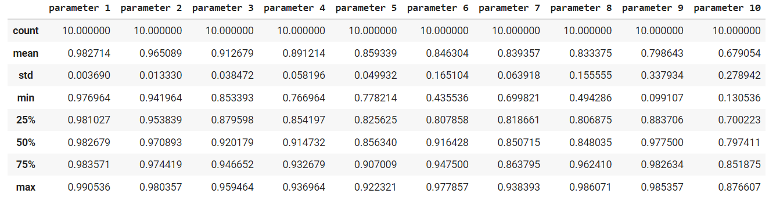
HYPERPARAMETERS
Grid Search CV
Cross validation
Federal University of Espírito Santo
Artificial Intelligence Applied to Images
Deep ANNs applied to images

Slide 21
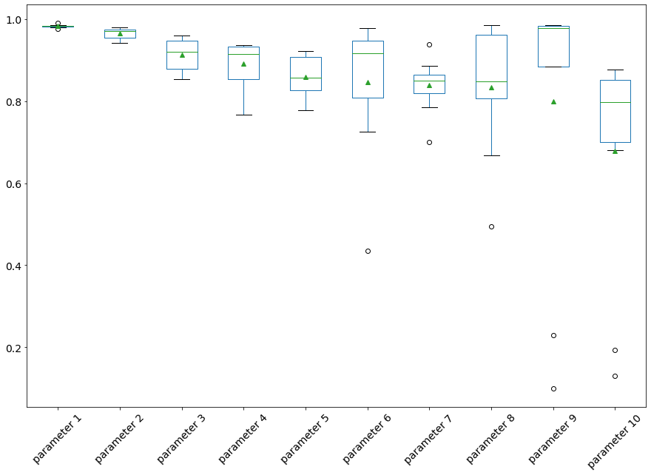
HYPERPARAMETERS
Grid Search CV
Cross validation
Federal University of Espírito Santo
Artificial Intelligence Applied to Images
Deep ANNs applied to images

Slide 22
HYPERPARAMETERS
Grid Search CV
Cross validation
Federal University of Espírito Santo
Artificial Intelligence Applied to Images
Deep ANNs applied to images

Slide 23
HYPERPARAMETERS
Grid Search CV
Cross validation
Conditions:
If P-value < 0.05: Reject NULL hypothesis - Significant differences exist between groups;
If P-value > 0.05: Accept NULL hypothesis - No significant difference between groups.
Acuracy:
H-statistic: 48.23030004800762
P-Value: 2.313012305778777e-07
Federal University of Espírito Santo
Artificial Intelligence Applied to Images
Deep ANNs applied to images

Slide 24
CNN
Final model
Federal University of Espírito Santo
Artificial Intelligence Applied to Images
Deep ANNs applied to images

Slide 25
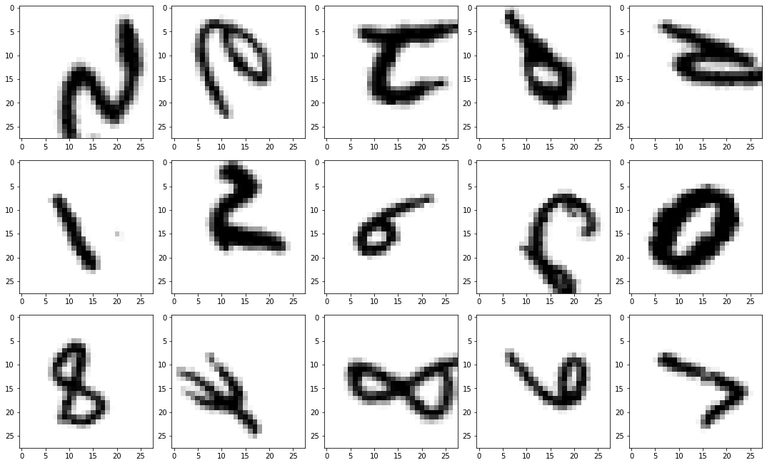
CNN
Final model
data augmentation
datagen_train = ImageDataGenerator(
rotation_range=80, # randomly rotate images in the range (degrees, 0 to 180)
zoom_range = 0.2, # Randomly zoom image
width_shift_range=0.1, # randomly shift images horizontally (fraction of total width)
height_shift_range=0.1, # randomly shift images vertically (fraction of total height)
horizontal_flip=True, # randomly flip images
vertical_flip=True, # randomly flip images
fill_mode='constant', cval = 0.0)
datagen_test = ImageDataGenerator()
trans = datagen_train.flow(X_training/255.0, y_training, batch_size=32, shuffle=True)
trans2 = datagen_test.flow(X_testing/255.0, y_testing, batch_size=32, shuffle=True)
Federal University of Espírito Santo
Artificial Intelligence Applied to Images
Deep ANNs applied to images

Slide 26
CNN
Final model
data augmentation
Federal University of Espírito Santo
Artificial Intelligence Applied to Images
Deep ANNs applied to images

Slide 27
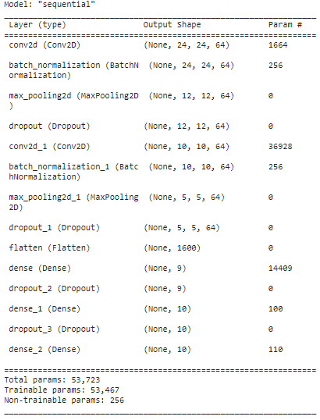
CNN
Final model
data augmentation
FINALMISSION = CNN_model(input_kernel_size = (5,5),
second_kernel_size = (5,5),
third_kernel_size = (3,3),
layers=[9,10],
input_filter = 64,
pool_type = 'max',
activation = 'tanh',
optimizer = 'adam' ,
dropout_rate = 0.2)
FINALMISSION.summary()
Federal University of Espírito Santo
Artificial Intelligence Applied to Images
Deep ANNs applied to images

Slide 28
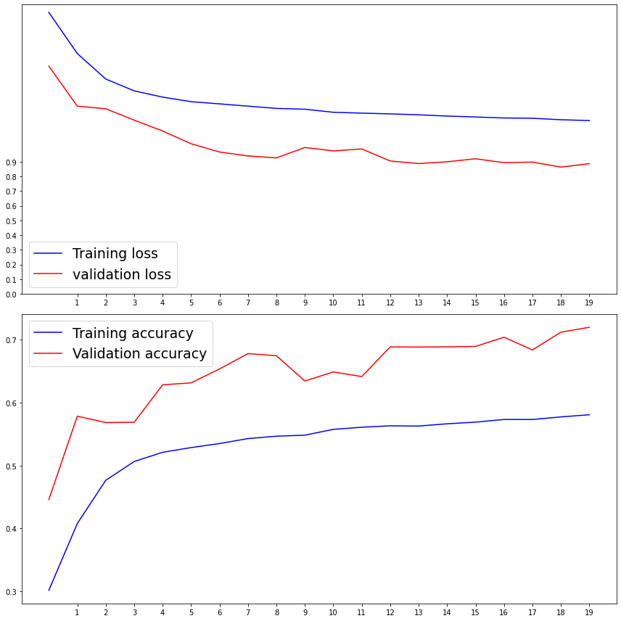
CNN
Final model
prediction
FINALMISSION = CNN_model(input_kernel_size = (5,5),
second_kernel_size = (5,5),
third_kernel_size = (3,3),
layers=[9,10],
input_filter = 64,
pool_type = 'max',
activation = 'tanh',
optimizer = 'adam' ,
dropout_rate = 0.2)
FINALMISSION.summary()
loss, accuracy= FINALMISSION.evaluate(trans,
verbose=False)
print('loss:%.2f, Accuracy: (%.1f)' % ((loss*100),
(accuracy*100)))
Loss:102.53
Accuracy:65.6
Federal University of Espírito Santo
Artificial Intelligence Applied to Images
Deep ANNs applied to images

Slide 29
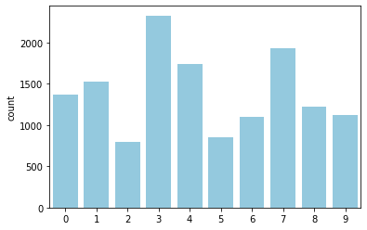
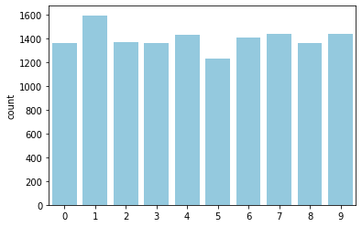
CNN
Final model
prediction
predict[0]
array([1.04356368e-04, 9.92780149e-01, 2.63184600e-04, 1.99359365e-05, 6.01544278e-04, 7.90776830e-05, 5.94439451e-04, 5.00127068e-03, 1.01333455e-04, 4.54800145e-04], dtype=float32)
sns.countplot(y_testing, color='skyblue')
predict = FINALMISSION.predict(trans2)
categoria = y_testing
categoria = np.argmax(predict, axis=-1)
sns.countplot(categoria, color='skyblue')
Federal University of Espírito Santo
Artificial Intelligence Applied to Images
Deep ANNs applied to images

Slide 30
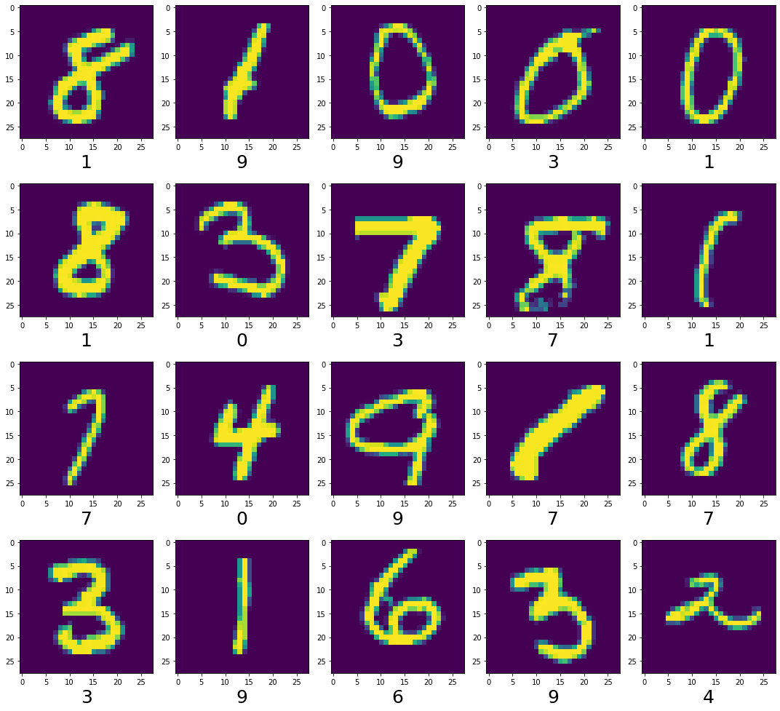
CNN
Final model
data augmentation
Federal University of Espírito Santo
Artificial Intelligence Applied to Images
Deep ANNs applied to images

Slide 31
REFERENCES
ANN: ConvNet with Keras
SCIKIT-LEARN. Tuning the hyper-parameters of an estimator. Available in: https://scikit-learn.org/stable/modules/grid_search.html#grid-search
. Access in: 25 NOV. 2021.
CHOLLET, Francois. Deep learning with Python. Simon and Schuster, 2021.
KAGGLE. Water Quality: Drinking water potability. Available in: https://www.kaggle.com/adityakadiwal/water-potability. Access in: 25 NOV. 2021.
GARRETA, Raul; MONCECCHI, Guillermo. Learning scikit-learn: machine learning in python. Packt Publishing Ltd, 2013.
GÉRON, Aurélien. Mãos à Obra: Aprendizado de Máquina com Scikit-Learn & TensorFlow. Alta Books, 2019.
ROIGER, Richard J. Data mining: a tutorial-based primer. Chapman and Hall/CRC, 2017.
Vitor Souza Premoli Pinto de Oliveira¹
¹Federal University of Espírito Santo
Artificial Intelligence Applied to Images
Federal University of Espírito Santo
Artificial Intelligence Applied to Images
Deep ANNs applied to images

