Slide 1

Python: Fundamentals for Exploratory Data Analysis
Eduardo Destefani Stefanato¹*
Vitor Souza Premoli Pinto de Oliveira¹*
¹Universidade Federal do Espírito Santo
Artificial Intelligence Applied to Images
Universidade Federal do Espírito Santo
Artificial Intelligence Applied to Images
Deep ANNs applied to images

Slide 2
Intoduction
Python
Sumary
Exploratory Data Analysis ...............................................................................................................3
Dataset extraction #1 ..............................................................................................................4
What’s dataset and its purpose? .....................................................................................4
Iris flower dataset ...........................................................................................................5
Basic statistics and variables correlation .…………………………………………………………………..6
plot data ……………………………………………………………………………………………….……………………7
Aggregation and transformation ..………………………………………………………….…………………..8
Variables correlation ..…………………………………………………………………………………………….….9
Machine Learning .................................................................................................................11
Predictive Model ..............................................…………………………………………………….…..12
Dataset extraction #2 ...........................................................................................................13
Sum spot dataset ...........................................................................................................14
Reference .....................................................................................................................................16
Universidade Federal do Espírito Santo
Artificial Intelligence Applied to Images
Deep ANNs applied to images

Slide 3
EXPLORATORY DATA ANALYSIS
Dataset extraction #1
Universidade Federal do Espírito Santo
Artificial Intelligence Applied to Images
Deep ANNs applied to images

Slide 4
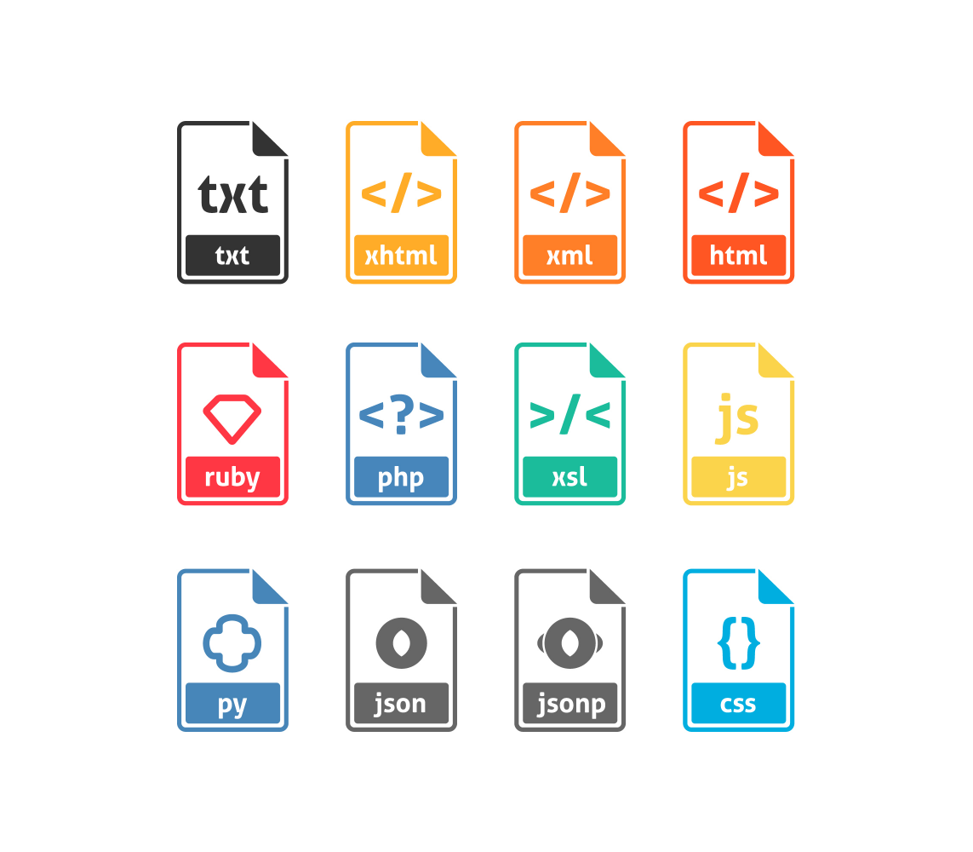
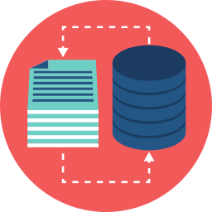

Exploratory Data Analysis
Dataset extraction #1
What’s dataset and its purpose?
Dataset is a set of tabular data that is represented in a spreadsheet format where the rows are the records of events and the columns are the characteristics of these events.
Iris data set
The data set used consists of 50 samples from each of the three Iris species (Iris setosa, Iris virginica and Iris versicolor). Four features were measured in each sample: the length and width of the sepals and petals, in centimeters. As a reference we have extracted from a .csv file available in the Kaggle repository.
Universidade Federal do Espírito Santo
Artificial Intelligence Applied to Images
Deep ANNs applied to images

Slide 5
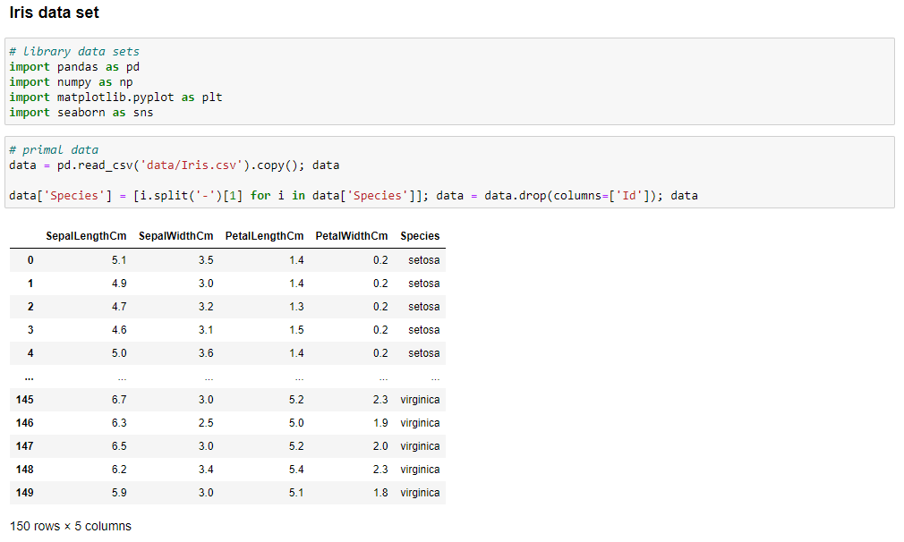
Exploratory Data Analysis
Dataset extraction #1
Iris flower dataset
The rows being the samples and the columns being: Sepal length (cm), Sepal width (cm), Petal length (cm) and Petal width (cm).
Universidade Federal do Espírito Santo
Artificial Intelligence Applied to Images
Deep ANNs applied to images

Slide 6
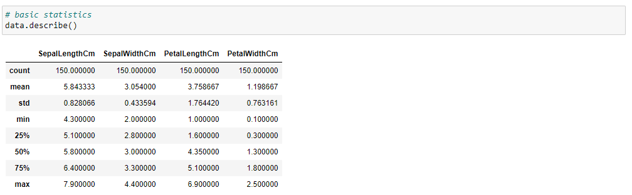
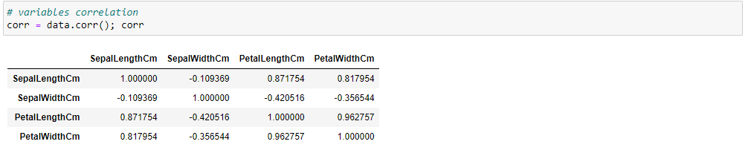
Exploratory Data Analysis
Dataset extraction #1
Basic statistics and variables correlation
Shows the basic statistics of the dataset primitive, such as mean, standard deviation, and quartile.
Correlation between the parameters of each species in the dataset.
Universidade Federal do Espírito Santo
Artificial Intelligence Applied to Images
Deep ANNs applied to images

Slide 7
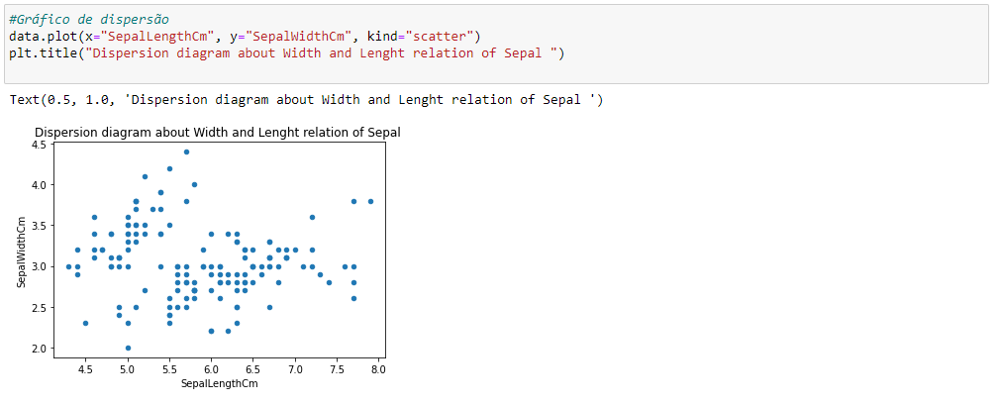
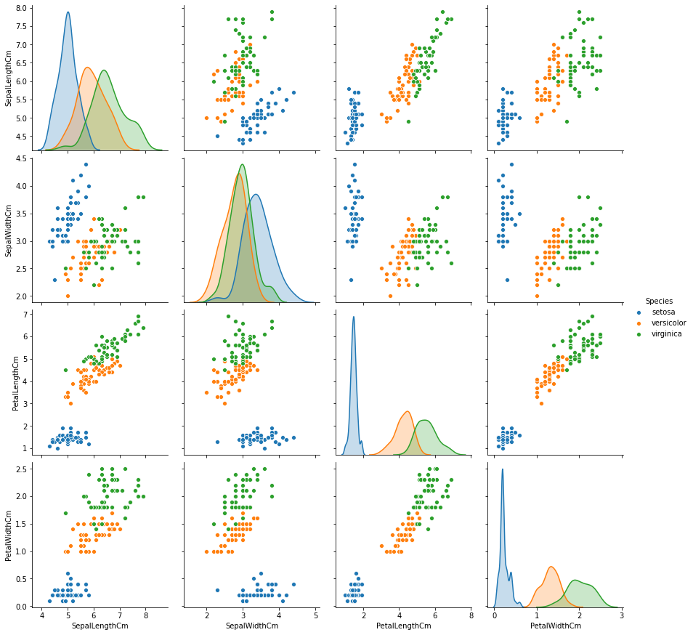
Exploratory Data Analysis
Dataset extraction #1
plot data
Universidade Federal do Espírito Santo
Artificial Intelligence Applied to Images
Deep ANNs applied to images

Slide 8
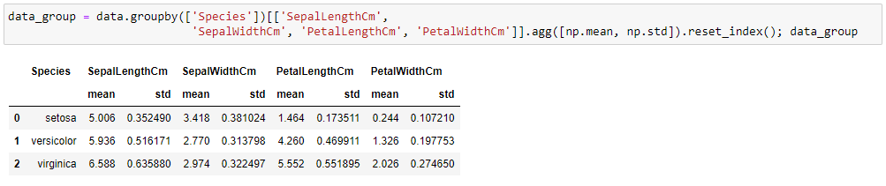
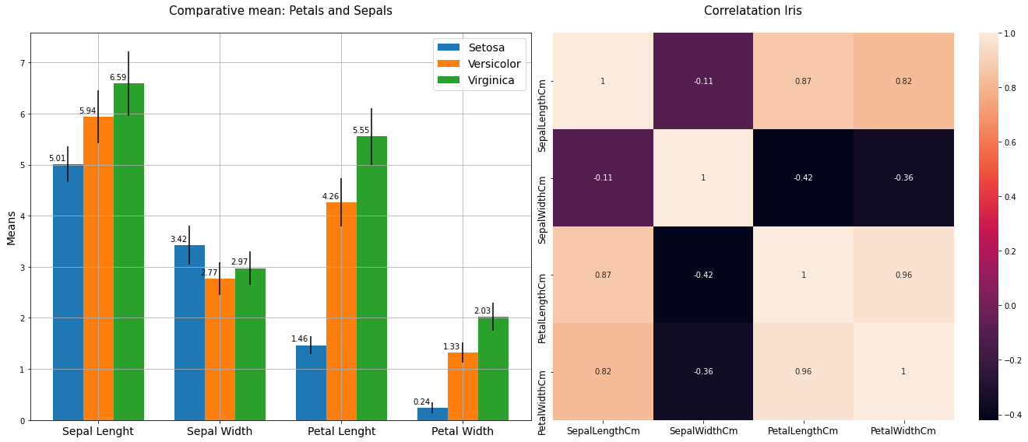
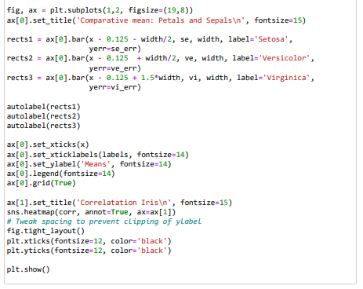
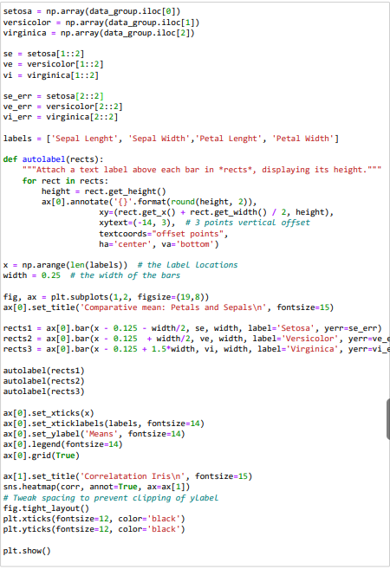
Exploratory Data Analysis
Dataset extraction #1
Aggregation and transformation
Universidade Federal do Espírito Santo
Artificial Intelligence Applied to Images
Deep ANNs applied to images

Slide 9
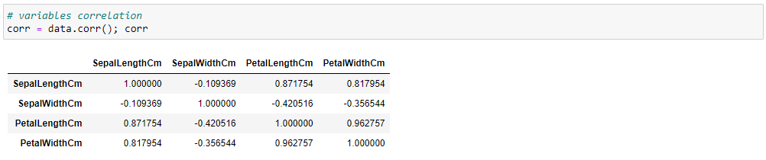
Exploratory Data Analysis
Dataset extraction #1
Variables correlation
Universidade Federal do Espírito Santo
Artificial Intelligence Applied to Images
Deep ANNs applied to images

Slide 10
Exploratory Data Analysis
Dataset extraction #1
Variables correlation
Universidade Federal do Espírito Santo
Artificial Intelligence Applied to Images
Deep ANNs applied to images

Slide 11
EXPLORATORY DATA ANALYSIS
Machine learning
Universidade Federal do Espírito Santo
Artificial Intelligence Applied to Images
Deep ANNs applied to images

Slide 12
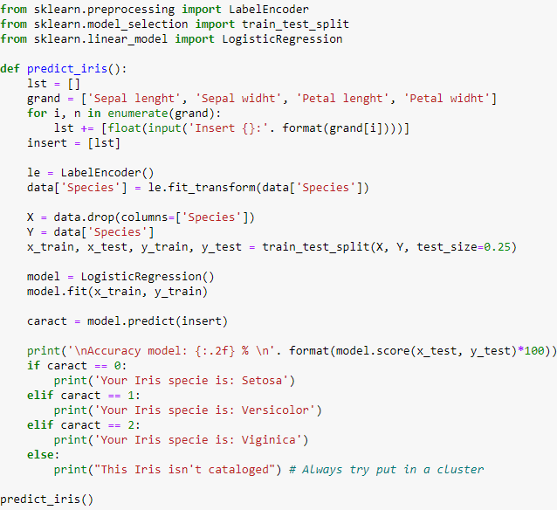
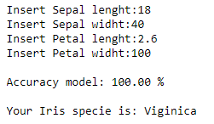
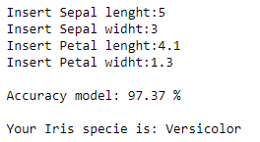
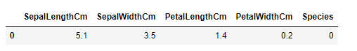
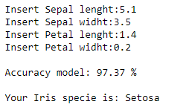
Machine Learning
Predictive Model
Predictive Model
out range parameters
Fake parameters
Universidade Federal do Espírito Santo
Artificial Intelligence Applied to Images
Deep ANNs applied to images

Slide 13
EXPLORATORY DATA ANALYSIS
Dataset extraction #2
Universidade Federal do Espírito Santo
Artificial Intelligence Applied to Images
Deep ANNs applied to images

Slide 14
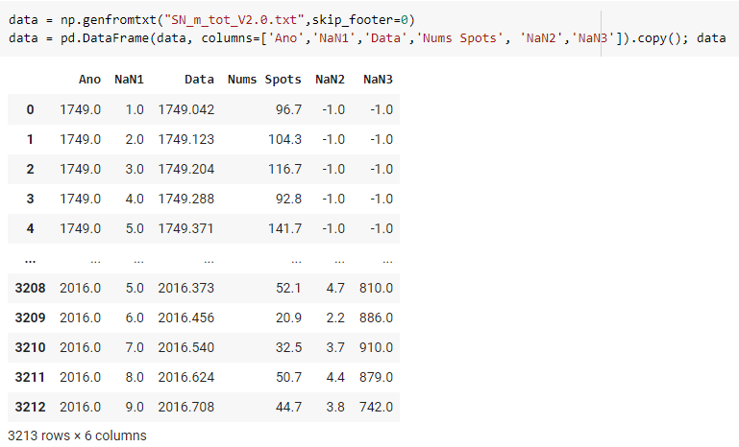
Exploratory Data Analysis
Dataset extraction #2
Sum spot dataset
Example of a data table taken from the NASA domain, Solar Cycle Prediction, from the .txt file format. It tells us the monthly sunspot averages over the years.
The table has 3213 rows and 6 columns.
Universidade Federal do Espírito Santo
Artificial Intelligence Applied to Images
Deep ANNs applied to images

Slide 15
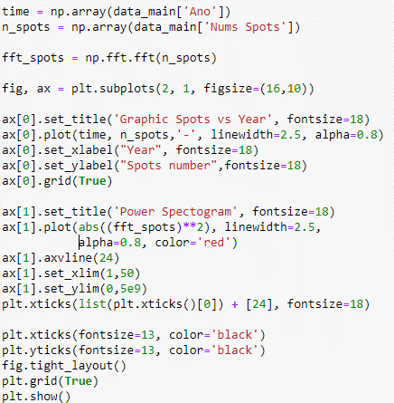
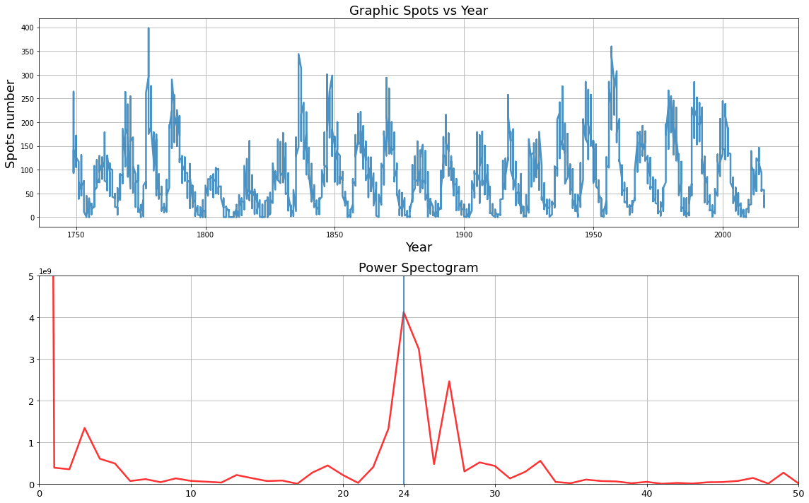

Exploratory Data Analysis
Dataset extraction #2
Sum spot dataset
We can see a peak at 24, with that, taking into account the normalization factor 𝑁, we invert to get the period instead of the frequency, the period:
$$\frac{N}{k}=\frac{3213}{24}=134 months ≅11 years$$
Universidade Federal do Espírito Santo
Artificial Intelligence Applied to Images
Deep ANNs applied to images

Slide 16
Python: Fundamentals for Exploratory Data Analysis
REFERENCES
PiPy. Find, install and publish Python packages with the Python Package Index. Available in: https://pypi.org/. Access in: 22 Jul. 2021.
Matplotlib. Matplotlib: Python plotting — Matplotlib 3.4.2 documentation. Available in: https://matplotlib.org/. Access in: 22 Jul. 2021.
Numpy. NumPy Reference — NumPy v1.21 Manual. Available in: https://numpy.org/doc/stable/reference/. Access in: 22 Jul. 2021.
NumFocus. Pandas. Available in: https://pandas.pydata.org/. Access in: 29 Jul. 2021.
Kaggle. Iris Species. Available in: https://www.kaggle.com/uciml/íris/. Access in: 08 Aug. 2021.
Eduardo Destefani Stefanato¹*
Vitor Souza Premoli Pinto de Oliveira¹*
¹Universidade Federal do Espírito Santo
Artificial Intelligence Applied to Images
Universidade Federal do Espírito Santo
Artificial Intelligence Applied to Images
Deep ANNs applied to images

