Slide 1

Python: K-NN and MlP classifier
Vitor Souza Premoli Pinto de Oliveira¹
¹Universidade Federal do Espírito Santo
Artificial Intelligence Applied to Images
Universidade Federal do Espírito Santo
Artificial Intelligence Applied to Images
Deep ANNs applied to images

Slide 2
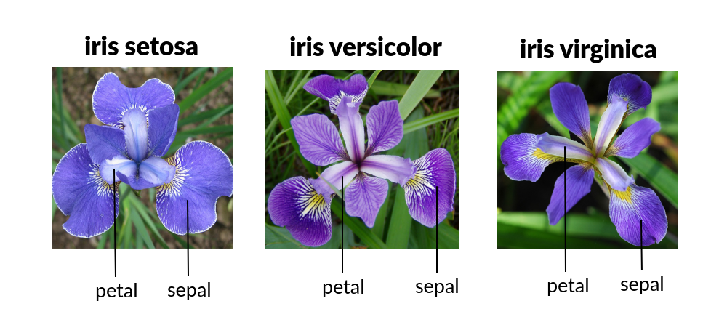
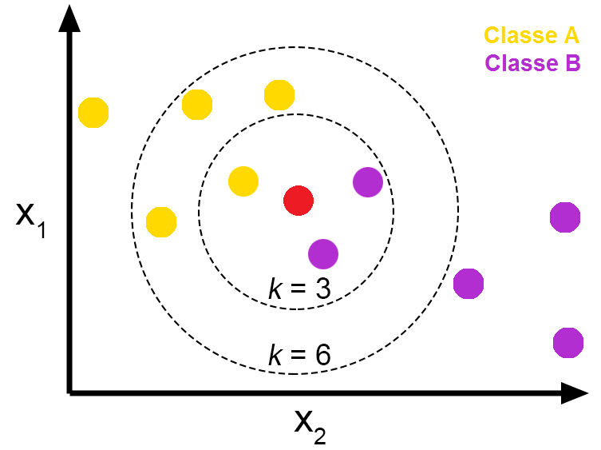
Intoduction
Python
Objectives
Iris Dataset
Choose the best parameters for K-NN and MLP classifier models;
Show the mathematical logic behind MLP classifier;
Evaluate (through cross-validation) between models with in different metrics;
After made the evaluation, verify if models have statistic differences.
Universidade Federal do Espírito Santo
Artificial Intelligence Applied to Images
Deep ANNs applied to images

Slide 3
MACHINE LEARNING
K-nearest neighbors algorithm
Universidade Federal do Espírito Santo
Artificial Intelligence Applied to Images
Deep ANNs applied to images

Slide 4
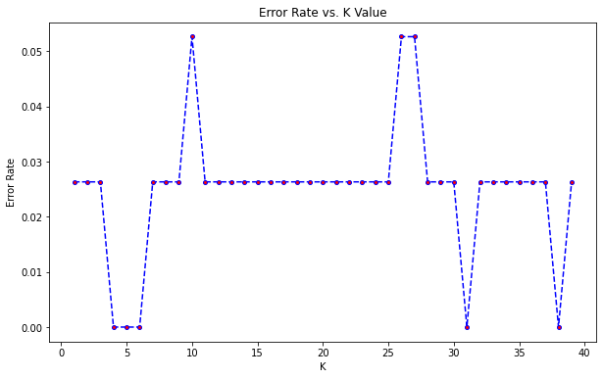
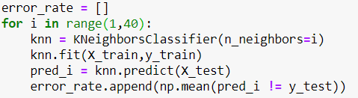
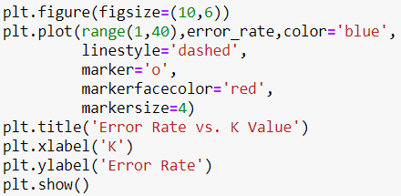
MACHINE LEARNING
K-nearest neighbors algorithm
Error Rate vs K value
Universidade Federal do Espírito Santo
Artificial Intelligence Applied to Images
Deep ANNs applied to images

Slide 5
MACHINE LEARNING
K-nearest neighbors algorithm
Error Rate vs K value
True and False rate per K value tested;
Based on the smallest value of the rate, we have as best Ks :[4, 5, 6, 31, 38]
Applied cross-validation, CV=10, with metrics(Accuracy and F1);
Universidade Federal do Espírito Santo
Artificial Intelligence Applied to Images
Deep ANNs applied to images

Slide 6
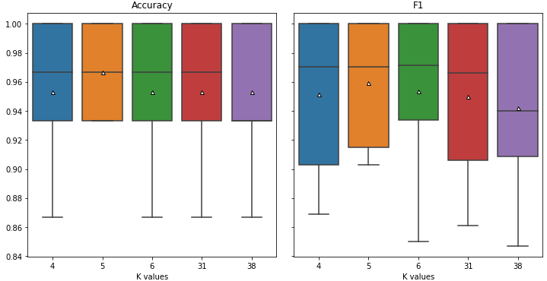
MACHINE LEARNING
K-nearest neighbors algorithm
Error Rate vs K value
Parametric tests work with numerical values and are sensitive to outliers and assumptions of independence, normality and homoscedasticity in the sample of results, while the non parametric tests operate with ordinal values (rankings) and are more flexible than the former in the type of results to which they can be applied (GARCÍA, 2010).
For this reason, non-parametric tests are proving to be very effective in multi-domain environments, where several instances of the data mining problem to be treated are evaluated, as is the usual procedure (DEMŠAR, 2006), (GARCÍA, 2010, 2010).
Universidade Federal do Espírito Santo
Artificial Intelligence Applied to Images
Deep ANNs applied to images

Slide 7
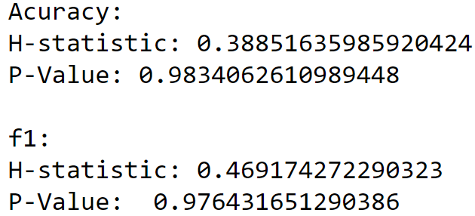
MACHINE LEARNING
K-nearest neighbors algorithm
Error Rate vs K value
from scipy.stats.mstats import kruskal
P-value > 0.05: Accept NULL hypothesis - No significant difference between groups.
Universidade Federal do Espírito Santo
Artificial Intelligence Applied to Images
Deep ANNs applied to images

Slide 8
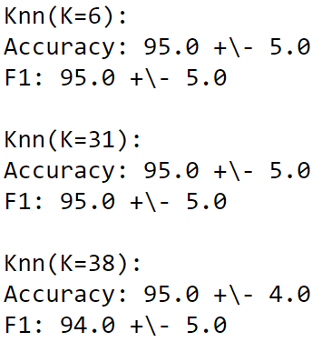
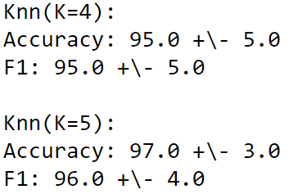
MACHINE LEARNING
K-nearest neighbors algorithm
Cross validation for differents Ks
Metrics | K- values
Accuracy | 5
F1 | 5
Universidade Federal do Espírito Santo
Artificial Intelligence Applied to Images
Deep ANNs applied to images

Slide 9
DEEP LEARNING
Multi-layer Perceptron classifier.
Universidade Federal do Espírito Santo
Artificial Intelligence Applied to Images
Deep ANNs applied to images

Slide 10
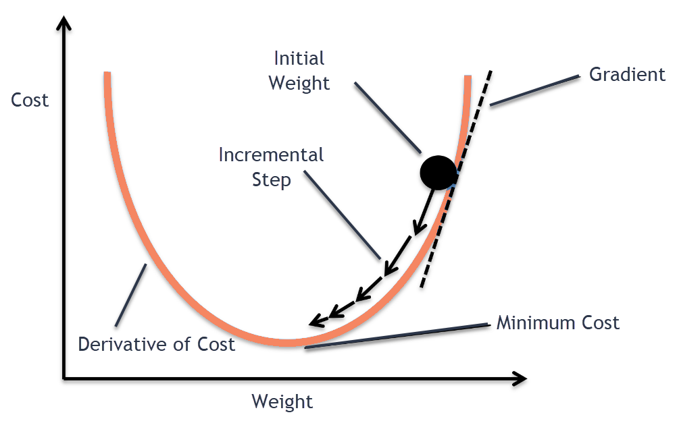

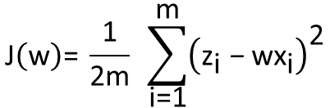
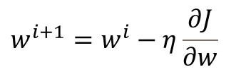


MACHINE LEARNING
Multi-layer Perceptron classifier.
Mathematical logic
Class MLPClassifier implements a multi-layer perceptron (MLP) algorithm that trains using Backpropagation. MLPClassifier trains iteratively since at each time step the partial derivatives of the loss function with respect to the model parameters are computed to update the parameters (SKTLEARN, 2021).
$$Z$$
$$\text{J}\left(\text{w}\right)\text{= }\frac{\text{1}}{\text{2}\text{m}} \sum_{\text{i}\text{=1}}^{\text{m}}{{\left({\text{z}}_{\text{i}} \text{−} \text{w}{\text{x}}_{\text{i}}\right)}^{\text{2}}}$$
$$X$$
$$w^{i+1}=w^{i}−η\frac{∂J}{∂w}$$
$$Z=wX$$
from sklearn.neural_network import MLPClassifier
Gradient Descent
Universidade Federal do Espírito Santo
Artificial Intelligence Applied to Images
Deep ANNs applied to images

Slide 11
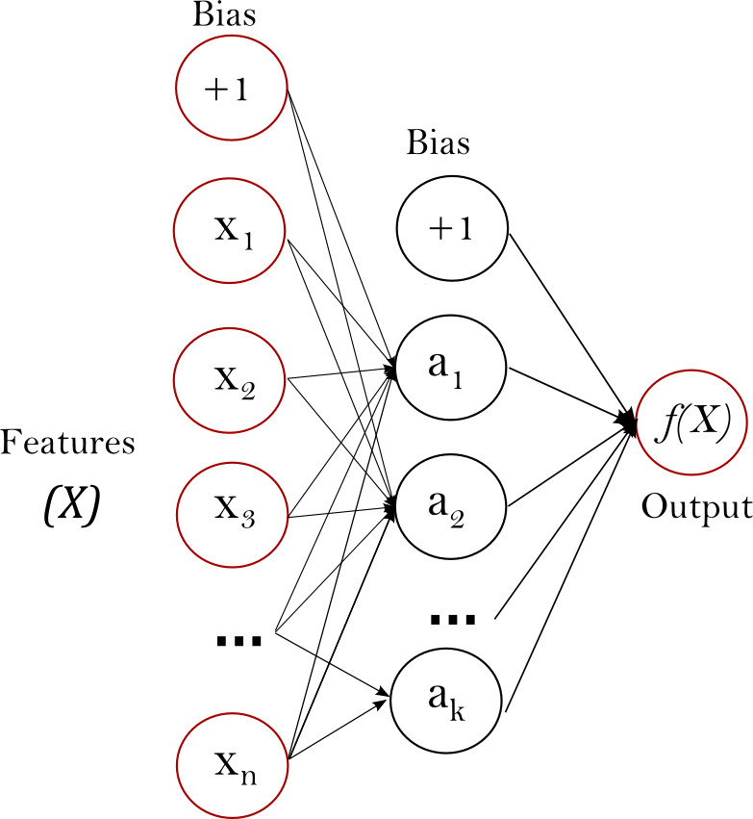
MACHINE LEARNING
Multi-layer Perceptron classifier.
Mathematical logic
This model optimizes the log-loss function using LBFGS or stochastic gradient descent.
LBFGS: is an optimizer in the family of quasi-Newton methods;
SGD: refers to stochastic gradient descent;
ADAM: refers to a stochastic gradient-based optimizer proposed by Kingma, Diederik, and Jimmy Ba.
$$Z$$
$$\text{J}\left(\text{w}\right)\text{= }\frac{\text{1}}{\text{2}\text{m}} \sum_{\text{i}\text{=1}}^{\text{m}}{{\left({\text{z}}_{\text{i}} \text{−} \text{w}{\text{x}}_{\text{i}}\right)}^{\text{2}}}$$
$$X$$
$$w^{i+1}=w^{i}−η\frac{∂J}{∂w}$$
$$Z=wX$$
from sklearn.neural_network import MLPClassifier
One hidden layer MLP
Universidade Federal do Espírito Santo
Artificial Intelligence Applied to Images
Deep ANNs applied to images

Slide 12
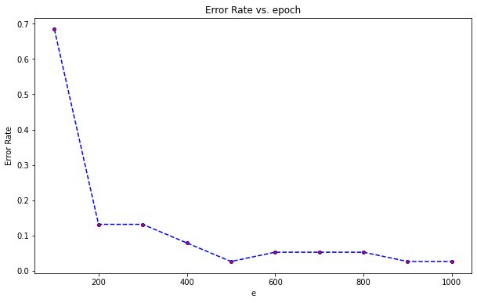
MACHINE LEARNING
Multi-layer Perceptron classifier.
epochs
The terminating condition can be given as a total number of passes (also called epochs) of the training data through the network.
Test the accuracy of the network on a test data set. If the accuracy is less than optimal, change one or more parameters of the network topology and start over.(ROIGER, 2017)
Universidade Federal do Espírito Santo
Artificial Intelligence Applied to Images
Deep ANNs applied to images

Slide 13
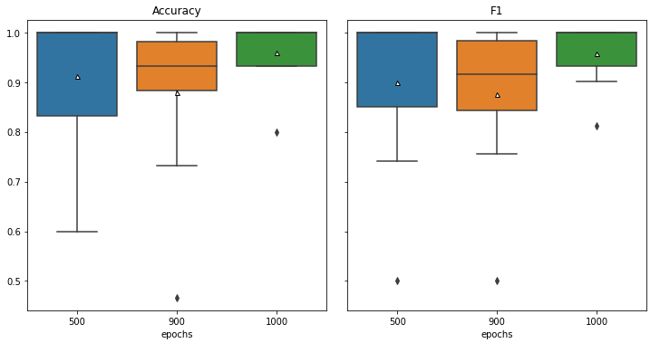
MACHINE LEARNING
Multi-layer Perceptron classifier.
epochs
The terminating condition can be given as a total number of passes (also called epochs) of the training data through the network.
Test the accuracy of the network on a test data set. If the accuracy is less than optimal, change one or more parameters of the network topology and start over.(ROIGER, 2017)
Universidade Federal do Espírito Santo
Artificial Intelligence Applied to Images
Deep ANNs applied to images

Slide 14
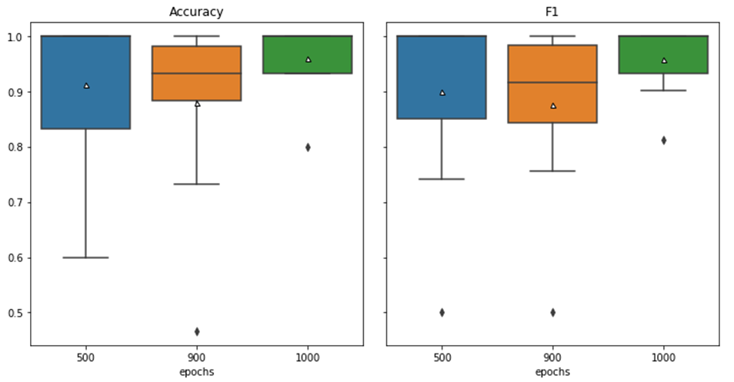
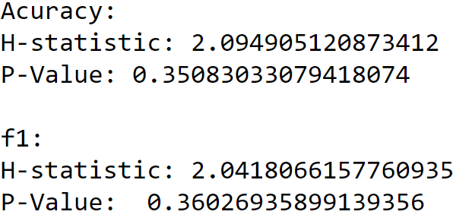
MACHINE LEARNING
Multi-layer Perceptron classifier.
epochs
P-value > 0.05: Accept NULL hypothesis - No significant difference between groups.
Universidade Federal do Espírito Santo
Artificial Intelligence Applied to Images
Deep ANNs applied to images

Slide 15
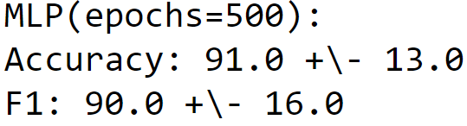
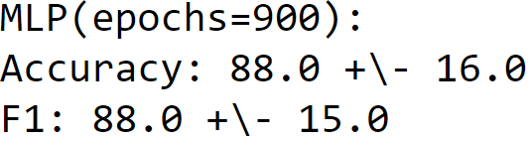
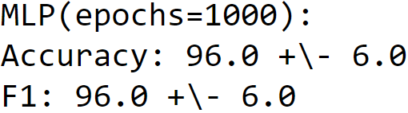
MACHINE LEARNING
Multi-layer Perceptron classifier.
epochs
Metrics | epochs
Accuracy | 1000
F1 | 500, 900, 1000
Universidade Federal do Espírito Santo
Artificial Intelligence Applied to Images
Deep ANNs applied to images

Slide 16
RESULTS AND DISCUSSION
Cross - validation
Universidade Federal do Espírito Santo
Artificial Intelligence Applied to Images
Deep ANNs applied to images

Slide 17
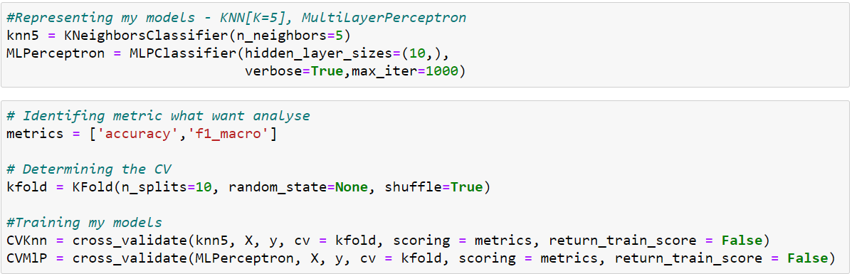
RESULTS AND DISCUSSION
Cross - validation
metrics
Universidade Federal do Espírito Santo
Artificial Intelligence Applied to Images
Deep ANNs applied to images

Slide 18
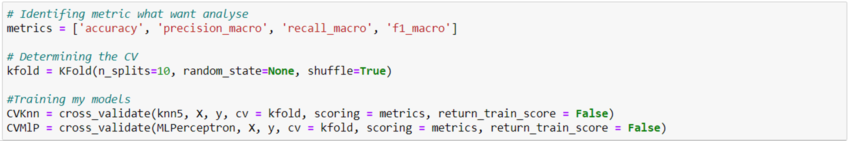
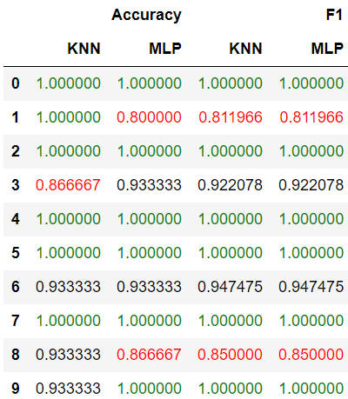
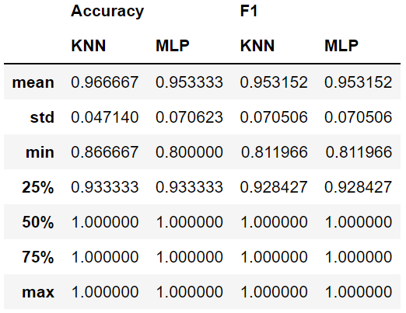
RESULTS AND DISCUSSION
Cross - validation
metrics
Universidade Federal do Espírito Santo
Artificial Intelligence Applied to Images
Deep ANNs applied to images

Slide 19
RESULTS AND DISCUSSION
Cross - validation
metrics
Universidade Federal do Espírito Santo
Artificial Intelligence Applied to Images
Deep ANNs applied to images

Slide 20
RESULTS AND DISCUSSION
Cross - validation
metrics
Universidade Federal do Espírito Santo
Artificial Intelligence Applied to Images
Deep ANNs applied to images

Slide 21
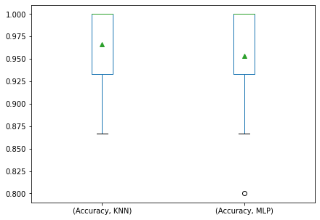
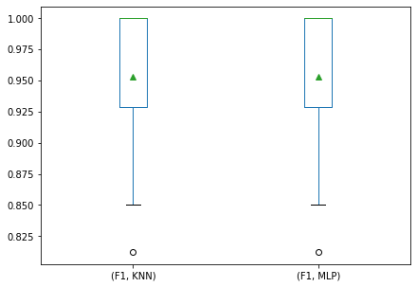
RESULTS AND DISCUSSION
Cross - validation
Box-plot
Universidade Federal do Espírito Santo
Artificial Intelligence Applied to Images
Deep ANNs applied to images

Slide 22
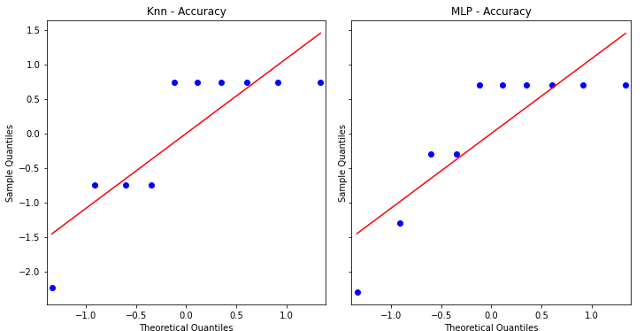
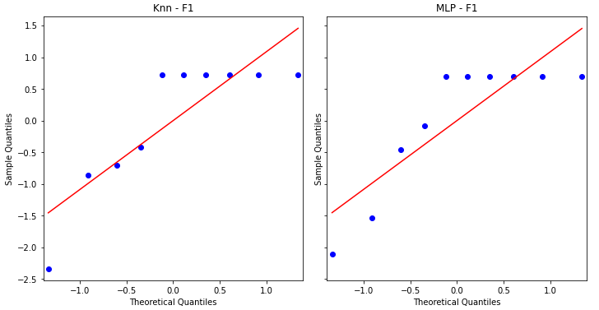
RESULTS AND DISCUSSION
Cross - validation
QQ plot
Universidade Federal do Espírito Santo
Artificial Intelligence Applied to Images
Deep ANNs applied to images

Slide 23
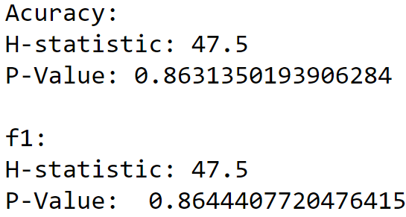
RESULTS AND DISCUSSION
Cross - validation
Wilcoxon Test
Perform the Mann-Whitney U rank test on two independent samples;
The Mann-Whitney U test is a nonparametric test of the null hypothesis that the distribution underlying sample x is the same as the distribution underlying sample y. It is often used as a test of of difference in location between distributions.
P-value > 0.05: Accept NULL hypothesis - No significant difference between groups.
Universidade Federal do Espírito Santo
Artificial Intelligence Applied to Images
Deep ANNs applied to images

Slide 24
REFERENCES
Python: K-NN and MlP classifier
SKTLEARN. Neural network models (supervised). Available in: https://scikit-learn.org/stable/modules/neural_networks_supervised.html#mlp-tips . Access in: 25 Oct. 2021.
ROIGER, Richard J. Data mining: a tutorial-based primer. Chapman and Hall/CRC, 2017.
GARCÍA, Salvador; HERRERA, Francisco; DERRAC, Joaquín. Un Tutorial Metodológico para hacer Comparaciones Estadísticas con Tests No Paramétricos en Propuestas de Minería de Datos, 2010.
DEMŠAR, J. Statistical comparisons of classifiers over multiple data sets. Journal of Machine Learning Research, 7, 1-30, 2006.
GARCÍA, S.; FERNÁNDEZ, A.; LUENGO, J.; HERRERA, F. Advanced nonparametric tests for multiple comparisons in the design of experiments in computational intelligence and data mining: Experimental analysis of power. Information Sciences, 180, 2044-2064, 2010.
Vitor Souza Premoli Pinto de Oliveira¹
¹Universidade Federal do Espírito Santo
Artificial Intelligence Applied to Images
Universidade Federal do Espírito Santo
Artificial Intelligence Applied to Images
Deep ANNs applied to images

