Slide 1

Python: k-Nearest Neighbor algorithms
Vitor Souza Premoli Pinto de Oliveira¹
¹Universidade Federal do Espírito Santo
Artificial Intelligence Applied to Images
Universidade Federal do Espírito Santo
Artificial Intelligence Applied to Images
Deep ANNs applied to images

Slide 2
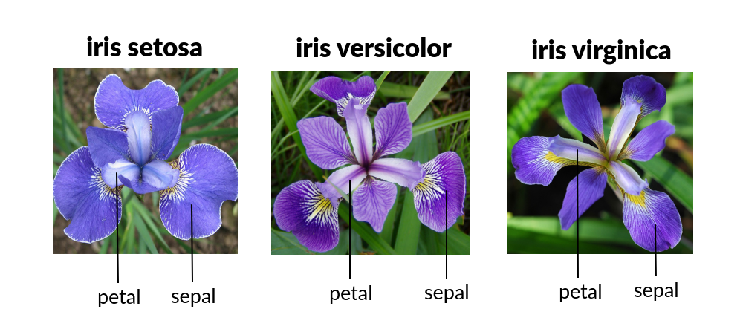
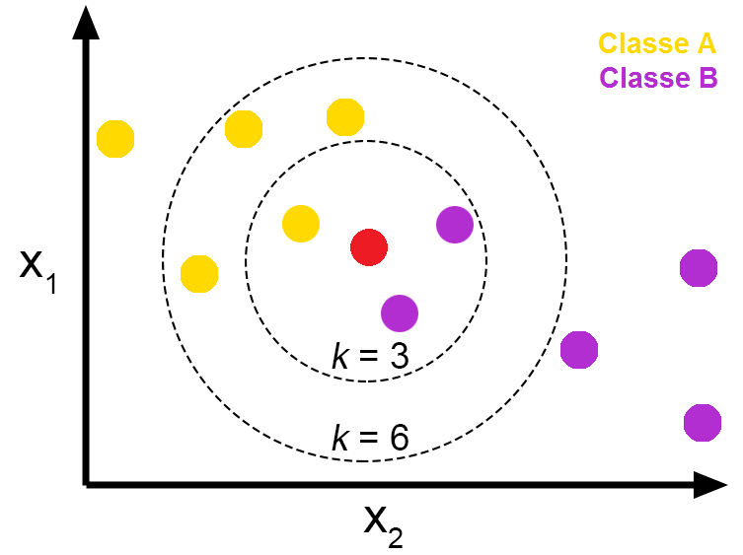
Intoduction
Python
Objectives
EDA of Iris dataset;
Show the mathematical logic behind KNN;
Evaluate (through cross-validation) the models with in different metrics;
After made the evaluation, verify if models have statistic differences.
Universidade Federal do Espírito Santo
Artificial Intelligence Applied to Images
Deep ANNs applied to images

Slide 3
MACHINE LEARNING
Iris Data Set Application
Universidade Federal do Espírito Santo
Artificial Intelligence Applied to Images
Deep ANNs applied to images

Slide 4
MACHINE LEARNING
Iris Data Set Application
Extracting the dataset
Data Set Characteristics:
Number of Samples: 150 (50 in each of three classes)
Number of Attributes: 4 numeric, predictive attributes and the class
Attribute Information:
sepal length in cm
sepal width in cm
petal length in cm
petal width in cm
class:
Iris-Setosa
Iris-Versicolour
Iris-Virginica
The famous Iris database, first used by Sir R.A. Fisher. The dataset is taken from Fisher's paper, introduced in 1936 by her to show how a statistical method (discriminant analysis) worked (GARRETA & MONCECCHI, 2013)(SKTLEARN, 2021).
This is perhaps the best known database to be found in the pattern recognition literature. Fisher's paper is a classic in the field and is referenced frequently to this day. (DUDA & HART, 1973). The data set contains 3 classes of 50 instances each, where each class refers to a type of iris plant. One class is linearly separable from the other 2; the latter are NOT linearly separable from each other.
Universidade Federal do Espírito Santo
Artificial Intelligence Applied to Images
Deep ANNs applied to images

Slide 5
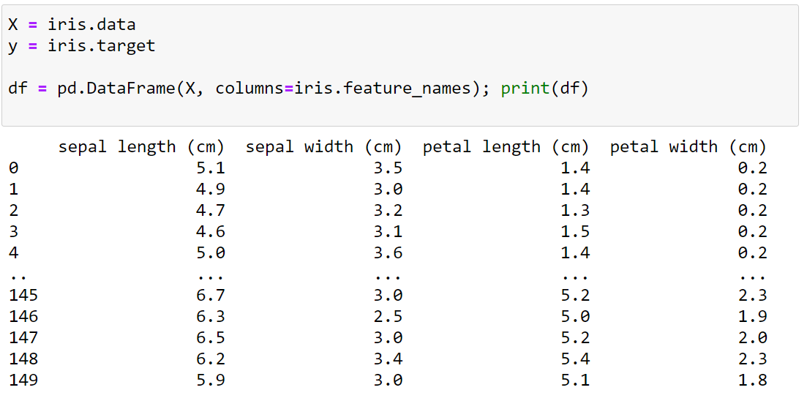
MACHINE LEARNING
Iris Data Set Application
Extracting the dataset
Data Set Characteristics:
Number of Samples: 150 (50 in each of three classes)
Number of Attributes: 4 numeric, predictive attributes and the class
Attribute Information:
sepal length in cm
sepal width in cm
petal length in cm
petal width in cm
class:
Iris-Setosa
Iris-Versicolour
Iris-Virginica
Universidade Federal do Espírito Santo
Artificial Intelligence Applied to Images
Deep ANNs applied to images

Slide 6
MACHINE LEARNING
Iris Data Set Application
Extracting the dataset
from sklearn.datasets import load_iris
Dict_Keys | class | descrition
data | <class 'numpy.ndarray’> | The data matrix, 150 samples (50 in each of three classes) per 4 caracteristics
target | <class 'numpy.ndarray’> | Associates the species with numbers, there are 150 lines, where 0 = Setosa, 1 = Versicolor, 2 = Virginica
frame | <class 'NoneType'> | Only present when as_frame=True. DataFrame with data and target(150, 5)
Target_names | <class 'numpy.ndarray’> | array associated with each species name, ['setosa' 'versicolor' 'virginica'];
DESCR | <class 'str'> | Contains the historical description of the dataset, a statistical sumary of the dataset's characteristics;
features_names | <class 'numpy.ndarray’> | The names of the dataset columns
filename | <class 'str'> | The path to the location of the data.
Universidade Federal do Espírito Santo
Artificial Intelligence Applied to Images
Deep ANNs applied to images

Slide 7
EXPLORATORY DATA ANALYTICS
Extracting dataset
Universidade Federal do Espírito Santo
Artificial Intelligence Applied to Images
Deep ANNs applied to images

Slide 8
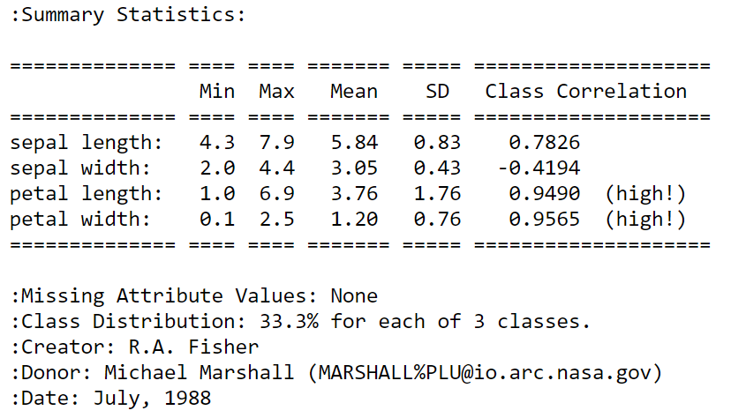
EXPLORATORY DATA ANALYTICS
Extracting dataset
Statistics and correlations
Universidade Federal do Espírito Santo
Artificial Intelligence Applied to Images
Deep ANNs applied to images

Slide 9
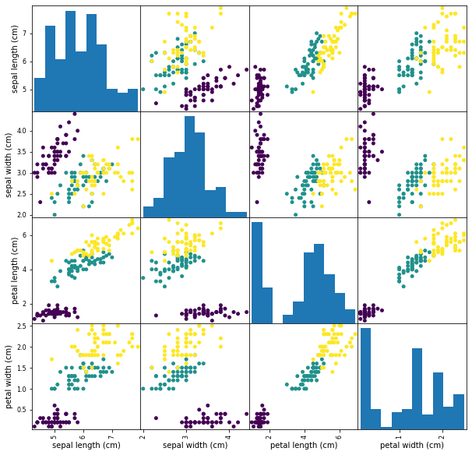
EXPLORATORY DATA ANALYTICS
Extracting dataset
Statistics and correlations
Iris - Setosa
Iris - Versicolor
Iris - Virginica
Universidade Federal do Espírito Santo
Artificial Intelligence Applied to Images
Deep ANNs applied to images

Slide 10

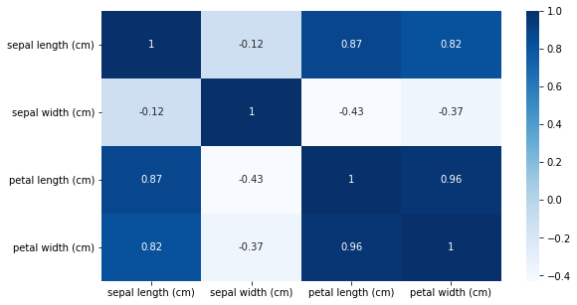
EXPLORATORY DATA ANALYTICS
Extracting dataset
Statistics and correlations
Iris - Setosa
Iris - Versicolor
Iris - Virginica
Universidade Federal do Espírito Santo
Artificial Intelligence Applied to Images
Deep ANNs applied to images

Slide 11
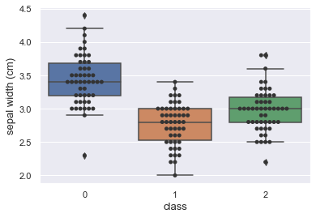
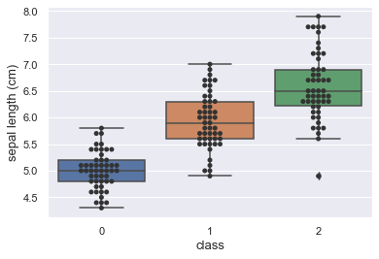
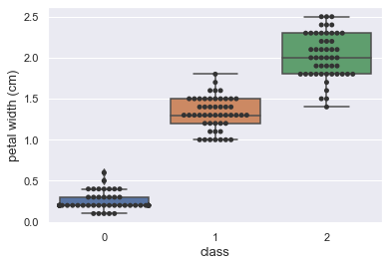
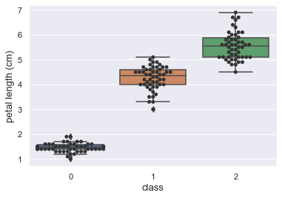
EXPLORATORY DATA ANALYTICS
Extracting dataset
Statistics and correlations
1
Iris - Setosa
2
Iris - Versicolor
3
Iris - Virginica
Universidade Federal do Espírito Santo
Artificial Intelligence Applied to Images
Deep ANNs applied to images

Slide 12
MACHINE LEARNING
Algorithms Classification
Universidade Federal do Espírito Santo
Artificial Intelligence Applied to Images
Deep ANNs applied to images

Slide 13
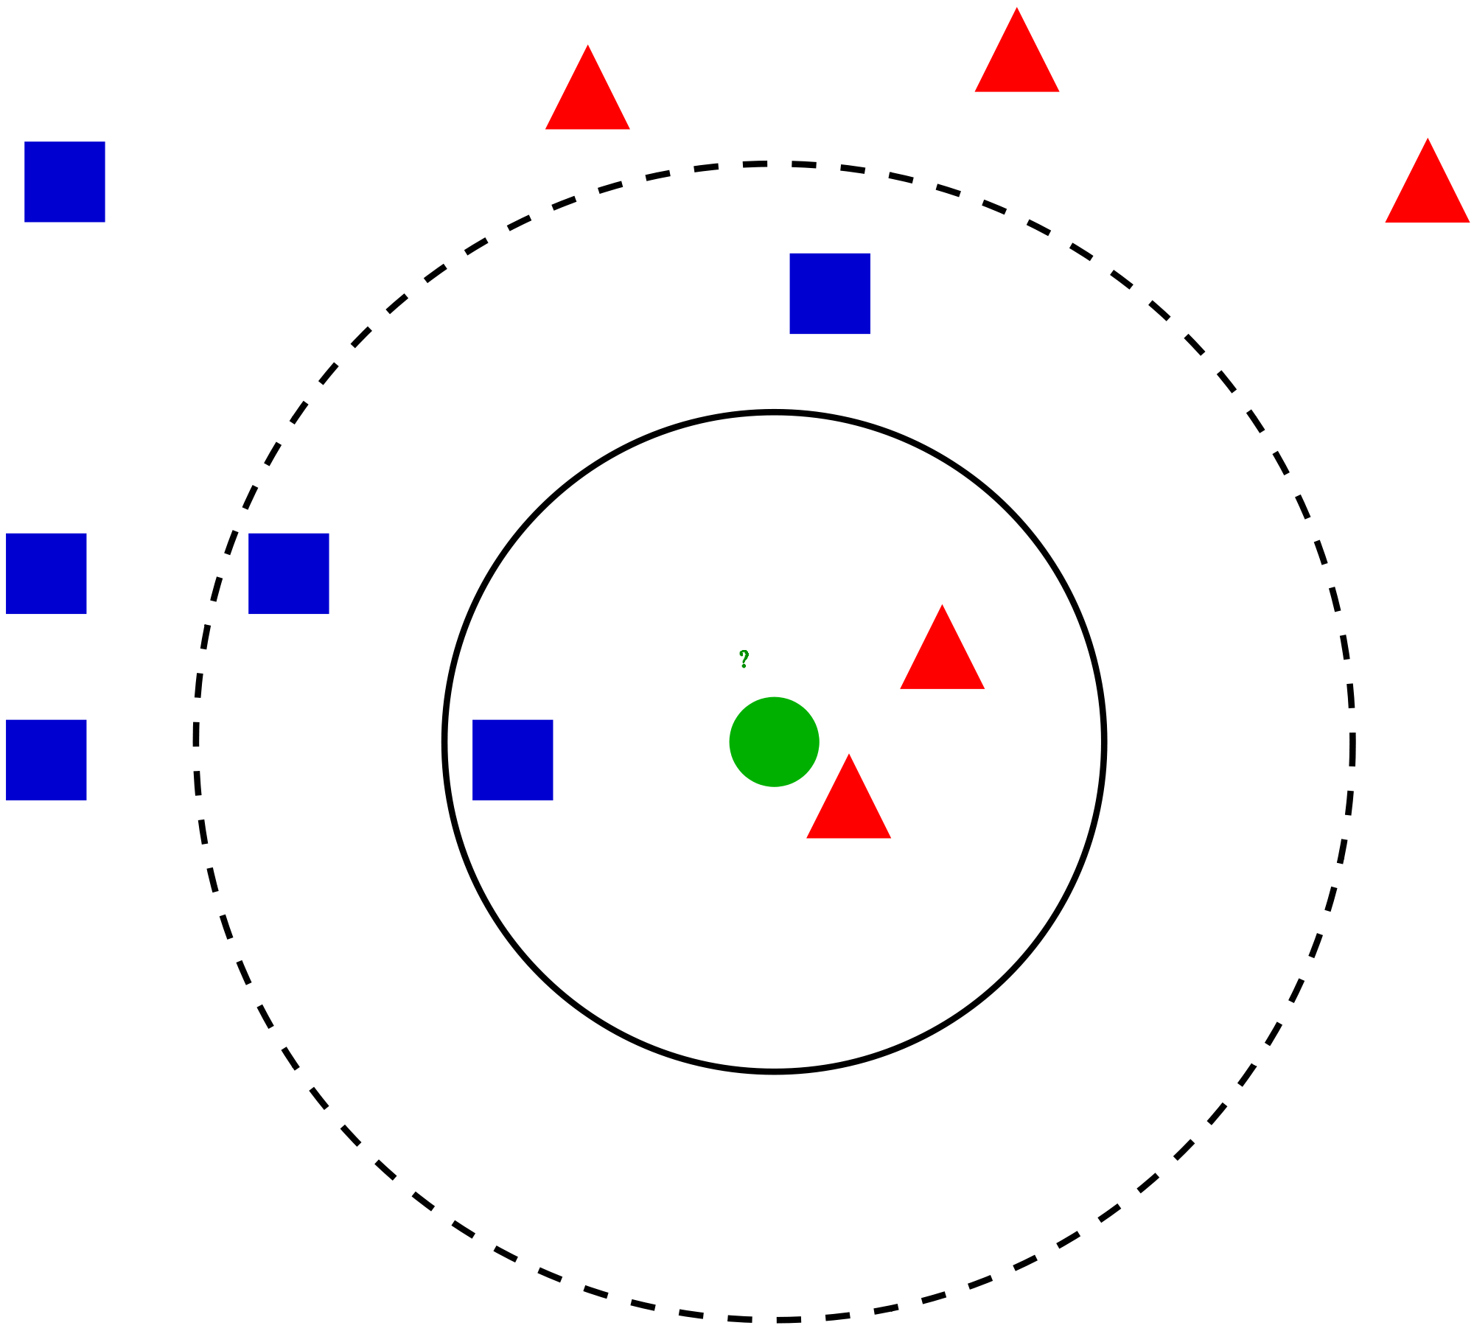


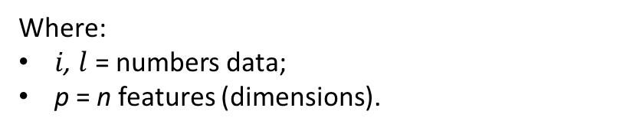

MACHINE LEARNING
Algorithms Classification
K-NN (K-Nearest Neighbor)
A variation of nearest neighbor classification where a new instance is classified with the most common class of its k nearest neighbors (ROIGER, 2017).
k-NN’s k parameter specifies the number of nearest neighbors used for comparative purposes. With a default of k = 5, k-NN places a new instance in the class of its closest neighbor (ROIGER, 2017).
The k-nearest-neighbor classifier is commonly based on the Euclidean distance between a test sample and the specified training samples.
$$X_{2}$$
K = 1
K = 2
$$d(X_{i}^{},X_{l}^{})=\sqrt{{(X_{i1}^{}−X_{l1}^{})}^{2}+…+{(X_{ip}^{}−X_{lp}^{})}^{2}}$$
$$X_{1}$$
Where:
$i$, $l$ = numbers data;
p = n features (dimensions).
Universidade Federal do Espírito Santo
Artificial Intelligence Applied to Images
Deep ANNs applied to images

Slide 14
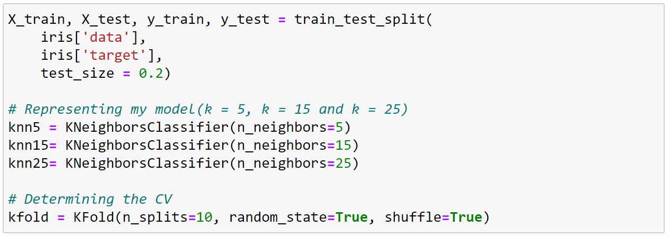
MACHINE LEARNING
Algorithms Classification
Methodology
$$X_{2}$$
Split the DataFrame in Training Data and Test Data;
Determine the test size in 20%;
Represent the models in k=5, k=15, k=25;
Apply cross-validation, CV=10, with metrics(Accuracy, Precision, Recall, F1);
Verify if models have statistic differences through Kruskal-Wallis test.
K = 1
K = 2
$$X_{1}$$
Universidade Federal do Espírito Santo
Artificial Intelligence Applied to Images
Deep ANNs applied to images

Slide 15
RESULTS AND DISCUSSION
Cross - validation
Universidade Federal do Espírito Santo
Artificial Intelligence Applied to Images
Deep ANNs applied to images

Slide 16
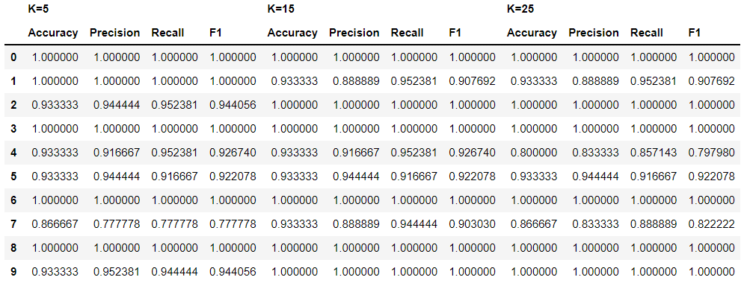


RESULTS AND DISCUSSION
Cross - validation
Metrics of cross validate
$$accuracy= \frac{TP+TN}{Total}$$
$$precision= \frac{TP}{TP+FP}$$
$$recall=\frac{TP}{TP+FN}$$
$$f1= \frac{2 ∗ precision ∗ recall}{precision+recall}$$
Universidade Federal do Espírito Santo
Artificial Intelligence Applied to Images
Deep ANNs applied to images

Slide 17
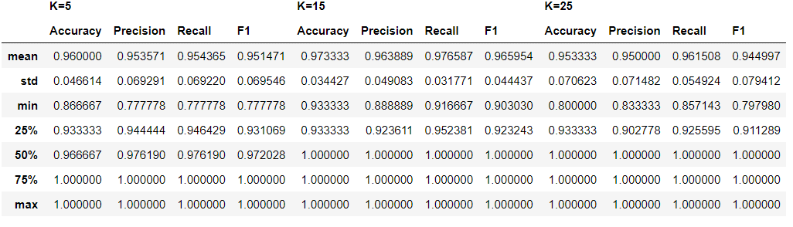
RESULTS AND DISCUSSION
Cross - validation
Metrics of cross validate
Universidade Federal do Espírito Santo
Artificial Intelligence Applied to Images
Deep ANNs applied to images

Slide 18
RESULTS AND DISCUSSION
Cross - validation
Metrics of cross validate
Universidade Federal do Espírito Santo
Artificial Intelligence Applied to Images
Deep ANNs applied to images

Slide 19
RESULTS AND DISCUSSION
Cross - validation
Metrics of cross validate
Universidade Federal do Espírito Santo
Artificial Intelligence Applied to Images
Deep ANNs applied to images

Slide 20
RESULTS AND DISCUSSION
Cross - validation
Metrics of cross validate
Universidade Federal do Espírito Santo
Artificial Intelligence Applied to Images
Deep ANNs applied to images

Slide 21
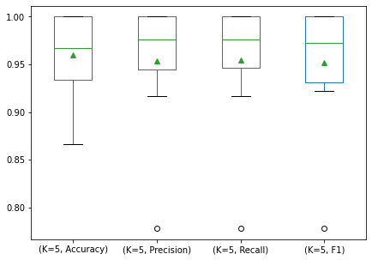
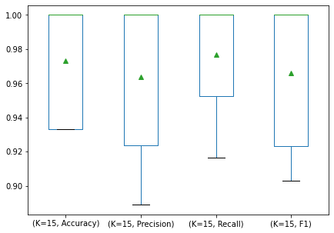
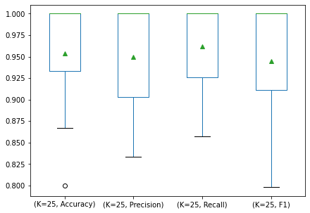
RESULTS AND DISCUSSION
Cross - validation
Metrics of cross validate
Universidade Federal do Espírito Santo
Artificial Intelligence Applied to Images
Deep ANNs applied to images

Slide 22
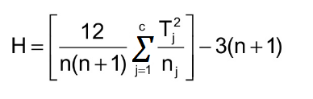
RESULTS AND DISCUSSION
Cross - validation
Kruskal-Wallis test
The Kruskal Wallis test is the non parametric alternative to the One Way ANOVA. Non parametric means that the test doesn’t assume your data comes from a particular distribution.
The test determines whether the medians of two or more groups are different. Like most statistical tests, you calculate a test statistic and compare it to a distribution cut-off point. The test statistic used in this test is called the H statistic. The hypotheses for the test are:
H₀: population medians are equal.
H₁: population medians are not equal.
The Kruskal Wallis test will tell you if there is a significant difference between groups
The test statistic is given by(DANIEL, 1990):
Where:
n = sum of sample sizes for all samples;
c = number of samples;
T_{j} = sum of ranks in the j^{th} sample;
n_{j} = size of the j^{th} sample.
Universidade Federal do Espírito Santo
Artificial Intelligence Applied to Images
Deep ANNs applied to images

Slide 23
RESULTS AND DISCUSSION
Cross - validation
Kruskal-Wallis test
Conditions:
If the critical chi-square value is less than the H statistic, reject the null hypothesis that the medians are equal.
If the chi-square value is not less than the H statistic, there is not enough evidence to suggest that the medians are unequal.
Conditions:
If P-value < 0.05: Reject NULL hypothesis - Significant differences exist between groups;
If P-value > 0.05: Accept NULL hypothesis - No significant difference between groups.
or
Universidade Federal do Espírito Santo
Artificial Intelligence Applied to Images
Deep ANNs applied to images

Slide 24
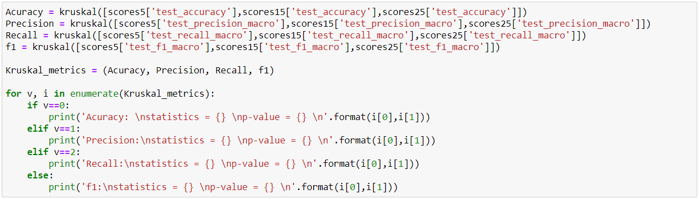
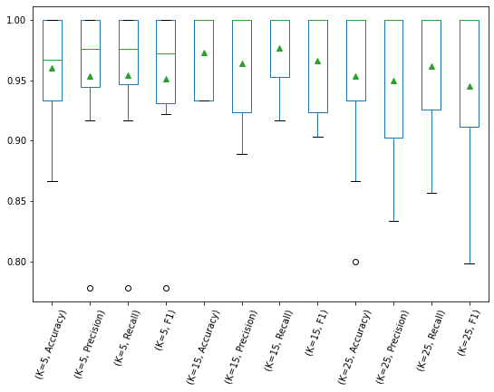
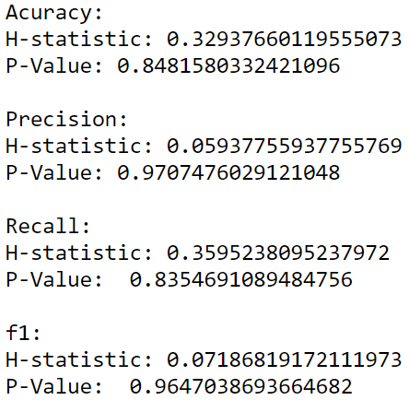
RESULTS AND DISCUSSION
Metrics
Metrics of cross validate
from scipy.stats.mstats import kruskal
Universidade Federal do Espírito Santo
Artificial Intelligence Applied to Images
Deep ANNs applied to images

Slide 25
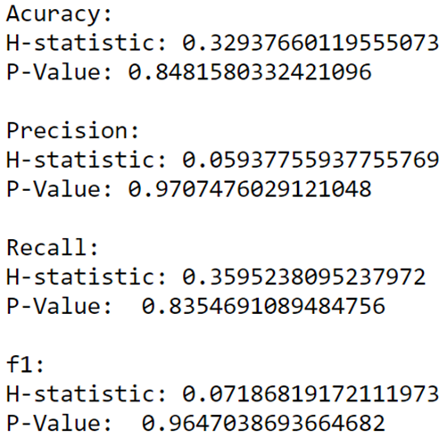
RESULTS AND DISCUSSION
Cross - validation
Conclusion
Conditions:
If P-value < 0.05: Reject NULL hypothesis - Significant differences exist between groups;
If P-value > 0.05: Accept NULL hypothesis - No significant difference between groups.
Universidade Federal do Espírito Santo
Artificial Intelligence Applied to Images
Deep ANNs applied to images

Slide 26
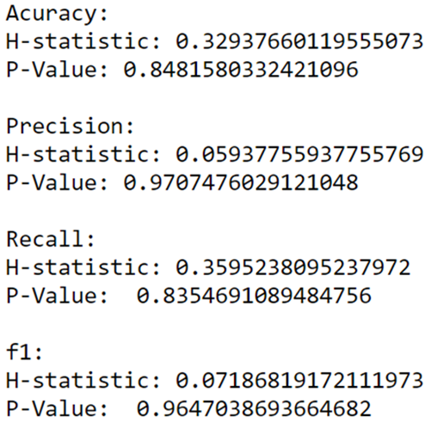
RESULTS AND DISCUSSION
Cross - validation
Conclusion
Conditions:
If P-value < 0.05: Reject NULL hypothesis - Significant differences exist between groups;
If P-value > 0.05: Accept NULL hypothesis - No significant difference between groups.
No significant difference between models(K=5, K=15 and K=25)
Universidade Federal do Espírito Santo
Artificial Intelligence Applied to Images
Deep ANNs applied to images

Slide 27
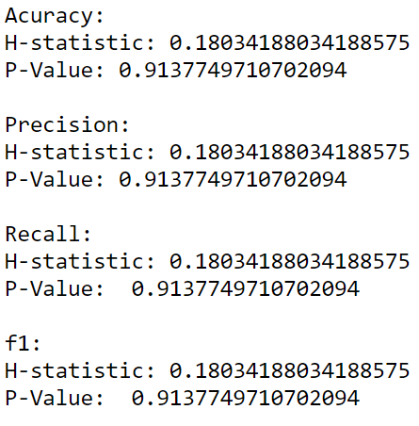
RESULTS AND DISCUSSION
Cross - validation
Conclusion
Conditions:
If P-value < 0.05: Reject NULL hypothesis - Significant differences exist between groups;
If P-value > 0.05: Accept NULL hypothesis - No significant difference between groups.
No significant difference between models(K=5, K=15 and K=25)
Universidade Federal do Espírito Santo
Artificial Intelligence Applied to Images
Deep ANNs applied to images

Slide 28
REFERENCES
Python: k-Nearest Neighbor algorithms
DUDA, R.O.; HART, P.E. Pattern Classification and Scene Analysis. (Q327.D83) John Wiley & Sons, ISBN 0-471-22361-1, 1973
GARRETA, Raul; MONCECCHI, Guillermo. Learning scikit-learn: machine learning in python. Packt Publishing Ltd, 2013.
SKTLEARN. sklearn.datasets.load_iris. Available in: https://scikit-learn.org/stable/modules/generated/sklearn.datasets.load_iris.html. Access in: 25 Oct. 2021.
ROIGER, Richard J. Data mining: a tutorial-based primer. Chapman and Hall/CRC, 2017.
DANIEL, Wayne W. Applied nonparametric statistics. [S.l.]: PWS-Kent Publ, 1990.
Vitor Souza Premoli Pinto de Oliveira¹
¹Universidade Federal do Espírito Santo
Artificial Intelligence Applied to Images
Universidade Federal do Espírito Santo
Artificial Intelligence Applied to Images
Deep ANNs applied to images

