Slide 1

Python: K-NN and MlP classifier
Vitor Souza Premoli Pinto de Oliveira¹
¹Universidade Federal do Espírito Santo
Artificial Intelligence Applied to Images
Universidade Federal do Espírito Santo
Artificial Intelligence Applied to Images
Deep ANNs applied to images

Slide 2
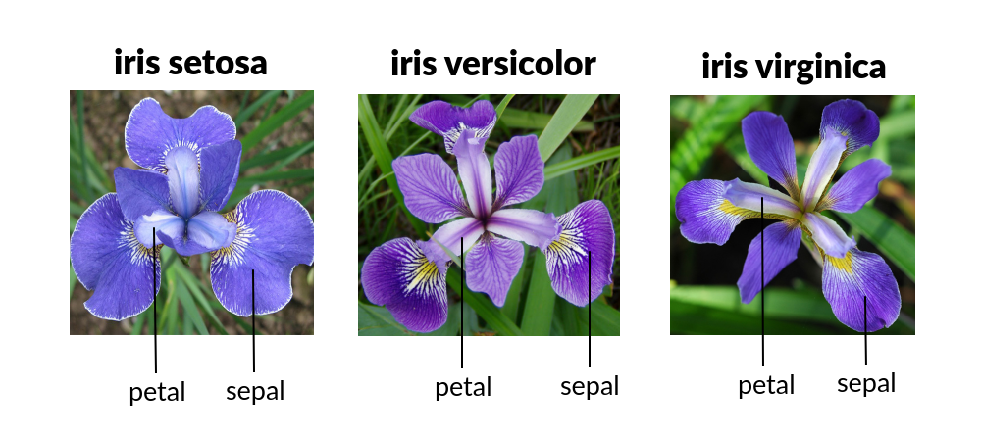
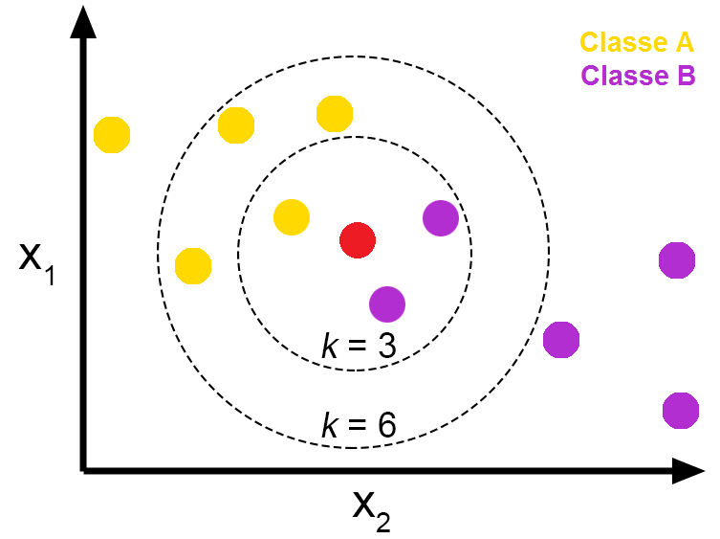
Intoduction
Python
Objectives
Iris Dataset
Choose the best K for K-NN model;
Show the mathematical logic behind MLP classifier;
Evaluate (through cross-validation) between models with in different metrics;
After made the evaluation, verify if models have statistic differences.
Universidade Federal do Espírito Santo
Artificial Intelligence Applied to Images
Deep ANNs applied to images

Slide 3
MACHINE LEARNING
K-nearest neighbors algorithm
Universidade Federal do Espírito Santo
Artificial Intelligence Applied to Images
Deep ANNs applied to images

Slide 4
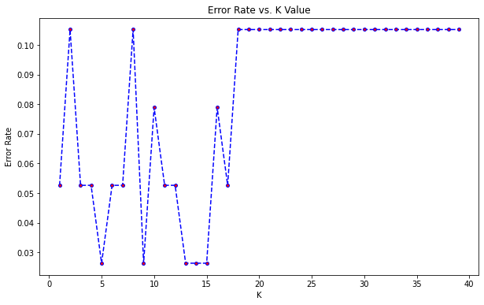
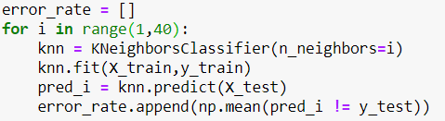
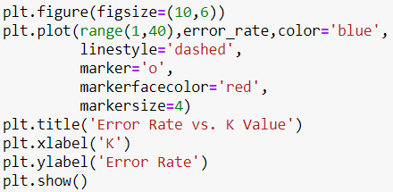
MACHINE LEARNING
K-nearest neighbors algorithm
Error Rate vs K value
Universidade Federal do Espírito Santo
Artificial Intelligence Applied to Images
Deep ANNs applied to images

Slide 5
MACHINE LEARNING
K-nearest neighbors algorithm
Error Rate vs K value
True and False rate per K value tested;
Based on the smallest value of the rate, we have as best Ks :[14, 16, 20, 21, 22, 28]
Applied cross-validation, CV=10, with metrics(Accuracy, Precision, Recall, F1);
Universidade Federal do Espírito Santo
Artificial Intelligence Applied to Images
Deep ANNs applied to images

Slide 6
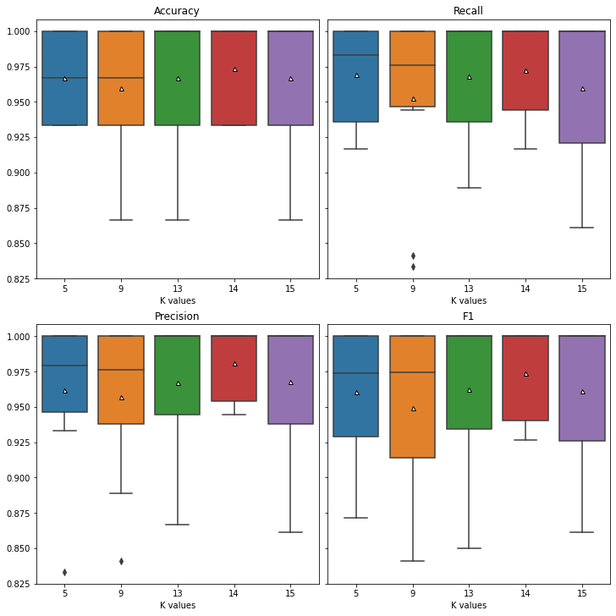
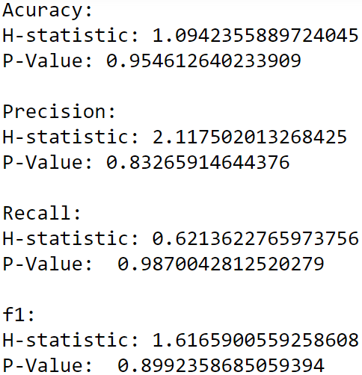
MACHINE LEARNING
K-nearest neighbors algorithm
Error Rate vs K value
from scipy.stats.mstats import kruskal
P-value > 0.05: Accept NULL hypothesis - No significant difference between groups.
Universidade Federal do Espírito Santo
Artificial Intelligence Applied to Images
Deep ANNs applied to images

Slide 7
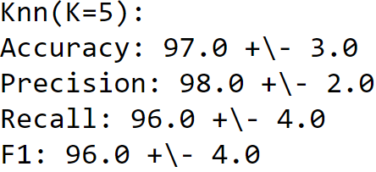
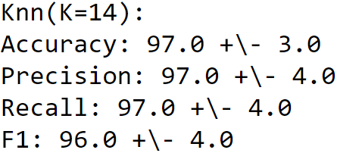
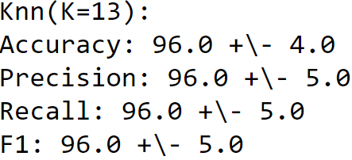
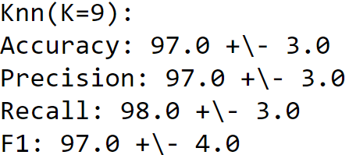
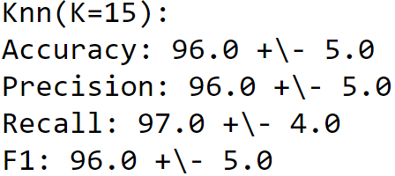
MACHINE LEARNING
K-nearest neighbors algorithm
Cross validation for differents Ks
Metrics | K- values
Accuracy | 9, 14, 13, 15
Precision | 5, 9, 13, 14, 15
Recall | 5, 9, 13, 14, 15
F1 | 5, 9, 13, 14, 15
Universidade Federal do Espírito Santo
Artificial Intelligence Applied to Images
Deep ANNs applied to images

Slide 8
DEEP LEARNING
Multi-layer Perceptron classifier.
Universidade Federal do Espírito Santo
Artificial Intelligence Applied to Images
Deep ANNs applied to images

Slide 9
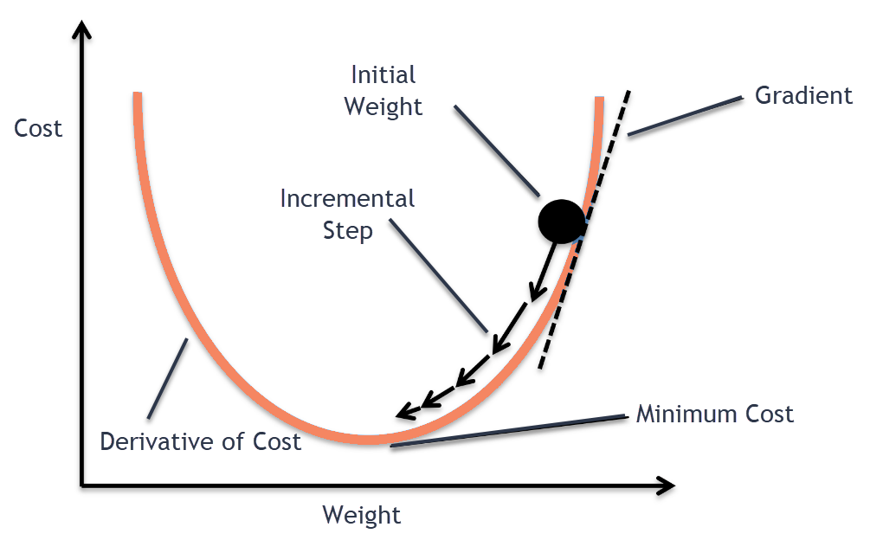

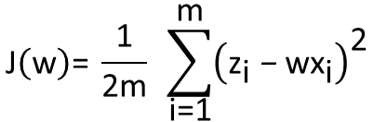
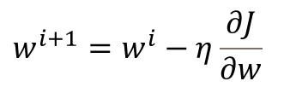


MACHINE LEARNING
Multi-layer Perceptron classifier.
Mathematical logic
This model optimizes the log-loss function using LBFGS or stochastic gradient descent
MLPClassifier trains iteratively since at each time step the partial derivatives of the loss function with respect to the model parameters are computed to update the parameters.
$$Z$$
$$\text{J}\left(\text{w}\right)\text{= }\frac{\text{1}}{\text{2}\text{m}} \sum_{\text{i}\text{=1}}^{\text{m}}{{\left({\text{z}}_{\text{i}} \text{−} \text{w}{\text{x}}_{\text{i}}\right)}^{\text{2}}}$$
$$X$$
$$w^{i+1}=w^{i}−η\frac{∂J}{∂w}$$
$$Z=wX$$
from sklearn.neural_network import MLPClassifier
Universidade Federal do Espírito Santo
Artificial Intelligence Applied to Images
Deep ANNs applied to images

Slide 10
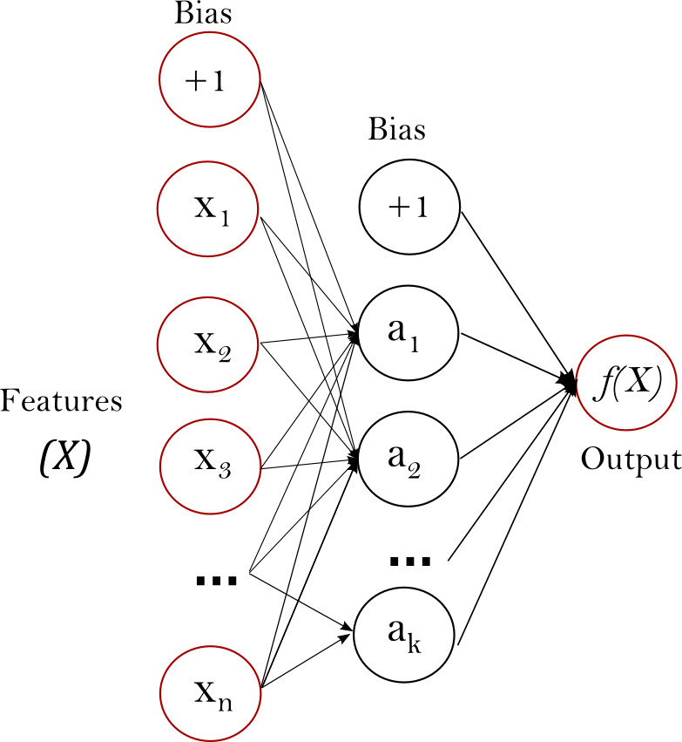
MACHINE LEARNING
Multi-layer Perceptron classifier.
Mathematical logic
This model optimizes the log-loss function using LBFGS or stochastic gradient descent
MLPClassifier trains iteratively since at each time step the partial derivatives of the loss function with respect to the model parameters are computed to update the parameters.
$$Z$$
$$\text{J}\left(\text{w}\right)\text{= }\frac{\text{1}}{\text{2}\text{m}} \sum_{\text{i}\text{=1}}^{\text{m}}{{\left({\text{z}}_{\text{i}} \text{−} \text{w}{\text{x}}_{\text{i}}\right)}^{\text{2}}}$$
$$X$$
$$w^{i+1}=w^{i}−η\frac{∂J}{∂w}$$
$$Z=wX$$
from sklearn.neural_network import MLPClassifier
One hidden layer MLP
Universidade Federal do Espírito Santo
Artificial Intelligence Applied to Images
Deep ANNs applied to images

Slide 11
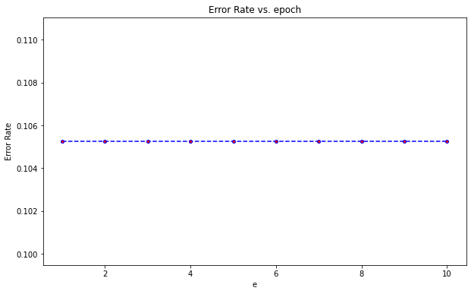
MACHINE LEARNING
Multi-layer Perceptron classifier.
epochs
The terminating condition can be given as a total number of passes (also called epochs) of the training data through the network.
Test the accuracy of the network on a test data set. If the accuracy is less than optimal, change one or more parameters of the network topology and start over.(ROIGER, 2017)
Universidade Federal do Espírito Santo
Artificial Intelligence Applied to Images
Deep ANNs applied to images

Slide 12
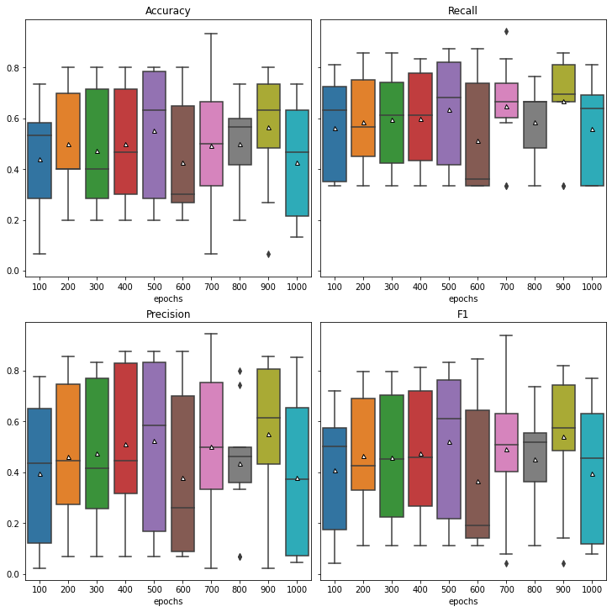
MACHINE LEARNING
Multi-layer Perceptron classifier.
epochs
The terminating condition can be given as a total number of passes (also called epochs) of the training data through the network.
Test the accuracy of the network on a test data set. If the accuracy is less than optimal, change one or more parameters of the network topology and start over.(ROIGER, 2017)
Universidade Federal do Espírito Santo
Artificial Intelligence Applied to Images
Deep ANNs applied to images

Slide 13
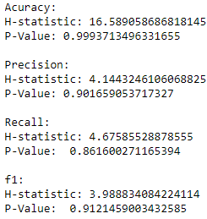
MACHINE LEARNING
Multi-layer Perceptron classifier.
epochs
P-value > 0.05: Accept NULL hypothesis - No significant difference between groups.
Universidade Federal do Espírito Santo
Artificial Intelligence Applied to Images
Deep ANNs applied to images

Slide 14
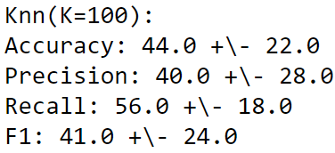
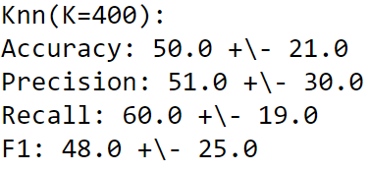
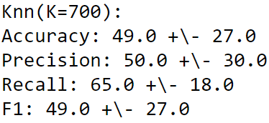
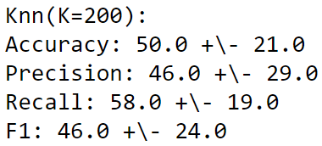
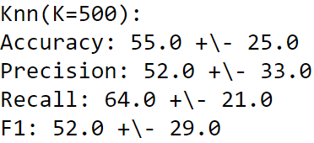
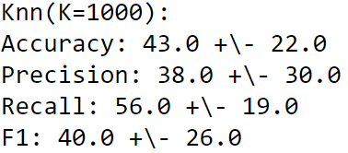
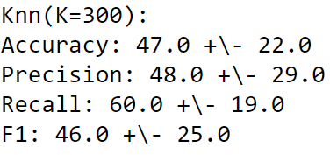
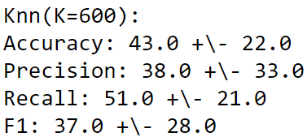
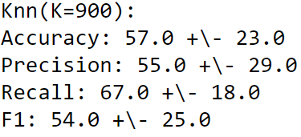
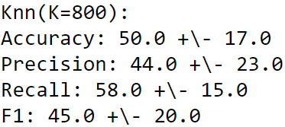
MACHINE LEARNING
Multi-layer Perceptron classifier.
epochs
Metrics | epochs
Accuracy | 200, 500, 900
Precision | 400, 500, 700, 900
Recall | 100, 200, 300, 400, 500, 600, 700, 800, 900, 1000
F1 | 500, 900
Universidade Federal do Espírito Santo
Artificial Intelligence Applied to Images
Deep ANNs applied to images

Slide 15
RESULTS AND DISCUSSION
Cross - validation
Universidade Federal do Espírito Santo
Artificial Intelligence Applied to Images
Deep ANNs applied to images

Slide 16
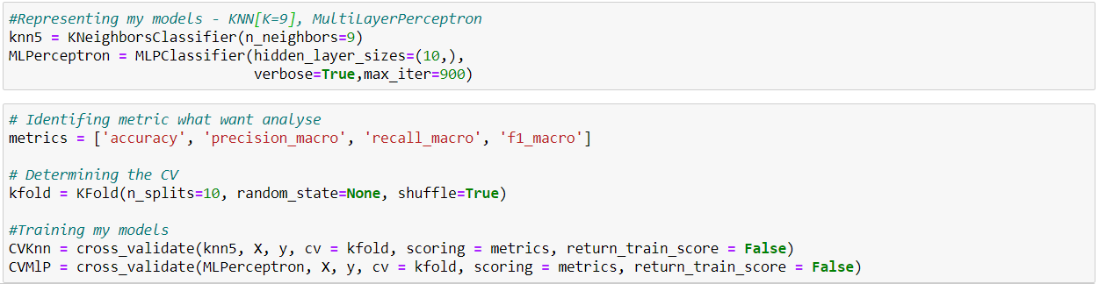
RESULTS AND DISCUSSION
Cross - validation
metrics
Universidade Federal do Espírito Santo
Artificial Intelligence Applied to Images
Deep ANNs applied to images

Slide 17
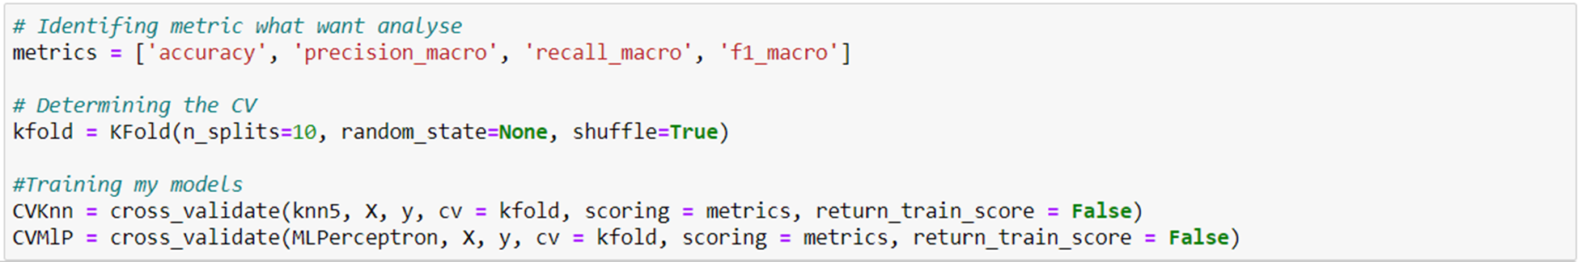
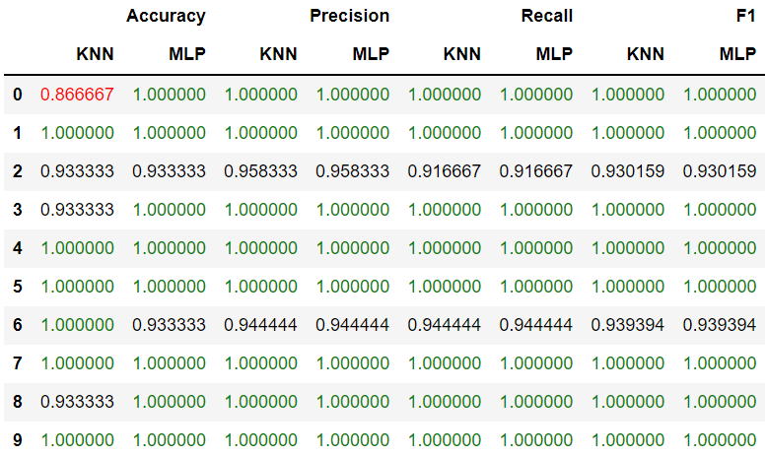
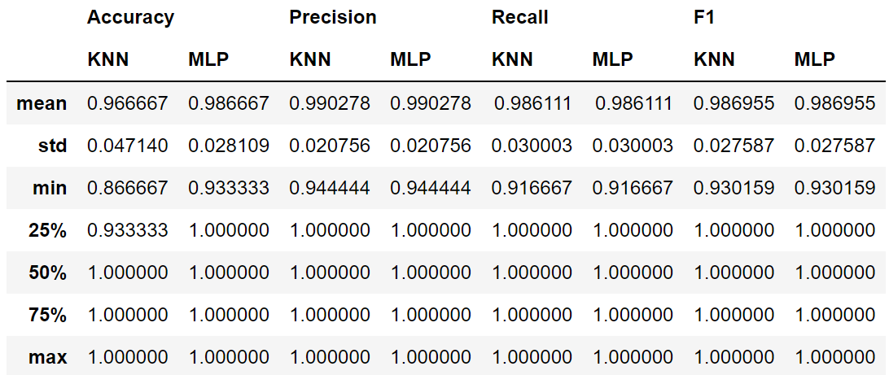
RESULTS AND DISCUSSION
Cross - validation
metrics
Universidade Federal do Espírito Santo
Artificial Intelligence Applied to Images
Deep ANNs applied to images

Slide 18
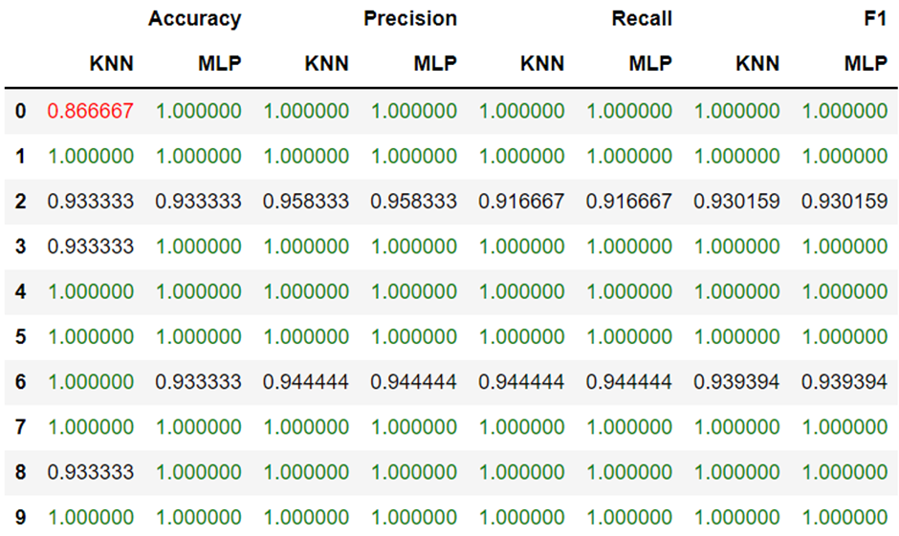
RESULTS AND DISCUSSION
Cross - validation
metrics
Universidade Federal do Espírito Santo
Artificial Intelligence Applied to Images
Deep ANNs applied to images

Slide 19
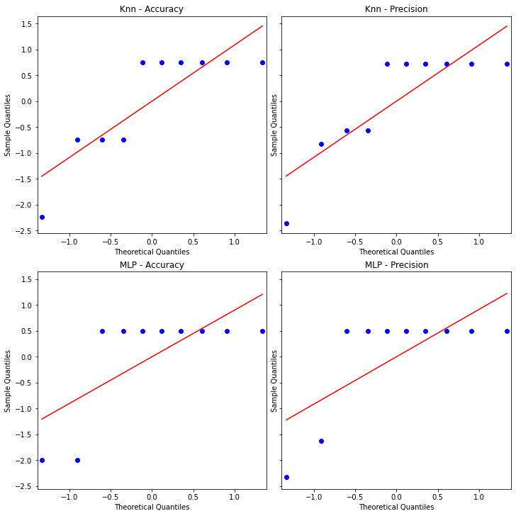
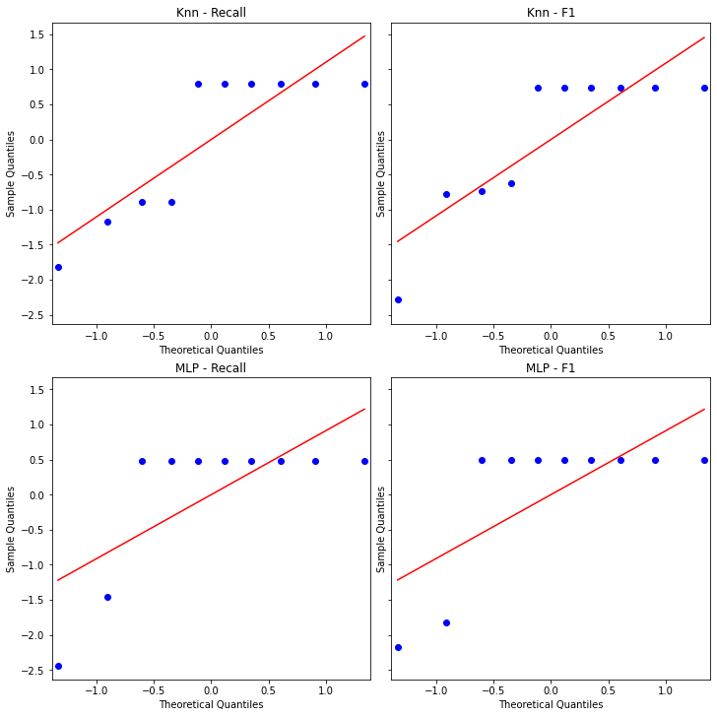
RESULTS AND DISCUSSION
Cross - validation
QQ plot
Universidade Federal do Espírito Santo
Artificial Intelligence Applied to Images
Deep ANNs applied to images

Slide 20
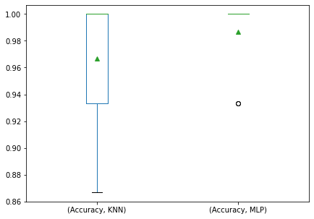
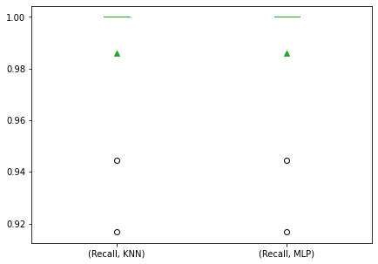
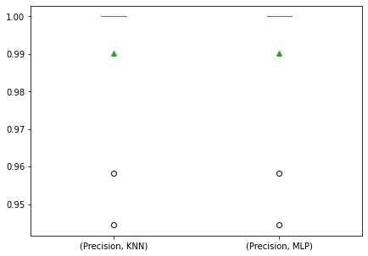

RESULTS AND DISCUSSION
Cross - validation
Box-plot
Universidade Federal do Espírito Santo
Artificial Intelligence Applied to Images
Deep ANNs applied to images

Slide 21
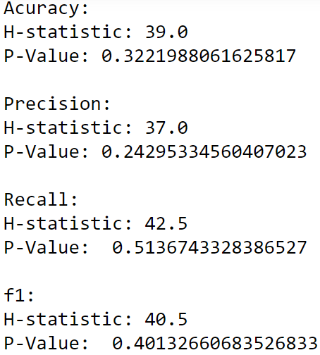
RESULTS AND DISCUSSION
Cross - validation
Wilcoxon Test
Perform the Mann-Whitney U rank test on two independent samples;
The Mann-Whitney U test is a nonparametric test of the null hypothesis that the distribution underlying sample x is the same as the distribution underlying sample y. It is often used as a test of of difference in location between distributions.
P-value > 0.05: Accept NULL hypothesis - No significant difference between groups.
Universidade Federal do Espírito Santo
Artificial Intelligence Applied to Images
Deep ANNs applied to images

Slide 22
REFERENCES
Python: k-Nearest Neighbor algorithms
SKTLEARN. Neural network models (supervised). Available in: https://scikit-learn.org/stable/modules/neural_networks_supervised.html#mlp-tips . Access in: 25 Oct. 2021.
ROIGER, Richard J. Data mining: a tutorial-based primer. Chapman and Hall/CRC, 2017.
Vitor Souza Premoli Pinto de Oliveira¹
¹Universidade Federal do Espírito Santo
Artificial Intelligence Applied to Images
Universidade Federal do Espírito Santo
Artificial Intelligence Applied to Images
Deep ANNs applied to images

