Slide 1


ANN: Multilayer perceptron with Keras
Vitor Souza Premoli Pinto de Oliveira¹
¹Federal University of Espírito Santo
Artificial Intelligence Applied to Images
Federal University of Espírito Santo
Artificial Intelligence Applied to Images
Deep ANNs applied to images

Slide 2
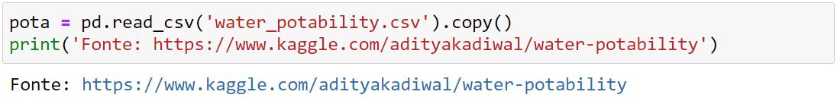


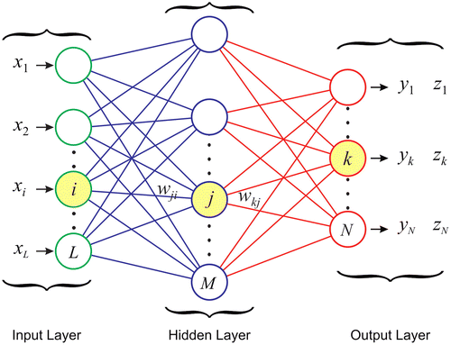
Intoduction
Python
Objectives
Importing dataset and making Exploratory Data Analysis;
Show the mathematical logic behind Keras.Sequential;
Choose hyperparameters through Grid Search CV;
After made the evaluation, verify if models with best hyperparameters have statistic differences.
Federal University of Espírito Santo
Artificial Intelligence Applied to Images
Deep ANNs applied to images

Slide 3
WATER POTABILITY
Exploratory Data Analysis
Federal University of Espírito Santo
Artificial Intelligence Applied to Images
Deep ANNs applied to images

Slide 4
WATER POTABILITY
Exploratory Data Analysis
Extracting the dataset
Columns | description | measurement unit
ph | hydrogen potential, which is a logarithmic scale that indicates it values | from 0 to 14 whether the solution is acidic, neutral or basic.
Hardness | Capacity of water to precipitate soap | mg/L
Solids | Total dissolved solids | ppm
Chloramines | Amount of Chloramines | ppm
Sulfate | Amount of Sulfates dissolved | mg/L
Conductivity | Electrical conductivity of water | μS/cm
Organic_carbon | Amount of organic carbon | ppm
Trihalomethanes | Amount of Trihalomethanes | μg/L
Turbidity | Measure of light emitting property of water | NTU
Access to safe drinking-water is essential to health, a basic human right and a component of effective policy for health protection. This is important as a health and development issue at a national, regional and local level. In some regions, it has been shown that investments in water supply and sanitation can yield a net economic benefit, since the reductions in adverse health effects and health care costs outweigh the costs of undertaking the interventions.(KAGGLE,2021)
The water_potability.csv file contains water quality metrics for 3276 different water bodies.
3276 rows × 10 columns
Federal University of Espírito Santo
Artificial Intelligence Applied to Images
Deep ANNs applied to images

Slide 5
WATER POTABILITY
Exploratory Data Analysis
Extracting the dataset
Characterizes | description | measurement unit
ph | hydrogen potential, which is a logarithmic scale that indicates it values | from 0 to 14 whether the solution is acidic, neutral or basic.
Hardness | Capacity of water to precipitate soap | mg/L
Solids | Total dissolved solids | ppm
Chloramines | Amount of Chloramines | ppm
Sulfate | Amount of Sulfates dissolved | mg/L
Conductivity | Electrical conductivity of water | μS/cm
Organic_carbon | Amount of organic carbon | ppm
Trihalomethanes | Amount of Trihalomethanes | μg/L
Turbidity | Measure of light emitting property of water | NTU
Class | description | measurement unit
Potability | Indicates if water is safe for human consumption | Potable [1]; Not potable [0].
Federal University of Espírito Santo
Artificial Intelligence Applied to Images
Deep ANNs applied to images

Slide 6
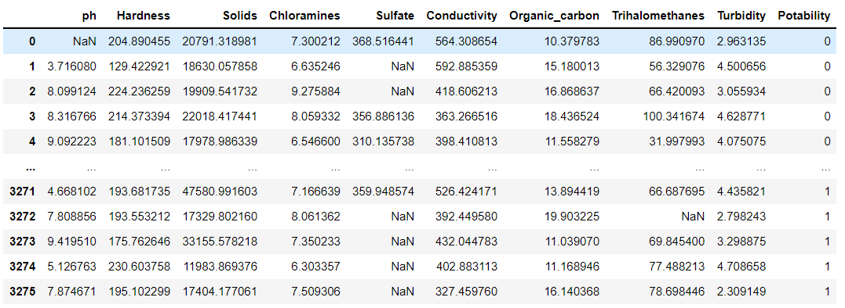
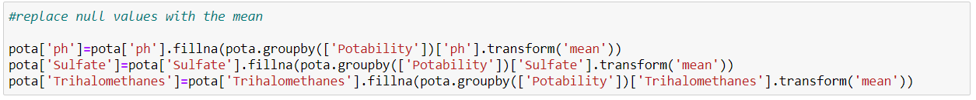
WATER POTABILITY
Exploratory Data Analysis
Statistics and correlations
Federal University of Espírito Santo
Artificial Intelligence Applied to Images
Deep ANNs applied to images

Slide 7
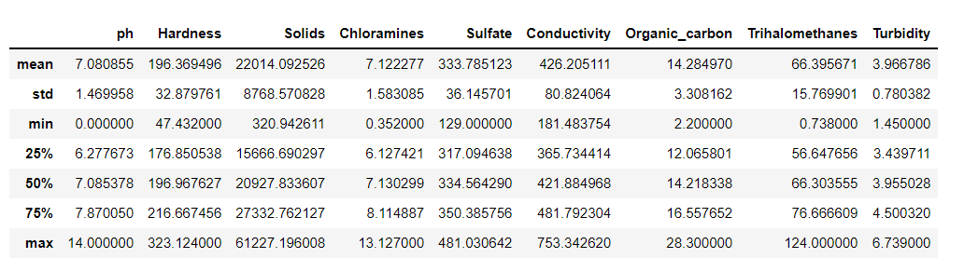
WATER POTABILITY
Exploratory Data Analysis
Statistics and correlations
Federal University of Espírito Santo
Artificial Intelligence Applied to Images
Deep ANNs applied to images

Slide 8
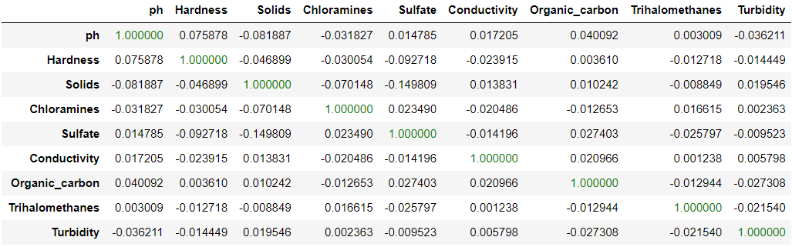
WATER POTABILITY
Exploratory Data Analysis
Statistics and correlations
Federal University of Espírito Santo
Artificial Intelligence Applied to Images
Deep ANNs applied to images

Slide 9
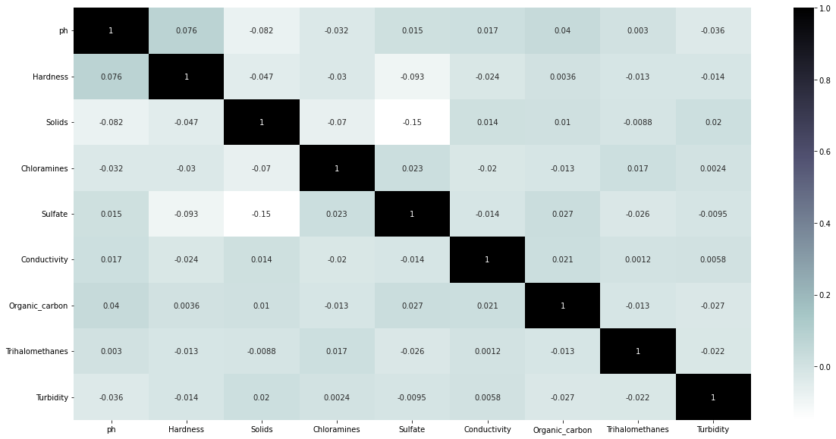
WATER POTABILITY
Exploratory Data Analysis
Graphic analyses
Federal University of Espírito Santo
Artificial Intelligence Applied to Images
Deep ANNs applied to images

Slide 10
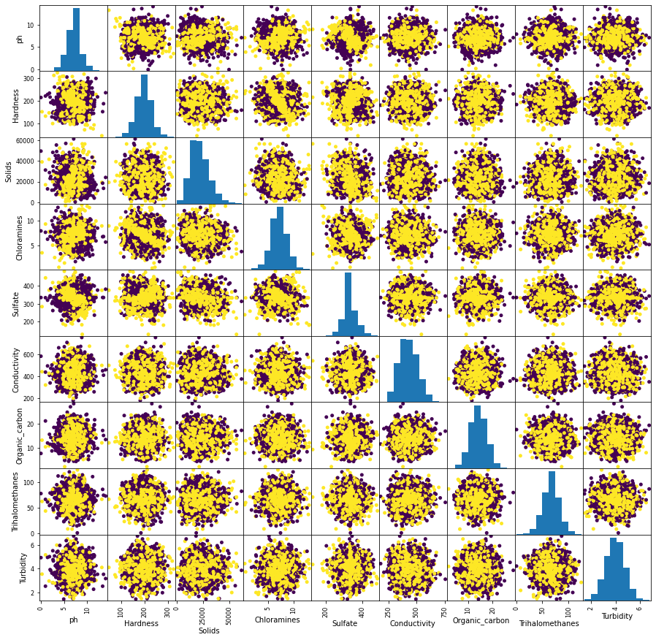
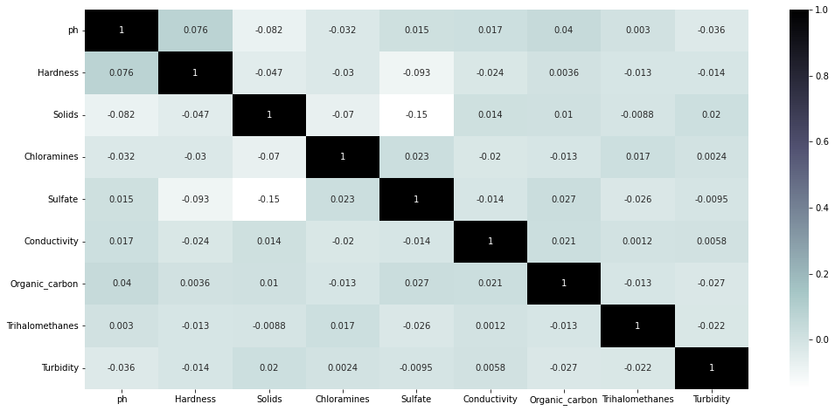
WATER POTABILITY
Exploratory Data Analysis
Graphic analyses
Federal University of Espírito Santo
Artificial Intelligence Applied to Images
Deep ANNs applied to images

Slide 11
WATER POTABILITY
Exploratory Data Analysis
Graphic analyses
Federal University of Espírito Santo
Artificial Intelligence Applied to Images
Deep ANNs applied to images

Slide 12
DEEP LEARNING MODEL
Multilayer Perceptron
Federal University of Espírito Santo
Artificial Intelligence Applied to Images
Deep ANNs applied to images

Slide 13
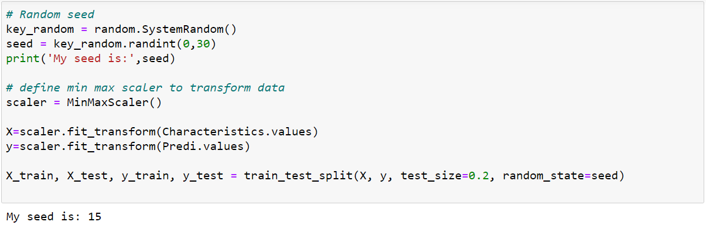
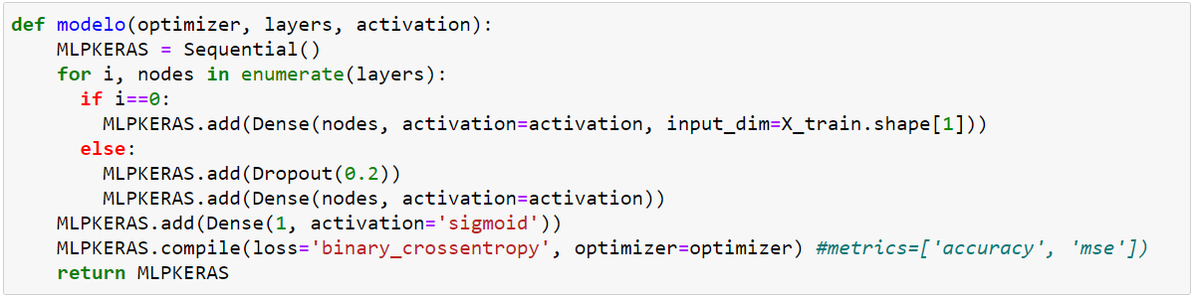
DEEP LEARNING MODEL
Multilayer Perceptron
Architecture
Multilayer perceptron(MLP) utilizes a supervised learning technique called backpropagation for training. MLP is used on:
Tabular datasets;
Classification/Regression prediction problems.
The Sequential model, the most approachable API—it’s basically a Python list. As such, it’s limited to simple stacks of layers(CHOLLET, 2021).
from tensorflow.keras.models import Sequential
from tensorflow.keras.layers import Dense, Dropout
Federal University of Espírito Santo
Artificial Intelligence Applied to Images
Deep ANNs applied to images

Slide 14
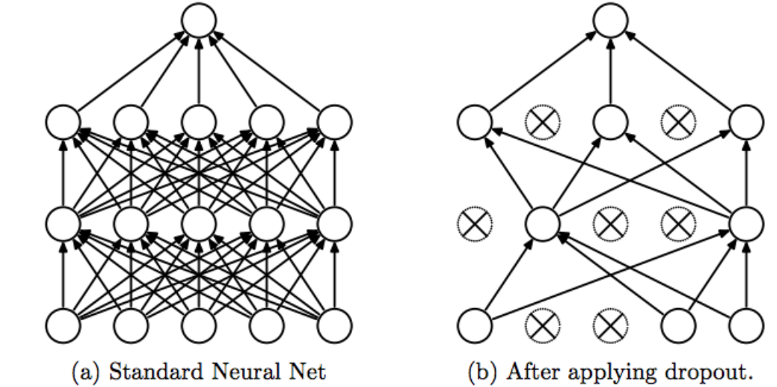
DEEP LEARNING MODEL
Multilayer Perceptron
Architecture
Federal University of Espírito Santo
Artificial Intelligence Applied to Images
Deep ANNs applied to images

Slide 15
DEEP LEARNING MODEL
Multilayer Perceptron
Architecture
Federal University of Espírito Santo
Artificial Intelligence Applied to Images
Deep ANNs applied to images

Slide 16
DEEP LEARNING MODEL
Multilayer Perceptron
Architecture
for a two-class classification problem(CHOLLET, 2021)
Federal University of Espírito Santo
Artificial Intelligence Applied to Images
Deep ANNs applied to images

Slide 17
HYPERPARAMETERS
Grid Search CV
Federal University of Espírito Santo
Artificial Intelligence Applied to Images
Deep ANNs applied to images

Slide 18
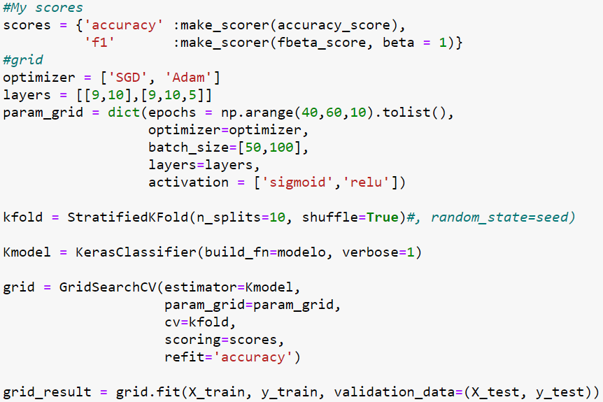
HYPERPARAMETERS
Grid Search CV
What’s Grid Search?
Hyper-parameters are parameters that are not directly learnt within estimators. In scikit-learn they are passed as arguments to the constructor of the estimator classes.(SCIKIT-LEARN, 2021)
GridSearchCV is a module in Scikit Learn and is used extensively to automate much of the tuning process. The primary purpose of GridSearchCV is to create combinations of parameters and then evaluate them.
Based on a "list"" of parameters, GridSearchCV will create the combinations and then evaluate them
from sklearn.model_selection import GridSearchCV
from keras.wrappers.scikit_learn import KerasClassifier
Federal University of Espírito Santo
Artificial Intelligence Applied to Images
Deep ANNs applied to images

Slide 19
HYPERPARAMETERS
Grid Search CV
What’s Grid Search?
Test the accuracy of the network on a test data set. If the accuracy is less than optimal, change one or more parameters of the network topology and start over (ROIGER, 2017).
from sklearn.model_selection import GridSearchCV
from keras.wrappers.scikit_learn import KerasClassifier
Federal University of Espírito Santo
Artificial Intelligence Applied to Images
Deep ANNs applied to images

Slide 20
HYPERPARAMETERS
Grid Search CV
Evaluate Deep Learning Models with Cross Validation
from sklearn.metrics import make_scorer, fbeta_score, accuracy_score
from keras.wrappers.scikit_learn import KerasClassifier
Federal University of Espírito Santo
Artificial Intelligence Applied to Images
Deep ANNs applied to images

Slide 21
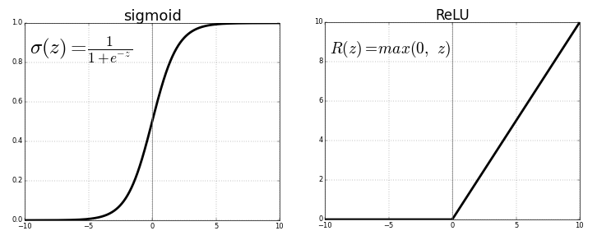
HYPERPARAMETERS
Grid Search CV
Evaluate Deep Learning Models with Cross Validation
Federal University of Espírito Santo
Artificial Intelligence Applied to Images
Deep ANNs applied to images

Slide 22
HYPERPARAMETERS
Grid Search CV
Evaluate Deep Learning Models with Cross Validation
SGD stands for Stochastic Gradient Descent, a very popular numerical procedure to find the local minimum of a function(GARRETA, 2013);
ADAM is another big speed boost comes from using a faster optimizer than the regular Descending Gradient optimizer. It requires less adjustment of the learning rate hyperparameter(GÉRON, 2019).
Federal University of Espírito Santo
Artificial Intelligence Applied to Images
Deep ANNs applied to images

Slide 23
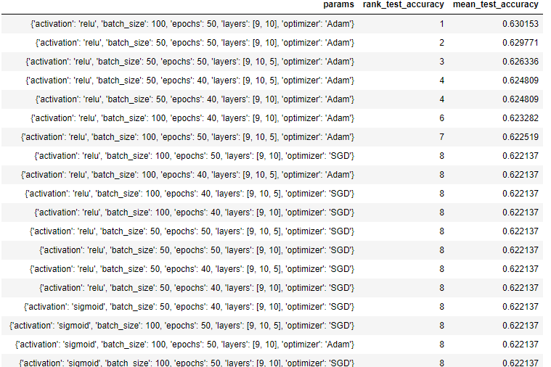
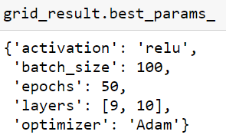
HYPERPARAMETERS
Grid Search CV
Evaluate Deep Learning Models with Cross Validation
30 combinations
Federal University of Espírito Santo
Artificial Intelligence Applied to Images
Deep ANNs applied to images

Slide 24
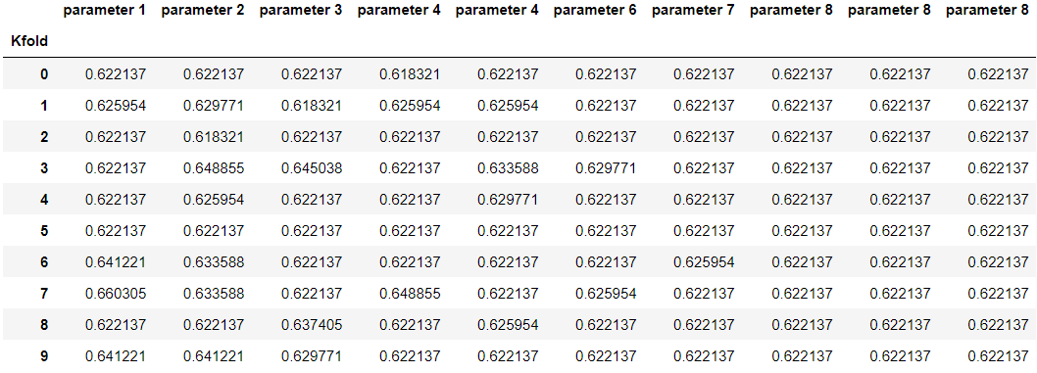
HYPERPARAMETERS
Grid Search CV
Evaluate Deep Learning Models with Cross Validation
Federal University of Espírito Santo
Artificial Intelligence Applied to Images
Deep ANNs applied to images

Slide 25
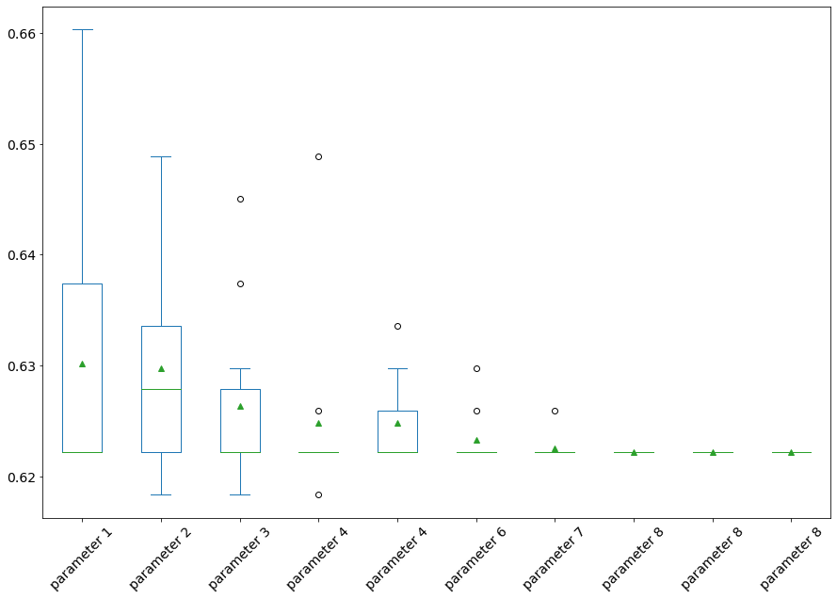
HYPERPARAMETERS
Grid Search CV
boxplots
Federal University of Espírito Santo
Artificial Intelligence Applied to Images
Deep ANNs applied to images

Slide 26
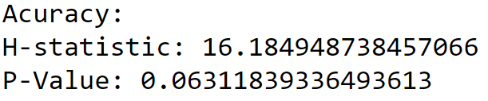
HYPERPARAMETERS
Grid Search CV
Cross validation
Conditions:
If P-value < 0.05: Reject NULL hypothesis - Significant differences exist between groups;
If P-value > 0.05: Accept NULL hypothesis - No significant difference between groups.
Universidade Federal do Espírito Santo
Artificial Intelligence Applied to Images
Deep ANNs applied to images

Slide 27
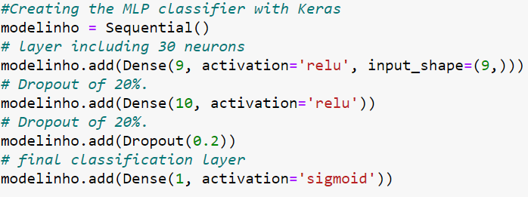
HYPERPARAMETERS
Grid Search CV
Multilayer Perceptron
Universidade Federal do Espírito Santo
Artificial Intelligence Applied to Images
Deep ANNs applied to images

Slide 28
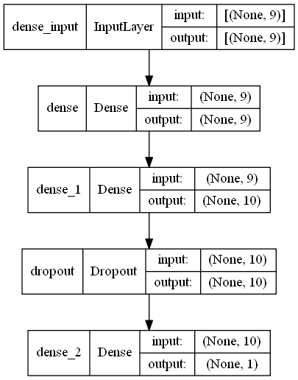
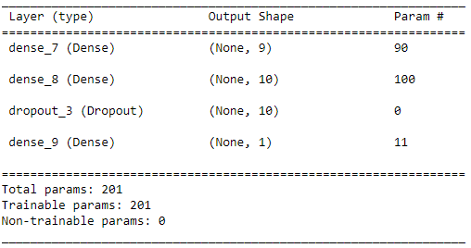
HYPERPARAMETERS
Grid Search CV
Multilayer Perceptron
Model loss: 0.6546;
Accuracy: 0.629 +/- 0.231);
Number of weights after calling the model: 6.
from tensorflow.keras.utils import plot_model
Universidade Federal do Espírito Santo
Artificial Intelligence Applied to Images
Deep ANNs applied to images

Slide 29
REFERENCES
ANN: Multilayer perceptron with Keras
SCIKIT-LEARN. Tuning the hyper-parameters of an estimator. Available in: https://scikit-learn.org/stable/modules/grid_search.html#grid-search
. Access in: 25 NOV. 2021.
CHOLLET, Francois. Deep learning with Python. Simon and Schuster, 2021.
KAGGLE. Water Quality: Drinking water potability. Available in: https://www.kaggle.com/adityakadiwal/water-potability. Access in: 25 NOV. 2021.
GARRETA, Raul; MONCECCHI, Guillermo. Learning scikit-learn: machine learning in python. Packt Publishing Ltd, 2013.
GÉRON, Aurélien. Mãos à Obra: Aprendizado de Máquina com Scikit-Learn & TensorFlow. Alta Books, 2019.
ROIGER, Richard J. Data mining: a tutorial-based primer. Chapman and Hall/CRC, 2017.
Vitor Souza Premoli Pinto de Oliveira¹
¹Federal University of Espírito Santo
Artificial Intelligence Applied to Images
Federal University of Espírito Santo
Artificial Intelligence Applied to Images
Deep ANNs applied to images

