Slide 1

24AIM113 Introduction to NN, CNN and GNN
24AIM114 Analog system design
Autonomous Car with Collision Detection and Avoidance
TEAM MEMBERS:
Dheeraj Chowdary CB.AI.U4AIM24109
Sai Charan CB.AI.U4AIM24124
Prem Siva Sai CB.AI.U4AIM24125
Chirudeep CB.AI.U4AIM24137
GUIDE: Dr. Snigdhatanu Acharya
Dr. Amrutha V
1

Slide 2
INTRODUCTION
Autonomous cars are self-driving vehicles capable of navigating without human intervention using control systems.
Collision detection and avoidance are critical for ensuring road safety, preventing accidents, and enabling smooth navigation in dynamic environment.
CNNs are powerful deep learning models used for real-time image recognition, enabling the car to detect obstacles, classifying objects, and make driving decisions.
The system processes real-time data from camera, detects obstacles and autonomously adjusts the car's speed and direction to avoid collisions.
2
2

Slide 3
OBJECTIVES
1.To implement CNN-Based Object Detection: Utilize Convolutional Neural Networks (CNNs) to accurately detect and classify obstacles.
2. To develop a Collision Avoidance System: Design an algorithm that predicts potential collisions based on detected objects and take actions such as braking.
3. To enhance Real-Time Data Processing and Control: Optimize computational efficiency by integrating ESP32 or microcontrollers to process CNN outputs.
4. To improve Safety and Navigation in Dynamic Environment: Develop a robust system capable of adapting to changing road conditions, unexpected obstacles, and traffic signals.
3

Slide 4
PROBLEM STATEMENT
1.It is taking more time to detect the obstacle by ESP32 cam module and giving the command wether to move left or right.
2. Detecting and accurately identifying dynamic obstacles (e.g., vehicles) in real-time is complex, specially in varying traffic and environmental conditions.
3. Autonomous vehicles require advanced algorithms that not only detect obstacles but also predict potential collisions and make quick, accurate driving decisions.
4

Slide 5
LITERATURE REVIEW
S.NO. | TITLE | AUTHORS | ALGORITHM | RESULT
1. | Human Detection and Avoidance Control Systems of an Autonomous Vehicle | T N Nizar | YOLO Fuzzy | Best accuracy is found at 2-7m. Average Accuracy is 74.4%
2. | Vehicle Detection Techniques for Collision Avoidance Systems | Amir Mukhtar, Likun Xia, and Tong Boon Tang | SVM HOG | No single detection method is perfect. Machine Learning classifiers are the most effective for vehicle classification.
5

Slide 6
3. | Collision Avoidance in Dynamic Environments Applied to Autonomous Vehicle Guidance on the Motorway | D. Reichardt, J. Schick | Potential Field Algorithm Riskmap Representation | The model runs in real-time on a PC and a transputer system. The system was tested in simulated environments and was sucessful.
4. | Data Science Using Warning Systems and Vehicle Crash Detection | N.Shilpa, K.Veera Kishore,S.Anitha | YOLO OpenCV | Accuracy reached upto 90% The model prints accident occured if the accident accuracy is above 90%
5. | Autonomous car using CNN deep learning algorithm | Ilvico Sonata, Lukas | CNN for autonomous driving | Able to drive autonomously without errors or oscillations.
6

Slide 7
RESEARCH GAPS
Detection algorithms struggle with dynamic environments and low-light conditions, reducing accuracy and increasing false positives.
Real-time data processing demands high computational power, increasing hardware costs and limiting commercial adoption.
Autonomous vehicles lack robust frameworks for ethical decisions in unavoidable collision scenarios.
7

Slide 8
HARDWARE COMPONENTS
1. Microcontroller
Raspberry pi 5:
Acts as main part of autonomous car, processing the sensor data and making decisions for navigation.
The core processor of the suggested system is the Raspberry Pi 5, which has a 2.4 GHz quad-core Cortex-A76 processor and up to 8GB of RAM.
Based on the object detection, Raspberry pi send the command to the Arduino UNO.
8

Slide 9
2. Motor Control System
Motor Driver(L298N):
The main role of this is to provide power supply to the motors.
The L298N is a 16-lead dual full-bridge motor driver IC that allows simultaneous control of two motors.
Speed control is achieved by sending PWM signals to the ENA and ENB pins.
It can operates with a minimum supply of 5V, supports motor voltages up to 35V, and provides up to 2A output current per channel.
9

Slide 10
3. Communication Modules
ESP32-CAM :
The main role of this is the capture the real time stream and send the data to the raspberry pi
It has a 2-megapixel camera sensor . Depending on the resolution and processing load, the ESP32-CAM can stream video at up to 1600×1200 resolutions.
Arduino UNO
Based on the 8-bit ATmega328P microcontroller, the Arduino UNO is an open-source board equipped with essential components like voltage regulators .
Features: Includes USB connectivity, 6 analog input pins, 14 digital I/O pins (6 with PWM), an ICSP header, reset button.
10

Slide 11
METHODOLOGY
A high speed object detection model called Faster R-CNN is used.
RPN( Regional Proposal network):
This is the main component of the R-CNN.
RPN reduces proposal time for each image to 10 ms from 2 seconds and improves feature representation by sharing layers with detecting stages.
The different components of RPN are:
Sliding Window approach
Anchor Boxes
Objectness Score
11

Slide 12
2. RoI(Region of Interest Pooling)
This layer is used to transform the RPN’s variable-sized region proposals into fixed-size feature maps that fed into the network’s subsequent layer.
RoI pooling divides each region proposal into a grid of equal-sized cells then applying max pooling within each cell.
A fixed-size feature map for each region proposal is generated which can be further processed by the network
3. Feature Extraction:
The RoI-pooled feature maps are fed into the CNN back-bone resnet 50 to extract meaningful feautres.
It draws hierarchical features from region proposals.
These features retain spatial information while abstracting away low-level details, allowing the network to understand the proposed regions’ content.
12

Slide 13
4. Fully connected layers:
These layers are responsible for object classification and bounding box regression tasks.
Object classification:
The network predicts class probabilities for each region proposal, indicating the possibility that the proposal contains an object of a specific class.
Bounding Box regression:
The network predicts bounding box adjustments for each region proposal.
The first layer is the soft-max layer with N+1 parameters
The second layer is the Bounding box regression with 4*N parameters.
Multi-task Loss function
A multi-task loss function that combines classification and regression losses
The classification loss computes the difference between expected and true class probabilities.
The regression loss computes the difference between expected and actual bounding box adjustments.
13

Slide 14
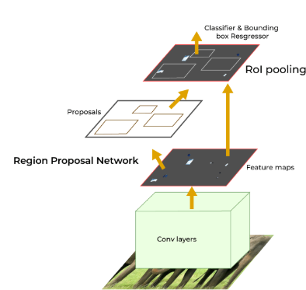
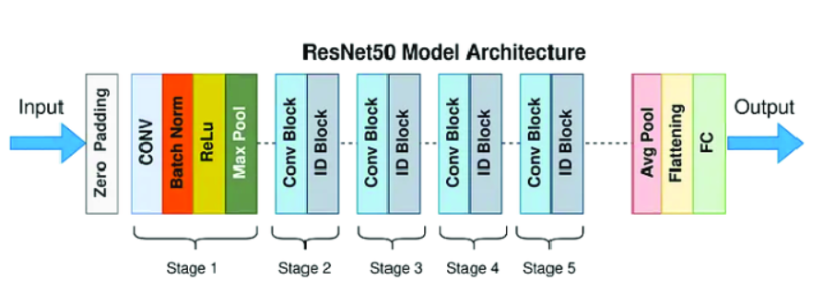
Architecture
R_CNN Architecture
ResNet50 Architecture
14

Slide 15
FLOW CHART
[ESP32-CAM (Video stream)]
↓
[Faster R-CNN (Object Detection)]
↓
[Obstacle co-ordinates]
↓
[Arduino UNO]
↓
[Motor Control (via L298N Driver)]
↓
[DC Motors (Car Navigation)]
15

Slide 16
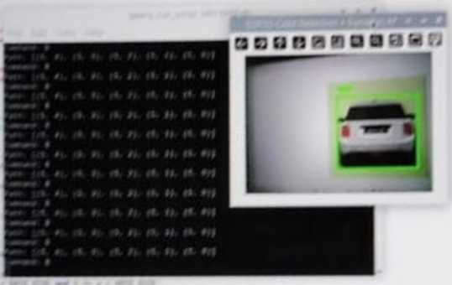
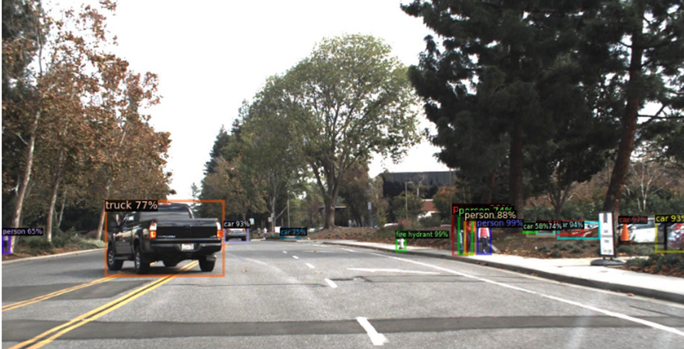
RESULTS
The green box represent the box labels after detecting the car.
The picture shows the Objectness score and also the name of the object.
16

Slide 17
FUTURE SCOPE
Try to implement A* algorithm in autonomous car in real life environment.
ESP32 cam module is detecting the image up-to maximum extent and detecting at starting point and searching for other path. Try to rectify so that it can take other after detecting the object at the near point.
To use better cam module to reduce the time of detection.
17

Slide 18
A* Algorithm
This algorithm is used for dynamic path planning.
This processes in 3 steps:
Object detection and obstacle planning:
The ESP32-CAM module captures video frames which are processed using a TensorFlow-based Faster R-CNN model.
The center coordinates of each bounding box are mapped onto a 2D grid representation of the environment, discretized into a 10×10 matrix.
Each grid cell is either marked as free (value 0) or as an obstacle (value 1) based on the presence of detected objects.
18

Slide 19
Grid construction:
To enable path planning, the continuous environment is abstracted into a uniform 10×10 grid.
Each detected obstacle is projected onto this grid using the formula:
gx = cx ∗ (GRIDSIZE/framewidth)
where,
(cx, cy) represents the center pixel of the bounding box in the image frame
gy = cy ∗ (GRIDSIZE/frameheight)
(gx, gy) is the corresponding grid coordinate.
A* Path planning:
It uses the A* search algorithm to compute for the shortest collision-free path from a predefined start position to a goal location.
A uses both cost from the start node and heuristic estimated cost from the goal.
the cost function represented as:
f(n) = g(n) + h(n)
g(n) is cost of the path from the start node to node n
h(n) is the Manhattan distance from node n to the goal.
19

Slide 20
REFERENCES
[1] T N Nizar, Human Detection and Avoidance Control Systems of an Autonomous Vehicle , 2020.
[2] Amir Mukhtar, Likun Xia, and Tong Boon Tang, Vehicle DetectionTechniques for Collision Avoidance Systems, 2015.
[3] D. Reichardt, J. Schick, Collision Avoidance in Dynamic Environments Applied to Autonomous Vehicle Guidance on the Motorway, 2002.
[4] N.Shilpa, K.Veera Kishore,S.Anitha, Data Science Using Warning Systems and Vehicle Crash Detection, 2022.
[5] Ilvico Sonata, Lukas, Autonomous car using CNN deep learning algorithm, 2021.
20

Slide 21

21

