Slide 1

24AIM113 Introduction to NN, CNN and GNN
24AIM114 Analog system design
Autonomous Car with Collision Detection and Avoidance
TEAM MEMBERS:
Dheeraj Chowdary CB.AI.U4AIM24109
Sai Charan CB.AI.U4AIM24124
Prem Siva Sai CB.AI.U4AIM24125
Chirudeep CB.AI.U4AIM24137
GUIDE: Dr. Snigdhatanu Acharya
Dr. Amrutha V
1

Slide 2
INTRODUCTION
Autonomous cars are self-driving vehicles capable of navigating without human intervention using sensors and control systems.
Collision detection and avoidance are critical for ensuring road safety, preventing accidents, and enabling smooth navigation in dynamic environment.
CNNs are powerful deep learning models used for real-time image recognition, enabling the car to detect obstacles, classifying objects, and make driving decisions.
The system processes real-time data from camera and sensors, detects obstacles and autonomously adjusts the car's speed and direction to avoid collisions.
2

Slide 3
PROBLEM STATEMENT
1. Increasing road accidents due to human errors like distraction and slow reaction times highlight the need for safer driving solutions.
2. Detecting and accurately identifying dynamic obstacles (e.g., vehicles) in real-time is complex, especially in varying traffic and environmental conditions.
3. Autonomous vehicles require advanced algorithms that not only detect obstacles but also predict potential collisions and make quick, accurate driving decisions.
4. Making collision detection systems both fast and accurate is a big challenge in self-driving cars that move quickly.
3

Slide 4
OBJECTIVES
1. Implement CNN-Based Object Detection: Utilize Convolutional Neural Networks (CNNs) to accurately detect and classify obstacles.
2. Develop a Collision Avoidance System: Design an algorithm that predicts potential collisions based on detected objects and take actions such as braking.
3. Integrate Analog System Design for Sensor Processing: Utilize analog circuits to handle signals from ultrasonic, ensuring efficient data collection and for real-time decision-making.
4. Enhance Real-Time Data Processing and Control: Optimize computational efficiency by integrating ESP32 or microcontrollers to process CNN outputs.
5. Improve Safety and Navigation in Dynamic Environment: Develop a robust system capable of adapting to changing road conditions, unexpected obstacles, and traffic signals.
4

Slide 5
LITERATURE REVIEW
S.NO. | TITLE | AUTHORS | ALGORITHM | RESULT
1. | Human Detection and Avoidance Control Systems of an Autonomous Vehicle | T N Nizar | YOLO Fuzzy | Best accuracy is found at 2-7m. Average Accuracy is 74.4%
2. | Vehicle Detection Techniques for Collision Avoidance Systems | Amir Mukhtar, Likun Xia, and Tong Boon Tang | SVM HOG | No single detection method is perfect. Machine Learning classifiers are the most effective for vehicle classification.
5

Slide 6
3. | Collision Avoidance in Dynamic Environments Applied to Autonomous Vehicle Guidance on the Motorway | D. Reichardt, J. Schick | Potential Field Algorithm Riskmap Representation | The model runs in real-time on a PC and a transputer system. The system was tested in simulated environments and was sucessful.
4. | Data Science Using Warning Systems and Vehicle Crash Detection | N.Shilpa, K.Veera Kishore,S.Anitha | YOLO OpenCV | Accuracy reached upto 90% The model prints accident occured if the accident accuracy is above 90%
5. | Autonomous car using CNN deep learning algorithm | Ilvico Sonata, Lukas | CNN for autonomous driving | Able to drive autonomously without errors or oscillations.
6

Slide 7
RESEARCH GAPS
Detection algorithms struggle with dynamic environments and low-light conditions, reducing accuracy and increasing false positives.
Real-time data processing demands high computational power, increasing hardware costs and limiting commercial adoption.
Autonomous vehicles lack robust frameworks for ethical decisions in unavoidable collision scenarios.
7

Slide 8
METHODOLOGY
Faster R-CNN (For Object Detection):
Input :
The ESP32-CAM captures real-time images of the environment.
Images are sent to the Raspberry Pi for processing.
Feature Extraction:
The image is passed through a Convolutional Neural Network (CNN) to extract important features like edges, shapes, and textures.
Using pre-trained networks like ResNet 50 as a backbone.
Region Proposal Network (RPN):
Generates Region Proposals where objects are likely to be found.
Uses anchor boxes to predict multiple object boundaries.
8

Slide 9
ROI (Region of Interest) Pooling:
Converts all proposed regions into the same size for uniform processing.
Helps speed up object classification.
Object Classification & Bounding Box Regression:
Classifies objects (like pedestrians, cars, obstacles).
Refines the boundaries of detected objects for precise localization.
Output (Obstacle Data):
Provides coordinates and labels of detected obstacles.
This data is passed to the Path Planning algorithm.
9

Slide 10
[ESP32-CAM (Image Capture)]
↓
[Faster R-CNN (Object Detection)]
↓
[Obstacle Coordinates]
↓
[A* Algorithm (Path Planning on Raspberry Pi)]
↓
[Motor Control (via L293D Driver)]
↓
[DC Motors (Car Navigation)]
10

Slide 11
HARDWARE COMPONENTS
1. Microcontroller
Raspberry pi:
Acts as main part of autonomous car, processing the sensor data and making decisions for navigation.
2. Sensors
Light Detection and Ranging Sensor :
Role: Measures distances by emitting laser pulses
Application: Used to detect obstacles and generate a point for navigation.
Ultra Sonic Sensors:
Role: Detects nearby objects by measuring sound wave reflections.
Application: Helps in short-range collision avoidance
11

Slide 12
Infrared Sensors
Role: Detects heat signatures.
Application: Helps in night vision-based object detection.
3. Motor Control System
Servo Motors:
Role: Controls the wheel movement of the car.
Application: Provides propulsion and steering for the car.
Motor Driver(L293D):
Role: Regulates power flow to motors.
Application: Adjusts speed and direction based on the microcontroller's commands.
4. Communication Modules
ESP32-CAM :
Role: ESP32-CAM captures real-time images → sends data to the microcontroller
12

Slide 13
CONCLUSION
The integration of Faster R-CNN with ResNet-50 enables accurate and real-time detection of obstacles, enhancing the car’s ability to make intelligent decisions.
Combining path planning algorithms (A*) with object detection ensures safe navigation, allowing the autonomous car to dynamically adjust routes and avoid potential collisions.
The use of ESP-32 Camera, LiDAR, and Raspberry Pi demonstrates effective coordination between hardware components and deep learning models for real-world applications.
13

Slide 14
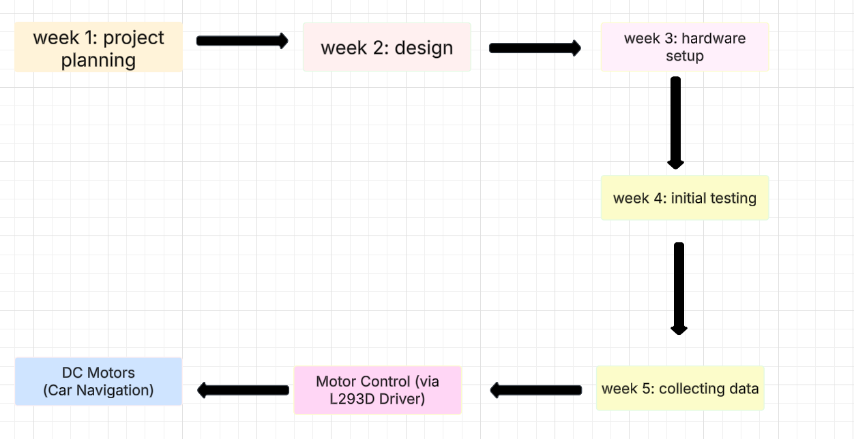
14

Slide 15
REFERENCES
1.Pedestrian Collision Avoidance in Autonomous Vehicles: AReview
Timothé Verstraete and Naveed Muhammad
2. N Multiple vehicle cooperation and collision avoidance in automated vehicles: survey and an AI‑enabled conceptual framework
Abu Jafar Md Muzahid, Syafiq Fauzi Kamarulzaman, Md Arafatur Rahman, Saydul Akbar Murad, Md Abdus Samad Kamal, Ali H Alenezi
3. Deep Learning Techniques for Obstacle Detection and Avoidance in Driverless Cars
Nischal Sanil, Pasumarthy Ankith Naga venkat, Rakesh V, Rishab Mallapur, Mohammed Riyaz Ahmed
4. Anti-collision Path Planning and Tracking of Autonomous Vehicle Based on Optimized Artificial Potential Field and Discrete LQR Algorithm
Chaoxia Zhang, Zhihao Chen, Xingjiao Li, Ting Zhao
5. An Investigation into the Appropriateness of Car-Following Models in Assessing Autonomous Vehicles
Akito Higatani and Wafaa Saleh
15

Slide 16

16

