Slide 1

1
Molecular biology and basic cellular physiology (24AIM112)&
Ethics, innovative research, businesses & IPR (24AIM115)
Autism Prediction Using Machine Learning
TEAM MEMBERS:
Dheeraj Chowdary CB.AI.U4AIM24109
Sai Charan CB.AI.U4AIM24124
Prem Siva CB.AI.U4AIM24125
Chirudeep CB.AI.U4AIM24137
FACULTY: Dr. Neelesh Ashok
Dr. Reshma

Slide 2
Introduction
2
Autism Spectrum Disorder (ASD) is a neurodevelopmental condition that affects social interaction, communication, and behavior.
Early detection of autism can play a crucial role in treatment, and in providing mental support.
THE MAIN AIM IS TO DEVELOP MODELS RELATED TO AUTISM:
1. Autism prediction model - predicts if a person has autism or not using some behavioral questions and some basic health data. (comparison between different ML algorithms)
2. Gene data analysis
a. Gene score classification model - This model classifies gene into low or high based on potential contribution to autism risk.
b. Syndromic prediction- This model predicts whether a gene is associated with syndromic or non-syndromic forms of autism based on its genetic features.

Slide 3
OBJECTIVES:
3
1. Develop a Robust Prediction Model: To create an accurate and reliable machine learning model capable of identifying individuals.
2. Improve Early Detection: To enhance early diagnosis and intervention by leveraging data-driven approaches.
3. Ensure Ethical Compliance and Intellectual Property Protection: To address ethical concerns by ensuring data privacy, informed consent, and fairness in predictions.
4. Promote Accessibility: To design a cost-effective and user-friendly system that can be widely implemented.

Slide 4
LITERATURE REVIEW
4
S.NO | TITLE | YEAR | RESULT
1. | Fusion of Features: A Technique to Improve Autism Spectrum Disorder Detection Using Brain MRI Images | 2023 | Accuracy is high for classification tree around 85.96 percent.
2. | Autism Detection for Toddlers using Facial Features with Deep Learning | 2024 | Used VGG16 and ViT Accuracy is around 89.06%

Slide 5

5
3 | Innovative Autism Spectrum Disorder Prediction Using Machine Learning | 2024 | They used KNN model. The accuracy they achieved is 66.10%
4 | Discovering the Gene-Brain-Behavior Link in Autism via Generative | 2024 | 89% accuracy in predicting genetic variations, strong correlation between structural brain changes and ASD-related traits.
5 | The Role of Intelligent Technologies in Early Detection of Autism Spectrum Disorder (ASD): A Scoping Review | 2022 | ML/DL techniques outperform traditional methods,need for robust datasets and multicultural validation identified.

Slide 6
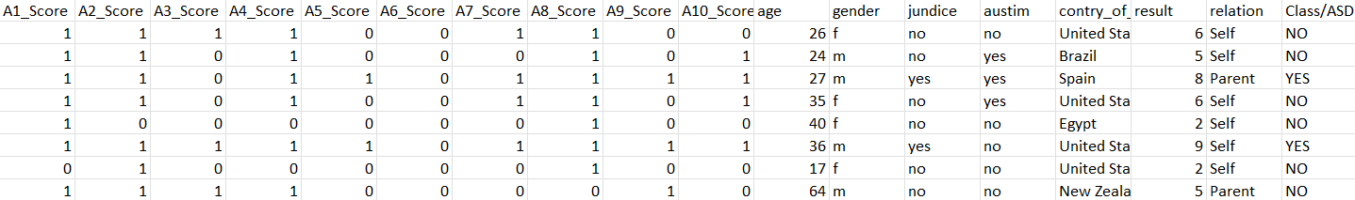
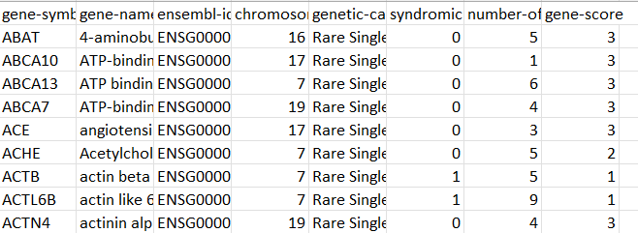
Datasets:
6
Behavioral Data
Gene related data
https://www.kaggle.com/datasets/andrewmvd/autism-screening-on-adults

Slide 7
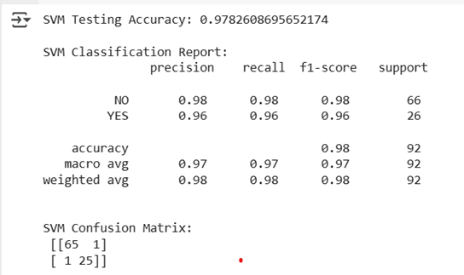
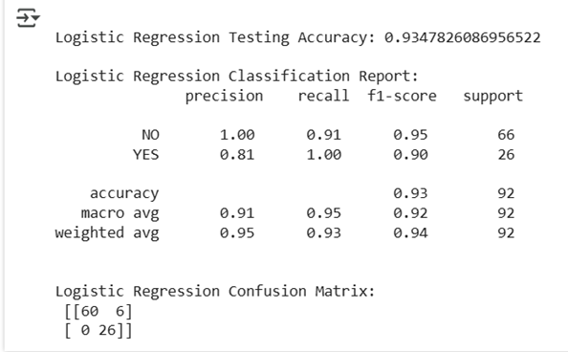
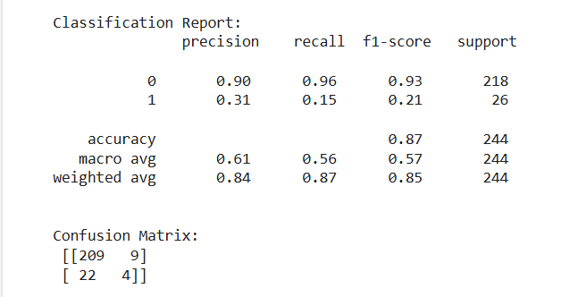
Results for Autism Prediction:
7
Support vector machine
Logistic regression
Decision tree

Slide 8
Autism prediction model (comparison between different ML algorithms)
8
SI.NO | Algorithm | Accuracy
1. | Decision Tree | 87 %
2. | Logistic Regression | 93.47 %
3. | Support vector machine | 97.82 %
SVM outperformed other algorithms
This is due to the nature of the SVM algorithm, which is best suited for well-structured, mostly binary or numerical features.
These features allow the algorithm to draw a clear decision boundary between ASD and non-ASD cases.

Slide 9
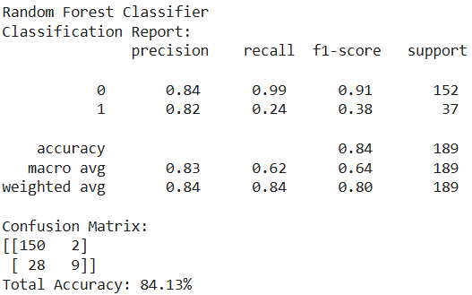
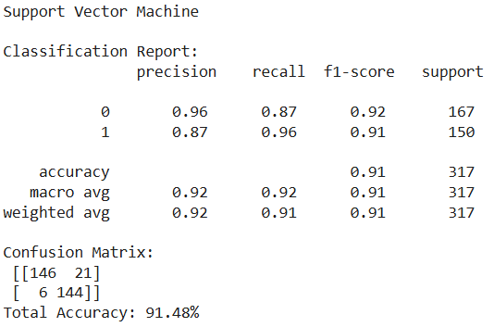
Gene score Classification
Syndromic Prediction
9
Purpose: Classify genes into Low or High risk based on gene score. Helps researchers quickly spot high-risk genes for further study.
Purpose: Predict if a gene is linked to syndromic (complex) or non-syndromic (isolated) conditions.
Why SVM?
Works well with high-dimensional genetic data.
Creates clear separation between two classes (syndromic/non-syndromic).
Good generalization on unseen data due to its margin-based learning.
Why Random Forest?
Handles non-linear and mixed-type data well.
Offers feature importance insights.
Resistant to overfitting because it uses multiple decision trees.

Slide 10
Patents
10
1) Methods for treating autism spectrum disorder and associated symptom (AU 2022203294 B2 )
The research was mainly conducted on ASD patients who had gastrointestinal (GI) symptoms like diarrhea, abdominal pain, and bleeding. They underwent behavioral assessments and gut health testing before and after treatment to observe the changes in their GI and ASD symptoms.
2) DETECTING VISUAL ATTENTION OF CHILDREN WITH AUTISM SPECTRUM DISORDER (US 2021/0256249 A1 )
In this they observed children with autism and some neurological disorder and observed there attention span. and they further developed a machine learning model to classify whether the child is able to pay attention or not. This can help improve learning experiences for children with ASD.

Slide 11
Journal
11
TITLE:
Multiple Classification of Brain MRI Autism Spectrum Disorder by Age and Gender Using Deep Learning
Year: 2024
Authors: Hidir Selcuk Nogay, Hojjat Adeli
They collected the datasets from ABDIE database for 29 different sites.
After collecting and pre-processing the data, trained by the CNN model using Optimal hyper‑parameter selection.
The first model, used age as the major parameter and predicted the accuracy.
The second model, used age as the major parameter and predicted the accuracy.
The third model, used both age and gender as the parameters

Slide 12
Paper: Video-based continuous affect recognition of children with Autism Spectrum Disorder using deep learning
Year:2023
They used two categories of data set that is lab controlled and uncontrolled.
SSBD dataset (Self-Stimulatory behaviors Dataset) to train the ASD detection model.
Used three deep learning models to predict ASD and emotional state.
Perceiver model got accuracy of 95.1
WGAN model got accuracy of 93.7
Inceptionv3 model got accuracy of 95.4.
12

Slide 13

Thank you

