Slide 1

24AIM112 Molecular biology & basic cellular physiology
24AIM115 Ethics, innovative research, businesses & IPR
Autism Prediction Using Machine Learning
TEAM MEMBERS:
Dheeraj Chowdary CB.AI.U4AIM24109
Sai Charan CB.AI.U4AIM24124
Prem Siva Sai CB.AI.U4AIM24125
Chirudeep CB.AI.U4AIM24137
FACULTY: Dr. Neelesh Ashok
Dr. Reshma
1

Slide 2
INTRODUCTION
ASD is a developmental condition that significantly affects communication, interaction behavior.
Machine learning can assist in making early predictions of autism by analyzing patterns in behavioral data, genetic information etc.
Some commonly used algorithms for classifying at-risk individuals include random forest, CNN, and deep learning models.
This improves the accuracy of diagnostics, reduces delays, and facilitates early intervention.
2

Slide 3
OBJECTIVES
1. Develop a Robust Prediction Model: To create an accurate and reliable machine learning model capable of identifying individuals.
2. Improve Early Detection: To enhance early diagnosis and intervention by leveraging data-driven approaches.
3. Ensure Ethical Compliance and Intellectual Property Protection: To address ethical concerns by ensuring data privacy, informed consent, and fairness in predictions.
4. Promote Accessibility: To design a cost-effective and user-friendly system that can be widely implemented.
3

Slide 4
ETHICAL RIGHTS
1. Right to Communication and Expression
This people should not be punished or excluded for different communication styles.
2. Right to Accessible Healthcare
They should not be subjected to forced treatments without informed consent.
3. Right to Dignity and Respect
Their differences should be respected as part of natural human beings rather than as defects.
4. Right to Representation
The autistic individuals should have a say in decisions that affect their lives, whether in education, healthcare etc.
4

Slide 5
ETHICAL CONSIDERATIONS
Patients with mental capacity have the right to accept or decline any medical procedure.
For Early detection parents should receive a balanced information not only about challenges but also about strengths.
Instead of eliminating autism, one should focus to thrive autistic individuals.
Autistic individuals, particularly minors and those with cognitive or communication challenges, may require additional safeguards to ensure ethical participation.
5

Slide 6
PATENTS
Methods for treating autism spectrum disorder and associated symptoms
(AU 2022203294 B2):
This patent relates to the composition and methods for treating ASD by restoring ASD patient’s gut microbiota.
2. Methods and systems for determining autism spectrum disorder risk
(US 2024/0019417 A1):
The result of this paper shows in the form of graph where it shows the difference between autistic people and non-autistic people (comparision of metabolites) .
3. Subtyping heterogeneous disorders using functional random forest models (US 11,676,719 B2) :
Using the random forest he trained a model to identify images of different autistic people.
6

Slide 7
LITERATURE REVIEW
S.NO | TITLE | YEAR | RESULT
1. | Multiple Classification of Brain MRI Autism Spectrum Disorder by Age and Gender Using Deep Learning. | 2024 | Accuracy rates of 80.94%, 84.42%, and 67.94% for gender, age, and combined classifications respectively using CNN models.
2. | Autism Detection for Toddlers using Facial Features with Deep Learning | 2024 | Facial recognition techniques promise early detection of ASD. Hybrid models improve diagnostic accuracy compared to traditional methods.
7

Slide 8

3 | Innovative Autism Spectrum Disorder Prediction Using Machine Learning | 2024 | They used KNN model. The accuracy they achieved is 66.10%
4 | Discovering the Gene-Brain-Behavior Link in Autism via Generative | 2024 | 89% accuracy in predicting genetic variations, strong correlation between structural brain changes and ASD-related traits.
5 | The Role of Intelligent Technologies in Early Detection of Autism Spectrum Disorder (ASD): A Scoping Review | 2022 | ML/DL techniques outperform traditional methods,need for robust datasets and multicultural validation identified.
8

Slide 9
Clinical Trials
Autism Biomarkers Consortium for Clinical Trials: Confirmation Study (ABC-CT CS) (NCT05294705)
N170 Latency to Upright Human Faces (EEG): Measures how fast the brain responds to human faces.
Oculomotor Index of Gaze (Eye-tracking): Tracks how much time children spend looking at human faces.
2. Personalized, Responsive Intervention Sequences for Minimally Verbal Children with Autism (PRISM) (NCT03883139)
Improveing language development in minimally verbal preschoolers with ASD.
Sequential Multiple Assignment Randomized Trial (SMART), meaning interventions are adjusted based on early response.
9

Slide 10
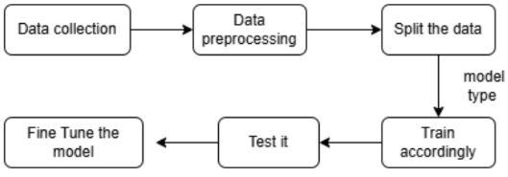
METHODOLOGY:
We are going to create a prediction model for autism using different algorithms and compare their performance.
WORK FLOW:
(Tunning is done if needed and according to algorithm).
10

Slide 11
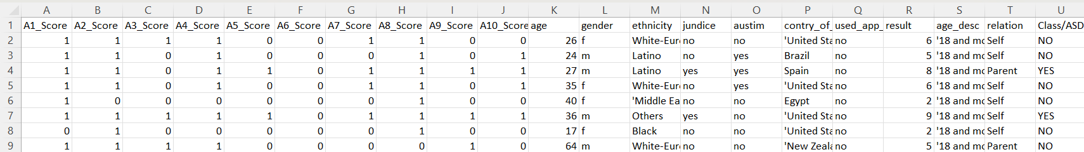
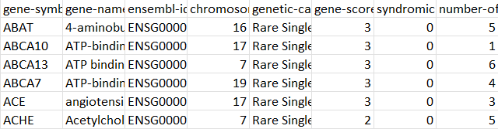
DATASET FOR PREDICTION :
The dataset consists data of 705 persons
19 features (10 questions, age, gender, jaundiced, autism in their family,country, relation, result,labelled value)
DATASET FOR ANALYSIS:
11

Slide 12
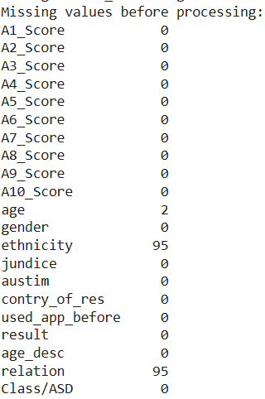
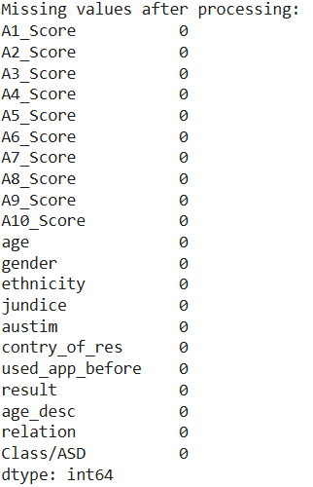
Data Preprocessing:
Data preprocessing done using standardization.
12

Slide 13
ALGORITHMS USED AND WHY:
1.Support vector machine:
Effective for high-dimensional datasets, especially with clear margins of separation. Can also be used in case of non-linear data.
2.Decision tree:
Intuitive and interpretable model that splits data based on key features.
Best for Understanding feature importance and simple rule-based classification
3.Logistic Regression :
Best for binary classification problems, easy to interpret and works well with
structured.
13

Slide 14
CONCLUSION
Machine learning models help in detecting autism spectrum disorder (ASD) at an early stage, enabling timely intervention and support.
Algorithms like SVM,Decision tree analyze behavioral and neurological data to enhance diagnostic accuracy and reduce human error.
Machine learning can support clinicians by providing data-driven insights, reducing diagnosis time.
Enhancing dataset diversity, integrating multi-modal data and refining feature selection can improve prediction performance.
14

Slide 15

15

