Slide 1


24AIM112 Molecular biology & basic cellular physiology
24AIM115 Ethics, innovative research, businesses & IPR
Autism Prediction Using Machine Learning
TEAM MEMBERS:
Dheeraj Chowdary CB.AI.U4AIM24109
Sai Charan CB.AI.U4AIM24124
Prem Siva Sai CB.AI.U4AIM24125
Chirudeep CB.AI.U4AIM24137

Slide 2
INTRODUCTION
·Autism Spectrum Disorder (ASD) is a neurodevelopmental condition that affects social interaction, communication, and behavior.
·Early detection of autism can play a crucial role in treatment, and for mental support.
We aim to develop and compare three different machine learning models for autism prediction. They are:
1. Support vector machine(SVM)
2. Logistic Regression
3. Decision tree

Slide 3
Modelling:
Data preprocessing is done with same code for all the three algorithms
Different Model Analysis:
 | Support vector machine | Logistic regression | Decision tree
Models Nature | Best for complex patterns & high-dimensional data | Simple, efficient, and interpretable model | Easily interpretable (tree structure & feature importance)
Models performance | Good (accuracy: 97.82) | Moderate (accuracy:93.47) | Low(accuracy:87)
Overfitting | NO | NO | No

Slide 4
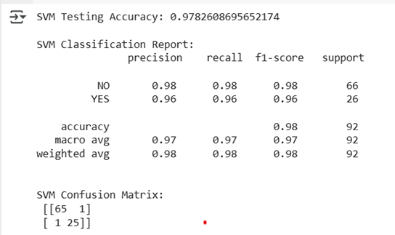
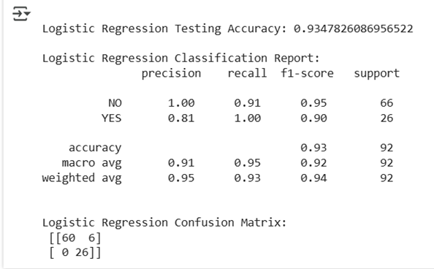
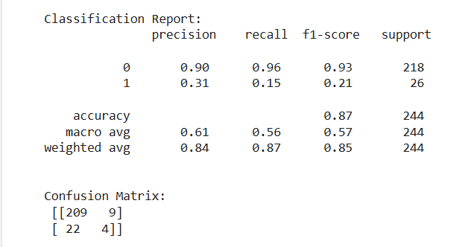
Model accuracy:
Support vector machine
Logistic regression
Decision tree

Slide 5
Patents
1) Methods for treating autism spectrum disorder and associated symptom (AU 2022203294 B2 )
The research was mainly conducted on ASD patients who had gastrointestinal (GI) symptoms like diarrhea, abdominal pain, and bleeding. They underwent behavioral assessments and gut health testing before and after treatment to observe the changes in their GI and ASD symptoms.
2) DETECTING VISUAL ATTENTION OF CHILDREN WITH AUTISM SPECTRUM DISORDER (US 2021/0256249 A1 )
In this they observed children with autism and some neurological disorder and observed there attention span. and they further developed a machine learning model to classify whether the child is able to pay attention or not. This can help improve learning experiences for children with ASD.

Slide 6
Journal
TITLE:
Multiple Classification of Brain MRI Autism Spectrum Disorder by Age and Gender Using Deep Learning
Year: 2024
Authors: Hidir Selcuk Nogay, Hojjat Adeli
They collected the datasets from ABDIE database for 29 different sites.
After collecting and pre-processing the data, trained by the CNN model using Optimal hyper‑parameter selection.
The first model, used age as the major parameter and predicted the accuracy.
The second model, used age as the major parameter and predicted the accuracy.
The third model, used both age and gender as the parameters

Slide 7
Paper: Video-based continuous affect recognition of children with Autism Spectrum Disorder using deep learning
Year:2023
They used two categories of data set that is lab controlled and uncontrolled.
SSBD dataset (Self-Stimulatory behaviors Dataset) to train the ASD detection model.
Used three deep learning models to predict ASD
Perceiver model got accuracy of 95.1
WGAN model got accuracy of 93.7
Inceptionv3 model got accuracy of 95.4.

Slide 8
AI Technological Innovations forAutism Spectrum Disorder
RoboTherapist 360 :
Interactive robots providing consistent therapeutic activities.
VitaMon AI :
Continuous real-time monitoring of vital signs and behavioral patterns.
TailoredRx AI:
Customizes treatment plans based on individual genetic and medical data.
DeepScan AI :
Advanced image processing for medical diagnostics.

Slide 9
Future scope of modeling:
Predict Gene Importance (Regression)
We can use ML to predict the gene-score, which tells how important a gene is for autism research.
The model can learn from patterns in number-of-reports, chromosome, and genetic-category to make predictions.
Example: If we have details about a gene but no gene-score, the model can estimate its score.

Slide 10
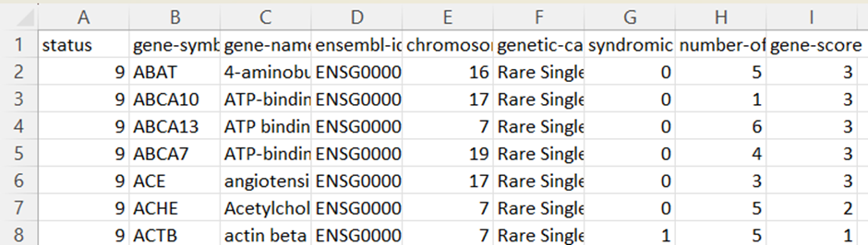
Gene Related Data Set:
Key features:
Chromosomes: The chromosome where the gene is found.
Genetic Category: Describes the kind of mutation the gene the gene had.
Gene score: This shows how important a gene is for autism research

Slide 11
THANK YOU

