Slide 1

23MAT112 - Mathematics for Intelligent Systems 2
24AIM111 Introduction to data structures & algorithms
Title: Simulating chaotic weather patterns: Analyzing weather forecasting insights using differential equations
Team Members:
Dheeraj Chowdary CB.AI.U4AIM24109
Sai Charan CB.AI.U4AIM24124
Prem Siva CB.AI.U4AIM24125
Chirudeep CB.AI.U4AIM24137
Guide: Dr. Prem Jagadeesan
Dr. S Manimaran
1

Slide 2
COMMENTS GIVEN
What is the use of data set in this project?
What is the use of data structure in this project?
Where did you refer variables and the constants of the Lorenz equation?
SOLUTIONS
We used dataset to compare the values( i. e x, y, z) at real time and predicted time.
2. Here the tree data structure is used to store the data in the dataset after normalizing the values of temperature, wind velocity and pressure and stored at each node
3. We got this information from the research paper.

Slide 3
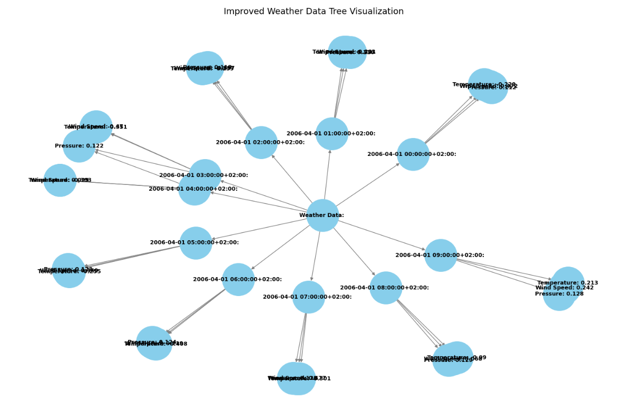
DSA CONCEPT
TREES
The data structure used here is TREE.
This consists of particular time , what are the predicted values of the 3 variables i.e the temperature, pressure, wind speed.
Graphs are not used for storing sequential time-series data.

Slide 4
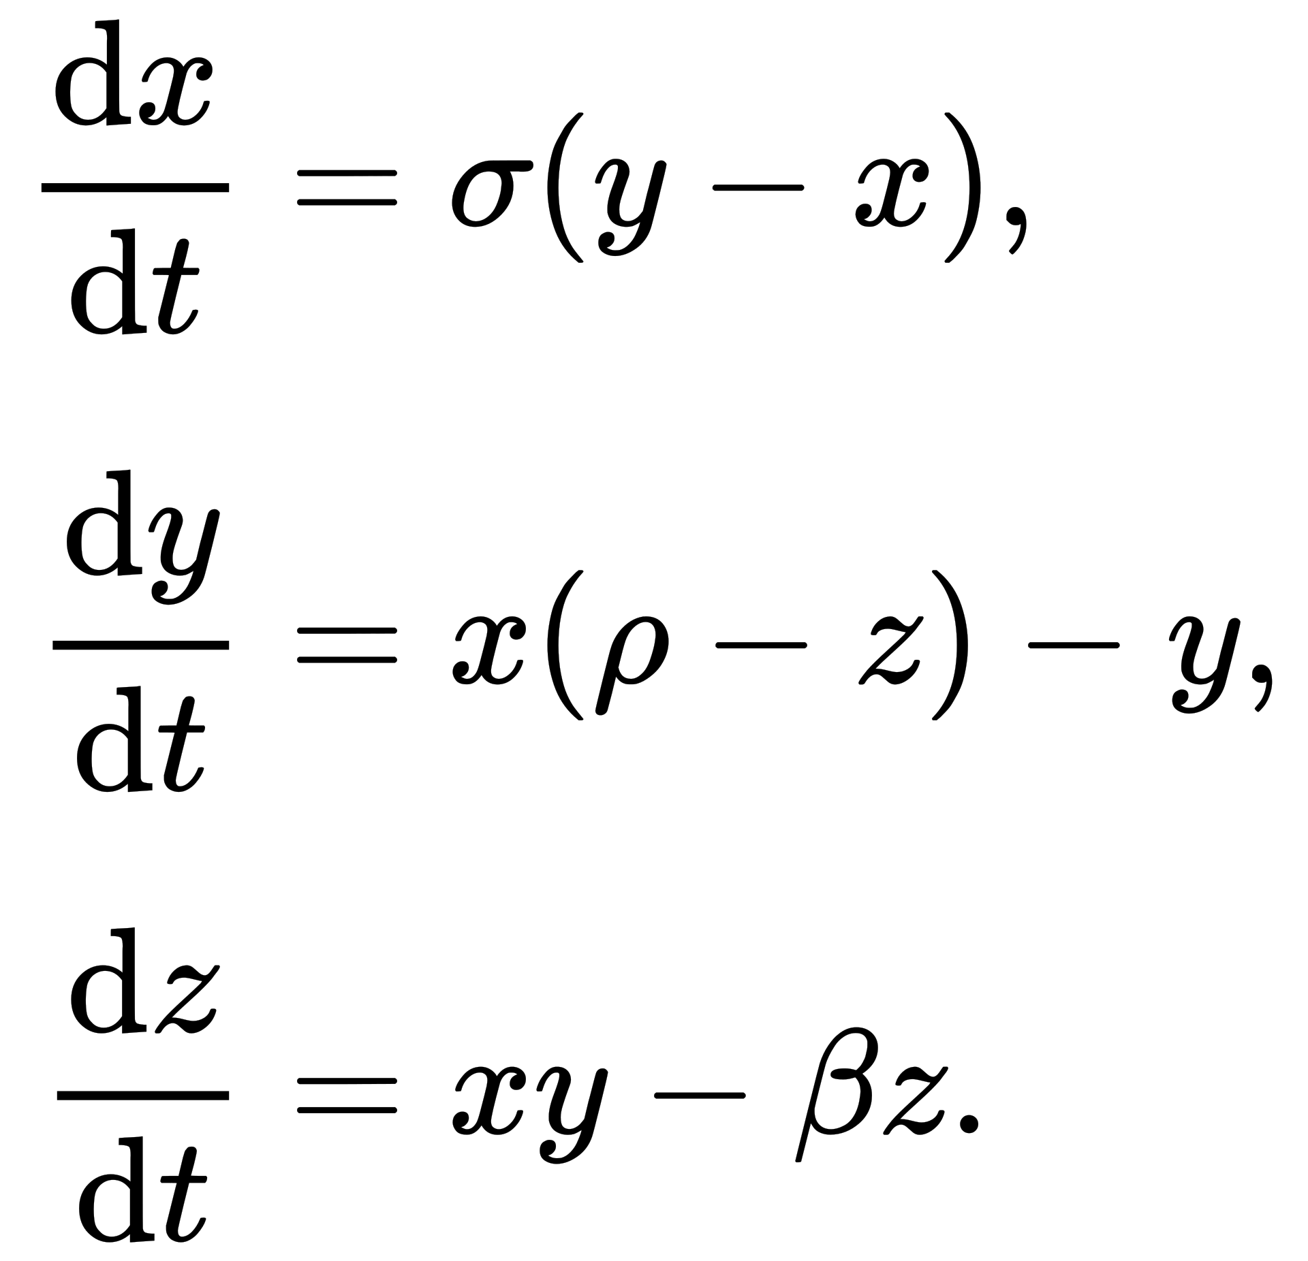
LORENZ EQUATIONS
The three non-linear differential equations are:
Here,
x represent temperature
y represent wind velocity
z represent pressure
Here the 3 constants represent:
σ (Prandtl number) shows how quickly temperature variations dissipate relative to velocity variations.
ρ ( Rayleigh number) shows temperature difference driving convection.
β ( Geometric ratio parameter) shows how pressure patterns (z) evolve.

Slide 5
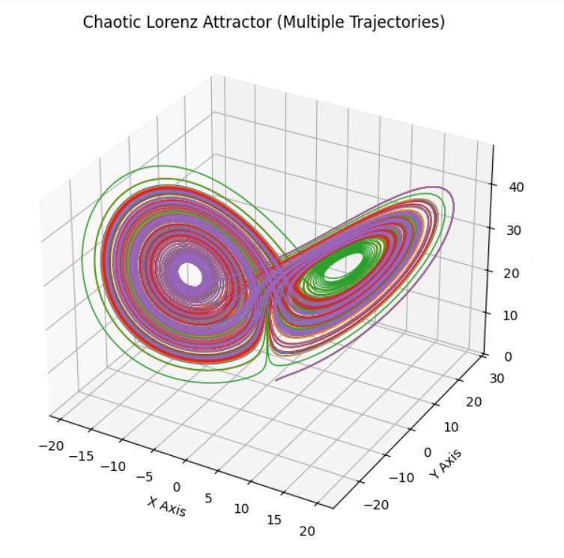
RESULT
This image displays the Lorenz 3-D structure
This pattern is called butterfly or figure eight pattern.
Here,
x-axis refers the temperature
y-axis refers the wind speed
z-axis refers the pressure

Slide 6
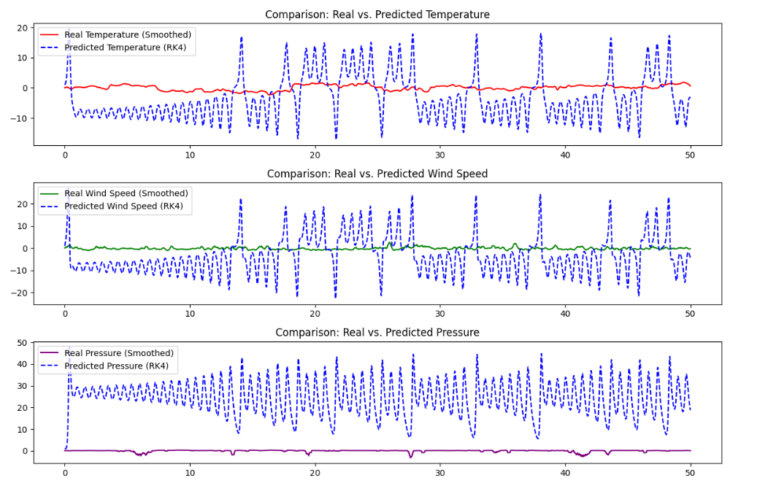

Slide 7
FUTURE WORK
Upgrading Lorenz equations to Lorenz 96 system(instead of 3 variables it has multiple state variables) .
dXi/dt = (Xi+1 -Xi-2)*Xi-1-Xi+F
Here,
Xi means state variable
F means external driving force
Predict future states of the Lorenz96 system by training LSTM( Long short term memory) model.
Reference:
https://scholar.google.com/scholarhl=en&as_sdt=0%2C5&q=lorenz+96+research+paper+google+scholar&btnG=#d=gs_qabs&t=1741674178505&u=%23p%3D61yL0-mhTRAJ

Slide 8


