Slide 1

23MAT112 - Mathematics for Intelligent Systems 2
24AIM111 Introduction to data structures & algorithms
Title: Simulating chaotic weather patterns: Analyzing weather forecasting insights using differential equations
Team Members:
Dheeraj Chowdary CB.AI.U4AIM24109
Sai Charan CB.AI.U4AIM24124
Prem Siva CB.AI.U4AIM24125
Chirudeep CB.AI.U4AIM24137
Guide: Dr. Prem Jagadeesan
Dr. S Manimaran
1

Slide 2
OBJECTIVES
To analyze the impact of chaotic behavior in weather systems.
2. To simulate weather dynamics using non-linear differential equations.
3. To evaluate the role of strange attractors in weather forecasting.
4. To propose methods for improving short-term weather predictions.
2

Slide 3
PROBLEM STATEMENT
1. Modeling Chaotic Weather Patterns Using Non-linear Differential
Equations
2. Sensitivity of Weather Forecasting to Initial Conditions
3. Evaluating the Role of Strange Attractors in Weather Pattern Prediction
4. Assessing the Limitations of Numerical Weather Prediction Models in
Chaotic Systems.
3

Slide 4
LITERATURE REVIEW
TITLE | AUTHORS | YEAR | RESULTS
Lorenz Equations: The Definitive Model for Meteorological Prediction | Robert Ferro | 2023 | Describes the different trajectories diverge rapidly even with slight change in the initial conditions
Direct statistical simulation of the Lorenz96 system in model reduction approaches | Kuan Li, Steven M | 2023 | This paper used Cumulation methods either CE2, CE2.5. The results of this paper gives the chaotic refimes and periodic regimes.
Using the probabilistic machione learning to better model temporal patterns in parameterizations: a case study with lorenz96 model | Raghul Parthipan, Hannah M. , J. Scott hosking, DamonJ. | 2025 | Used L96-RNN. The result of the paper shows the models of various metrics, including lower Kullback–Leibler divergence scores for probability density functions arising from long-range simulations.
4

Slide 5
Performance Comparison Analysis on Weather Pre diction using LSTM and TKAN | Ajie Kusuma Wardhana, Yudha Riwanto, Budi Wi jaya Rauf | 2024 | They stated the result as the model for both LSTM and TKAN achieved 0.09 and 0.11 for model loss and 0.08 and 0.96 for MAE.
Modelling Weather Conditions Using Encoder Decoder and Attention Based on LSTM Deep Regression Model | Amr Badr, Khder Alakkari, Mostafa Abotaleb, El sayed | 2022 | The result shows that Encoder and Decoder LSTM model performed better than the Attention LSTM.
5

Slide 6
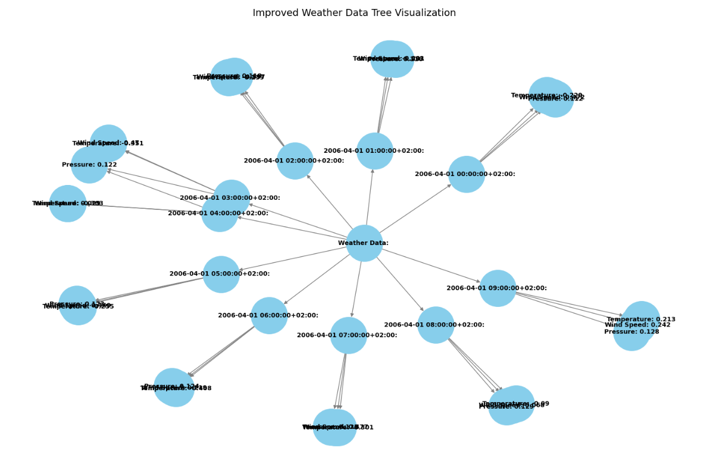
DATA STRUCTURE
TREES
The data structure used here is TREE.
It stores the values of temperature, pressure, and wind speed at particular time steps.
Graphs are not used for storing sequential time-series data.

Slide 7
FORMULAS USED
Lorenz Equations:
2. Lorenz96 System:
dx/dt = σ(y −x)
dx /dt=(x -x )*x -x +F
i
i+1
i-2
i-1
i
dy/dt = x(ρ−z)−y
Notations:
dz/dt = xy −β(z)
x represents the state variable
where i represent the grid points i.e
i= 1,2,.....N
Notations:
σ represent prandtl number
N typically range between 20 to 40
ρ represent Rayleigh number
F represents external influences like heating from the Sun or other atmospheric sources (controls energy input).
β represent geometric ratio parameter
C. Sparrow, "An introduction to the Lorenz equations," in IEEE Transactions on Circuits and Systems, vol. 30, no. 8, pp. 533-542, August 1983, doi: 10.1109/TCS.1983.1085400
7

Slide 8
METHODOLOGY
R. K. METHOD
This is the iterative method used to solve the ordinary differential equations, typically used for its accuracy and efficiency in approximating solutions to the differential equations.
The general form:
n+1
X =x + t/6(k +2k +2k +k )
n
1
2
3
4
Where,
k is the slope of derivative at the current step.
k is the slope of derivative at a half-step forward.
k is another slope estimated at a half-step forward using k2
k is the slope of the derivative at the full step forward.
1
2
3
4
8

Slide 9
LSTM( Long- Short Term Memory)
Gate | Formula | Use
Forget Gate | f = σ(W .[h ,x ]+b | This gate mainly determines which past information should be discarded either mainly focus on past weather states.
Input Gate | i = σ(W .[h ,x ]+b | This gate determines what new information should be added to the memory.
Cell state | C = tanh(W .[h ,x ]+b C = f .C +i .C | After the input gate, a new cell state is created. This is the main memory unit that store the long term dependencies.
Output Gate | O = σ(W .[h ,x ]+b | This gate determines which part of the memory should be used to predict the next state of the Lorenz96 system.
t
f
t-1
t
f
t
t
i
t-1
t
i
t
c
t
c
t
t-1
t
t
o
t-1
t
o

Slide 10
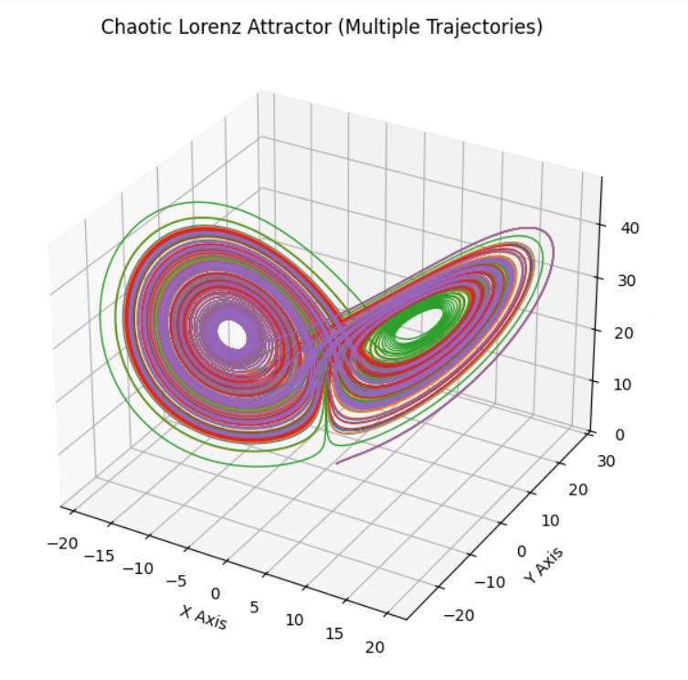
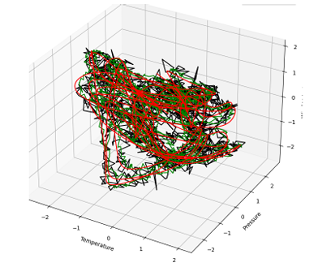
RESULTS
LORENZ EQUATIONS:
2. LORENZ96 SYSTEM
10

Slide 11
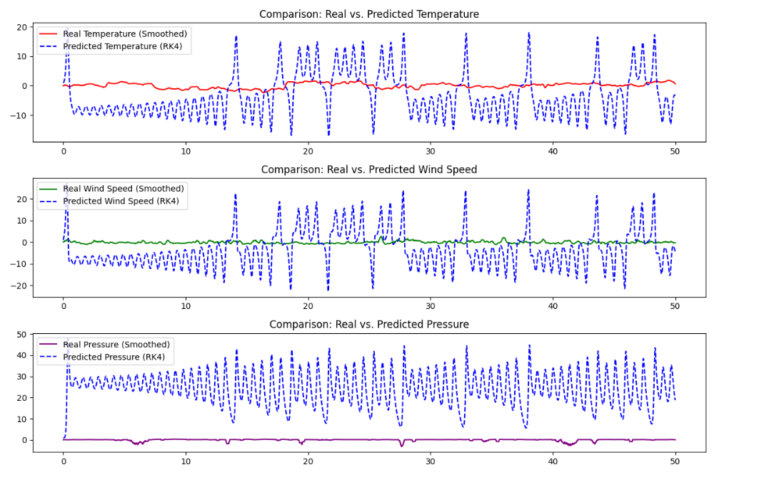
Lorenz equations
11

Slide 12
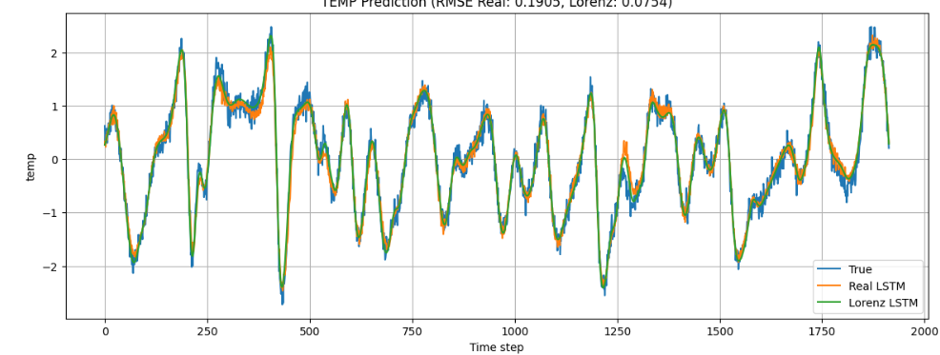
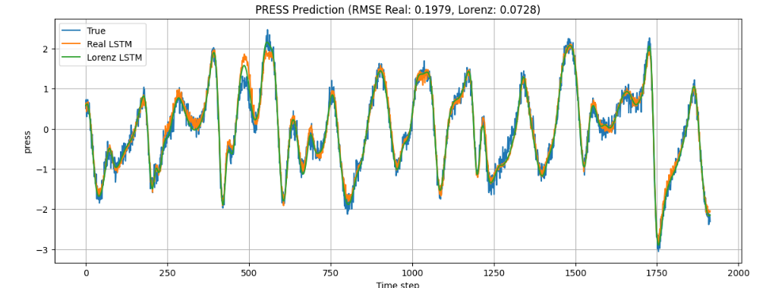
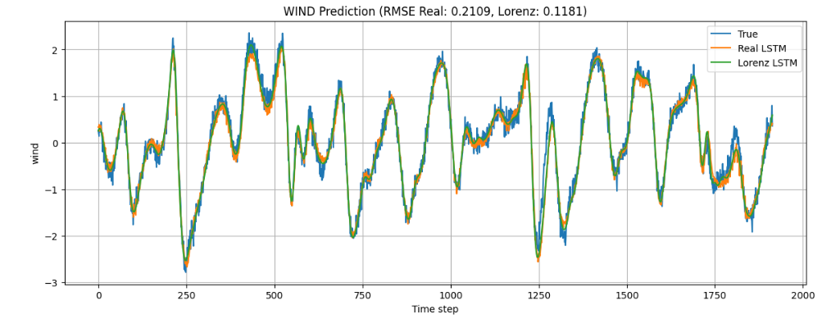
2. LORENZ96 SYSTEM:
12

Slide 13
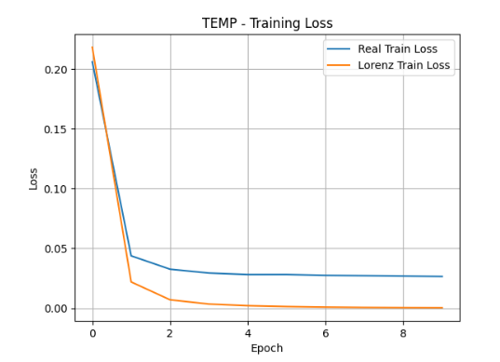
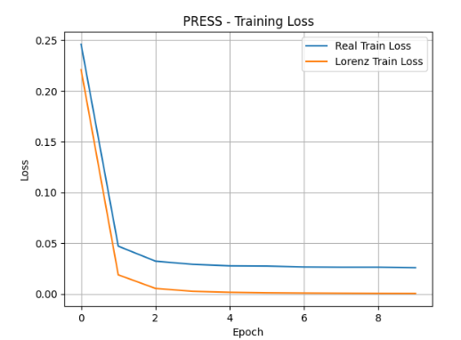
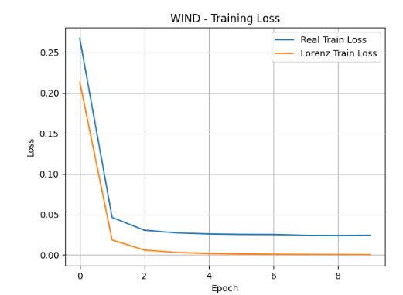
13

Slide 14
REFERENCES
[1] Raghul Parthipan, Hannah M. , J. Scott hosking, DamonJ, Using the probabilistic machine learning to better model; temporal patterns in parameterizations: a case study with lorenz96 model, 2023.
[2] Aarana Vitarana, Visualisation chaos with RK4, 2023.
[3] Bo-Wen Shen, Roger Pielke, Xubin Zeng, Robert Atlas, Amit Kesarkar, Xiping Zeng, Sara Faghih Naini, Jialin Cai, The Dual nature of Chaos and Order in the Atmosphere, 2022.
[4] Kuan Li J.B. , Direct statistical simulation of the Lorenz96 system in model reduction approaches, 2025.
[5] Robert Ferro, Lorenz Equations: The Definitive Model for Meteorolog ical Prediction, 2021.
[6] Pavithra E, Mayuri Reddy, Suresh Bhukya, Performance Analysis of LSTM Vs GRU in Predicting Weather Patterns For Climate Change Models, 2025.
[7] Ajie Kusuma Wardhana, Yudha Riwanto, Budi Wijaya Rauf, Perfor mance Comparison Analysis on Weather Prediction using LSTM and TKAN, 2024.
[8] Amr Badr, Khder Alakkari, Mostafa Abotaleb, El sayed, Modelling Weather Conditions Using Encoder-Decoder and Attention Based on LSTM Deep Regression Model, 2022.
[9] Md. Mahamudul Hasan, Md. Jahid Hasan, Parisha Binte Rahman, Comparison of RNN-LSTM, TFDF and stacking model approach for weather forecasting in Bangladesh using historical data from 1963 to 2022, 2024.
14

Slide 15

15

