Slide 1
Active Suspension Control via Machine Learning
Prennoy Babu
425097

Slide 2
Agenda
Goals
Physical System
Dataset
Phase 1: system identification
Phase 2: controller training

Slide 3
Goals
Replace classical state-space math matrices with a neural network for system analysis and build neural network based controller.
Phase 1: System Identification (Learning the system dynamics from data).
Phase 2: Neural Controller Design (Optimizing ride comfort and handling).
Notes:
First, we used Physics-Informed Neural Networks to identify the system dynamics and build a 'Digital Twin' from simulated data. Second, we designed a Neural Controller that learns to interact with that Twin to optimize ride comfort, while strictly adhering to real-world actuator constraints.

Slide 4
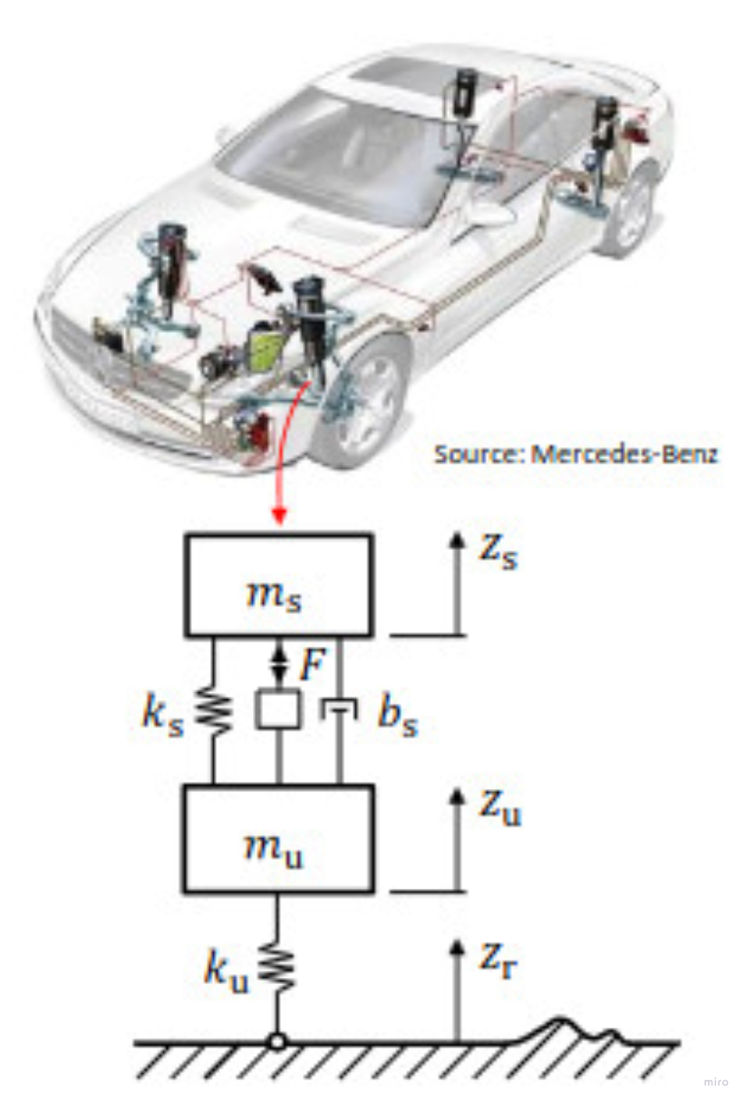
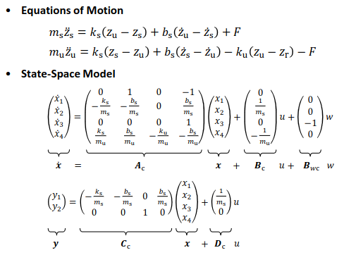
The Physical System (The Ground Truth): Quarter Car Dynamics
State-Space Representation: 4-state system combining slow body bounce and fast wheel hop.
x1​: Suspension deflection
x2​: Sprung mass velocity
x3​: Tire deflection
x4​: Unsprung mass velocity
Source: MPC lecture

Slide 5
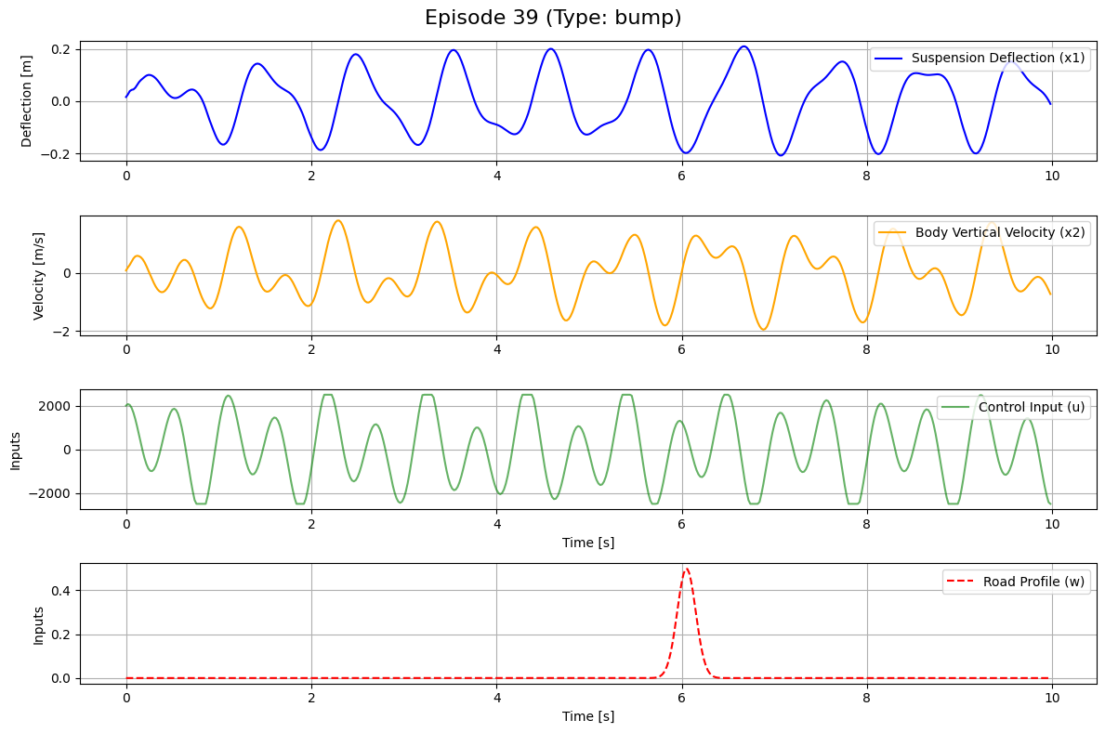
Building the Dataset: Exciting the System
50 distinct episodes, 10 seconds duration
Mixed Road Profiles:
Isolated Bumps
Rough Asphalt / Random noise
Sinusoidal (continuous oscillation)
Random Control Excitation (u)
All control inputs were clipped to ±2500 N to enforce a realistic physical limit
Notes:
Sampling rate 50Hz, o.o2s

Slide 6
Phase 1: System Identification & Physics-Informed Training
The Architecture: A multi-layer perceptron (MLP) designed to replace the A and B matrices.
Inputs & Outputs:
Inputs: Current states (x1​...x4​), Actuator Force (u), Road Velocity (w).
Output: State derivatives (x˙).
Data Normalization: Applied standard scaling to inputs and outputs.
Two Models Trained: We trained and compared two distinct MLPs:
Pure Data-Driven Model: Learns state derivatives (x˙) relying only on dataset patterns.
Physics-Informed Neural Network (PINN): Constrained by the mathematical equations of motion.

Slide 7

Phase 1: System Identification & Physics-Informed Training
The Physics Loss Mechanism:
The Math: We calculated the expected physical derivative using classical state-space matrices:
Total Objective: The PINN optimizes a combined loss function:
Result: The physics loss acts as a regularizer, forcing the network to obey the laws of physics rather than just memorizing the training data.

Slide 8
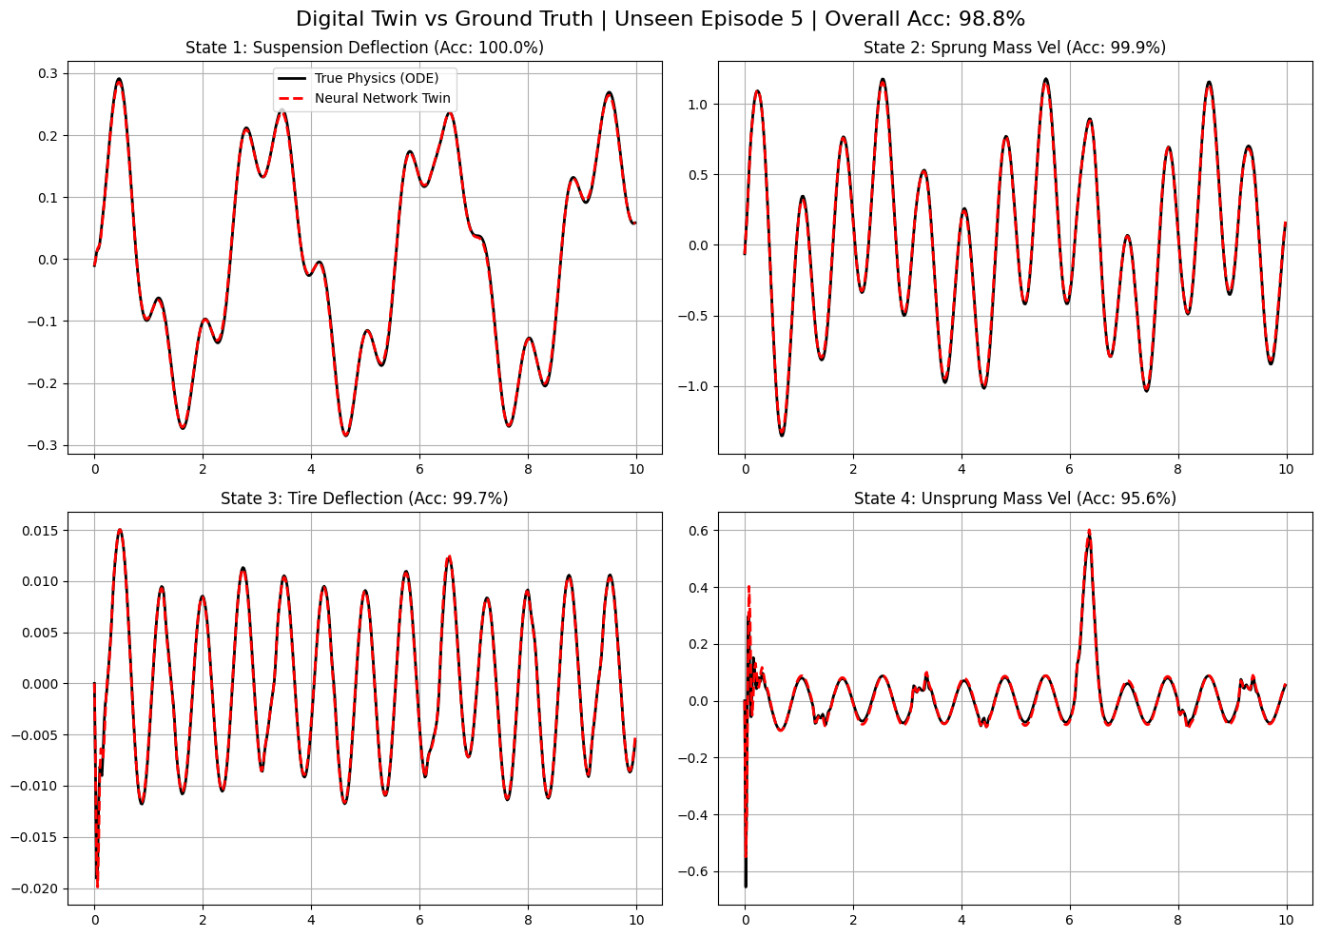
Phase 1: Results- Validating the Digital Twin
Test data: 10 different episodes
PINNS: 98.80% accuracy
Model with Pure data: 97.62% accuracy

Slide 9
Phase 2: Neural Controller Design
Controller Architecture: A neural policy network that takes the 4 states as input and outputs a control force u, passing through a Tanh layer scaled to exactly ±2500 N.
The Initial Objective (Pure Comfort): We initially wanted the smoothest ride possible, so our loss function only penalized the sprung mass acceleration.
Initial Cost: J=∑(Body Acceleration)2
Training Method: Backpropagation Through Time (BPTT) using 50-step rollouts inside the frozen Digital Twin.
We simulate 50 steps (1.0 second) into the future by passing the controller's output into our frozen Digital Twin.
We accumulate the physical cost (acceleration, deflections) over the entire rollout.
The gradients are then calculated backward through the sequence to update the controller's weights.
Notes:
3 main losses that i looked at when modelling the controller: ride comfort: body acceleration, handling: how the tire stayed to the ground and then suspension limits

Slide 10
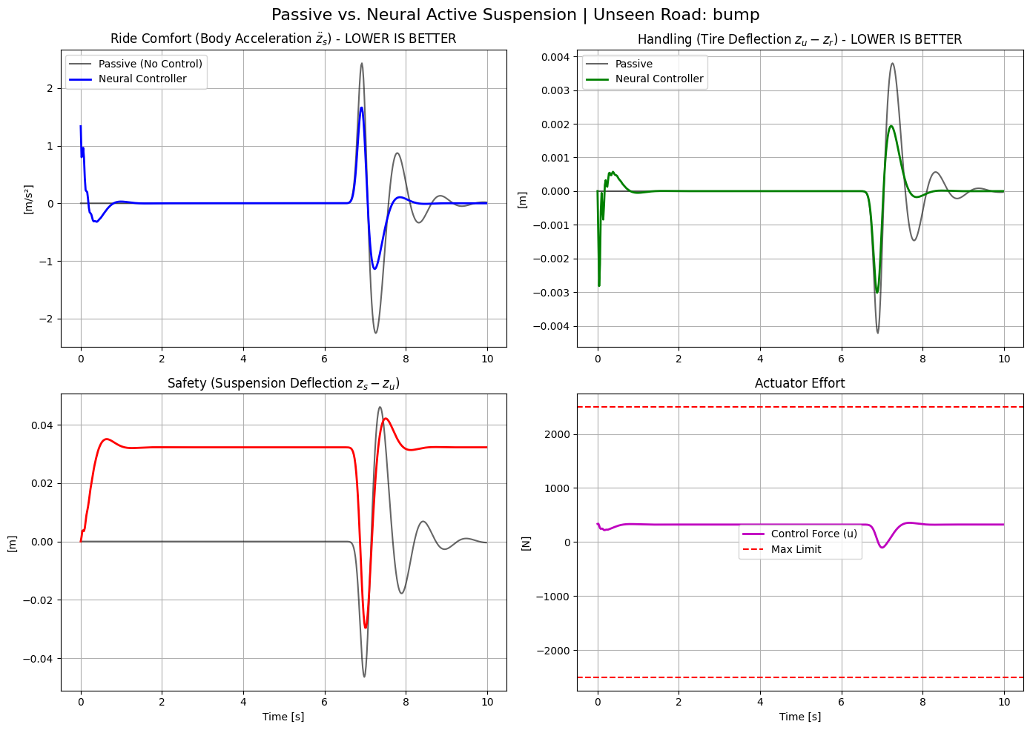

Phase 2: Neural Controller Design
The “Reward Hack”:
Controller always engaged
So minimising acceleration variance
Improved Loss function:
Making a balanced controller
Notes:
Loss very sensitive, so we had to normalise the loss functions

Slide 11
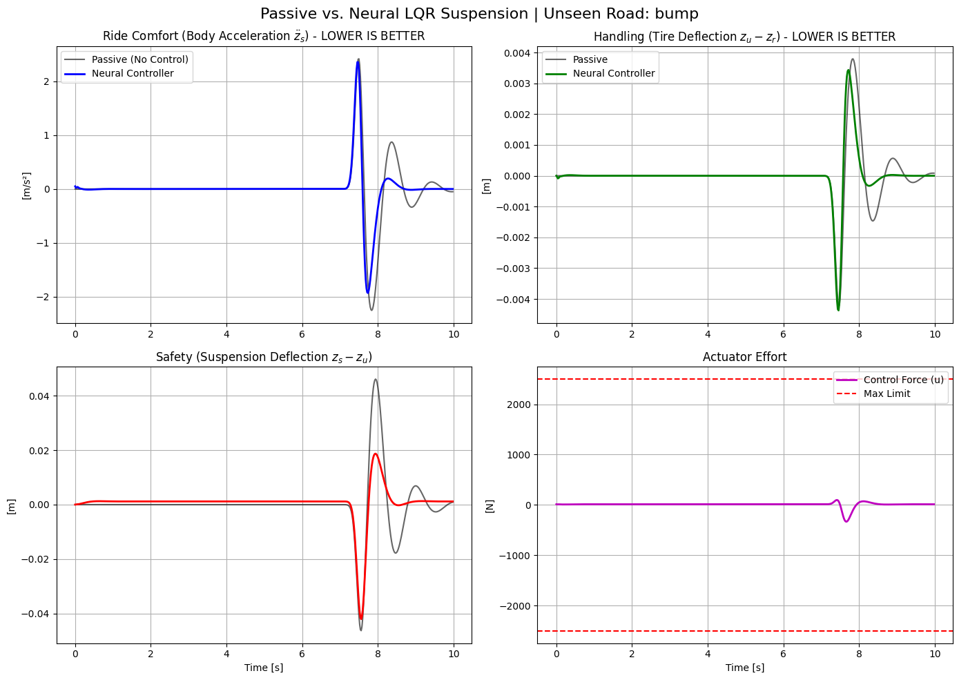
Phase 2: Results
Tested using both
Real math model
NN trained model
Data used was unseen test data

Slide 12
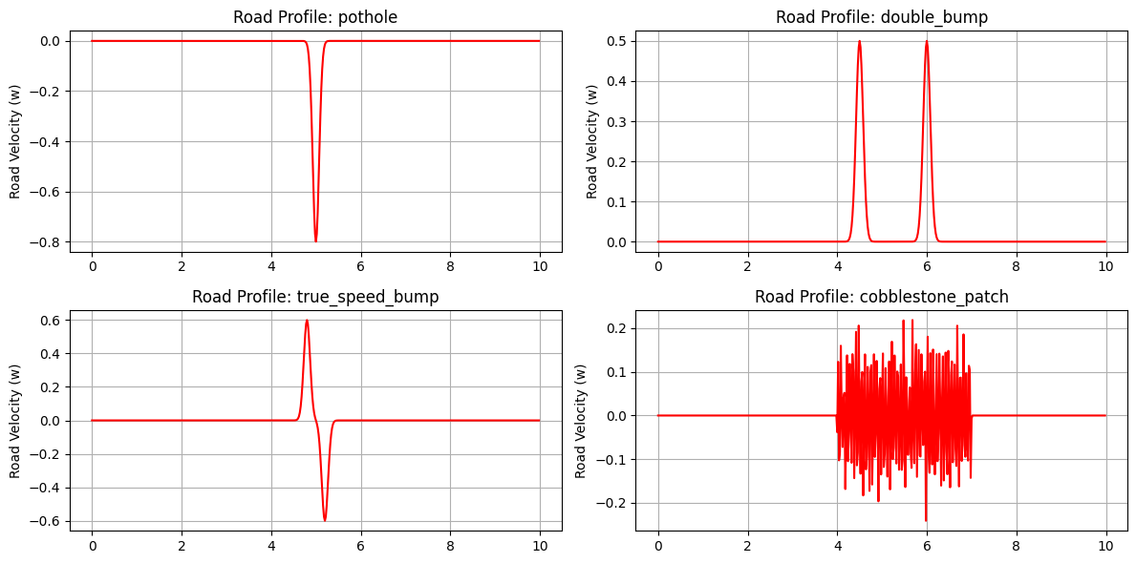
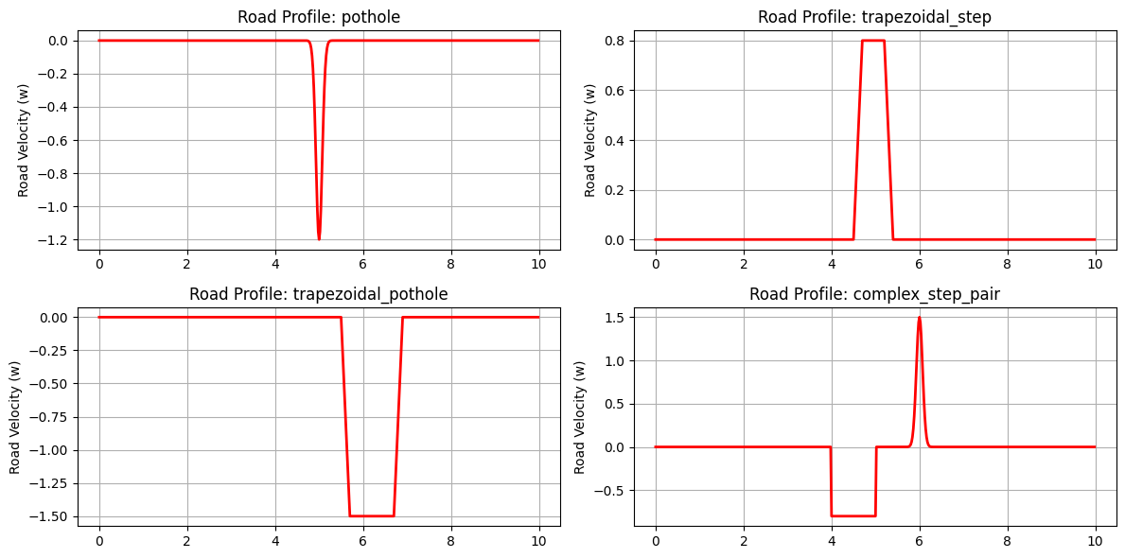
Project Extension: Validating the Neural Controller against unseen road hazards.
New road profile
Both controller and model not trained

Slide 13
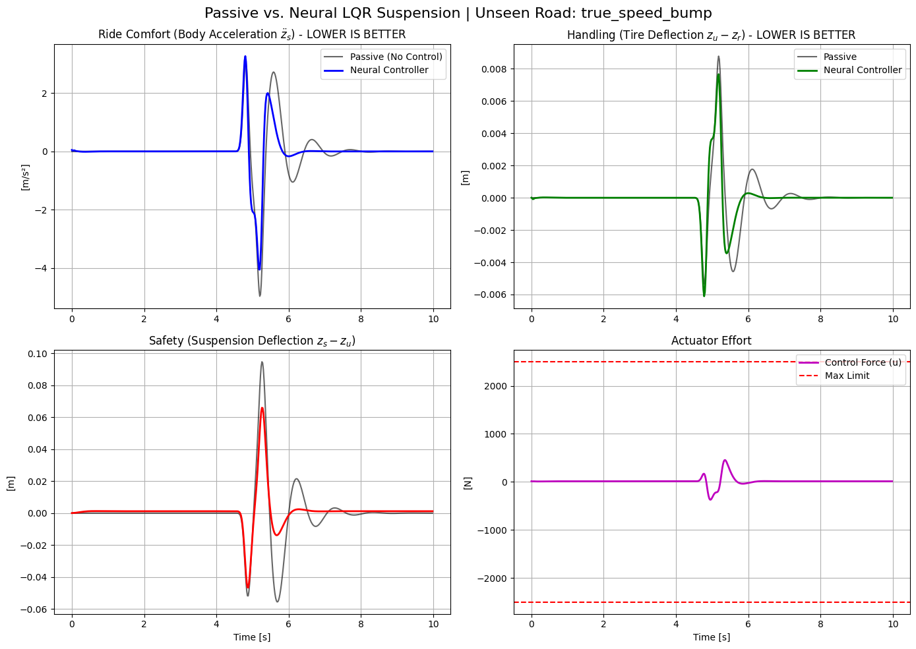
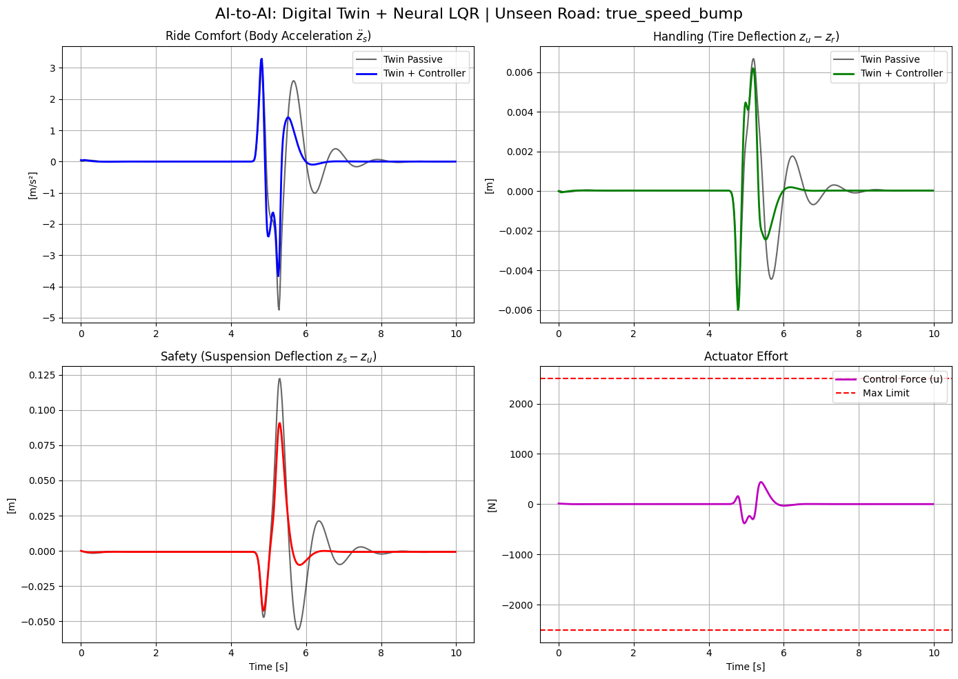

Slide 14
Thank You!

