Slide 1

Qwen Medical Chatbot
Fine-Tuned LLM for Healthcare Instruction-Response Chat using Qwen2.5-0.5B-Instruct
Dev Wankhede 244156017(CICPS)
Guided By : Prof. Neeraj Kumar Sharma

Slide 2
Project Overview
- Fine-tuned Qwen2.5-0.5B-Instruct model using LoRA
- Trained on custom medical Q&A dataset (instruction-response)
- Quantized (4-bit) for low-resource training on Colab
- Deployed using Gradio UI on Hugging Face Spaces

Slide 3
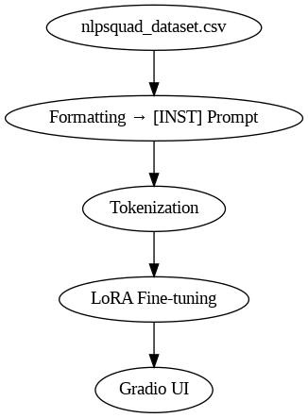
Project Architecture

Slide 4
Dependencies and Libraries
Transformer
Peft
Trl, SFTTrainer
Bitsandbytes, accelerate
GradioUI
Torch
Pandas
Dataset
AutoTokenizer, AutoModelForCausalLM
LoraConfig, get_peft_model

Slide 5
Dataset Preparation
- CSV format: Instruction, Response
- Book : The-Gale-Encyclopedia-of-Medicine-3rd-Edition
- Reformatted using [INST] prompt template
- Tokenized using Qwen tokenizer
- Example:
[INST] What are herbal remedies for anxiety? [/INST] Chamomile, ashwagandha, etc.

Slide 6
Model & Training Setup
- Base: Qwen2.5-0.5B-Instruct
- Quantized: 4-bit with bitsandbytes
- Fine-tuning method: LoRA (Low-Rank Adaptation)
- Trainer: SFTTrainer (Supervised Fine-Tuning)
- Loss logged using TensorBoard

Slide 7
LoRA
🧠 What is LoRA (Low-Rank Adaptation)?
A parameter-efficient fine-tuning method.
Instead of updating all model weights, LoRA inserts trainable low-rank matrices into specific layers.
Saves memory, enables training on low-resource hardware
Only ~0.5–2% of the model parameters are updated

Slide 8
Tokenization
🔤 What is Tokenization?
Converts text into tokens (numbers) that the model understands.
Essential preprocessing step before training a language model.
Example: "Take medicine" → [1012, 3451, 7890]
Tokenized inputs enable numerical training.

Slide 9
Training Metrics
- Epochs: 3
- Step 624
- Batch size: 2 (accumulated)
- Learning rate: 2e-4
- Optimizer : paged_adamw_8bit
- Loss steadily decreased → stable convergence
- LoRA + 4-bit quantization = memory efficient
- TensorBoard: Visualizes loss & LR schedule

Slide 10
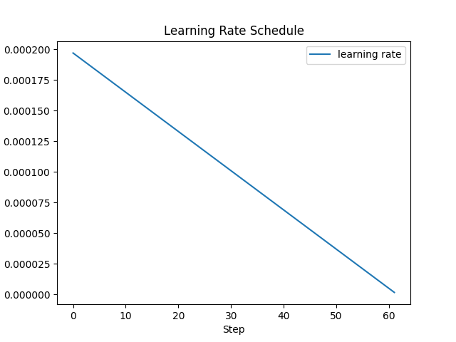
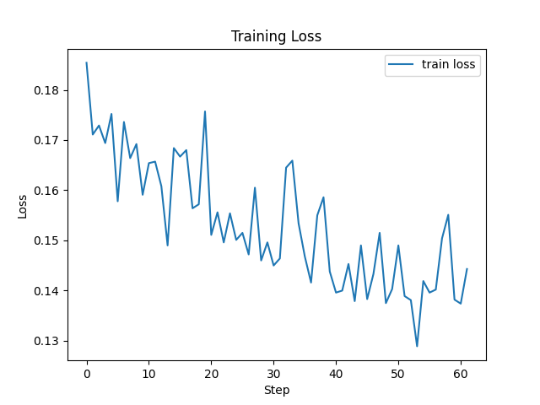
Plots training loss vs steps: confirms that loss is decreasing
Plots learning rate schedule: helps debug training stability.

Slide 11
Inference & Results
- Clean chatbot-style responses from user prompts
- Model responds with clear, structureed medical response
- Sample Output:
Q: What helps with insomnia?
A: Herbal remedies include valerian, chamomile, and melatonin-rich foods.

Slide 12
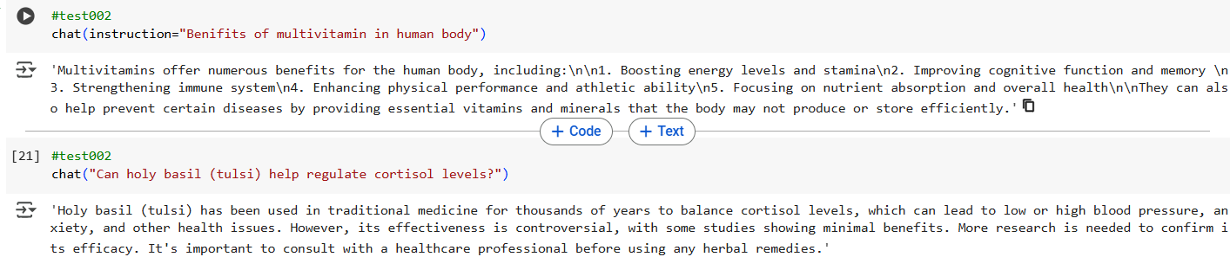
Inference & Results

Slide 13
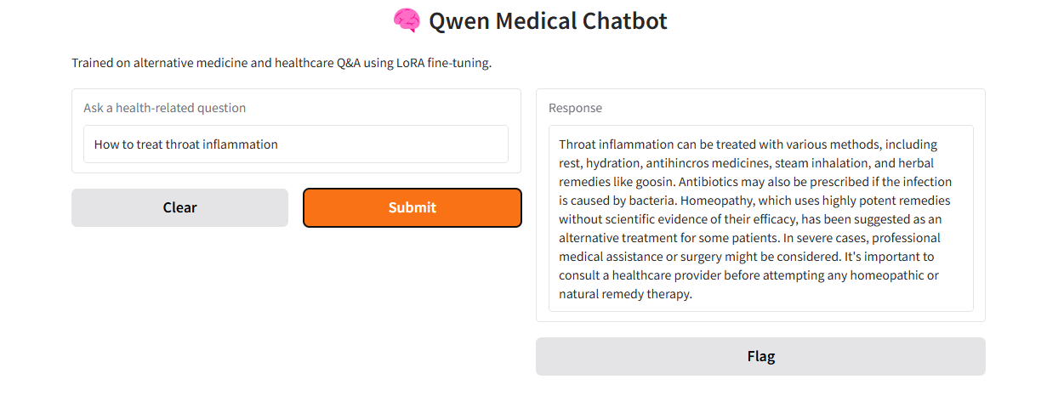
Gradio Chatbot UI
- Interactive interface hosted on Hugging Face
- Web-based chat powered by fine-tuned model
- Link: PrepStation201/medical-chat-bot

Slide 14
Demonstration

Slide 15
Summary
- Demonstrates efficient LLM training using LoRA
- Medical chatbot adapts to domain-specific Q&A
- Resource-light and deployable in real-time
- Great for applied NLP, healthcare automation, education

Slide 16
Thank you ☺

