Slide 1
Architecture
& Design
Stove & Oven
Robert Chin
Abhijit Amin
Mrunal Salvi
Tanvi Hanamshet
Sadie Stokes
Github Repository: https://github.com/msalvi96/Prep_Your_Meal

Slide 2
INTRODUCTION
In this presentation we are going to discuss the architectural and design aspects of our web application. We also present a high level architecture diagram of how the system would work and what components would it comprise of.

Slide 3
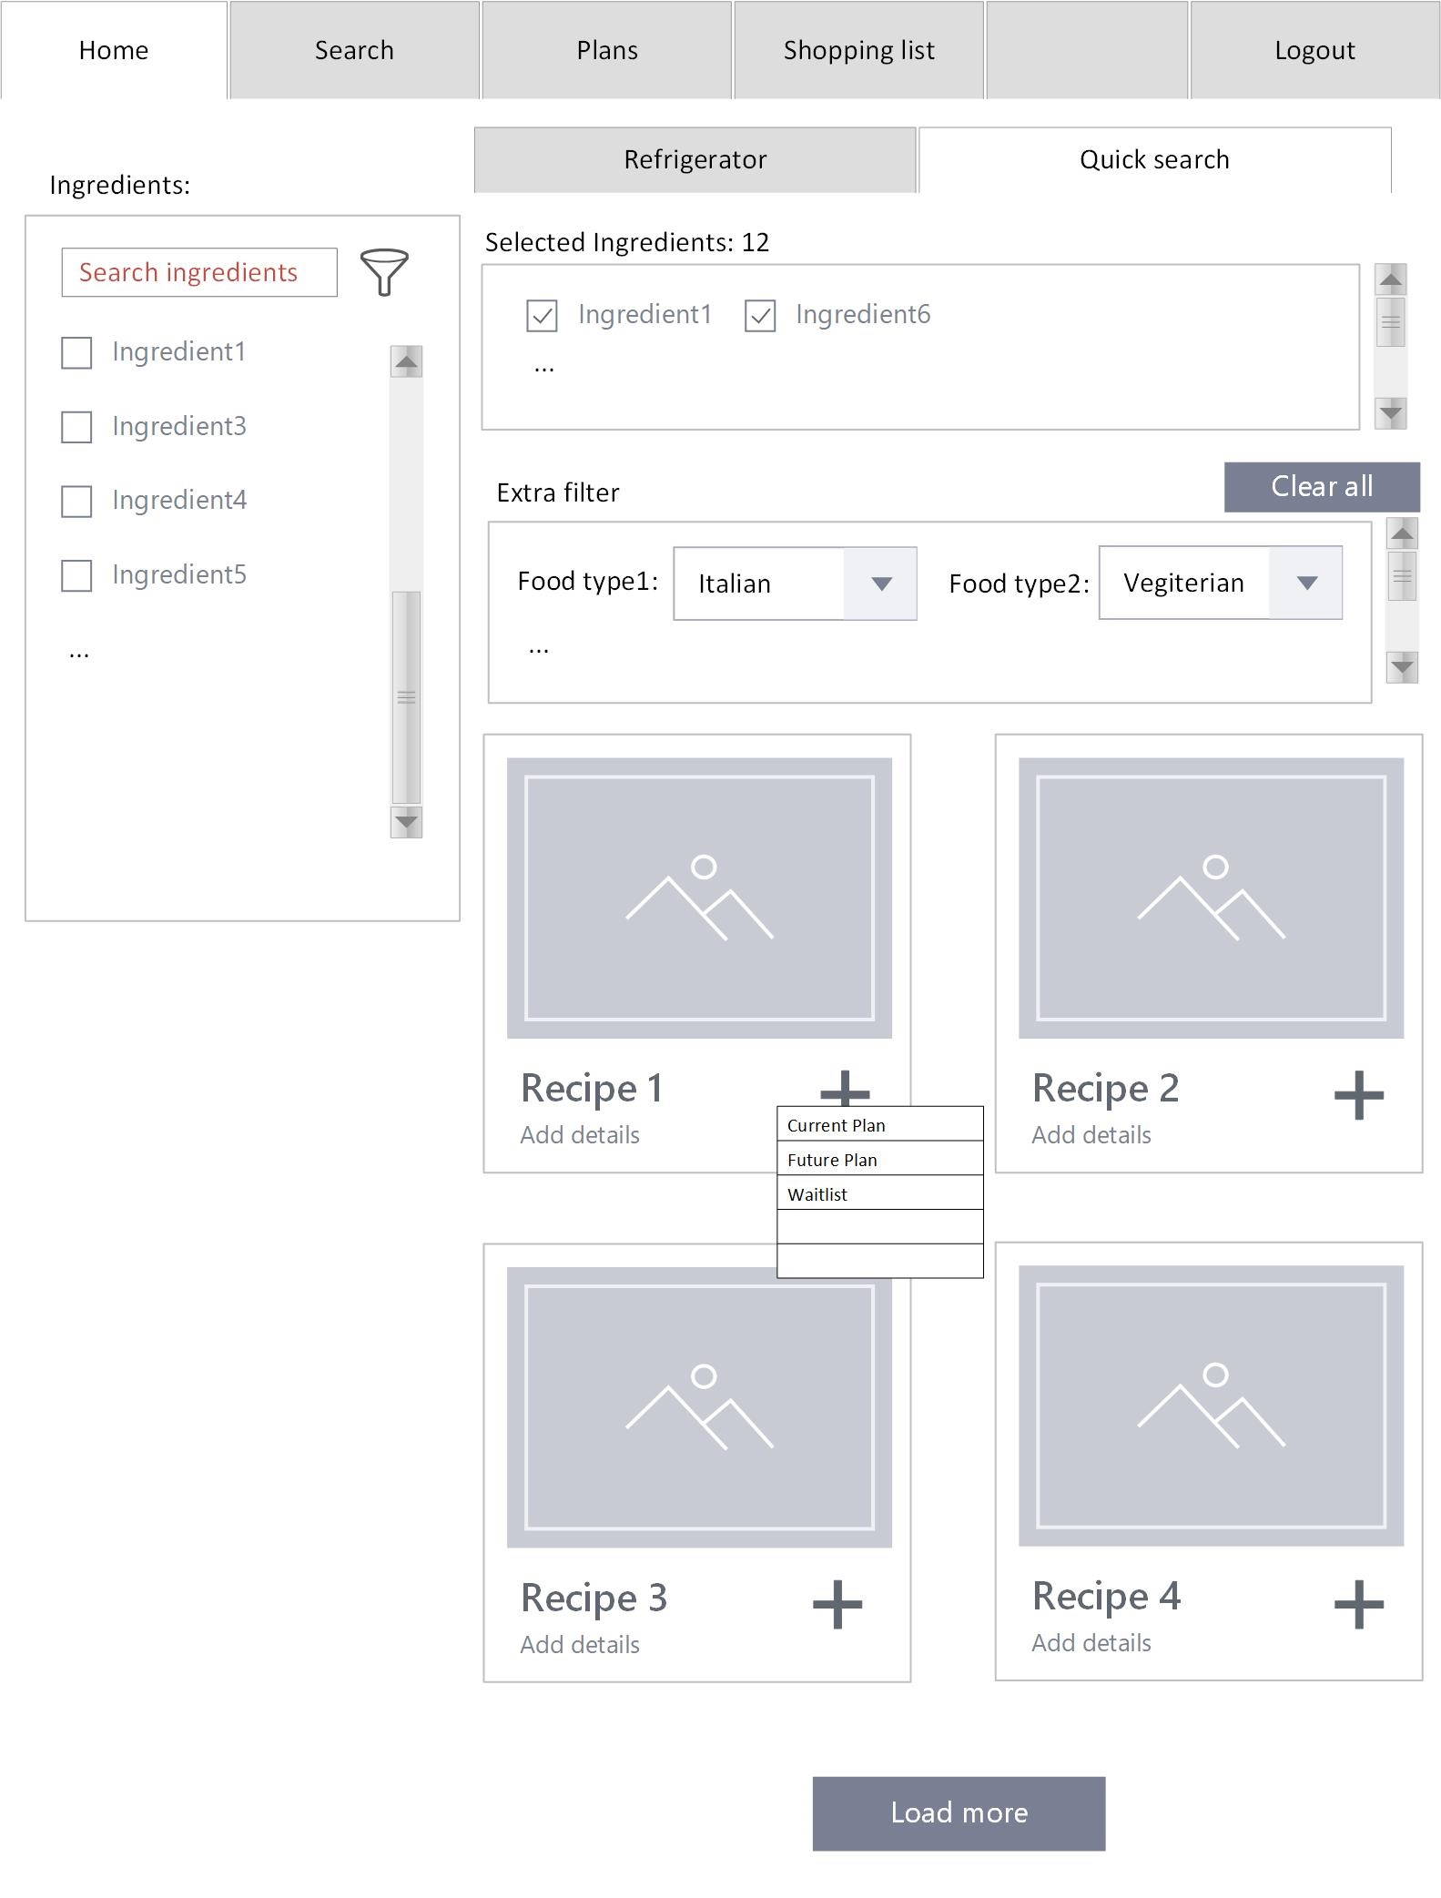
A
Wireframe

Slide 4
A
ROLES AND RESPONSIBILITIES
1
Name | Role
Robert Chin | PM / Tester
Abhijit Amin | BA
Mrunal Salvi | Source Code Manager / Backend Developer
Tanvi Hanamshet | Frontend Dev
Sadie Stokes | Architect/Frontend Dev

Slide 5
A
MAJOR COMPONENTS
2
MongoDB
Express.js
Spoonacular Recipe API
Google Sign In Authentication
React Components
JXML, CSS Design

Slide 6

3
TECHNOLOGY STACK
A
We have decided to follow the MERN stack model to develop our web application.
MongoDB
Express.js
React.js
Node.js

Slide 7
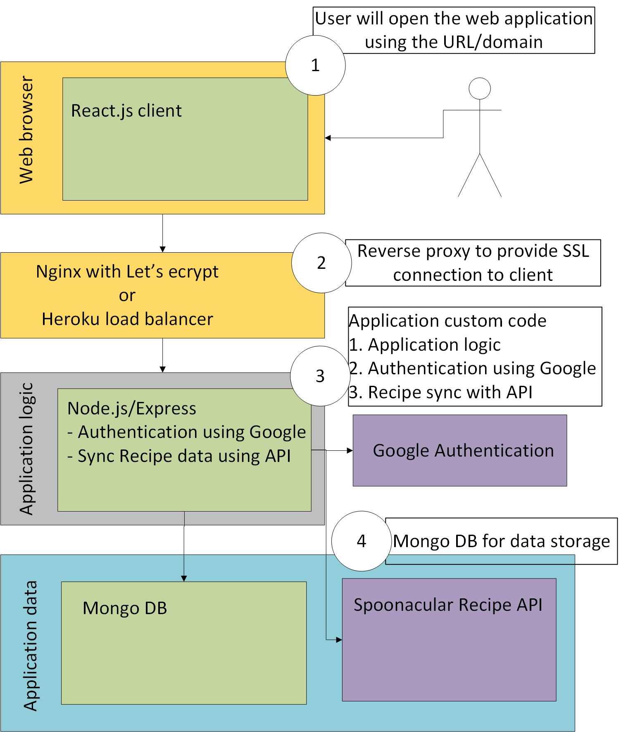
A
4
LOGICAL ARCHITECTURE

Slide 8
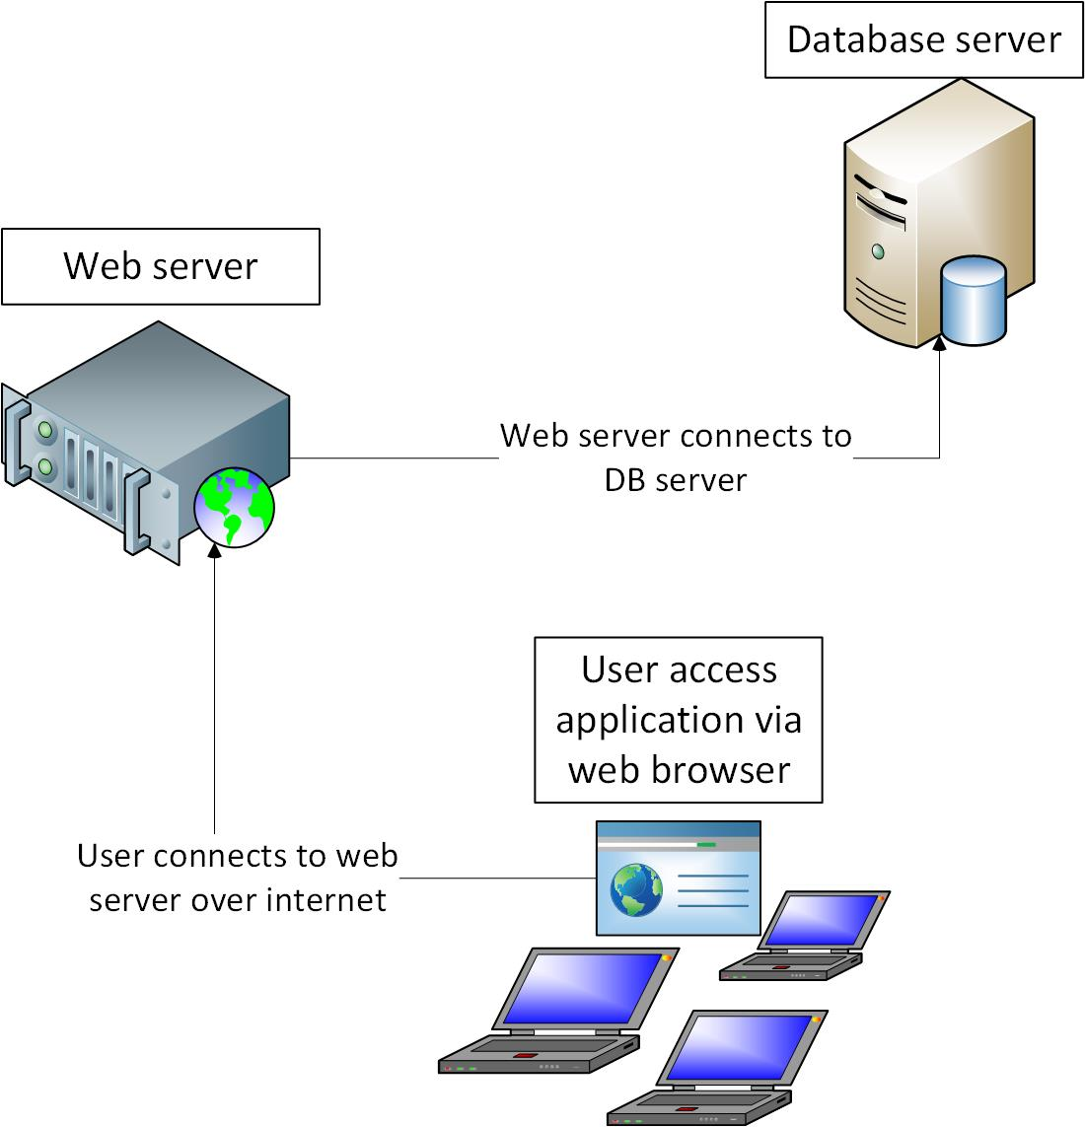
5
PHYSICAL ARCHITECTURE
A

Slide 9

A
GOVERNANCE AND SOURCE CONTROL
6
Repository Link - https://github.com/msalvi96/Prep_Your_Meal
We plan to have weekly standup meetings on Wednesday to plan our sprints. Similarly we also plan to have a Sprint review meeting just as the sprint is coming to an end to review team’s work during that particular sprint. That being said, we will constantly keep the team updated using group messages on Whatsapp.

Slide 10
B
COLOR GUIDE
7
Color combinations
Below are the color combinations we intend to use for our web app and any other communication to keep a consistent brand.
Primary
Secondary
Additional
C: 86 %
C: 0 %
C: 0 %
M: 66%
M: 86%
M: 0%
Y: 45%
Y: 70%
Y: 0%
K: 31%
K: 0%
K: 50%
#2e475b
#f04b4c
#939598

Slide 11
C
FONT GUIDE
8
Font Usage
Below are the fonts we intend to use for our web app and any other communication to keep a consistent brand.
Roboto
Roboto
Regular
Bold
ABCDEFGHIJKLMNOPQRSTUVWXYZ
Abcdefghijklmnopqrstuvwxyz
0123456789!@#$%^&*()_+=
ABCDEFGHIJKLMNOPQRSTUVWXYZ
Abcdefghijklmnopqrstuvwxyz
0123456789!@#$%^&*()_+=

Slide 12
QUESTIONS?

Slide 13
Backup Slides

Slide 14
A
Project Plan / Sprint Planning
Link to Project Plan / Sprint Planning:
https://drive.google.com/file/d/10Kg5GZ7zFebulDOzSzF8icREX90LzFAd/view?usp=sharing
Comments:
At this time, User Stories are very high level to allow for later decisions / design to be made during implementation
We’ve slotted a single user story for the first sprint (but it will probably slip to the next sprint, to first setup web application infrastructure)
6 Sprints (currently defined, might need to be reduced to account for final presentation preparation / actual presentation)

Slide 15
A
Testing
Tests will be conducted from a user perspective (manual) to validate user stories (as user story acceptance)
Test cases / results will be provided per each sprint (where applicable, Sprint 1 may slip)
Bugs, Defects/New Features will be entered via the Github

