Slide 1
Java Remote Method Invocation
CPE 545 – Communication Middleware and Software
Fall 2016 – Professor Mousavi
Presented by:
Tanvir Talukder
Prerakkumar Doshi

Slide 2
Agenda
Problem Definition
Remote Method Invocation Client-Server Architecture
Remote Method Invocation
Stub and Skeleton
Approach to writing Java RMI Program
Server Design
Client Design
Project Design Demonstration
<number>

Slide 3
Problem Definition
Demonstrate the Java RMI project using the same syntax on the both client and server side and get the full name of student when you provide the first name.
Server – Store the student full name and provide method to look up for last name and once we provide that it returns Full name or a list of full names.
Client – query for the last name and Display the received Information
<number>

Slide 4
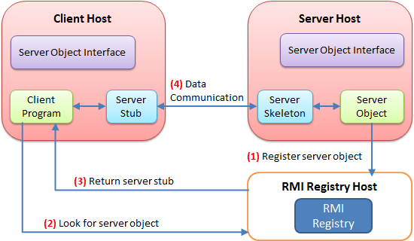
RMI Client-Server Architecture
<number>

Slide 5
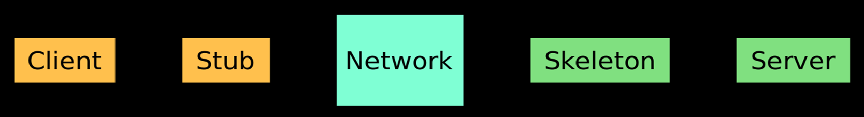
Remote Method Invocation
The Java Remote Method Invocation (Java RMI) is a Java API that performs remote method invocation, the object-oriented equivalent of remote procedure calls (RPC), with support for direct transfer of serialized Java classes and distributed garbage collection (DGC)
Java Remote Method Invocation (Java RMI) enables the programmer to create distributed Java technology-based to Java technology-based applications, in which the methods of remote Java objects can be invoked from other Java virtual machines*, possibly on different hosts. RMI uses object serialization to marshal and unmarshal parameters and does not truncate types, supporting true object-oriented polymorphism
<number>

Slide 6
Stub and Skeleton
The stub is an object, acts as a gateway for the client side. All the outgoing requests are routed through it.
It initiates a connection with remote Java Virtual Machine (JVM)
The skeleton is an object, acts as a gateway for the server side object. All the incoming requests are routed through it. When the skeleton receives the incoming request, it does the following tasks:
It invokes the method on the actual remote object, and
It writes and transmits (marshals) the result to the caller.
<number>

Slide 7
Approach
Create remote interface
Provide the implementation of the remote interface
Compile the implementation class, create the stub and skeleton objects using RMIC tool
Start the registry service by RMIregistry tool
Create and start the remote application
Create and start the client application
<number>

Slide 8
Server Design
Class List
First Name
Last Name
Server creates the array list to store student information
Takes input from the user and stores the information
Creates the server object and bind it to the registry over port 5000
Handle the method invocation for lastname(“firstName”).
<number>

Slide 9
Client Design
Lookup server object over port 5000 on server machine’s IP address
Take input from the user for the “First Name”
Call the method lastName() using the stub
Print the received information
If no matching information, output: “No student matching provided name”
If one match, output: “First Name, Last Name”
If more than one match, output list of students who’s first names match
<number>

Slide 10
Concept Demonstration
LastNameLookup(firstName) (4)
Client
Stub
Skeleton
Server
Client Object
Server Object
Return StudentList (5)
Lookup “RMI://<IP Address:Port>/ClassList” (3)
Rebind(RMI://<IP Address:Port>/ClassList, skeleton) (1)
Initiliaze list of students (2)
RMI Registry
Class List (Object Registry)
<number>

Slide 11
Thank You
<number>

