Slide 1
Interface -by Prerana and Sanika

Slide 2
Introduction to Interface
An interface in Java is just like a class, which contains abstract methods.
An interface is declared by using the ‘interface’ keyword.
Interface Methods :- public +abstract.
Interface Variable :-public +static + final.
Interface methods must be overridden inside the implementing classes.
Java Interface also represents the IS-A relationship.

Slide 3
Why interfaces are needed
There are mainly three reasons to use interface. They are given below.
It is used to achieve abstraction.
By interface, we can support the functionality of multiple inheritance.
It can be used to achieve loose coupling.

Slide 4
Syntax
interface <interface_name>{
// declare constant fields
// declare methods that abstract
// by default.
}

Slide 5
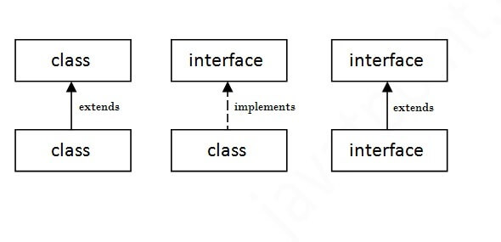
The relationship between classes and interfaces
As shown in the figure given below, a class extends another class, an interface extends another interface, but a class implements an interface.

Slide 6
Abstract class and interface
Abstract class contains both abstract and non abstract method. It does not support multiple inheritance. There are no any restrictions on abstract class method modifier. No need to declare variable as a public + static + final. Abstract keyword is used to declare abstract class. Abstract class can declare constructor. An abstract class can be extended using keyword "extends".
Interface contain only abstract method. It support multiple inheritance. By default interface method are public and abstract. By default interface variable as a public + static + final. Interface keyword is used to declare interface. Interface does not allow to declare constructor An interface can be implemented using keyword "implements".

Slide 7
Thank you

