Slide 1
Proof of Concept Of BookMyCon

Slide 2
Agenda
1. Background
Work Space Management, the future of HOW WE WORK!
Solution to Setup a Booking System for Meeting rooms.
Collaboration with video conferencing apps that allows you to view and present in real time.-*
Integration With Calendar, so you can stay on top of your schedule.
GDPR compatible Database Migration.
2. Work Flow
Requirement Gathering
Planning Phase
Tools used
Work Flow
Future Planned Enhancement

Slide 3
Requirement Gathering
Future of workspace is scheduling software and suite of integrations help ensure your people have everything they need to plan their day, to collaborate better, and to be more productive.
Click to Open doc:-

Slide 4
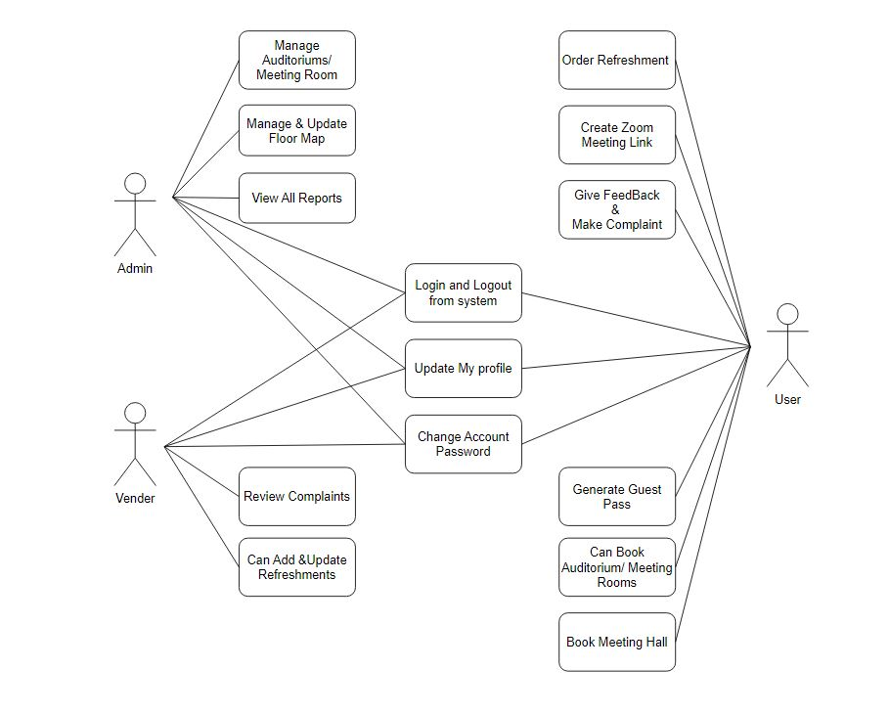
II. Planning phase
Use Case Diagram

Slide 5
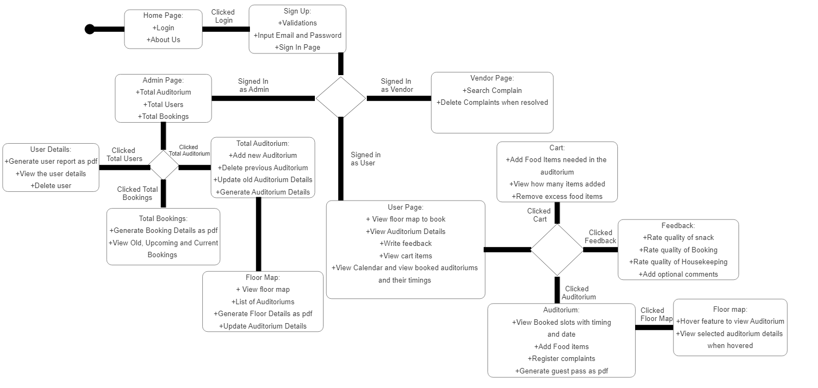
UML Diagram

Slide 6
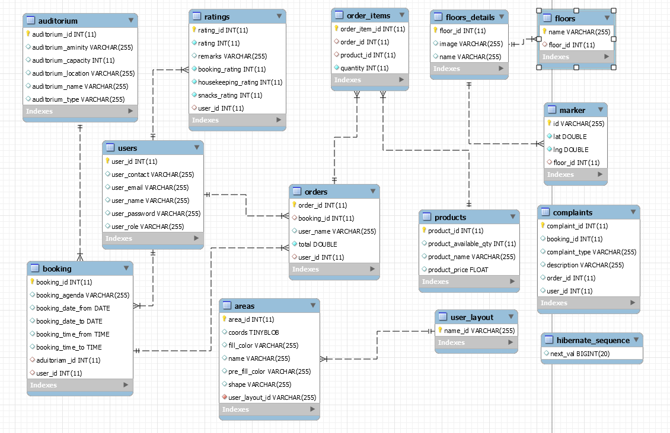
ER Diagram

Slide 7
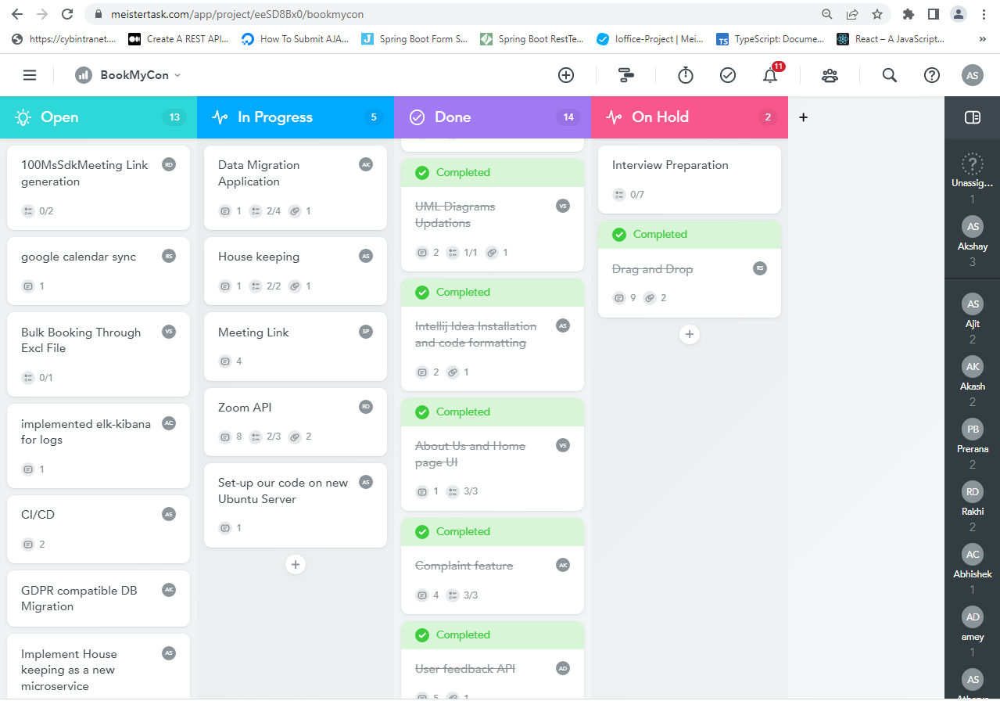
Approaches
Meister Task – Agile Mythology

Slide 8
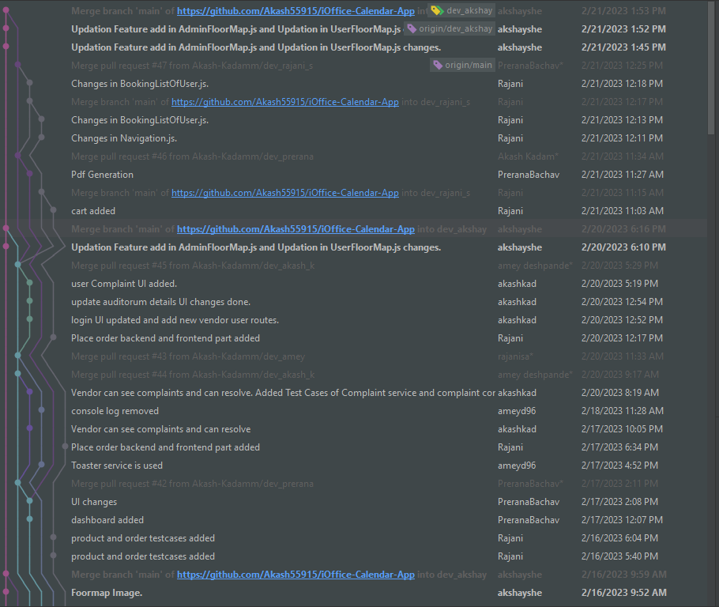
III.Tools And Technologies
Java (Version 11)
React js
Spring Boot Rest Api
Mysql Database
Kafka
Postgresql Database
Junit 4,5
Github
Kibana
Jenkins
Docker
Redis
Future Planned enhancement
Migrate to java 19
Migrate to spring boot 3.3
Use NoSQL
CICD
Use Redis cache
Use CDN to store Floor Map

Slide 9
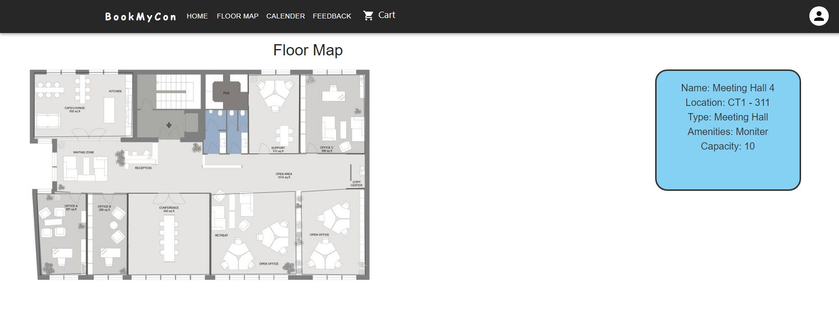
IV. Working Flow
Floor Map

Slide 10
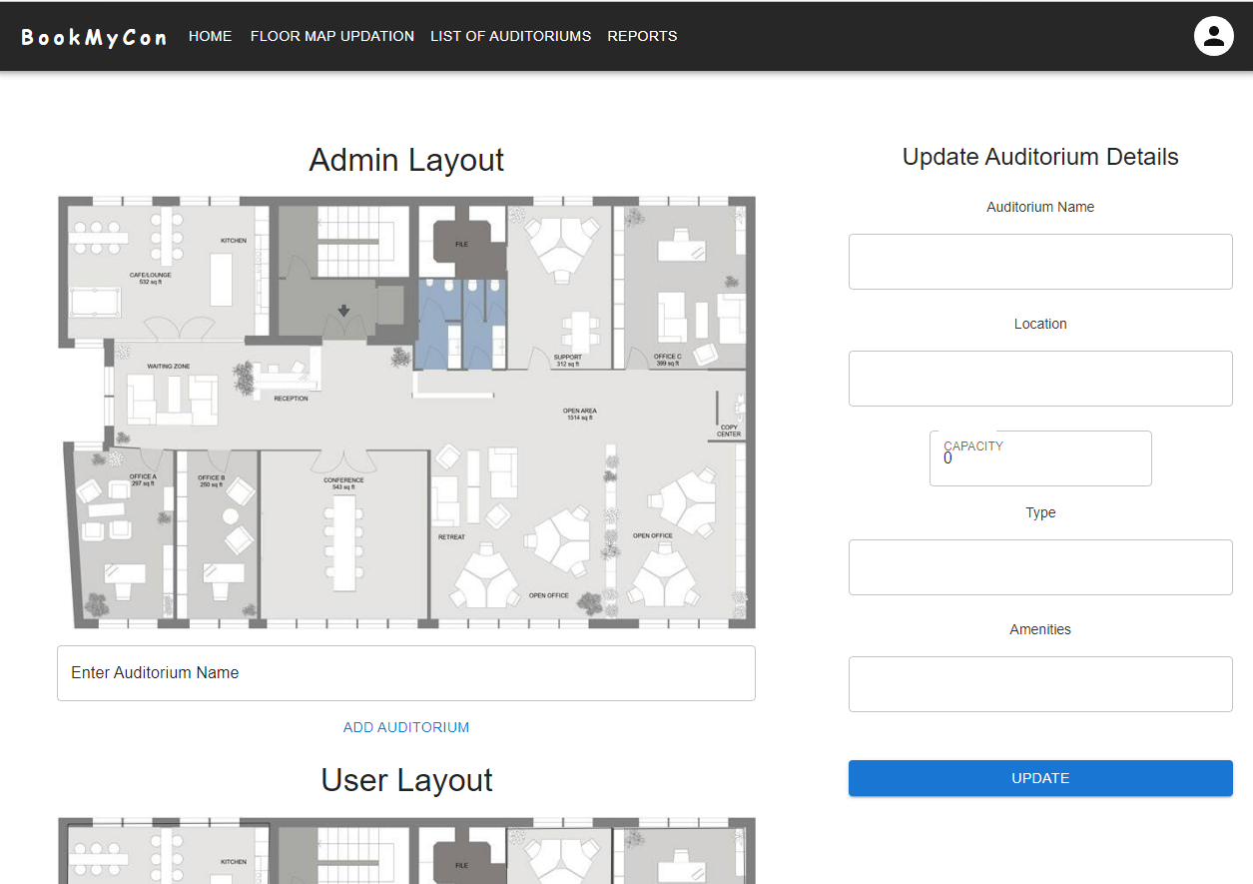
Floor Map Interaction

Slide 11
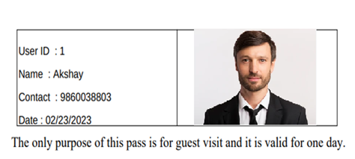
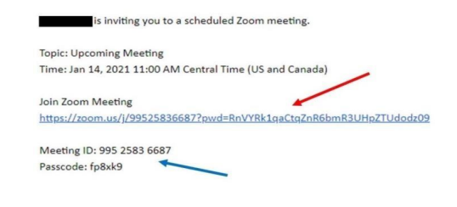
Guest Pass and Zoom link
Guest Pass :-User can generate Guest Pass
Zoom Link:-On Booking User can create zoom link
Report generation in pdf form

Slide 12
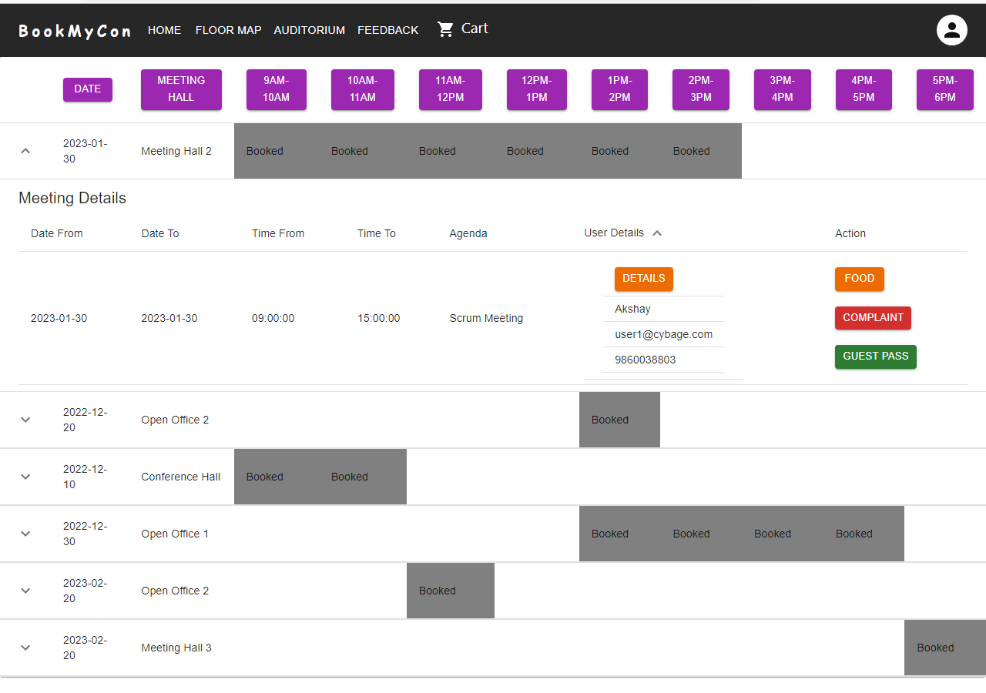
View

Slide 13
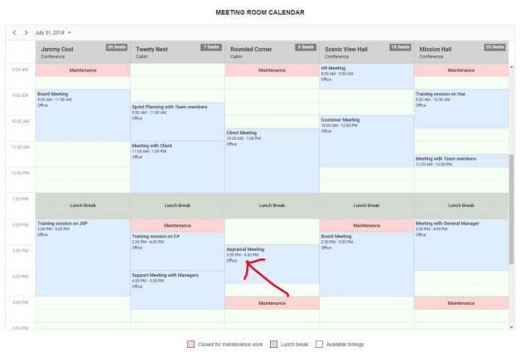
Calendar

Slide 14
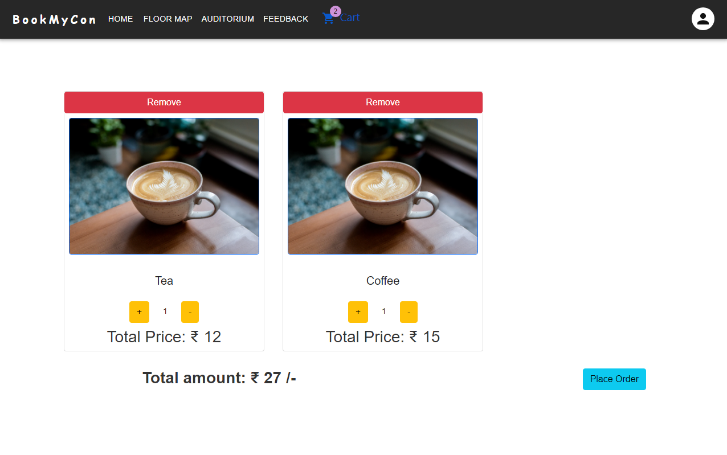
Refreshments
Future enhancement
Zoom and Teams integration
House Keeping

Slide 15
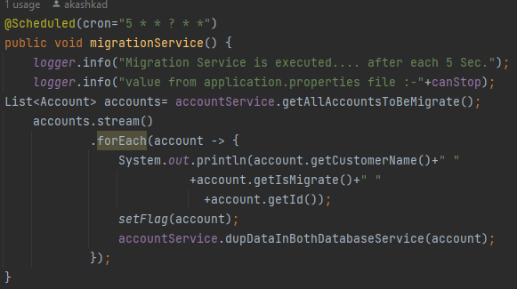
Database Migration
We solve this problem with two different solutions
Database Migration with Scheduler
Database Migration with Kafka
1. Database Migration with Scheduler
Declared two data source properties in application.properties
Configure two data source classes for mysql database and postgresql database.
Database migration service with @scheduled annotation for older data migration.
Pass the cron expression to database migration service.
For new upcoming data create end points to store data in both database.

Slide 16
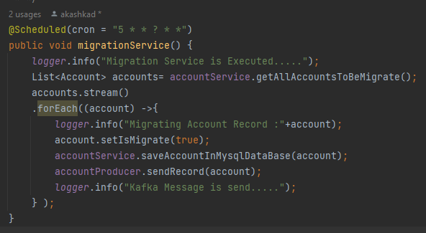
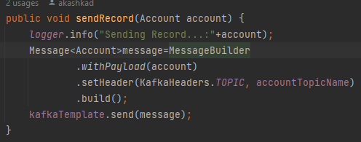
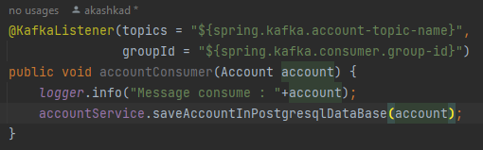
2. Database Migration with Kafka
Declared two data source properties and kafka configuration in application.properties
Configure two data source classes for mysql database and postgresql database.
Create kafka topic and use kafka template.
Create kafka producer and kafka consumer which is responsible to produce and consume kafka events.
Database migration service with @scheduled annotation for older data migration.
Pass the cron expression to database migration service.
For new upcoming data create end points to store data in both database.
Benefits:-
We done load test on both applications and we found that second solution is having higher performance.
Kafka stores data as well as do Asynchronous operations.

Slide 17
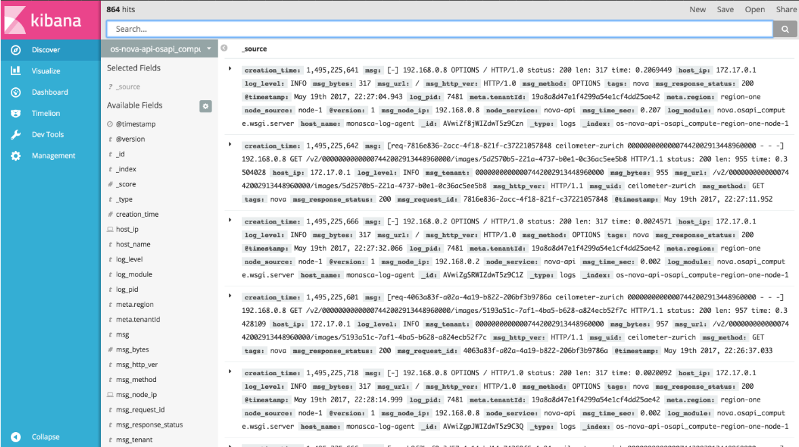
Kibana Logs
Kibana Logs is a great way to see what's going on in your application and to debug performance issues

Slide 18
V. Future Enhancement for Database Migration
Make Ui for migrating user data as per company name
Make Migration GDPR Compatible.

Slide 19

Any Questions

Slide 20
Thank You!

