Slide 1

Web Application Project on
RENT N GO
by :
Rinkiraj Prasad
Prerana Bachhav
Aishwarya Pawar
Sainand Shitole

Slide 2
Introduction:
"Rent n Go" is a web application which provides user to get all day to day essentials while relocating.
Our site lets user to take beds, dressing tables, or even washing machines , etc. on rent for the amount of
time that they specify . Our application will provide the direct interface between vendors/businesses to
consumers i.e. you, by excluding the agent or middleman.

Slide 3
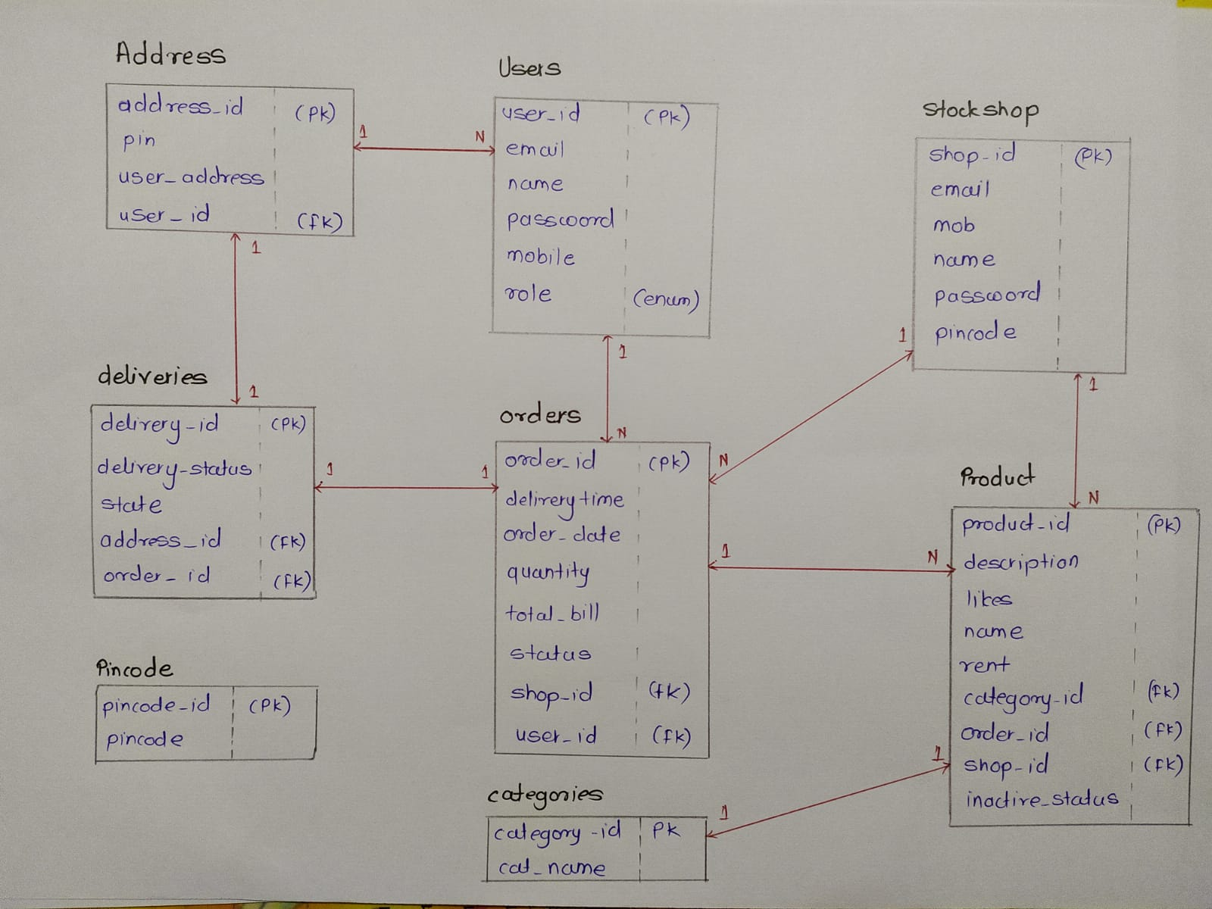
ER Diagram:

Slide 4
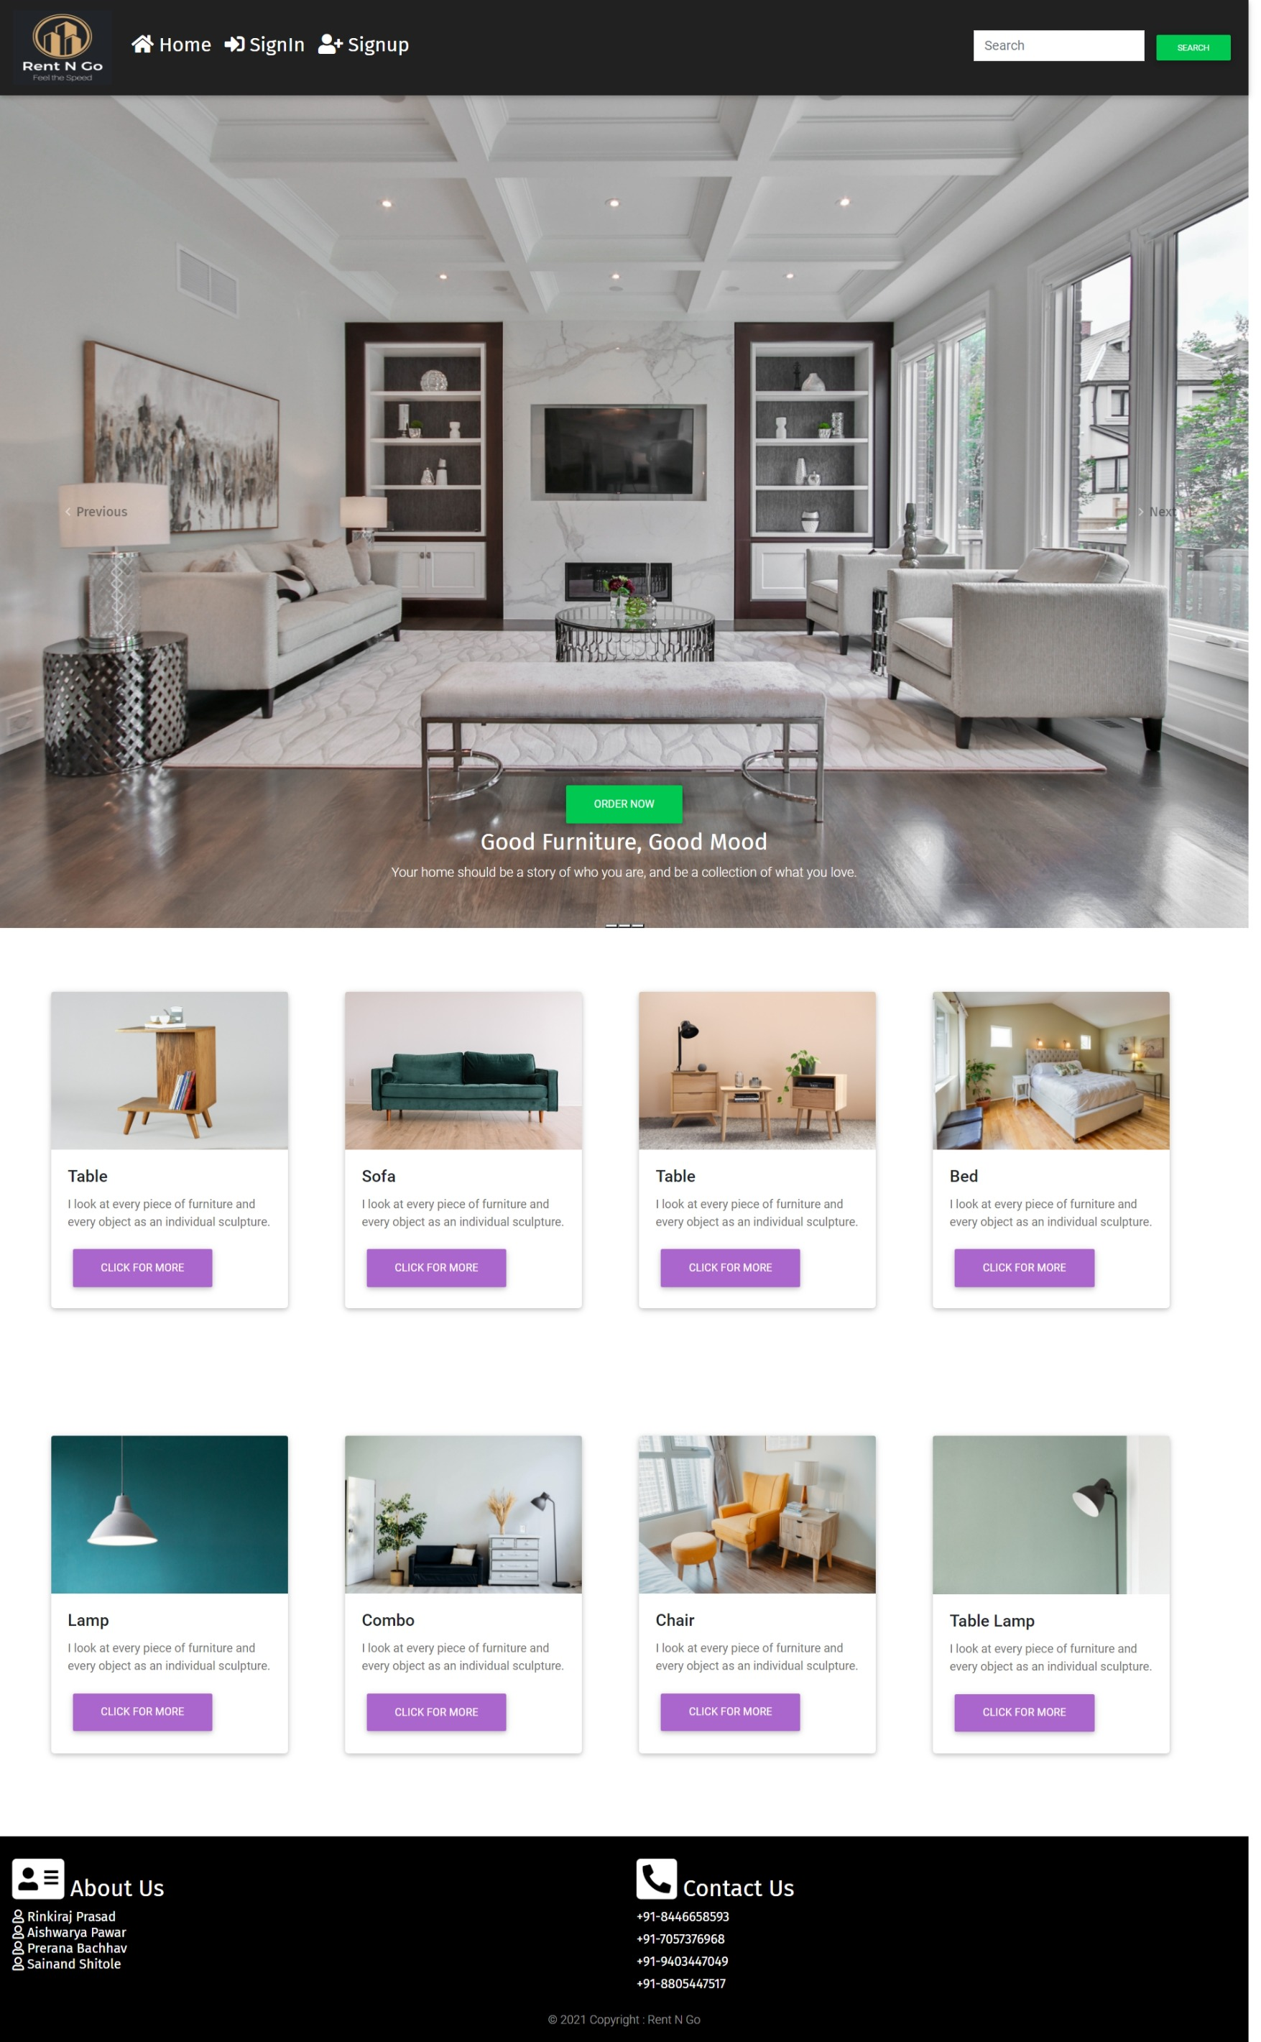
UI Design:

Slide 5
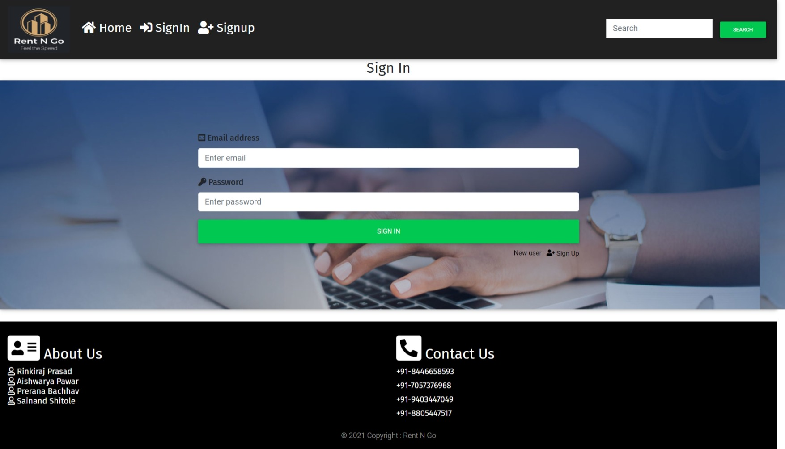
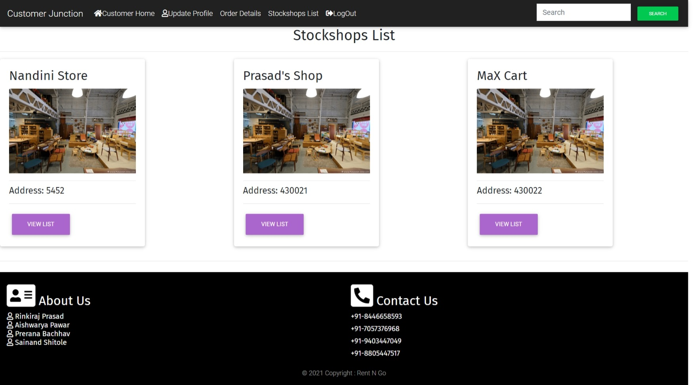
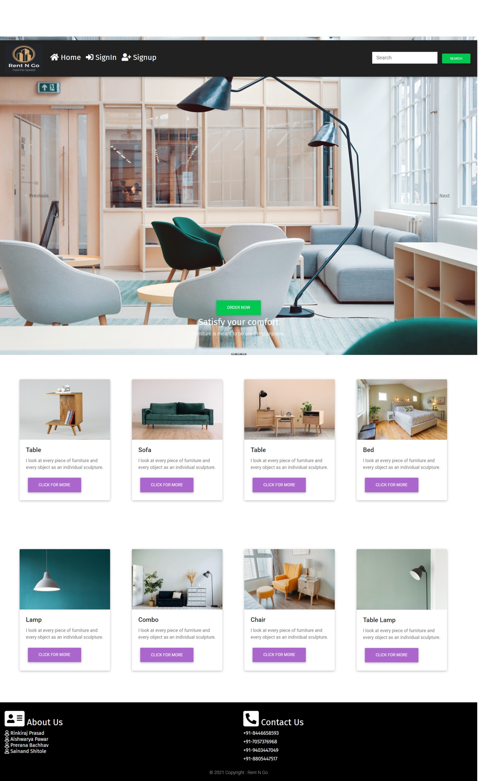
Shop Page
User Login Page

Slide 6
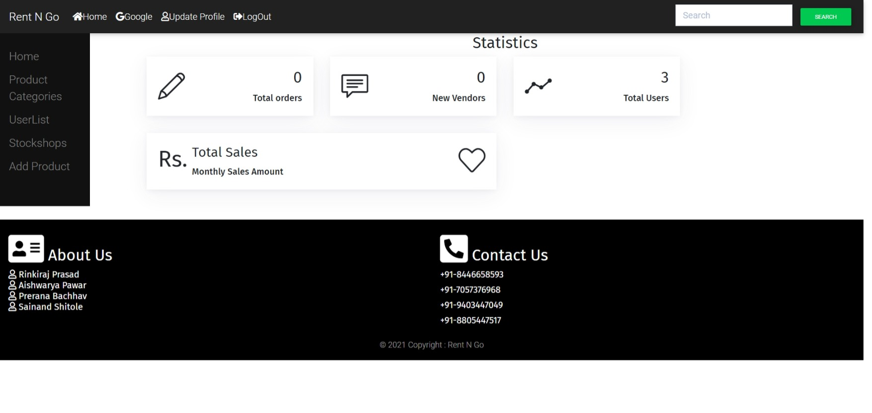
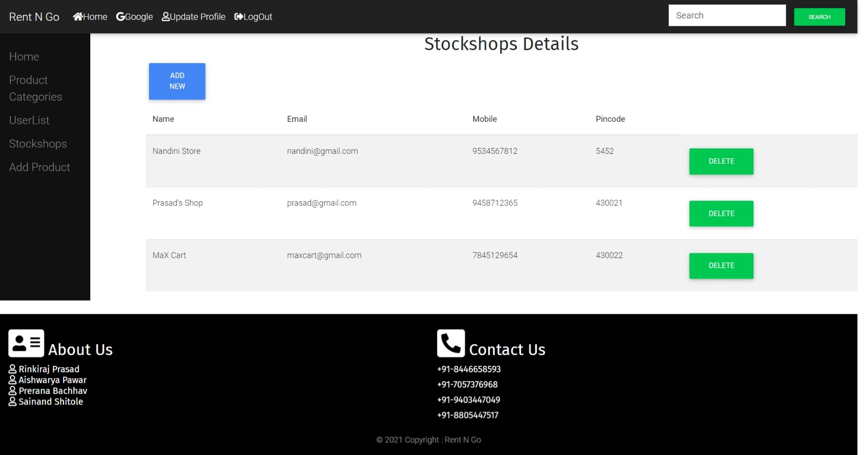
Vendor Page
Admin Page

Slide 7
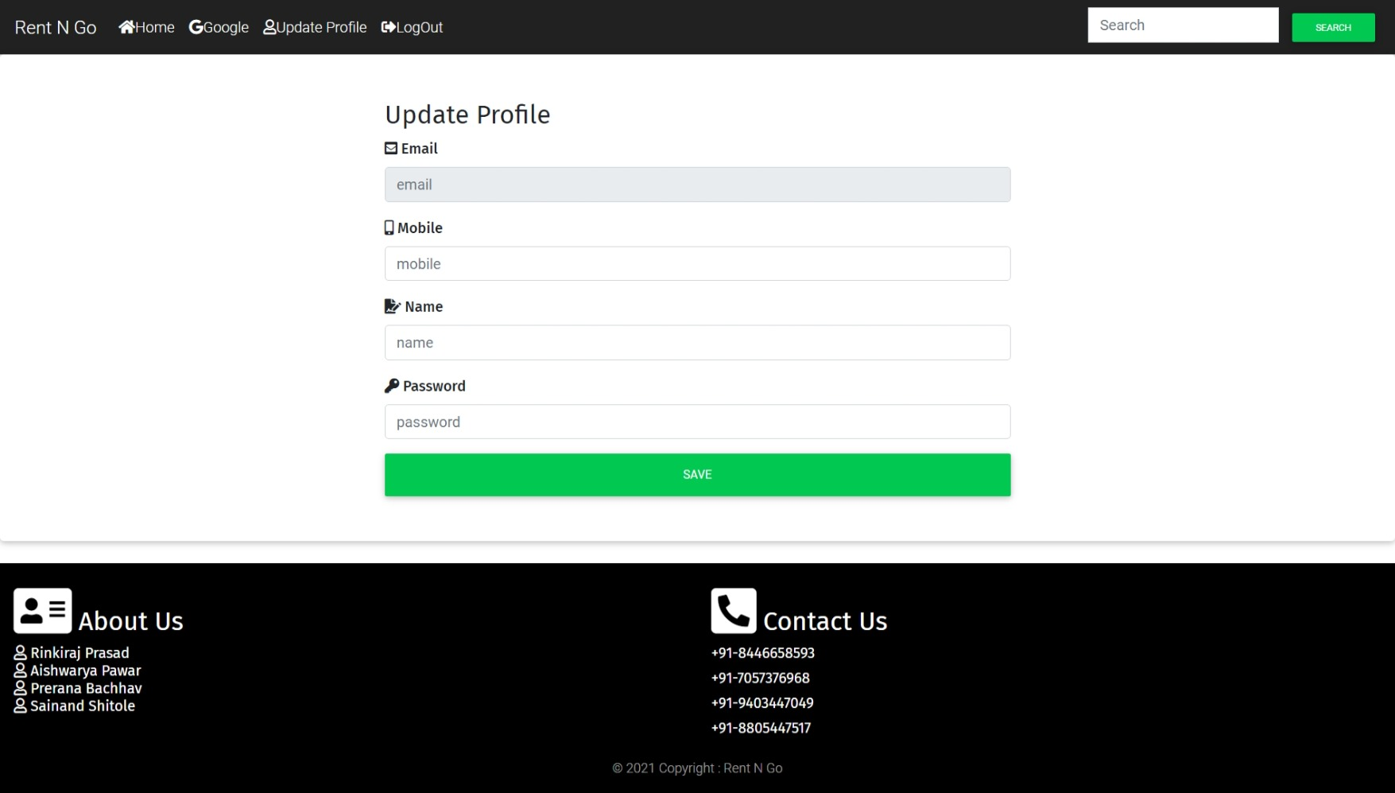
Profile Page

Slide 8
Hardware and Software Requirements (Minimum):
Hardware:
Intel i3 processor 3rd generation or later / AMD Ryzen 200 2nd generation or later
2 GB ddr3 ram.
Windows 10 Home edition or later.
200 GB Sata HDD Space
Data Connection 200 kbps
Software:
Eclipse 4.7 Oxygen
MySQL 5.7 with Workbench 8.0
Google Chrome version 79.0
Apache Tomcat Server 8.5
Maven Dependencies

Slide 9
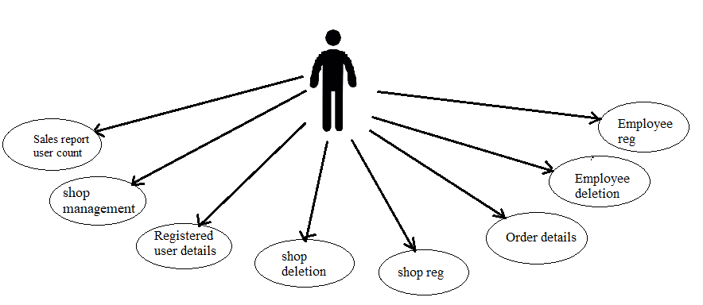
FUNCTIONAL REQUIREMENT
Role: 1. Admin Module
2.Shop Owner Module
3.Customer Module
4.Delivery Boy Module
Admin Module:
User Registration, user deletion,
Shop Registration , deletion , list of shops
Showing order details, customer details
Statistics of sales, commission
Login, Logout and edit profile

Slide 10
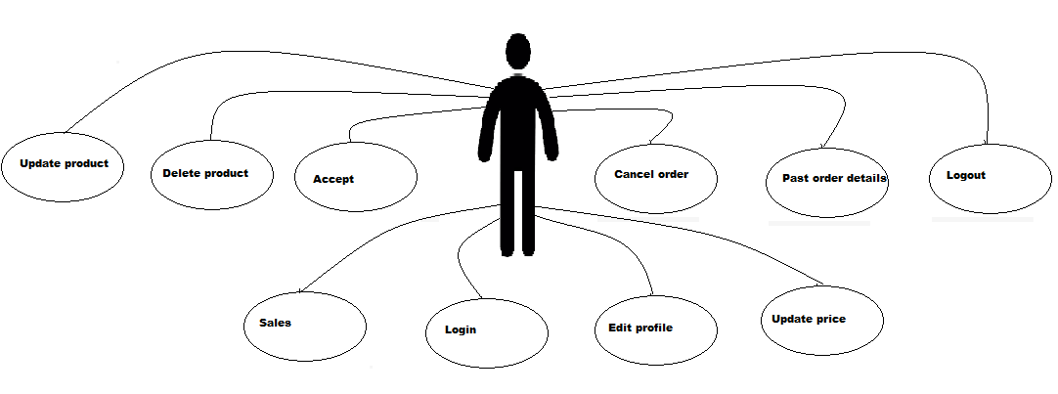
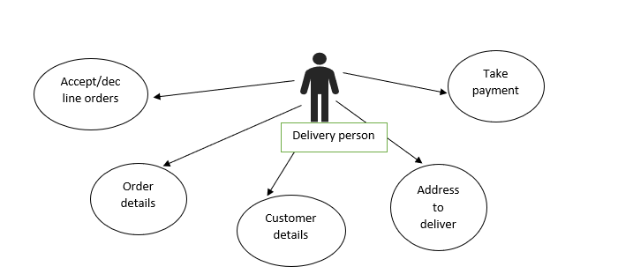
Shop Owner Module:
1)Add Product, Delete Product,
2) Update Product (in list- product list, rent ,active status)
3) show orders list
4) payment details or monthly sale
5) Login, Logout, edit profile
Delivery Boy Module:
Accept/decline order
Order details
Address to deliver
Take payment
Customer details

Slide 11
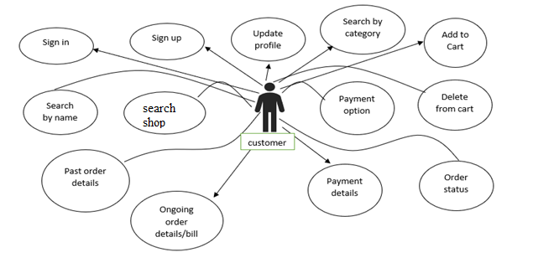
Customer / User
Registration, Login, Logout, edit profile
Searching – Product by name or category , searching shop by name
Ordering – adding order, changing status of order, showing order details list.
Payment options
Accept/delete order

Slide 12
Future Scope:
1)The concept of renting furniture is not yet properly settled in the mind of the old generation as owing the basic thing like furniture is often thought as the best option.
2) But millennials are practical, they know the hardships that come with owing furniture. It’s not just practical for them to own a 40-50k sofa set when they know they would be in another city in the next 2-3 years and transportation is not cheap!
3) Indian furniture rental market can be divided into further categories as per the needs of the customers.

Slide 13
Thank you!!!

