Slide 1

Health and Hacking
Presented By Aashish karki, Prerana Pandit, Raznesh Prajapati, Sanjeeb Lama

Slide 2
Mental Health
Our emotional, psychological and social well-being.
It affects how we think, feel and act.

Slide 3
Problem Definition
One person dies every 40 seconds from suicide – WHO
Second leading cause of death among young people 15-29 in 2016
One in 10 young people experience a period of major depression
Close to 800,000 people die due to suicide
Source : World Health Organization

Slide 4
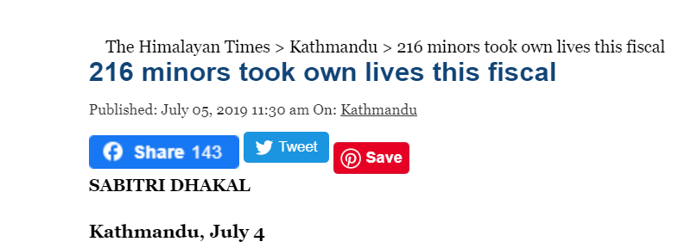
In Nepal
Suicide rate is high among the people aged between 15 and 45 years

Slide 5
Suicide rates which were only recorded
4,680
8000
2014-2015
2016-2017
2018-2019
2015-2016
2017-2018
3,974
5,124
7,144
Source : The Himalayan Times - May 2, 2019

Slide 6

We Cannot ELIMINATE

Slide 7
But we can PREVENT

Slide 8

ChangeMaker

Slide 9
ChangeMaker
Progressive Web Application
Raise awareness about Mental health problem
Provides knowledge and resources

Slide 10
ChangeMaker Features:

