Slide 1
Car Sales Analysis Dashboard
Presented by Prerana Patil

Slide 2
Dashboard Objective
Provide a unified view of car sales performance.
Identify profitable segments by model, year, condition, and location.
Enable data-driven decision-making through visual insights.
Track time-series trends in vehicle sales, condition, and pricing.

Slide 3
Problem Statement
Car sales data is scattered across brands, states, and time.
Lack of clarity on which models, colors, or years are most profitable.
Difficult to detect market trends and customer preferences.
Business users lack real-time insights to drive strategic decisions.

Slide 4
Key Deliverables
KPIs: Total Listings, Avg. Odometer, Avg. Condition, Profitable Sales.
Drill-down capability by transmission, year, and model.
Visuals: Bar charts, pie charts, donut charts, trend lines.
Time trend analysis and seller analysis included.
Interactive filters for deep dives.

Slide 5
Page 1 – Sales Overview
Total Listings: 448K, Avg. Condition: 30.55, Avg. Odometer: 67.92K, Profitable Sales: $211K
Top models by maker (Ford, Chevrolet, Nissan…)
Distribution by body type (SUV, Sedan, Hatchback…)
Popular colors (White, Black, Gray…)

Slide 6
Insights from Sales Overview
Ford dominates listings.
Sedans are the most common body type.
White is the most preferred color.

Slide 7
Page 2 – Time-Series Trends
Avg. Odometer by Year – wear and tear trend over decades.
Profitable Sales by Year – peak in 2011.
Total Listings by Year – spike in 2012.
Average Selling Price by Year – consistent increase.

Slide 8
Insights from Time-Series Trends
Older vehicles have higher mileage.
Profits and sales peaked between 2010–2012.
Average selling price has increased over the years.

Slide 9
Page 3 – Seller Analysis
Count of Sellers by State – distribution of sellers geographically.
Profitable Sales by Seller – identify top revenue generators.
Count of Sellers by Transmission Type – manual vs automatic.

Slide 10
Insights from Seller Analysis
Automatic transmission dominates seller inventory — most sellers deal in automatic cars.
Top sellers like Nissan-Infiniti LLC and Ford Motor Credit Co. generate $6K–$7.5K in profits each.
California has the highest concentration of sellers (11.54%), followed by PA, FL, TX, and NY.
Many smaller sellers contribute under $2K profit — potential for training or performance boosting.
Use seller segmentation to tailor support and maximize ROI from high-potential sellers.

Slide 11
Strategic Takeaways
Focus on high-performing sellers to increase profitability.
Expand in states with fewer sellers but high potential.
Align inventory with transmission preferences of sellers.

Slide 12
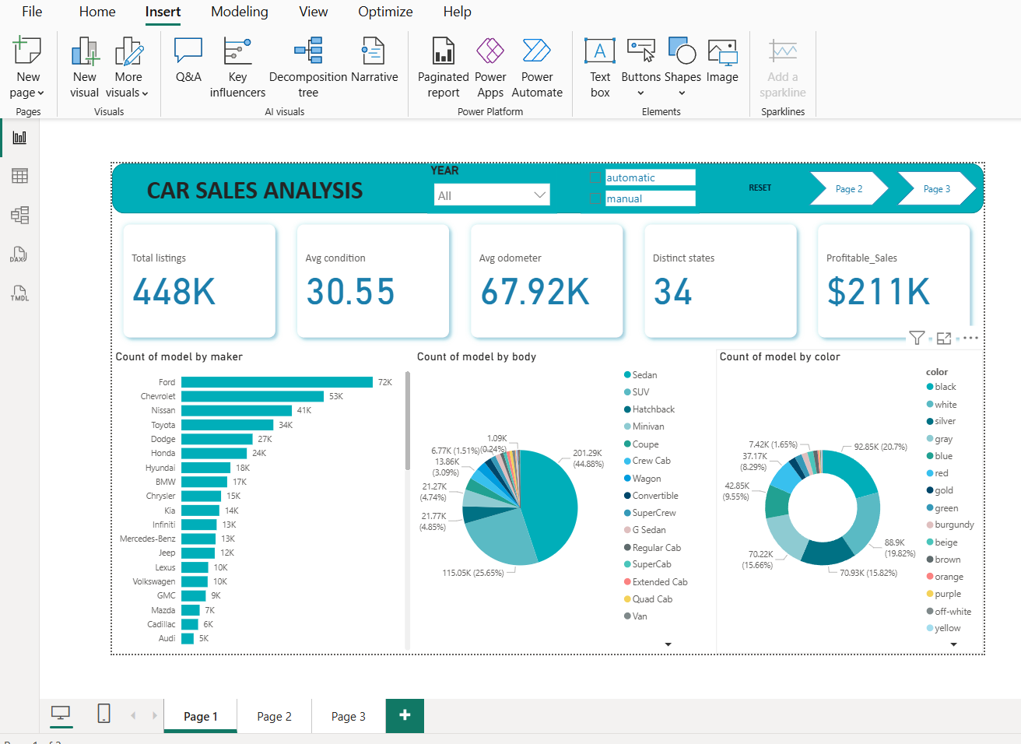
Dashboard screenshots:

Slide 13
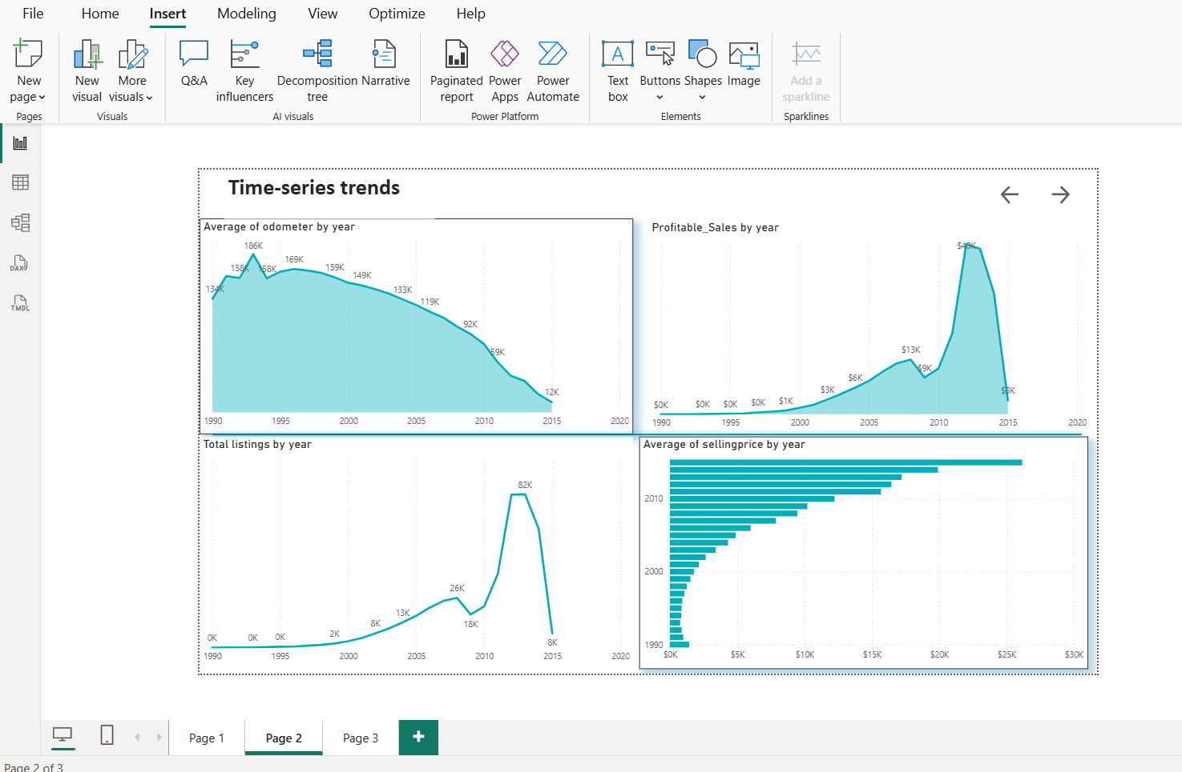

Slide 14
