Slide 1
CRIME ANALYSIS ACROSS DIFFERENT COUNTRIES
By
Prerana N Raj

Slide 2
PROBLEM STATEMENT :
All the countries face significant challenges in managing and addressing various forms of criminal activities. Law enforcement agencies, policymakers, and the public need a comprehensive tool to analyse and visualize crime data for better decision-making and strategic planning. The aim is to address these challenges by leveraging Power BI, providing a unified and advanced analytical solution to enhance global crime analysis and collaboration.

Slide 3
Objective :
The objective is to analyse and visualize crime statistics in different countries to gain insights into crime trends, distribution, and potential influencing factors. The project aims to provide a comprehensive understanding of various aspects of crime, enabling informed decision-making and policy recommendations.

Slide 4
METHODOLOGY :
1.Data Integration: Extract and integrate data from various sources into Power BI.
Aggregated and cleaned crime data from reliable sources to ensure accuracy and reliability.
2.Data collection and Data cleaning
3.EDA Findings: Summarize the key insights gained during exploratory data analysis ,highlighting patterns, trends, or outliers observed in the crime data.
4.Dashboard Design: Collaborate with stakeholders to identify key metrics and design visually appealing dashboards.
5.Interactivity: Implement interactive features for drill-down analysis and trend exploration for the crime data analysis.

Slide 5
DATA:
Crime ID: Unique identifier for each criminal cases
Crime date: Date of the crime happened
Crime time: Most dangerous crime time
Country: France, Italy, Spain, Denmark, Sweden, Belgium, etc..
People involved: How many people are actually involved in the criminal activity
Resolved: Number of crimes that are actually resolved
Crime type: Different types of crimes happened across different countries
for example:- Vehicle crime, Shoplifting, Drugs and illegal substances, Violence and sexual offences etc…

Slide 6
Dashboard Tasks :
Read Through
1. Total Crimes:
- Sum of all reported crimes in the dataset.
2. Crime Distribution by Year and Yearly Changes:
- Analysis of crimes categorized by year, including insights into the year-over-year changes.
3. Crimes by Time Range (e.g., 3:00 AM to 5:59 AM):
- Exploration of crime occurrences within specific time intervals, providing a detailed breakdown.
4. Heatmap Showing Crime Distribution by Weekdays and Months:
- Visualization using a heatmap to illustrate how crimes are distributed across weekdays and months.
5. Crimes by Country:
- Examination of crimes categorized by the country where they occurred.

Slide 7
6. Total Resolved and Unresolved Crimes:
- Distinction between resolved and unresolved crimes, offering an overview of the overall resolution rate.
7. Monthly Crime Trend with Percentage Variance:
- Analysis of the monthly crime trend, accompanied by the percentage variance to highlight fluctuations.
8. Identification of the Most Dangerous Time of the Day:
- Exploration to pinpoint the specific time periods during the day associated with a higher frequency of crimes.

Slide 8
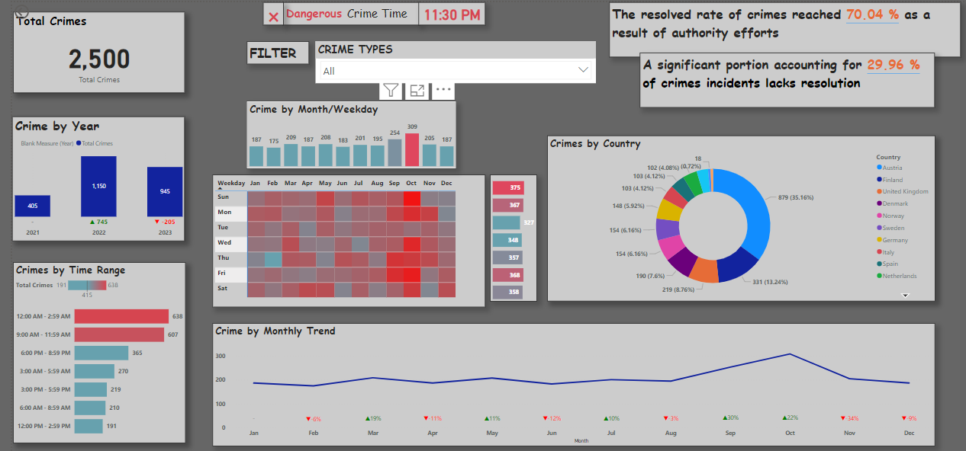

Slide 9
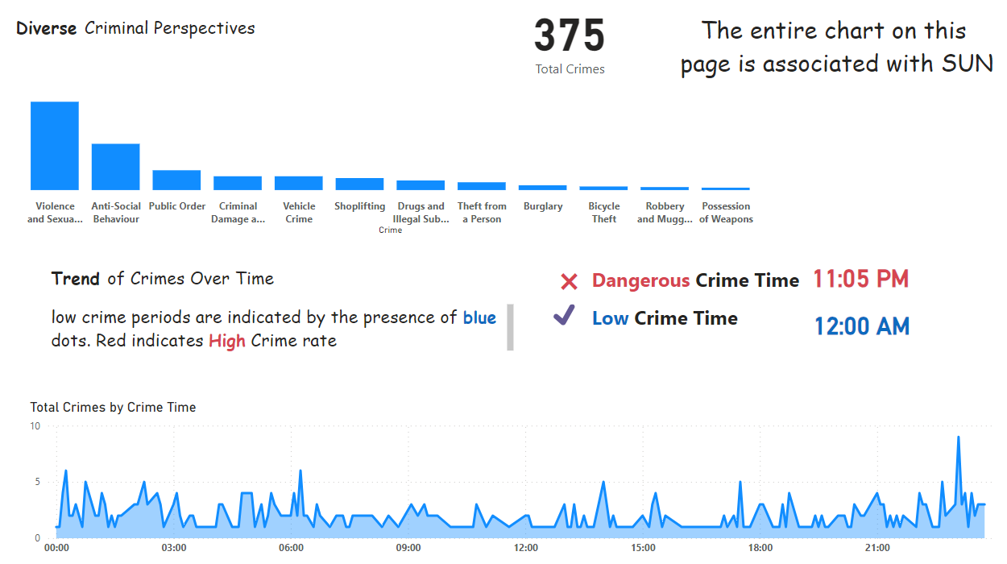

Slide 10
THANK YOU

