Slide 1
Predicting Uber Fare Amounts Using Machine Learning Algorithms
An Analysis of Uber Trip Data
By
Mrs. Prerana Rokade Howladar

Slide 2
Problem Statement and Objectives
Problem Statement:
The transportation industry has seen a significant shift with the advent of ride-sharing services like Uber. Predicting the fare amount for a given trip based on various factors such as distance, time of day, and location can help improve customer satisfaction, optimize pricing strategies, and enhance operational efficiency.

Slide 3
Objectives:
1. Understand the structure and characteristics of the Uber dataset.
2. Preprocess the data to handle missing values, convert data types, and create new features for analysis.
3. Apply various machine learning algorithms to predict the fare amount.
4. Evaluate the performance of each model using appropriate metrics.
5. Identify outliers where the fare per mile is unusually high or low.

Slide 4
Data Exploration and Preprocessing
Description of the dataset.
Steps taken for data preprocessing:
1. Converting pickup_datetime to datetime format.
2. Creating new features for the day of the week and hour of the day.
3. Calculating the distance between pickup and dropoff locations.

Slide 5
Feature Engineering
Creating meaningful features such as the distance covered per trip.
Extracting temporal features from the pickup datetime.

Slide 6
Model Building and Evaluation
Models used:
1. Linear Regression
2. Random Forest
3. Gradient Boosting
4. K-Nearest Neighbors (KNN)
5. Support Vector Machine (SVM)
Evaluation metrics: MAE and RMSE
Comparison of model performance.

Slide 7
Results
Summary of model performance:
1. Linear Regression: MAE: 6.19, RMSE: 9.97
2. Random Forest: MAE: 2.31, RMSE: 4.44
3. Gradient Boosting: MAE: 2.40, RMSE: 4.81
4. K-Nearest Neighbors: MAE: 2.82, RMSE: 5.25
5. Support Vector Machine: MAE: 4.97, RMSE: 9.42

Slide 8
Outlier Analysis
Identification of outliers where the fare per mile is unusually high or low.
Analysis and interpretation of the outliers.

Slide 9
Conclusion
Insights from the analysis:
1. The Random Forest model performed the best in predicting Uber fare amounts.
2. Importance of feature engineering and model selection in predictive modeling.

Slide 10
Data Preprocessing Code
# Convert pickup_datetime to datetime format df_new['pickup_datetime'] = pd.to_datetime(df_new['pickup_datetime']) # Extract day of the week df_new['pickup_day_of_week'] = df_new['pickup_datetime'].dt.dayofweek

Slide 11
Feature Engineering Code
# Function to calculate distance between two coordinates def calculate_distance(pickup_lat, pickup_lon, dropoff_lat, dropoff_lon): return geodesic((pickup_lat, pickup_lon), (dropoff_lat, dropoff_lon)).miles # Apply the function to create a new column for distance df_new['distance'] = df_new.apply(lambda row: calculate_distance(row[
'pickup_latitude'], row['pickup_longitude'], row['dropoff_latitude'], row['dropoff_longitude']), axis=1)

Slide 12
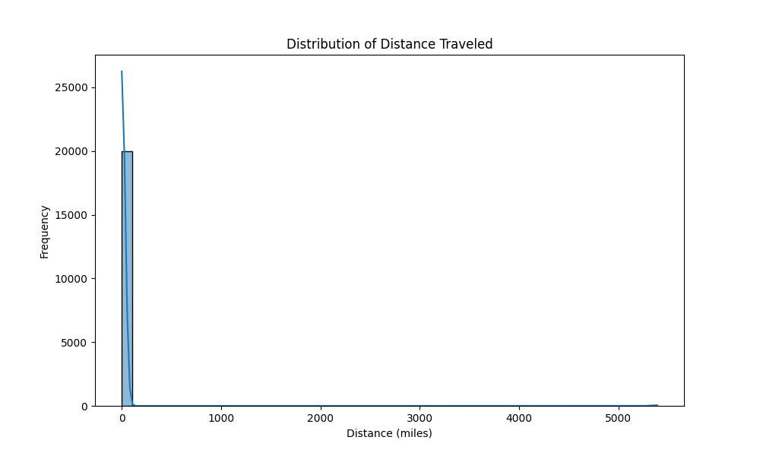
Distribution of Distance Traveled

Slide 13
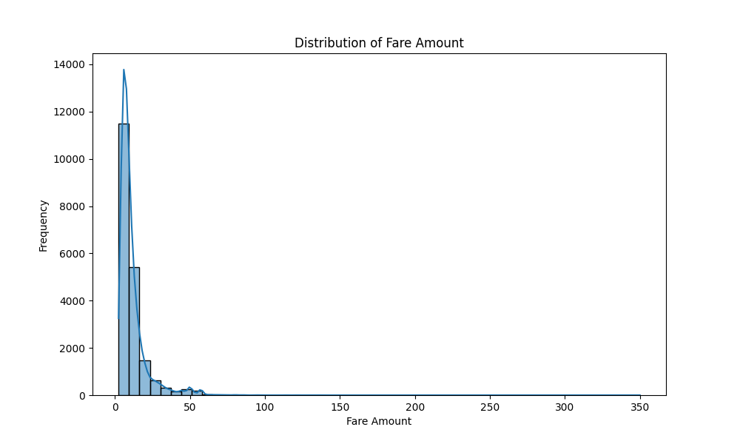
Distribution of Fare Amount

