Slide 1
Case Study : Workplace Inclusion
Prerit Saxena

Slide 2
Problem Statement
Business Objectives
Gather insights to support the organization’s inclusion strategy
Evaluate whether the organization ensures equitable compensation for employees across various groups
Analytical Objectives
Determine each employee's level within given hierarchy
Calculate the organization size of each employee
Build a predictive model to estimate the salary of each employee based on available data
Identify the key factors influencing salaries

Slide 3
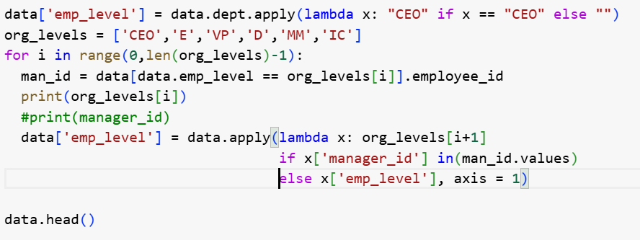
Determine hierarchy
Organization Structure
Individual Contributors (IC): Employees who don’t manage anyone.
Middle Managers (MM): Direct supervisors of ICs.
Directors (D): Direct supervisors of MMs.
VPs: Direct supervisors of Directors.
Executives (E): Direct supervisors of VPs.
CEO: The single leader at the top.
Steps followed to determine hierarchy:
Use Dept = ‘CEO’ to identify CEO
Recursively identify the below levels using the rule:
If manager_id’s level is CEO then employee_id’s level is Executive
Code
Snippet

Slide 4
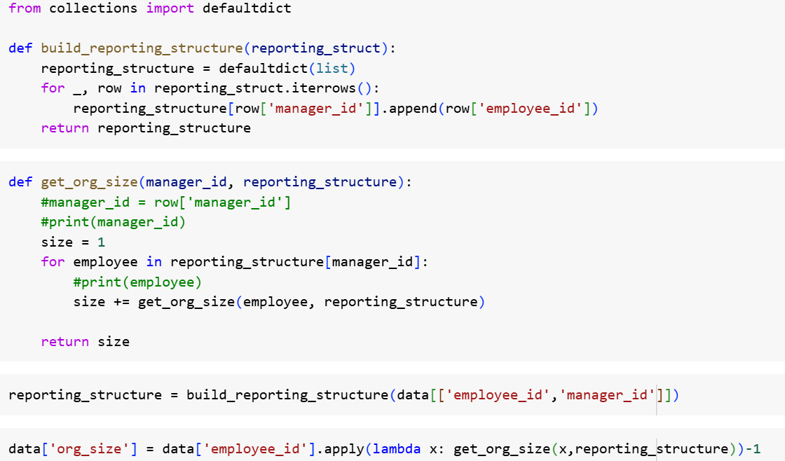
Organization Size
Rule:
For every employee, calculate how many people they manage directly and indirectly.
For example, if John directly manages 2 people, and those 2 manage 5 others each, John ultimately manages 12 people.
Steps followed to calculate organization size:
Use dictionary data structure to create a ‘reporting structure’ such that each key is a manager and all elements in it are their direct reports
For each employee. Recursively traverse through the dictionary to sum the organization size till root node
Subtract 1 from total org size returned to exclude the employee themselves
Code
Snippet

Slide 5
Equitable Salary distribution Analysis

Slide 6
On average, male employees earn significantly more than female employees Further investigation required to analyze the interaction effects of multiple factors
Average salary for male employees is significantly high compared to female employees at an organizational level and for each degree
Employees in HR department are paid significantly less compared to other department
In each department male and female employees are paid equitably
1
1
1
Sample | Male | Female
 | 6439 | 3561
2
3
3
2

Slide 7
Gender is the least important variable in all predictive models
To establish causal relationship between gender & salary and analyse interaction effect of firmographic characteristics, several models were built to predict employee salary and identify key influencing factors
Model 1 | Model 2 | Model 3
Dataset : All Data (Except CEO)
Technique : Random Forest
Independent Variables : Department, Experience, Degree, Level & Gender*
MAPE : 38%
Dataset : Only IC
Technique : Random Forest
Independent Variables : Department, Experience, Degree & Gender*
MAPE : 37%
Dataset : Levels above IC (excluding CEO)
Technique : Random Forest
Independent Variables : Department, Experience, Degree, Level & Gender*
MAPE : 42%
*All models had variations without using ‘Gender’ feature, no impact in accuracy was observed

Slide 8
Salary distribution is dependent on specific nuances of each department Majority of females are in lower paid jobs (HR)
P-Values for Chi-Sq. Test
Department has strong correlation with level and gender
Understanding level wise salary trends for each department
HR salaries are least as compared to other department
Salaries in Engineering and Marketing do not increase with level as steeply as other departments
Though, salaries for males & females are equitable in each department, females are significantly over indexed in HR
1
 | Degree | Department | Emp level
Department | 0.297
Emp level | 0.000 | 0.000
Gender | 0.839 | 0.000 | 0.160
3
1
2
2
3
4
4

Slide 9
Insights & Recommendations
Insights | Recommendations
Need more data to create a better predictive model such as: Salary split by components Performance Skill and proficiency Organization work culture insights Gender representation is not consistent across departments Salary distribution is highly driven by nuances within each department 45% of employees earn more than their managers | Analyse key factors leading to low diversity among departments. Hypothesis: Certain skill sets do not attract diverse applications for hire Hiring funnel leaking diverse candidates Certain departments have high attrition of diverse employees Based on findings of the above hypothesis certain steps can be taken to increase diversity, e.g. Explore labour markets offering diverse candidates for specific roles (e.g. states / regions with more female engineers) Re-think compensation philosophy: Managers must have higher salary than their reports Compensation must increase with increase in level

