Slide 1
PROBLEM STATEMENTS
Current system uses papers,file and binders which consumes a lot of time and money.
Records are managed manually which makes it vulnerable to security.
Managing manually also becomes a hectic job for the administrator.
The current system has a high risk of misplace of documents provided from different administrative and account council.

Slide 2
OBJECTIVES
To facilitate the students with an interactive online website where they can access and edit their profiles.
The students can also retrieve information about their account status. (e.g.: College fee, Examinations form fee, Hostel fee etc.) as well as administrative information.

Slide 3
SCOPE AND APPLICATIONS
Ensure data accuracy, minimize manual data entry and ensure security.
More convenient and faster method and reduces unnecessary paperwork.
Eliminates the need of more faculty members.
Perfect package of all the requirements of an ideal college system.
It can be a prototype to create student management system for schools and other colleges.

Slide 4
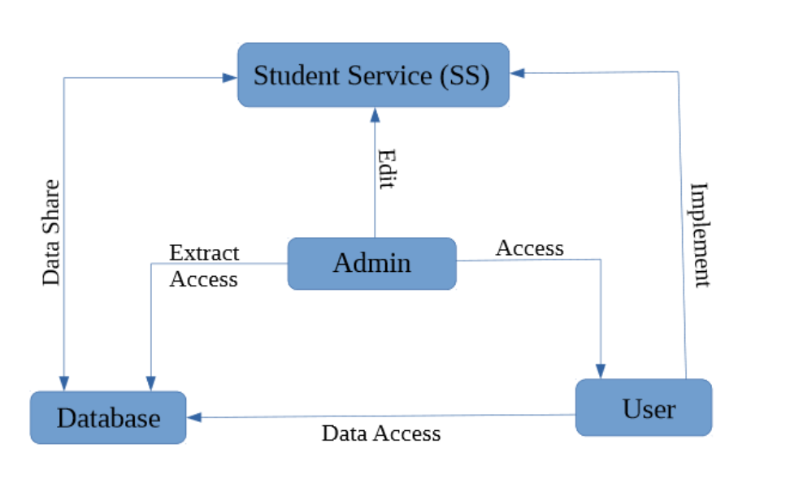
SYSTEM BLOCK DIAGRAM

Slide 5
EXISTING WEBAPP ONLINE
Blackbaud Education Management System is one of the leading webapp which has good data representation and collection and messaging system.
Hero is another great time saver for any busy school administrator where the teachers can positively manage and reinforce student behavior.
Fee Report is a good Student Management System made with Java and MySQL where student can open their respective profiles and view about their fee report.

Slide 6
LIMITATIONS
Blackbaud Education Management System : Chunky notification system, bad search tools, no communicative feature between student and department.
Hero : Issue of remembering passwords and accessing accounts, no good review page.
Fee Report : Only information about the fees, no information of the exam and department section, user will not be regularly updated.

Slide 7
SOLUTIONS
Blackbaud Education Management System : advanced notification system and search tool, great communicative environment between students and their respective departments.
Hero : Provides unique password, good review page to suggest improvements.
Fee Report : Included exam and department section, advanced blog page for interaction

Slide 8
EXPECTED OUTPUT
Easy interaction between the college and the user.
Interactive blog page for each departments through online.
Regular notification for happening events as results, fee status, etc.
Time saving service.

Slide 9
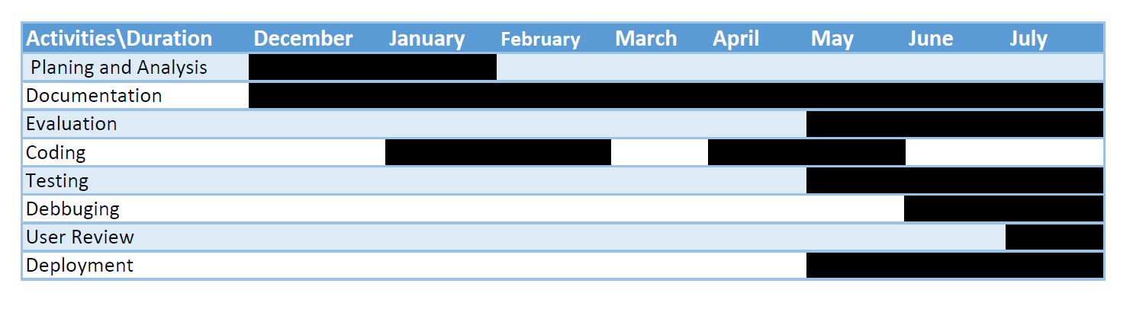
GANTT CHART

Slide 10
REFERENCES / BIBLIOGRAPHY
”TrustRadius -Student Management System” ,2013-2019
Available on: https://www.trustradius.com/student-management-systems (Accessed 28 Nov 2019)
“Fee Report-Java Project on SMS”,2011-2018
Available on: https://www.javatpoint.com/fee-report-project-in-java
(Accessed 23 Nov 2019)
“LinkedIn-Project Proposal Writing”, October 24, 2017
Available on: https://www.linkedin.com
(Accessed 20 Nov 2019)
https://www.goodfirms.co/school-management-software/
http://services.lovelycoding.org/student-management-system/

