Slide 1
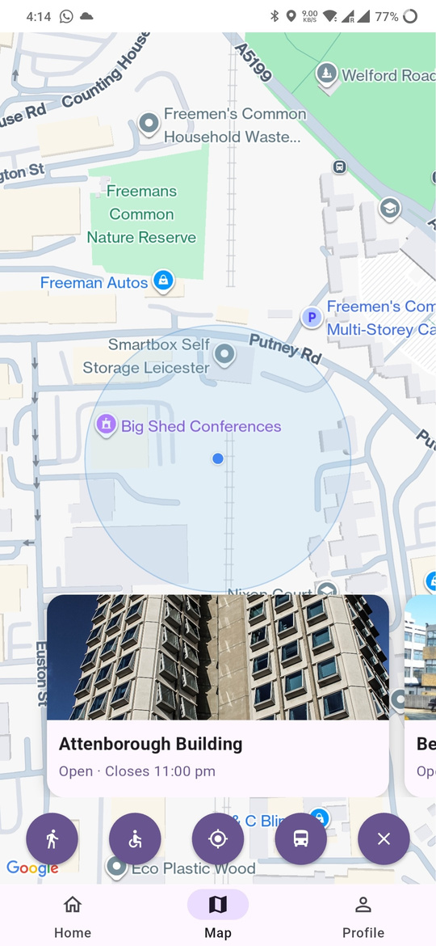
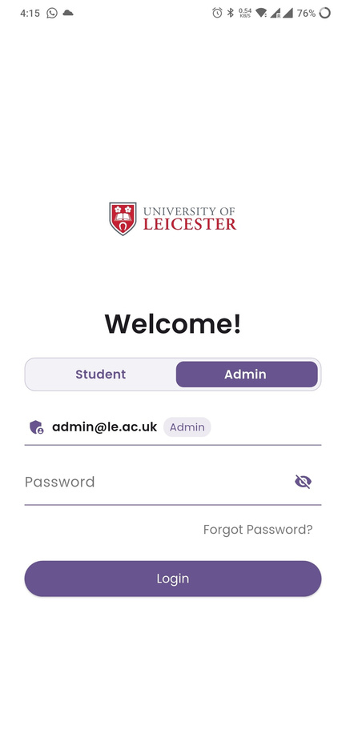
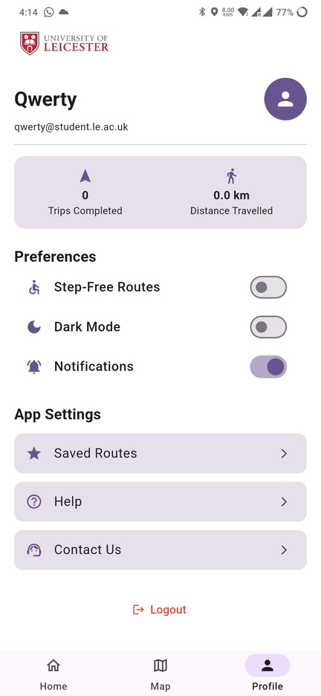
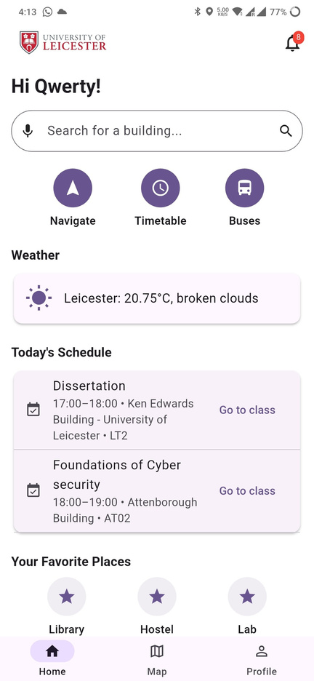
A MOBILE APP FOR CAMPUS NAVIGATION

Slide 2





INTRODUCTION
01
02
03
04
05
Emphasizes user-friendly design, accessibility, and seamless interaction.
Built with Flutter (Dart) and Firebase (Auth, Firestore, backend services).
Admin console to manage
student accounts, maps,
timetables, and announcements.
Android app to simplify movement across the University of Leicester campus.
Integrates real-time maps, weather, live bus tracking and class schedules into one platform.

Slide 3
AIMS AND OBJECTIVES
01.
02.
03.
04.
INTEGRATION
ACCESSIBILITY
REAL TIME
PERSONALIZATION
Develop a unified campus navigation solution integrating maps, schedules, and essential campus services into one app.
Improve accessibility and usability for students through step-free routes and responsive UI.
Enable real-time updates for weather, bus schedules, and notifications to enhance on-campus decision-making.
Implement secure authentication and personalized content using Firebase to create a tailored user experience.

Slide 4
MOTIVATION
Navigating a large university campus can be confusing and time-consuming for new and international students.
Students often rely on multiple platforms for maps, schedules, and transport updates, leading to inconvenience.
01
02
03
04
One app. Real-time. Accessible. Personal.
Improving the University of Leicester student experience.
Existing navigation apps (e.g., Google Maps) lack campus-specific features such as step-free access, timetable integration, and Live bus tracking.

Slide 5
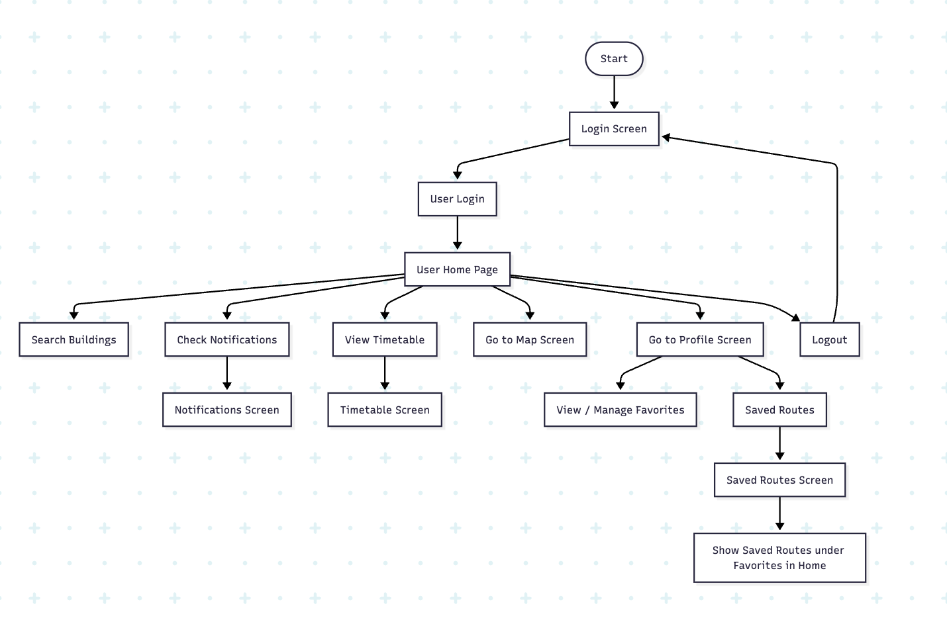
FLOW DIAGRAM
USER

Slide 6
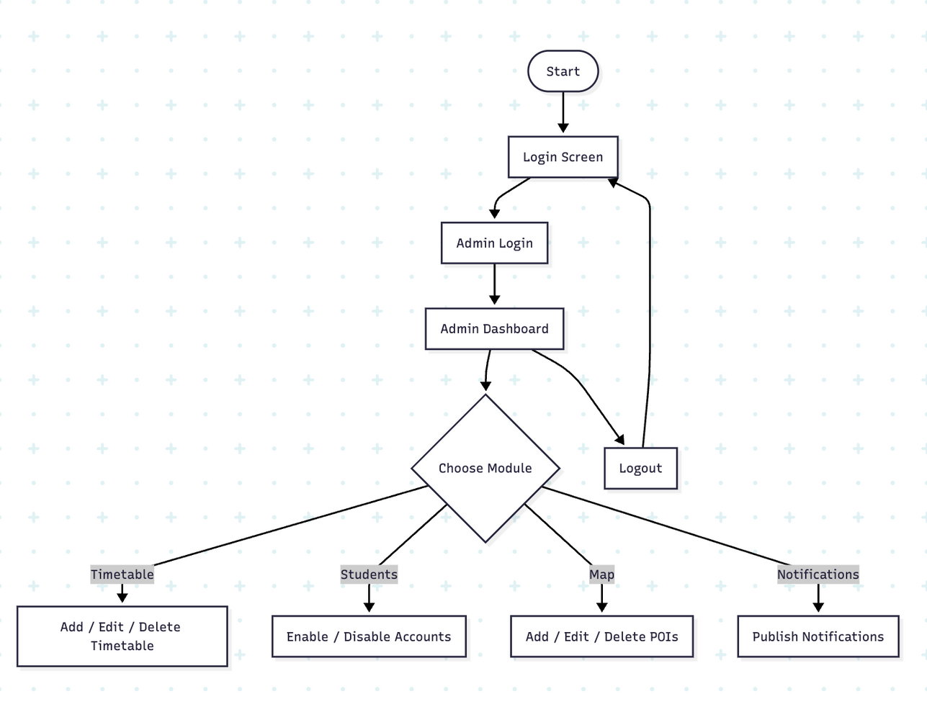
ADMIN

Slide 7
CONTRIBUTIONS
END-TO-END DEVELOPMENT
ADMIN INTERFACE
FOCUS ON ACCESSIBILITY AND UX
Designed and implemented a fully functional mobile application using Flutter (Dart) for the frontend and Firebase for backend services.
Developed an administration module allowing account management, timetable editing, map updates, and notification posting.
Prioritized step-free routes and intuitive UI design to ensure usability for a diverse student population.
USER-CENTRIC FEATURES
SYSTEM INTEGRATION
RESEARCH AND DESIGN CONTRIBUTION
Integrated voice search, live bus tracking, step-free routes, personalized timetables, and notifications to improve campus navigation and accessibility.
Successfully combined real-time data (maps, weather, schedules) into a single, seamless platform.
Conducted background research on Human-Computer Interaction (HCI) and mobile navigation systems to inform design decisions.

Slide 8






RESULTS
PUSH NOTIFICATIONS
FIRESTORE INTEGRATION
Connected dynamic data for saved routes, location details, and user settings.
Enabled live push notifications.
Bus API IntEGRATION
ADMIN DASHBOARD
Built an interface for managing maps, schedules, and user activity.
Implemented live Centre Bus tracking for campus shuttles.
VoicE SEARCH
SAVED ROUTES
Added saved searches for quick access.
Implemented and integrated the speech-to-text feature for hands-free navigation.

Slide 9

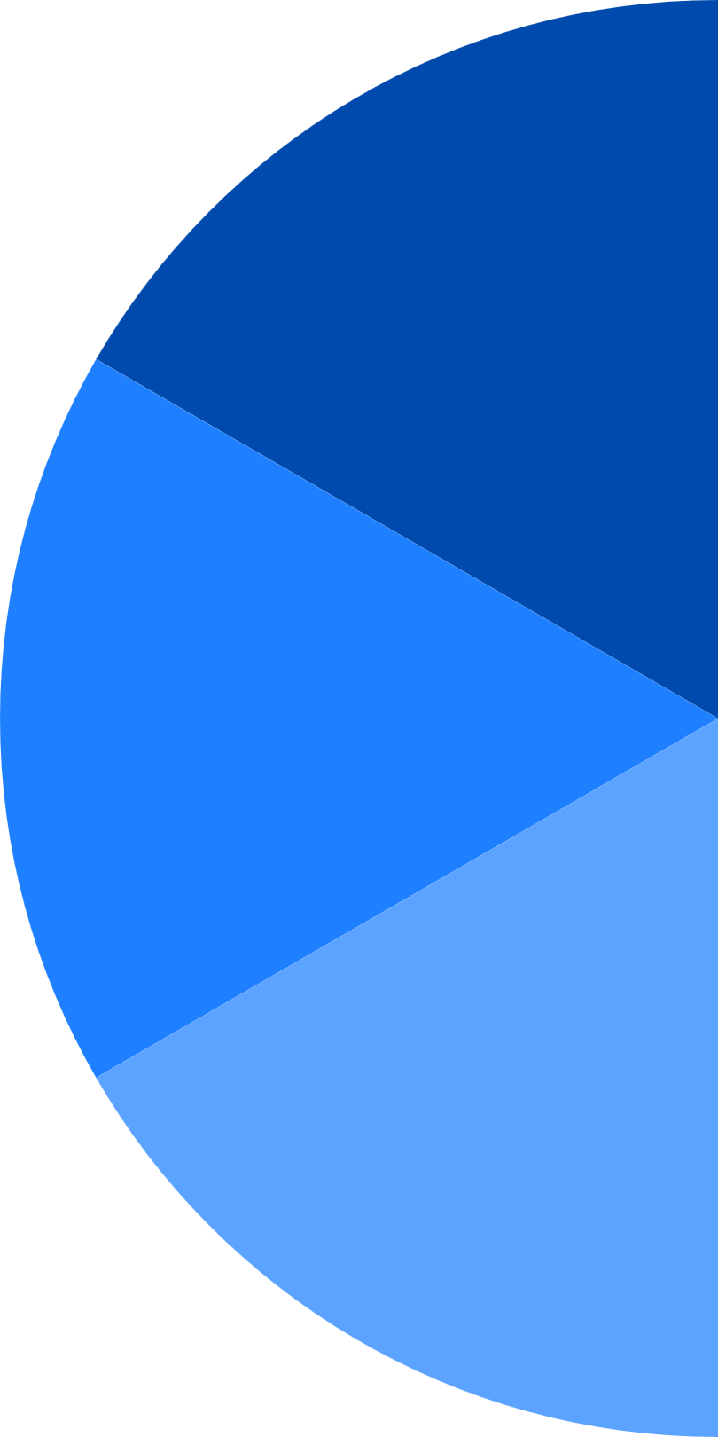
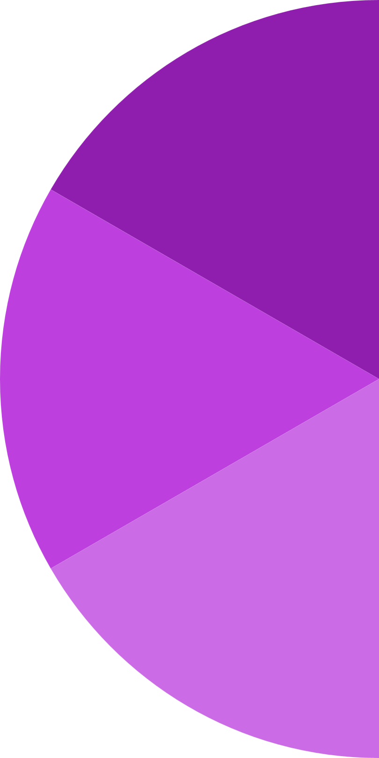


TARGET KPIS
1
4
faster access to timetable info compared to searching university websites.
account security ensured with Firebase Authentication.
85%
100%
2
5
80%
95%
reduction in confusion for new students when finding lecture halls
notification delivery success for campus alerts via Firebase Cloud Messaging
90%
85%
3
6
accuracy in real-time bus arrival updates through integration with live data
voice search success rate

Slide 10
CONCLUSION
  Because students obviously love guessing lecture halls and juggling five apps, we built one Android app that actually unifies maps, weather, timetables, live buses, and step-free routes.
  Flutter + Firebase handle the real-time, secure, scalable bits, while the admin console keeps maps, timetables, and alerts sane.
  Result: faster access, fewer wrong turns, accurate ETAs, and voice search that works—so getting to class is the easy part for once.

