Slide 1
INTER PROCESS COMMUNICATION
BY :
SACHIN DEV(2021A1R102)
ISHAN BHAT(2021A1R103)
PRERIT MUJOO(2021A1R098)
GOKUL PANDEY(2021A1R096)
Notes:
We designed this template so that each member of the project team has a set of slides with its own theme. Members, here’s how you add a new slide to just your set:
Mark where you want to add the slide: Select an existing one in the Thumbnails pane, click the New Slide button, then choose a layout. The new slide gets the same theme as the other slides in your set.
Careful! Don’t annoy your fellow presenters by accidentally changing their themes. That can happen if you choose a different theme from the Design tab, which changes all of the slides in the presentation to that look.

Slide 2
Table of Contents
What is Inter Process Communication
Methods of IPC
How we are using it
Writers Program
Readers Program
Output
Applications of IPC

Slide 3
What is Inter Process Communication(IPC)
Inter Process Communication (IPC) is used for programs to communicate data to each other and to synchronize their activities.
IPC is a method for two or more separate programs or processes to communicate with each other. This avoids using real disk-based files and the associated I/O overhead to pass information

Slide 4
Methods of IPC
Using Pipes
Using FIFO
Using Message Queue

Slide 5
How we are using it
We are using message queue method for this.
A Message queue is a linked list of messages stored within the kernel and identified by a message queue identifier.
System calls used for message queues:
ftok(): is use to generate a unique key.
msgget(): either returns the message queue identifier for a newly created message queue or returns the identifiers for a queue which exists with the same key value.
msgsnd(): Data is placed on to a message queue by calling msgsnd().
msgrcv(): messages are retrieved from a queue.
msgctl(): It performs various operations on a queue.

Slide 6
Writers Program
#include <stdio.h>
#include <sys/ipe.h>
#include <sys/msg h>
#include <stdlib.h>
#include <string.h>
#include "queue.h"
void report_and_exit(const char* msg) {
perror(msg);
exit(-1);
{
int main()
key_t key = ftok/PathName ProjectId).
if (key<0) report_and_exit("couldn't get key...");

Slide 7
Writers Program(Contd.)
int qid = msgget(key, 0666 IPC_CREAT)
if (qid <0) report_and_exit("couldn't get queue id...");
char payloads[] = ["msg1", "msg2", "msg3", "msg4", "msg5", "msg6"} int types[] (1, 1, 2, 2, 3.3%) ;
for (i=0; i<MsgCount; i++)
queuedMessage msg.
msg.type = types[i].
strepy(msg.payload, payloads[i]):
msgsnd(qid, &msg, sizeof(msg), IPC_NOWAIT)
printf("%s sent as type "in", msg payload, (int) msg.type).
return 0;
}

Slide 8
Readers Program
#include <stdio.h>
#include <sys/ipc.h>
#include <sys/msg.h>
#include <stdlib.h>
#include "queue.h"
void report_and_exit(const char* msg) {
perror(msg).
exit(-1)
{
int main()
key_t key=ftok(PathName ProjectId);
if (key<0) report_and_exit("key not gotten..."); int qid = msgget(key, 0666 IPC_CREAT);
if (qid <0) report_and_exit("no access to queue_").

Slide 9
Readers Program
int types[]=(3,1,2, 1, 3.2), int i;
for (i=0; i<MsgCount; i++) queuedMessage msg.defined in queue.h
if (msgrev(qid, &msg, sizeof(msg), types[1], MSG_NOERROR IPC_NOWAIT)<0) puts("msgrev trouble..."). printf("%s received as type "in" msg payload, (int) msg type),
remove the queue
if (msget(qid IPC_RMID, NULL)<0) / NULL - 'no flags" */
report_and_exit("trouble removing queue").
return 0;
}

Slide 10
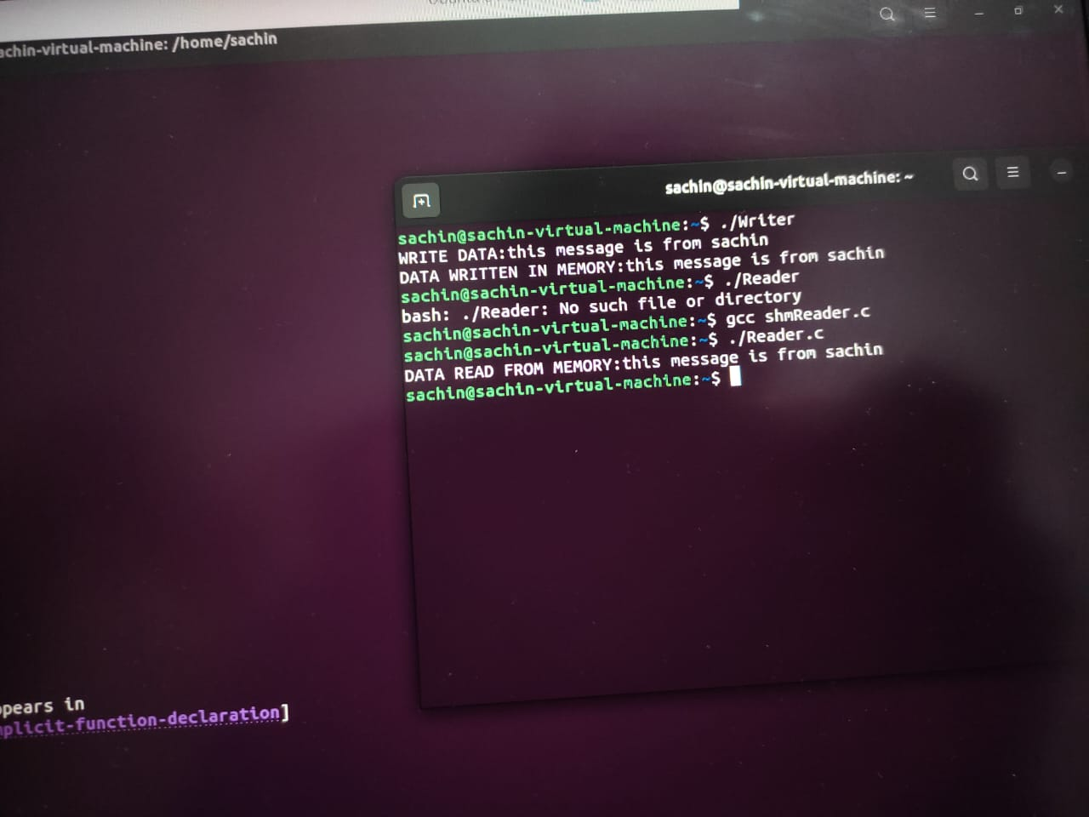
Output

Slide 11
Applications of IPC
IPC is mainly used to exchange data in between several threads within a single or multiple programs/processes.
IPC is one type of mechanism that allows programs to interact with each other & synchronize their actions.
IPC is essential in the design process of microkernels & nanokernels decrease different functionalities which are provided through the kernel. After that, these functionalities are attained by interacting with servers through IPC.
IPC is the key for an application design like a set of co-operating process handles one well-defined fraction of the whole.

Slide 12
THANK YOU!

