Slide 1
INTRODUCTION TO INTEL GALILEO GEN 2 AND ARDUINO PROGRAMMING
ZEENAT SHAREEF

Slide 2
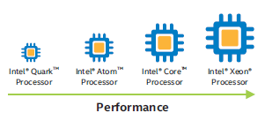
INTEL ARCHITECTURE
Low power and size SoC.
Take priority when lower power and size takes priority. Eg. Intel Galileo
Exceptional computing, graphics and media performance.
Low power and thermally efficient processors for applications performance in small form factor devices. Eg. Intel Edison
Highest computing power, exceptional computing density
Hardware application.

Slide 3
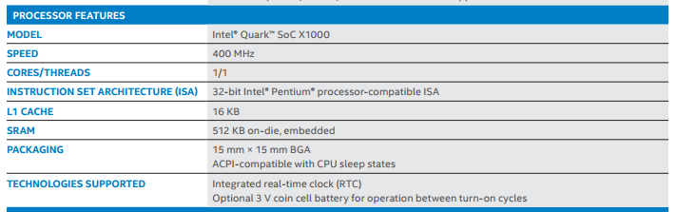
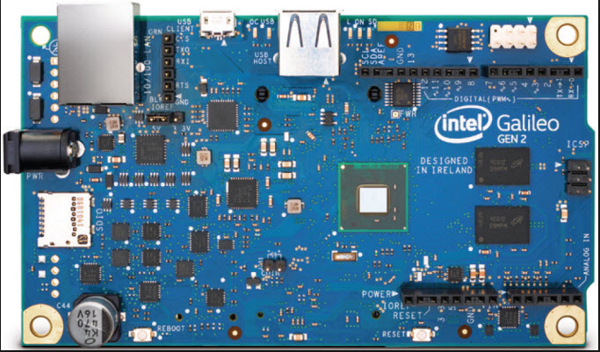
INTEL GALILEO GEN 2
Intel Galileo is the first in a line of Arduino-certified development boards based on Intel x86 architecture and is designed for the maker and education communities. Intel released two versions of Galileo-Gen 1 and Gen 2.
Intel Galileo features the Intel Quark SoC X1000, the first product from the Intel Quark technology family of low-power, small-core products. Intel Quark represents Intel's attempt to compete within markets such as the Internet of Things and wearable computing. Designed in Ireland, the Quark SoC X1000 is a 32-bit, single core, single-thread, Pentium (P54C/i586) instruction set architecture (ISA)-compatible CPU, operating at speeds up to 400 MHz.
Fig 1: Intel Galileo Gen 2 processor features

Slide 4
INTEL GALILEO GEN 2 Intel Quark SoC
Intel Quark is a line of 32-bit x86 SoCs by Intel, designed for small size and low power consumption, and targeted at new markets including wearable devices. Based on Intel Quark X1000, a 32 bit Intel Pentium processor-class system on chip the genuine Intel processor and I/O capabilities,of Intel Gen 2 provide full range of capabilities.
The technical specifications of Intel Quark SoC includes:
Processor Number | X1000
Cache | 16 KB
Instruction Set | 32-bit
Lithography | 32 nm
# of Cores | 1
# of Threads | 1
Processor Base Frequency | 400 MHz
Max Memory Size (dependent on memory type) | 2 GB
Memory Types | DDR3 800
Max # of Memory Channels | 1
Max Memory Bandwidth | 1.6 GB/s

Slide 5
USB Revision | 2.0
# of USB Ports | 3
Total # of SATA Ports | 0
Integrated LAN | 2
Integrated IDE | 0
General Purpose IO | 16
UART | 2
Max # of SATA 6.0 Gb/s Ports | 0
TDP | 2.2 W

Slide 6
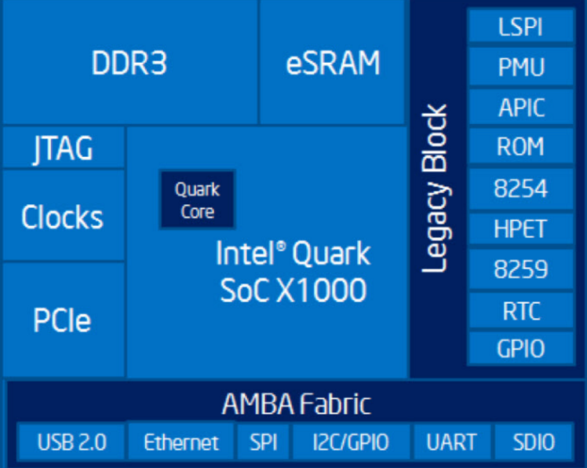
Block diagram of Intel Quark SoC for Intel Galileo Gen 2

Slide 7

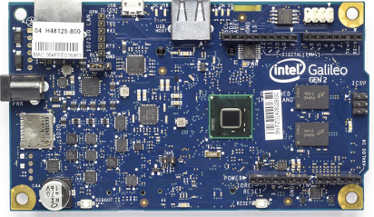
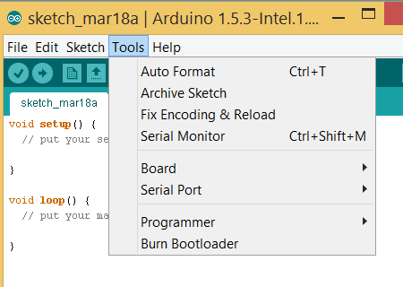
INTRODUCTION TO ARDUINO IDE for Intel Galileo Gen 2
STEPS to use Arduino with Intel Galileo Gen 2
Download the Arduino IDE for Intel. (https://www.arduino.cc/en/Main/Software)
Download the drivers for Intel Galileo Gen 2.
Connect Galileo with your PC via USB cable. First time users get Gadget Serial V.2. Update it.
Open Arduino-Intel IDE.
Tools->Board->Intel Galileo Gen 2
Tools->COM Port
6. Start programming as per your project
USB Port

Slide 8
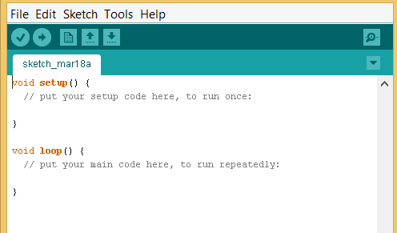
INTRODUCTION TO ARDUINO PROGRAMMING
BASIC STRUCTURE OF ARDUINO PROGRAM
The basic structure of arduino includes two main parts:
void setup()
void loop()
• setup( ): A function present in every Arduino sketch. It is used to set pinmode to input or output, initialize serial. The setup( ) function looks like:
void setup( )
{ //code goes here }
• loop( ):After calling setup function, this function loops consecutively, allowing program to change, respond and control arduino based boards.
The loop( ) function looks like:
void loop( )
{ //code goes here }

Slide 9
INTRODUCTION TO ARDUINO PROGRAMMING
DIGITAL INPUT/OUTPUT
1. pinMode(pin,mode)
Used in void setup() to configure a specific pin to behave as input or output.
Example: int pin1 = 5;int pin2=7;
pinMode(pin1,OUTPUT);
2. digitalRead(pin)
Read the value from a specified digital pin with the result either HIGH or LOW.
Example: value=digitalRead(pin2);
3. digitalWrite(pin)
Outputs either logic level HIGH or LOW at a specified digital pin.
Example: digitalWrite(pin1,HIGH);

Slide 10
INTRODUCTION TO ARDUINO PROGRAMMING
ANALOG INPUT/OUTPUT
analogRead(pin)
Reads the value from specific analog pin with 10 bit resolution. The resulting integer value ranges from 0 to 1023.
Example: value= analogRead(A0);
2. analogWrite(pin)
Writes a pseudo analog value using hardware enabled pulse width modulation to an output pin. The value can be specified as variable or constant from 0-255.
A value to zero generates a steady 0 volts output at a specified pin. A value to 255 generated a steady 5 volts output at a specified pin.
Example:analogWrite(pin,value);

Slide 11
INTRODUCTION TO ARDUINO PROGRAMMING
SERIAL
1. serial.begin(rate)
Opens serial port and sets baud rate for serial serial transmission. Typical baud rate for communicating is 9600.
Example:serial.begin(9600);
2. serial.println(Data):
Prints data on serial port.
Example:serial.println(analogValue);
DELAY
Pauses your program for amount of time soecified in ms.
Syntax: delay(ms);
Example: delay(1000);

Slide 12
THANK YOU

