Slide 1
EXPERIMENT Interfacing switch and button with Intel Galileo Gen 2 and ring the buzzer when switch is pressed
Zeenat Shareef, PhD Scholar
Department of Computer Science
IGDTUW

Slide 2
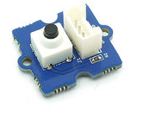

INTRODUCTION
In this experiment, we will send ring the sensor when switch is pressed.
GROVE SWITCH
GROVE BUZZER
REQUIREMENTS
HARDWARE:
Intel Galileo Gen 2
Power Cable
USB cable
Base shield of grove kit
Switch of grove kit
buzzer of grove kit
SOFTWARE:
Arduino1.5.3-Intel.1.0.4
Intel Galileo driver

Slide 3
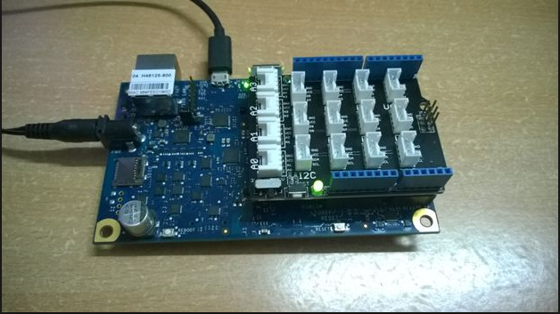
INTERFACING DIAGRAM
GND
VCC
NC
OUTPUT
GND
VCC
NC
OUTPUT
SWITCH
BASE SHIELD-GROVE KIT
BUZZER

Slide 4
CODE
int buz = 3;
int but=4;
void setup()
{
pinMode(buz, OUTPUT);
pinMode(but, INPUT);
}
void loop()
{
int sensorValue = digitalRead(4);
if(sensorValue == 1)
digitalWrite(buz,HIGH);
else
digitalWrite(buz,LOW);
}
WORKSHOP ON INTEL IOT / 19.03.2016

Slide 5
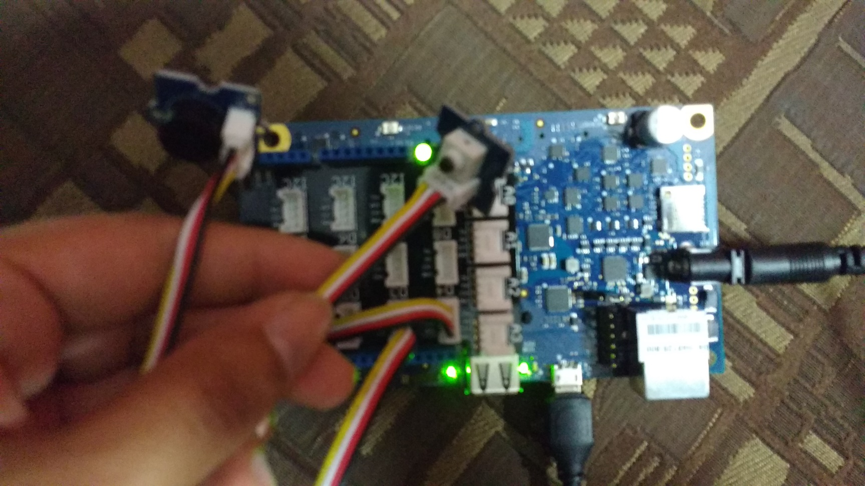
OUTPUT and SCREENSHOTS
buzzer
Button
ACTUAL DEPLOYMENT

