Slide 1
EXPERIMENT Displaying sensor value on LCD
Zeenat Shareef, PhD Scholar
Department of Computer Science
IGDTUW

Slide 2
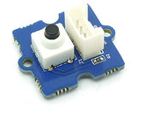
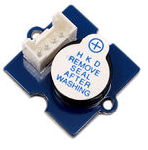
INTRODUCTION
In this experiment, we will display sensor value on grove LCD.
GROVE SWITCH
GROVE BUZZER
REQUIREMENTS
HARDWARE:
Intel Galileo Gen 2
Power Cable
USB cable
Base shield of grove kit
sensor of grove kit
LCD of grove kit
SOFTWARE:
Arduino1.5.3-Intel.1.0.4
Intel Galileo driver

Slide 3
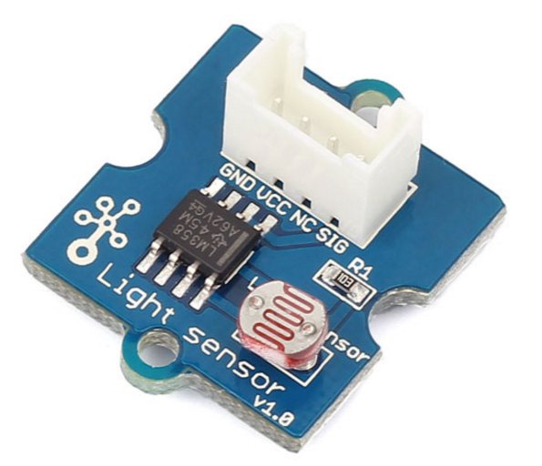
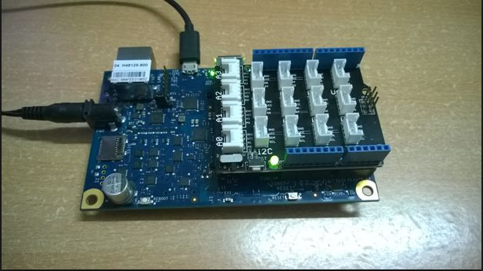
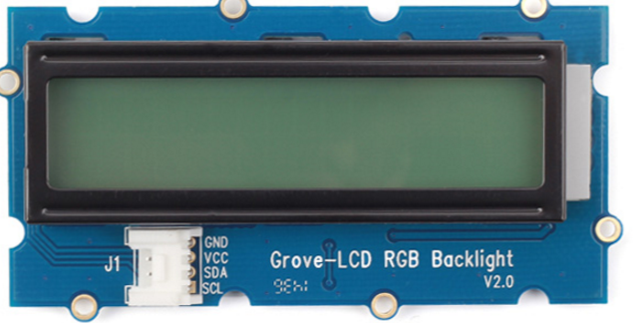
INTERFACING DIAGRAM
GND
VCC
NC
OUTPUT
GND
VCC
SDA
SCL
SENSOR
BASE SHIELD-GROVE KIT
LCD

Slide 4
CODE
#include <math.h>
#include <Wire.h>
#include "rgb_lcd.h"
rgb_lcd lcd;
const int colorR = 255;
const int colorG = 0;
const int colorB = 0;
float Rsensor;
void setup()
{
// set up the LCD's number of columns and rows:
lcd.setRGB(colorR, colorG, colorB);
lcd.begin(16, 2);
delay(1000);
}
void loop()
{int sensorValue = analogRead(0);
Rsensor=(float)(1023-sensorValue)*10/sensorValue;
lcd.setCursor(0, 1);
lcd.print(Rsensor);
delay(100);
}

Slide 5
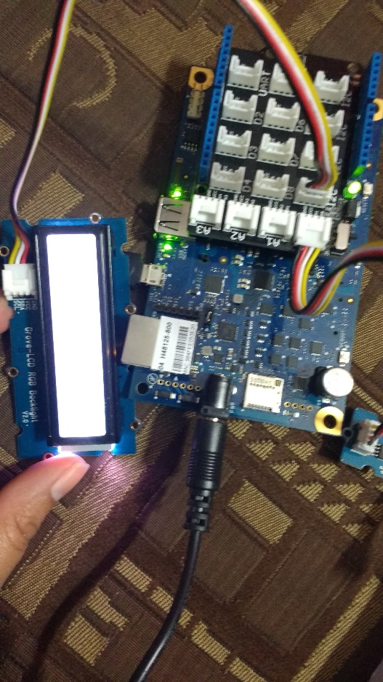
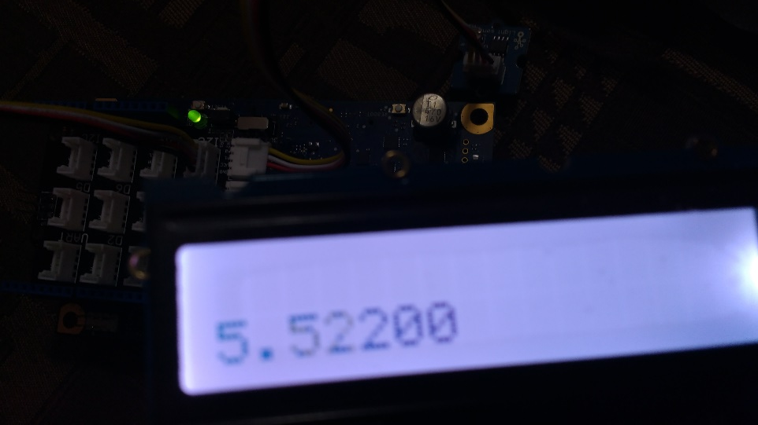
OUTPUT and SCREENSHOTS
SENSOR
LCD
ACTUAL DEPLOYMENT

