Slide 1
EXPERIMENT Interfacing temperature sensor with Intel Galileo Gen 2 and displaying data on serial monitor
Zeenat Shareef, PhD Scholar
Department of Computer Science
IGDTUW

Slide 2
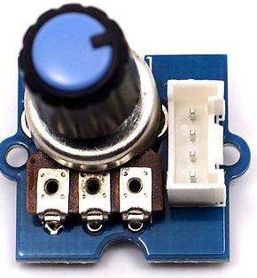
INTRODUCTION
In this experiment, we will send temperature sensor data from Intel Galileo Gen 2 to SPP manager through Bluetooth HC - 05
TEMPERATURE SENSOR
The Grove temperature sensor uses a thermistor to determine the ambient temperature. The detection range of this sensor is between -40 to 125 degrees Celsius with an accuracy of ±1.5℃
REQUIREMENTS
HARDWARE:
Intel Galileo Gen 2
Power Cable
USB cable
Base shield of grove kit
Temperature sensor of grove kit
Bluetooth HC 05
SOFTWARE:
Arduino1.5.3-Intel.1.0.4
Intel Galileo driver

Slide 3
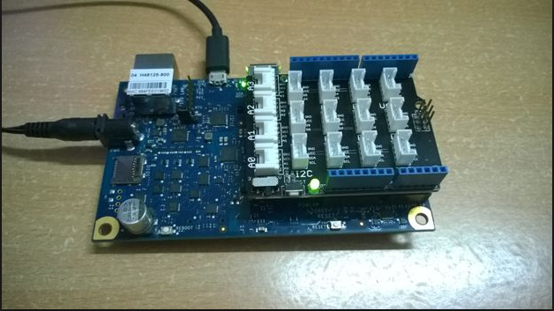
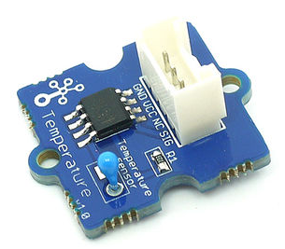
INTERFACING DIAGRAM
GND
VCC
NC
OUTPUT
TEMPERATURE SENSOR
BASE SHIELD-GROVE KIT
A1 Input

Slide 4
CODE
int a;
int del=1000; // duration between temperature readings
float temperature;
int B=3975; //B value of the thermistor
float resistance;
void setup()
{
Serial.begin(9600);
}
void loop()
{
a=analogRead(1);
resistance=(float)(1023-a)*10000/a;
temperature=1/(log(resistance/10000)/B+1/298.15)-273.15;
delay(del);
Serial.println(" The temperature reading is ");
Serial.println(temperature);
delay(1000);
}

Slide 5
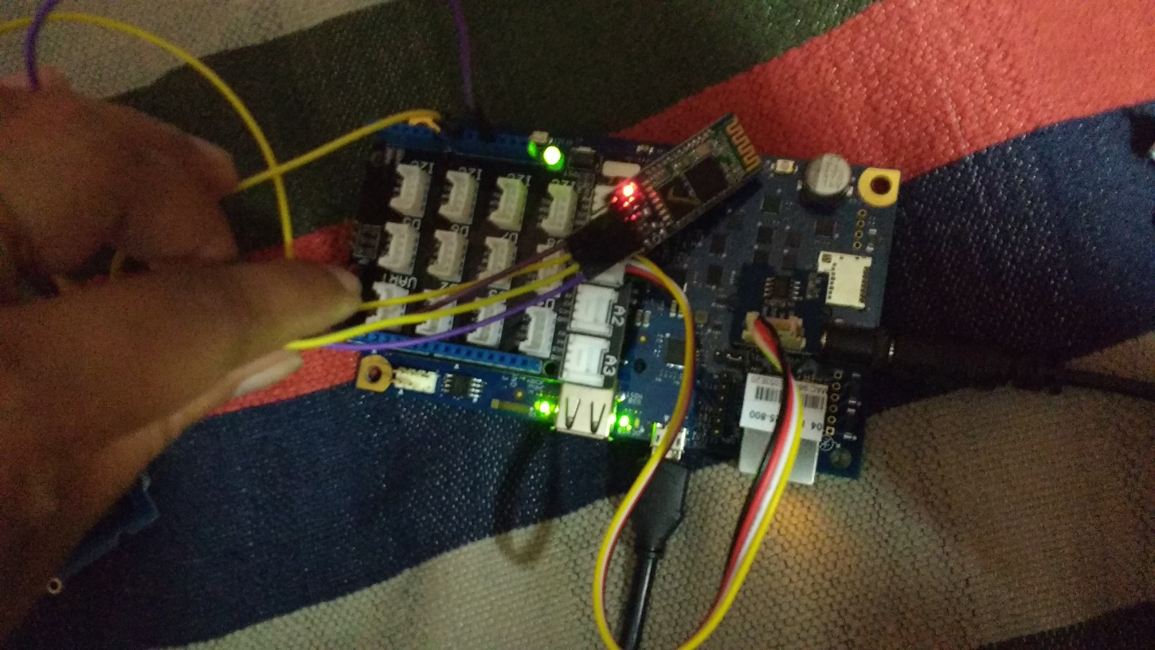
OUTPUT and SCREENSHOTS
BLUETOOTH
TEMPERATURE SENSOR
ACTUAL DEPLOYMENT

