Slide 1

Smart Cradle

Slide 2
Abstract
Child growth and development is a continuous process that needs utmost monitoring. Growth can be retrogressive or progressive. In the modern world, infants (within age limit 24 months) face under- nourishment or poor nutrition which escapes in the regular examination by medical practitioners. This hinders the normal growth curve thus making the child prone to diseases. WHO provides certain parameters to determine a child’s growth rate (length- weight, weight- age, length-age) which helps them to record and draw a growth chart. This database is the key base to provide diagnosis and prognosis for any medical condition the child is suffering from. The other reason behind the substandard growth rate is inefficient track of vaccines given to the child. Our project aims at providing world with a method to identify the poor or anomalous growth rate of child by WHO standards and rectifying it by providing certain instructions and suggestions. The ideology behind the project is to provide a healthy and well monitored childhood
.

Slide 3
Weight & Length Calculation

Slide 4
Using sensors for measurement
For measuring baby’s length we are going to use an ultrasonic sensor. And for the measurement of weight, we are going for a load sensor.
As per the design of our product, we are planning to incorporate both these sensors in the baby’s craddle itself.
Due to the unavailabilty of load sensor right now, we have used the value of average weight in our code for the time being.

Slide 5

Comparing with WHO standards

Slide 6
The Growth Charts
Length for age
On the length-for-age chart, the child’s age in months is along the bottom (x-axis) and the child’s length (in centimeters) is up the left side (y-axis). Children are considered to be stunted when their length-for-age falls below the -2 z-score line.
Weight for age
On the weight-for-age growth chart, the child’s age in months is along the bottom (x-axis) and the child’s weight (in kilograms) is up the left side (y-axis). Children are considered underweight if their weight-for-age falls below the -2 z-score line.
Weight for Length
On the weight-for-length growth chart, the child’s length (in centimeters) is along the bottom (x-axis) and the child’s weight (in kilograms) is up the left side (y-axis). Children with weight-for-length falling below the -2 z-score line are considered to be wasted

Slide 7
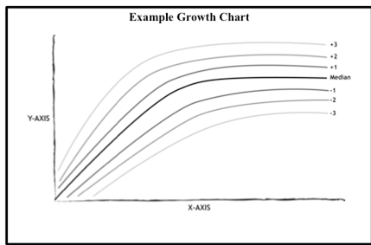
We have used weight for length chart here
Weight-for-length is used typically for children 0-24 months, whereas weight-for-height is used for older children who are able to stand up on their own. It can be very difficult to accurately assess weight-for-length for infants less than 55 cm long. Children with weight-for-length falling below the -2 z-score line are considered to be wasted. Wasting is a major cause of mortality in children under 5, so children assessed as being “wasted” need immediate medical attention. Children with weight-for-length above the +2 z-score line are considered overweight and may be at risk for child obesity.

Slide 8
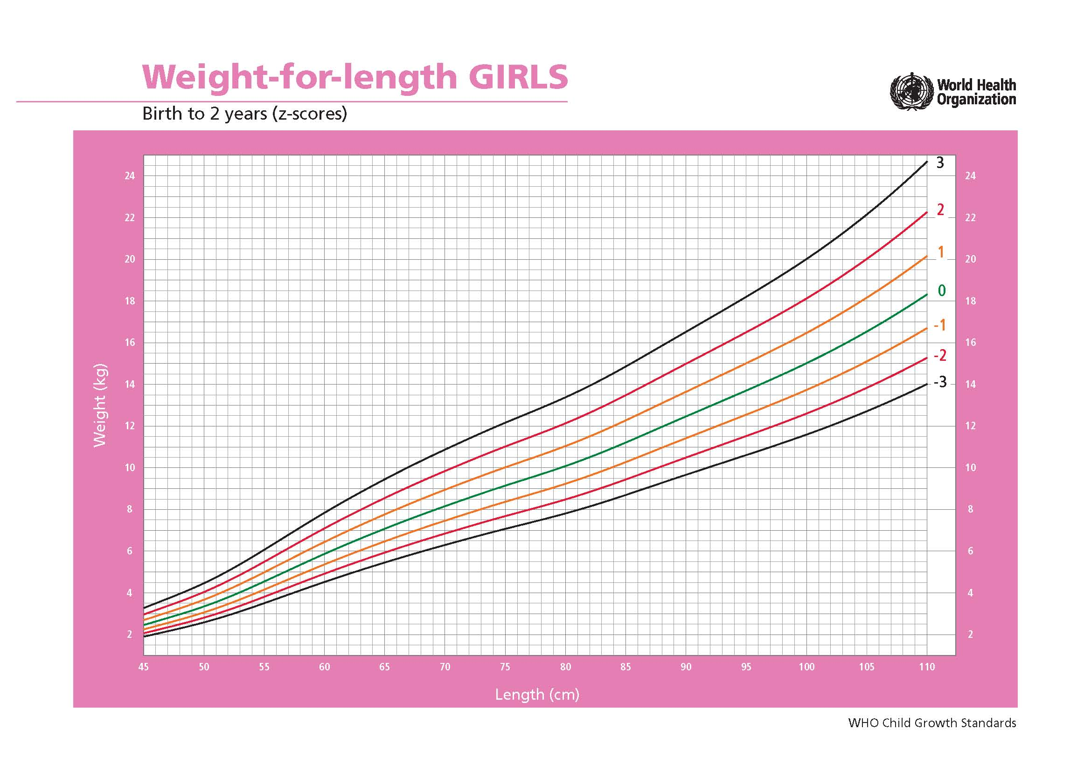

Slide 9
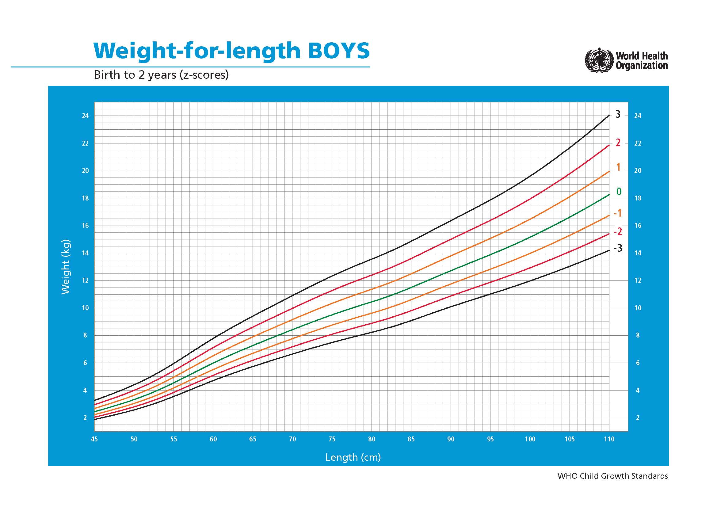
Use charts to explain your ideas
Yellow
Blue
Red

Slide 10
Displaying result
By comparing the recorded weight and length against WHO standards, the calculated result is displayed on the LCD
Child is underweight

Slide 11
Additional Features
Discussing some additional features of our project

Slide 12
Baby crying alert system

Slide 13
If the baby starts crying in the absence of parents, a message via Bluetooth is send to the parent’s device alerting him/her that the baby is crying.
Also the lights in baby’s room are switched on if they were off.
To implement the above, we have made use of a sound sensor, an LDR sensor and an LED respectively.
Baby is crying.

Slide 14
Baby monitoring system : Using a camera

Slide 15

Also in the near future, we are planning to install a camera on the craddle so that parents can monitor their kid anytime from anywhere.

Slide 16
Thanks!
That’s all for now.

Slide 17
Credits
Group 7
Dilsheen Kaur
Prerna Singh
Tripti Saini

