Slide 1
CAPSTONE PROJECT
Submitted By: Prerna Bajaj
Email: PBB532941@tatamotors.com

Slide 2
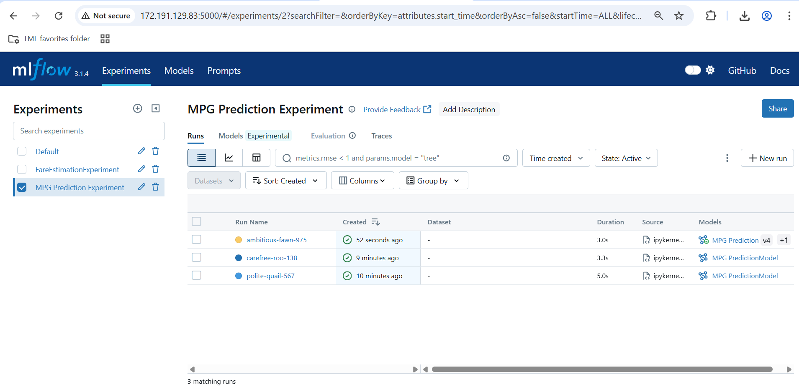
Screenshot depicting experiment created to predict MPG (MLFlow)

Slide 3
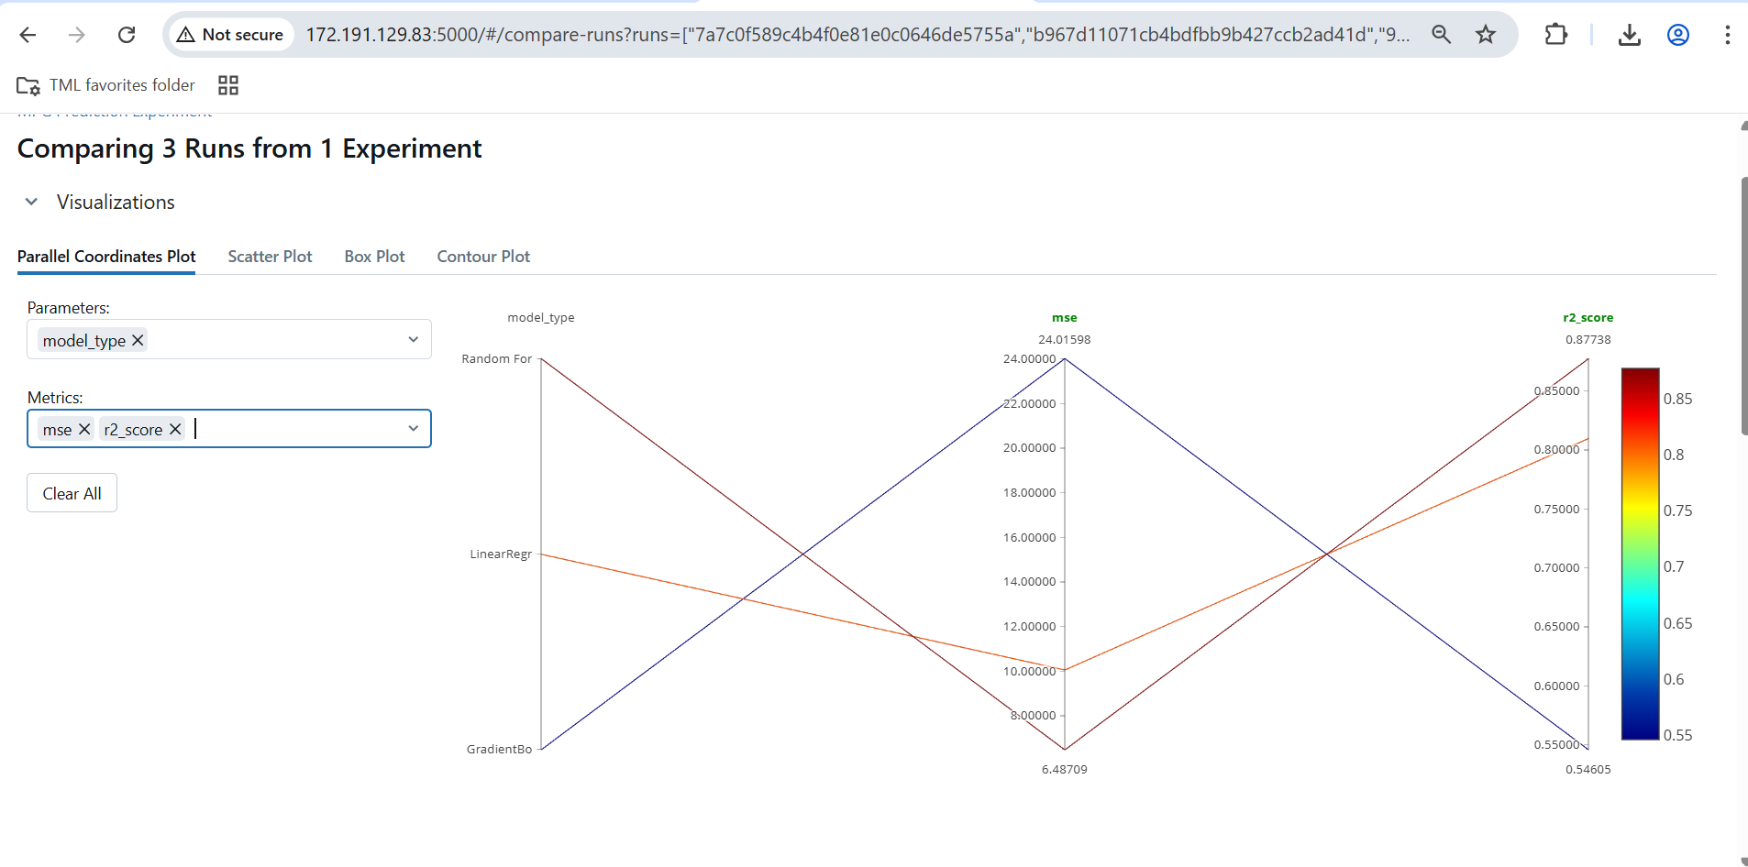
Screenshot depicting comparison of 3 models
Random Forest is the best model with lowest mse and highest r-square

Slide 4
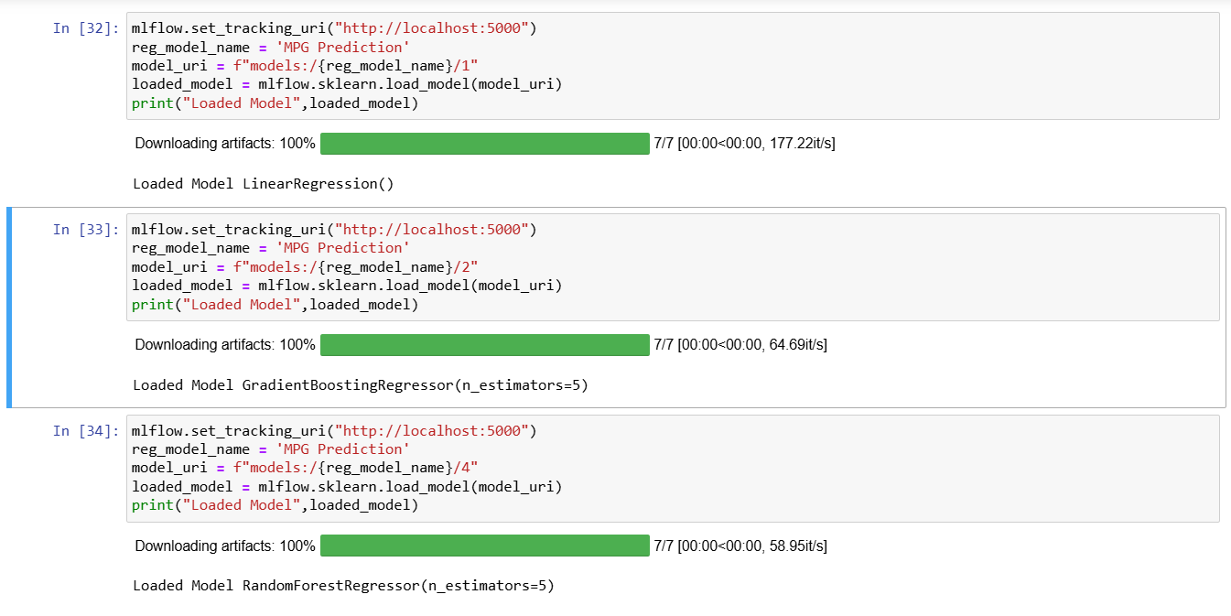
Screenshot depicting loading of model versions in MLFlow

Slide 5
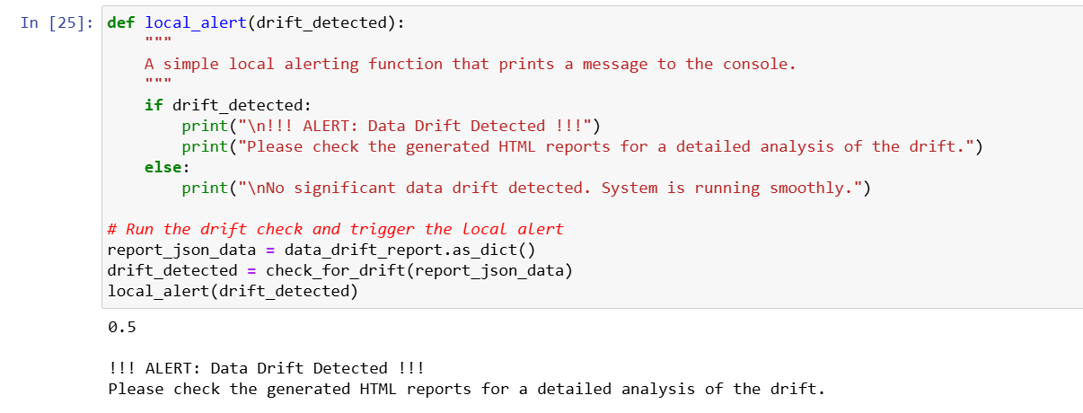
Screenshot depicting data drift

Slide 6
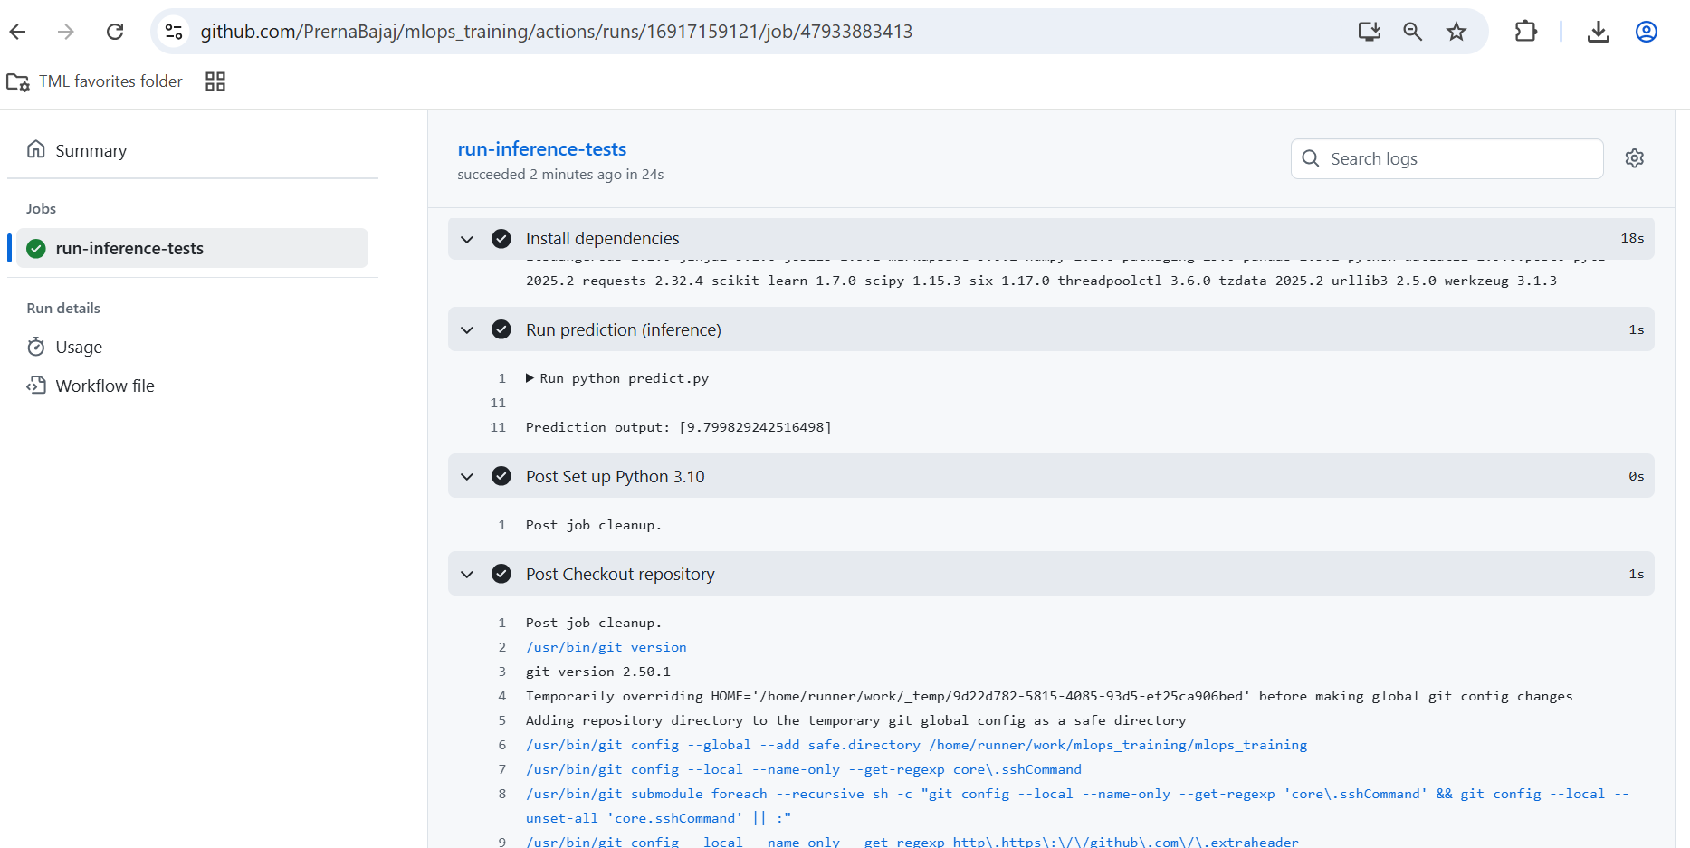
Screenshot depicting deployment of Random Forest Regressor model in github

Slide 7
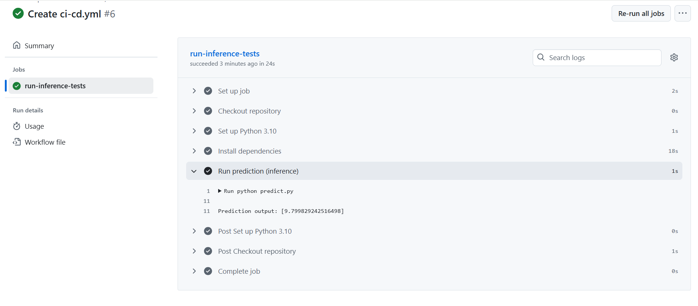
Screenshot depicting prediction output of Random Forest Regressor model

Slide 8
THANK YOU

