Slide 1
DEVELOPMENT SUPPORT TOOLS ECLERX
Name: PRERNA BHATIA
Regis. No.: 11611526

Slide 2
About ECLERX
Eclerx Digital
Eclerx Financial Market
Eclerx Customer Operations
Internship Duration: 1 year
Location: Airoli, Mumbai

Slide 3
Web Page Module
Bootstrap
HTML/CSS
JavaScript
JQuery

Slide 4


Slide 5

Gulp.JS
Gulp is a toolkit for automating tasks.
4,075 Gulp Plugins.
1000+ companies using Gulp.
Simple usage

Slide 6
Plugins
gulp-sass
gulp-clean-css
gulp-concat-css
gulp-spritesmithe
gulp-imagemin

Slide 7
KOA.JS
Registration API
Login API
Password Hashing
Http request and post method validation

Slide 8
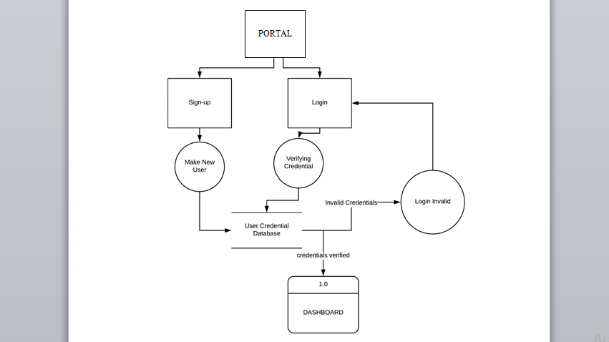
Login and Register Flow Chart

Slide 9
MongoDB
Store data in database
Reading Data from Database
Post method and Validation

Slide 10
Thank You!!!!

