Slide 1

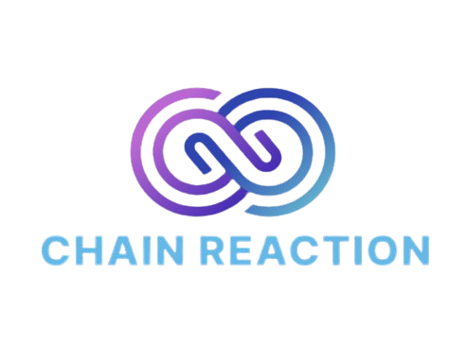
An error is not an event it’s a Chain Reaction!
Team Members
Prerna Narendra Kumar
Nikita Pandey
Sonali Singhal
Vaidehee Salunkhe
Rutuja Udhane

Slide 2
ChAIn Reaction
Problem
Customers
Key Metrics
Manual impact analysis of code changes is slow, deeply dependent on experts, and highly error-prone. Developers spend hours inspecting diffs, tracing dependency chains, and trying to understand how changes propagate across large multi-repo systems.
Developers, tech leads, architects, and enterprise software teams
QA engineers, release managers, and DevOps teams
Impact Coverage
Time to production
Graph Completeness
Risk Hotspots Identified
AI Explanation Accuracy
Solution
Unique Value Proposition
Channels
ChAIn-Reaction – A platform that builds a unified enterprise graph spanning microservices, data stores & middleware.
The UI visualizes this structure for exploration, impact propagation, and even manual addition of edges where tribal knowledge exists.
On a pull request, it computes the impact from the graph and uses AI to explain it clearly.
ChAIn-Reaction combines AST parsing, graph theory, and LLM interpretation to provide an end-to-end view of how changes ripple across a system’s entire software landscape.
Extensible plug-in architecture lets new languages and system types be added without touching the core
Shows how any change ripples across services, databases, queues, and shared libraries in seconds.
Helps architects spot fragile clusters & high-dependency services that drive systemic risk.
AI turns complex graph insights into clear, actionable explanations for teams.
Effective time to production with minimal learning curve.
Model integrated directly into the GitHub Pull Request workflow, where developers already review and approve changes.
Supported by a lightweight web dashboard to explore dependency graphs, impact summaries, and cross-repo relationships in more detail.
1

Slide 3
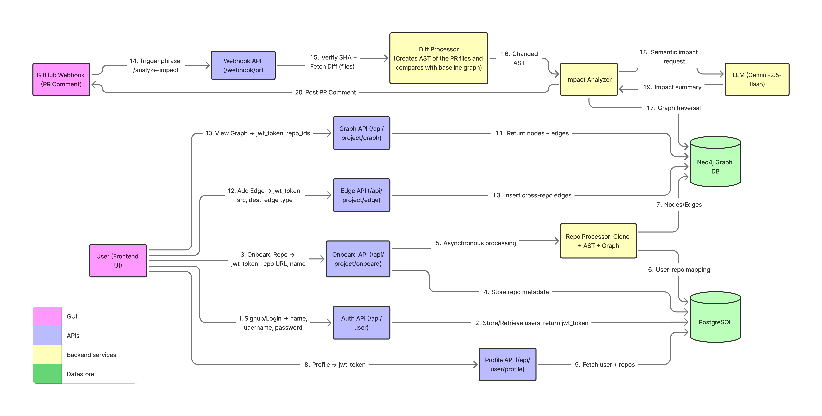

Slide 4
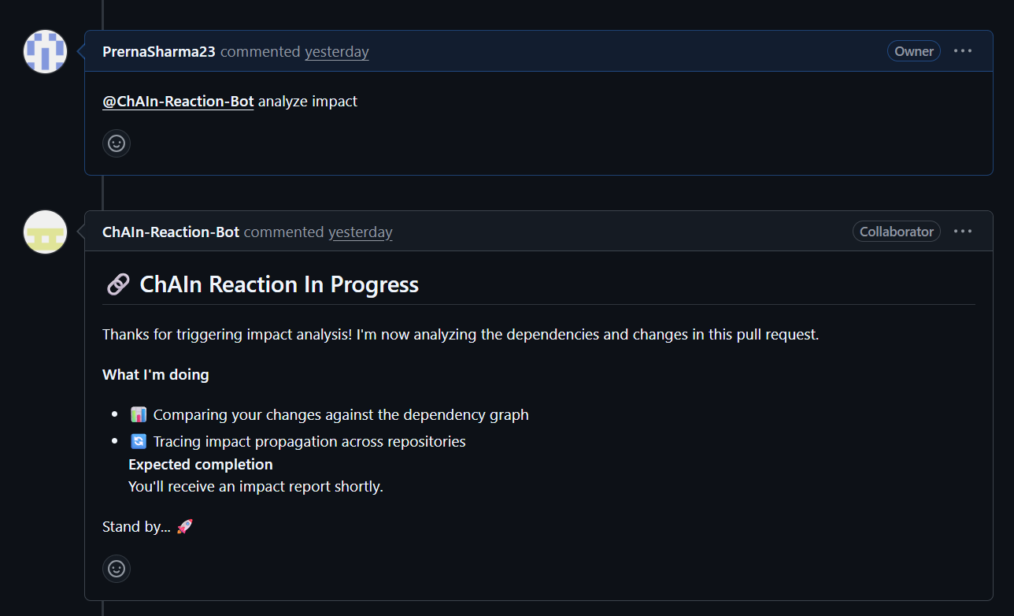
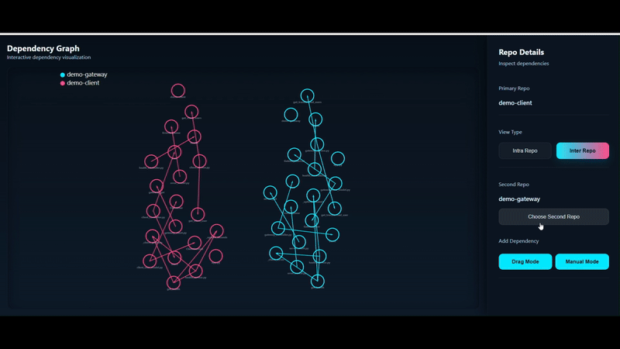
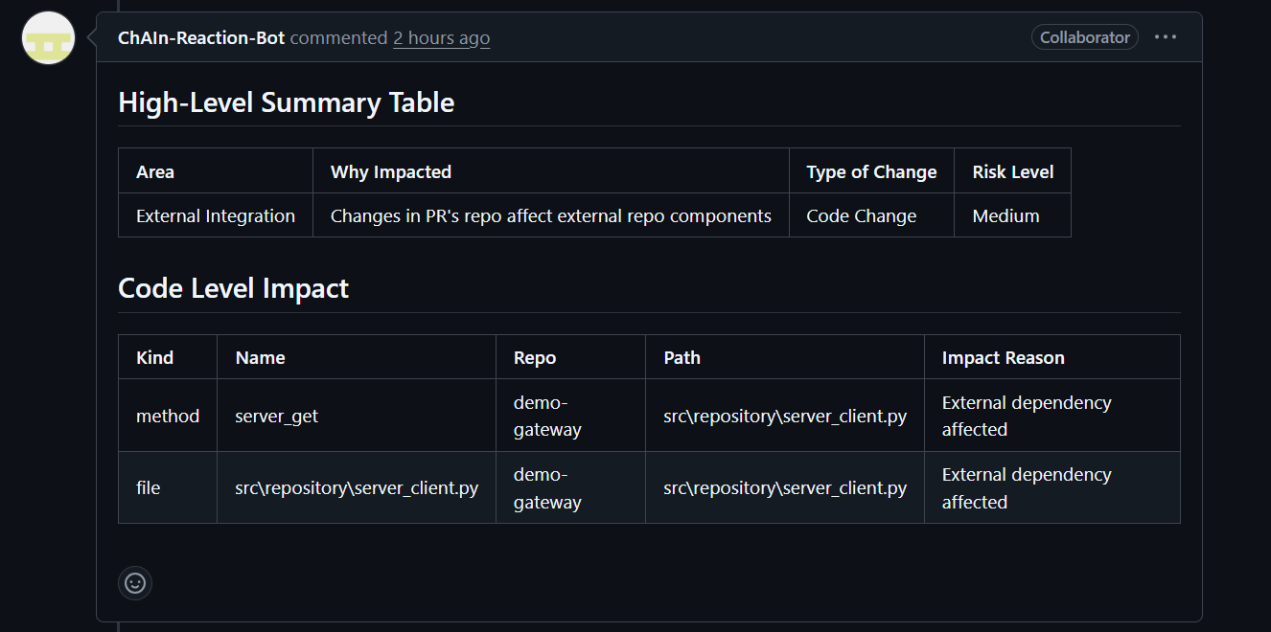
Outcomes
Comment ‘Analyze Impact!’ on the pull request of your version control platform to get a clear impact analysis explained by an AI helper.
Find out cross repo or complete impact by one comment!
Visualize Chain Reaction upon modification of any node and identify risk hotspots and inter-dependent clusters!
Fig 1. Pull request impact analysis by chain reaction
Fig 2. Chain Reaction UI for onboarding repo and dependency analysis

Slide 5
An error is not an event it’s a Chain Reaction!
Thank You!

