Slide 1
A Prediction Service
For Remos and QuO
Peter A. Dinda
CMU SCS

Slide 2
Outline
Bette Davis
Remos in QuO
Peter’s Prediction Service in Remos
Software abstractions
Implementation
Example

Slide 3
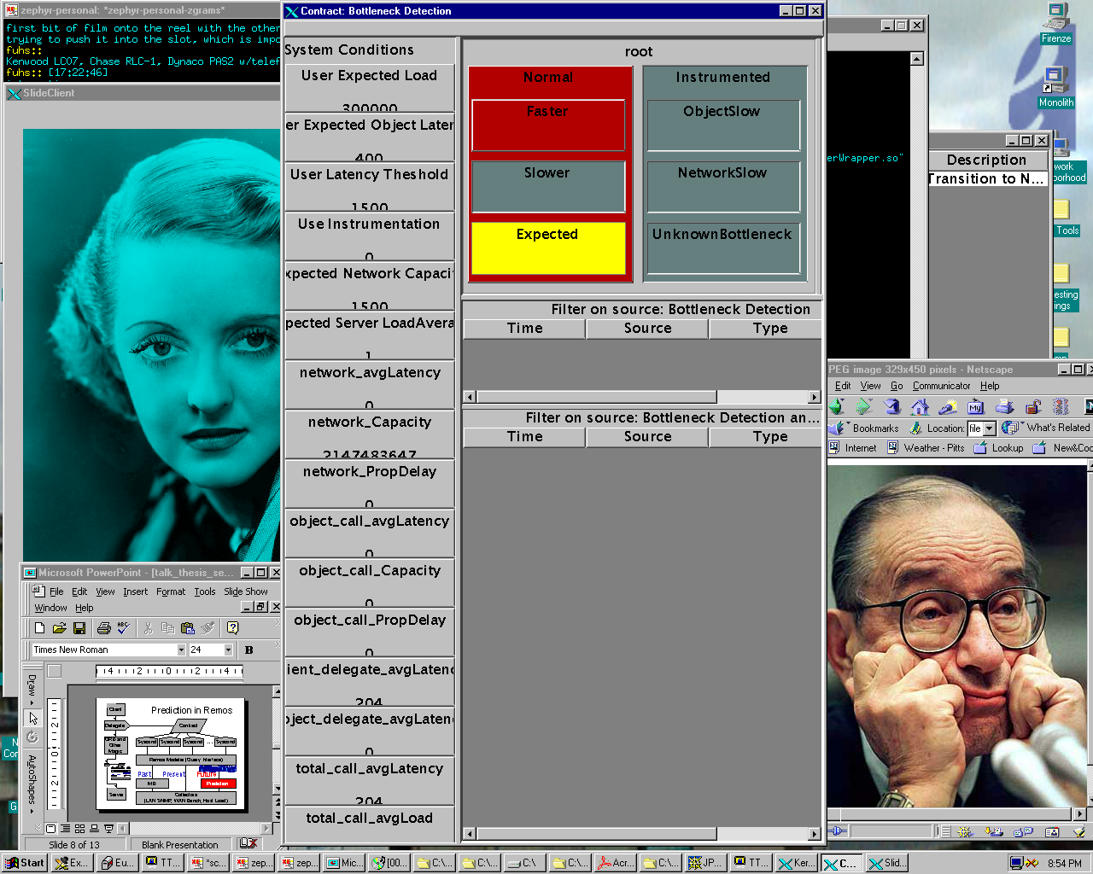
Bette Davis “Hello World” Program
Choose whether to fetch a small or large image from the Bette Davis Server based on predicted network and host load
3 Systems (BBN QuO, CMU Remos, Peter’s Prediction Service)
10 Programming Languages (i386 assembly, C, C++, Java, Fortran 77, CORBA IDL, BBN SDL, BBN CDL, Perl, Sh)
Network and Host Load Predictions

Slide 4
Abstract Model of QuO
Client
Delegate
Contract
ORB and
Other
Magic
Syscond
Syscond
Syscond
Syscond
Delegate
Contract
Syscond
Syscond
Syscond
Syscond
Server

Slide 5
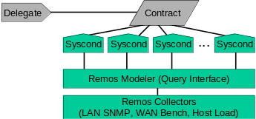
Remos in QuO
Client
Delegate
Contract
ORB and
Other
Magic
...
Syscond
Syscond
Syscond
Syscond
Impedence Mismatch
Remos Modeler (Query Interface)
Remos Collectors
(LAN SNMP, WAN Bench, Host Load)
Server

Slide 6
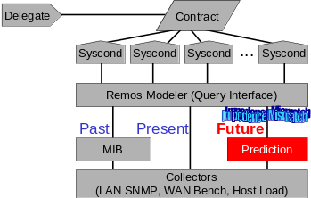
Prediction in Remos
Client
Delegate
Contract
ORB and
Other
Magic
...
Syscond
Syscond
Syscond
Syscond
Remos Modeler (Query Interface)
Remos Modeler (Query Interface)
Impedence Mismatch
Past
Present
Future
MIB
Prediction
Server
Collectors
(LAN SNMP, WAN Bench, Host Load)

Slide 7
What is this Impedence Mismatch?
Queries
Prediction Pipeline
(Inherently
Stream Oriented)
Measurement
Stream

Slide 8
PPL: Peter’s Prediction Library
Abstractions
Implementations
Data Sequence
Modeler
Best Mean, AR, MA, ARMA, ARIMA, ARFIMA
Model
Best Mean, AR, MA, ARMA, ARIMA, ARFIMA
Data
Stream
Prediction Stream
Predictor
EtaTheta
Data path
Evaluator
Statistical Metrics
Creates

Slide 9
A Prediction Service For Remos 1/2
Buffer
Trigger Refit
Statistical
Metrics
Modeler
z’_{t+2,t+2+m}
z’_{t+1,t+1+m}
Evaluator
...
z’_{t,t+m}
Model
...
...
...
z’_{t+2,t+4}
z’_{t+1,t+3}
z’_{t,t+2}
...
z’_{t+2,t+3}
z’_{t+1,t+2}
z’_{t,t+1}
...
Predictor
Predictor
z_{t}
...
z_{t+2}
z_{t+1}
z_{t}
z_{t+1}
z_{t+2}
...
Output Measurement
And Prediction Stream
Measurement Device (eg, Collector)

Slide 10
A Prediction System For Remos 2/2
Remos Modeler
Present and
Near Past Queries
Remos Modeler
Future Queries
Buffer
Buffer
Output Measurement
And Prediction Stream

Slide 11
Implementation Goals
Completely flexible component placement
Flexible communication
  No CORBA/Java/Whatever dependence
  Support most internet protocols (UDP, TCP, Multicast, pipes, files, etc)
Portability
  No CORBA, no threads, no Java, minimal Unix assumptions
    Lessons learned after initial CORBA, LDOS implementation attempts

Slide 12
The Mirror C++ Template Class 1/2
UDP Streams
Handler
UDP Streams
TCP Streams
Handler
TCP Streams
File Streams
Handler
File Streams
Pipes
Handler
Data Forwarder
Pipes
Timed Callbacks
Handler
Callbacks
TCP Stream
Connection Reqs
Handler
TCP Req/Resp
Connection Reqs
Req Resp
Handler
TCP
UDP
Handler
Server

Slide 13
The Mirror C++ Template Class 2/2
Parameterized by handlers
Default handlers for 2 kinds of Mirrors
  Raw Data
  Serializeable Objects
And several behaviors
  Buffering, Req/Resp, Compute-on-input

Slide 14
Example: Measurement Buffer 1/2
template <class SOURCEHANDLER,class SOURCECONNECTHANDLER,class REQUESTRESPONSEHANDLER, class REQUESTRESPONSECONNECTHANDLER> class Mirror : public AbstractMirror {…}
template <class SERIN, class COMPUTE, class SEROUT> class GenericSerializeableInputComputeOutputMirror : public SerializeableMirror<SERIN, SerializeableMirrorInputComputeOutputHandler<SERIN,COMPUTE,SEROUT>, GenericMirrorNewConnectionHandler,NullHandler, NullHandler> {};
template <class SERIN> class BufferingSerializeableMirror : public SerializeableMirror<SERIN,SerializeableMirrorInputHandler<SERIN>,GenericMirrorNewConnectionHandler, BufferDataRequestResponseHandler<SERIN>, GenericMirrorNewRequestResponseConnectionHandler> {…}
typedef BufferingSerializeableMirror<Measurement> MeasureBuffer;

Slide 15
Example: Measurement Buffer 1/2
MeasureBuffer mirror(depth);
for (i=2;i<argc;i++) {
ep = new EndPoint;
if (ep->Parse(argv[i])) { exit(-1); }
mirror.AddEndPoint(*ep);
}
mirror.Run();
Server
Reference<BufferDataRequest,BufferDataReply<Measurement>> ref;
BufferDataRequest req;
BufferDataReply<Measurement> repl;
ref.ConnectTo((new EndPoint())->Parse(argv[2]));
req.num=num;
ref.Call(req,repl)
for (i=0;i<repl.num;i++) {
repl.data[i].Print(stderr);
}
Client

Slide 16
Command Lines From Hell
Measure Load and streams to stdout, multicast, connected TCP sessions
% loadserver 1000000 target:file:stdout connect:tcp:5000 target:udp:239.99.99.99:5000 |
load2measure 0 source:file:stdin connect:tcp:5001 target:file:stdout |
measurebuffer 100 source:file:stdin target:file:stdout server:tcp:5002 |
predserver 8 source:file:stdin target:file:stdout connect:tcp:5003 target:udp:239.99.99.99:5003 |
predbuffer 100 source:file:stdin target:file:stdout server:tcp:5004 |
predclient source:file:stdin
Accept stream from stdin, make generic, stream to TCP and stdout
Buffer stdin stream, stream to stdout, accept tcp requests for buffer contents
Predict stdin stream 8 steps ahead, stream preds to stdout, TCP, and multicast
Buffer predictions from stdin, stream to stdout, accept tcp requests for buffer contents
Accept stdin pred stream and print

Slide 17
Meeting Implementation Goals
Completely flexible component placement
  Mostly, yes
  Open implementation issues: Instantiation and naming problem: Who instantiates components, how do we find them, etc
    This is really a Remos/QuO issue - we all need to solve it
    Database?
Flexible communication
  Yes. You name it, you can communicate with it on as many channels as you want
Portability
  Yes. You only need g++ 2.7.2 or later or similar C++ compiler
  Running on: Linux, FreeBSD, Solaris, DUX

Slide 18
Zukunft
Finish integration with Remos
  Partially me
Finish integration of Remos with QuO
  NOT ME
Address instantiation and naming problem
  Database? Globus?
  NOT ME
Use prediction service to dynamically map a RT interactive application and show benefits
  DV, OpenMap, DynBench, Feature tracking...
  ME ME ME

Slide 19
Vergangenheit
Host load study (LCR98, SciProg99)
  Self-similarity, epochal behavior, etc.
Study of linear models for host load prediction (TR 98-174, sub. to HPDC99)
  Statistical statement: “AR(16) models or better are appropriate for Host Load Pred”
Initial flailing on applications (WPDRTS99)

