Slide 1
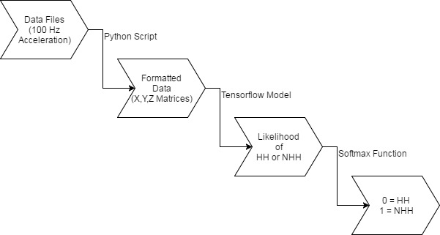
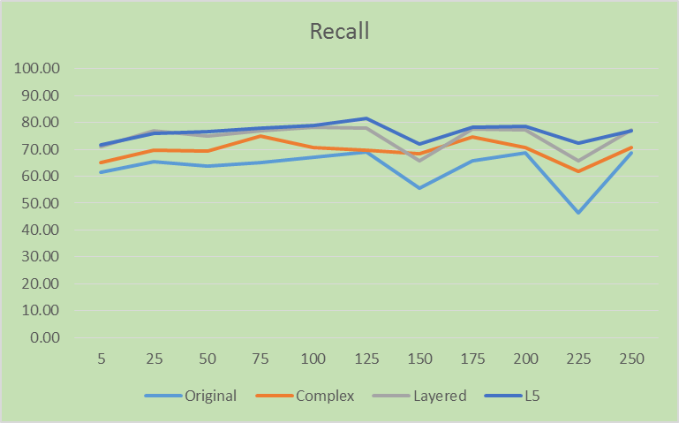
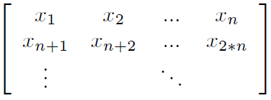
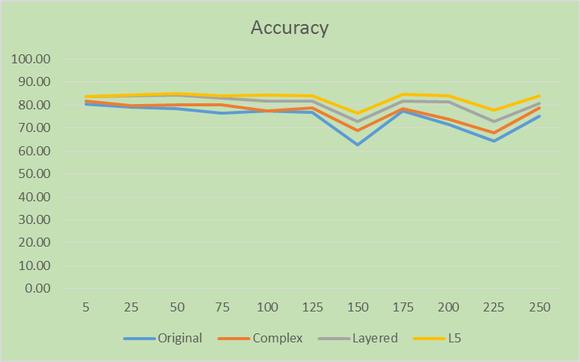
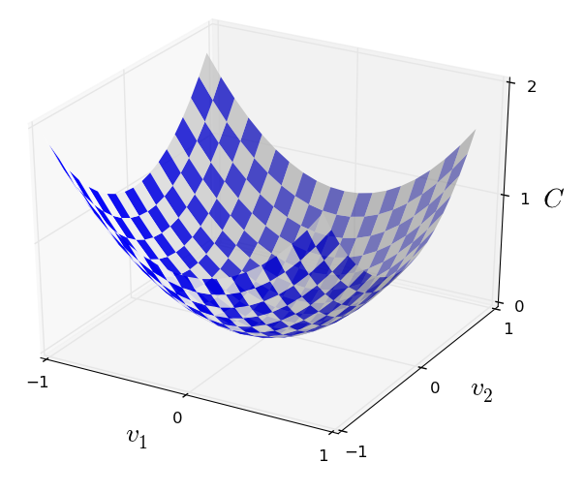
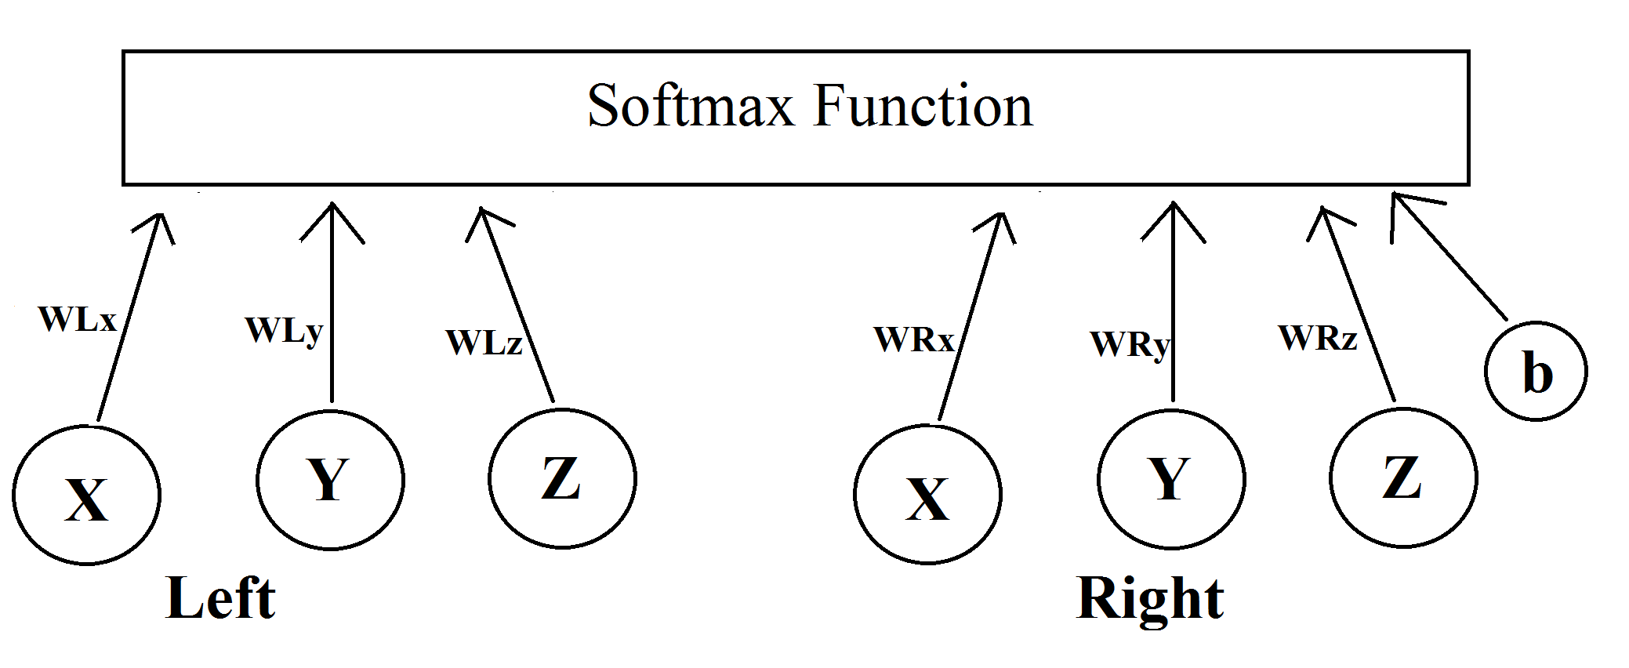
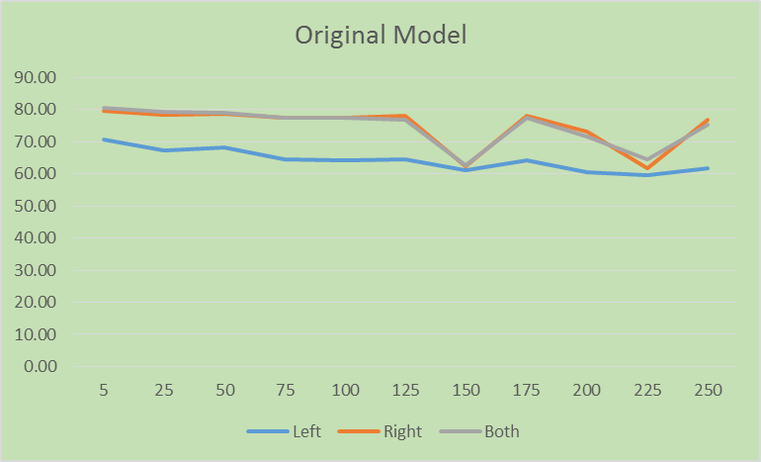
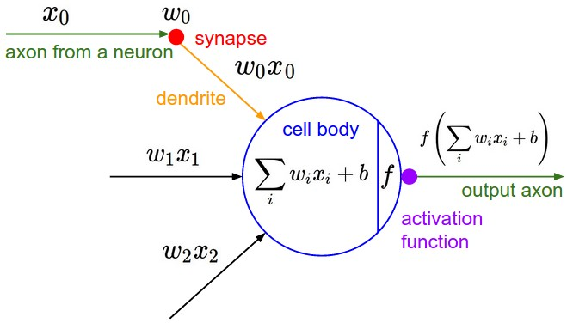
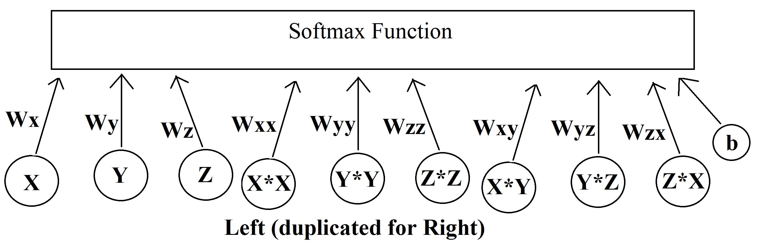
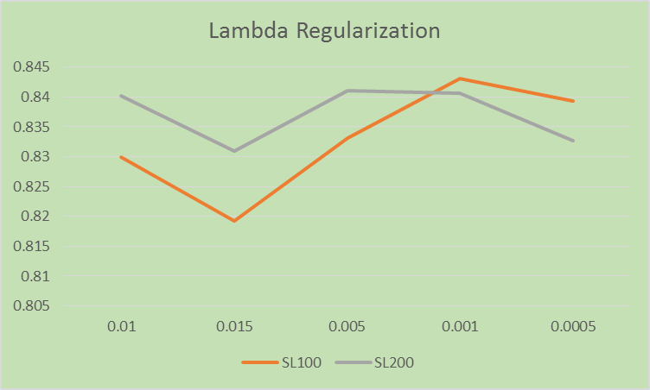
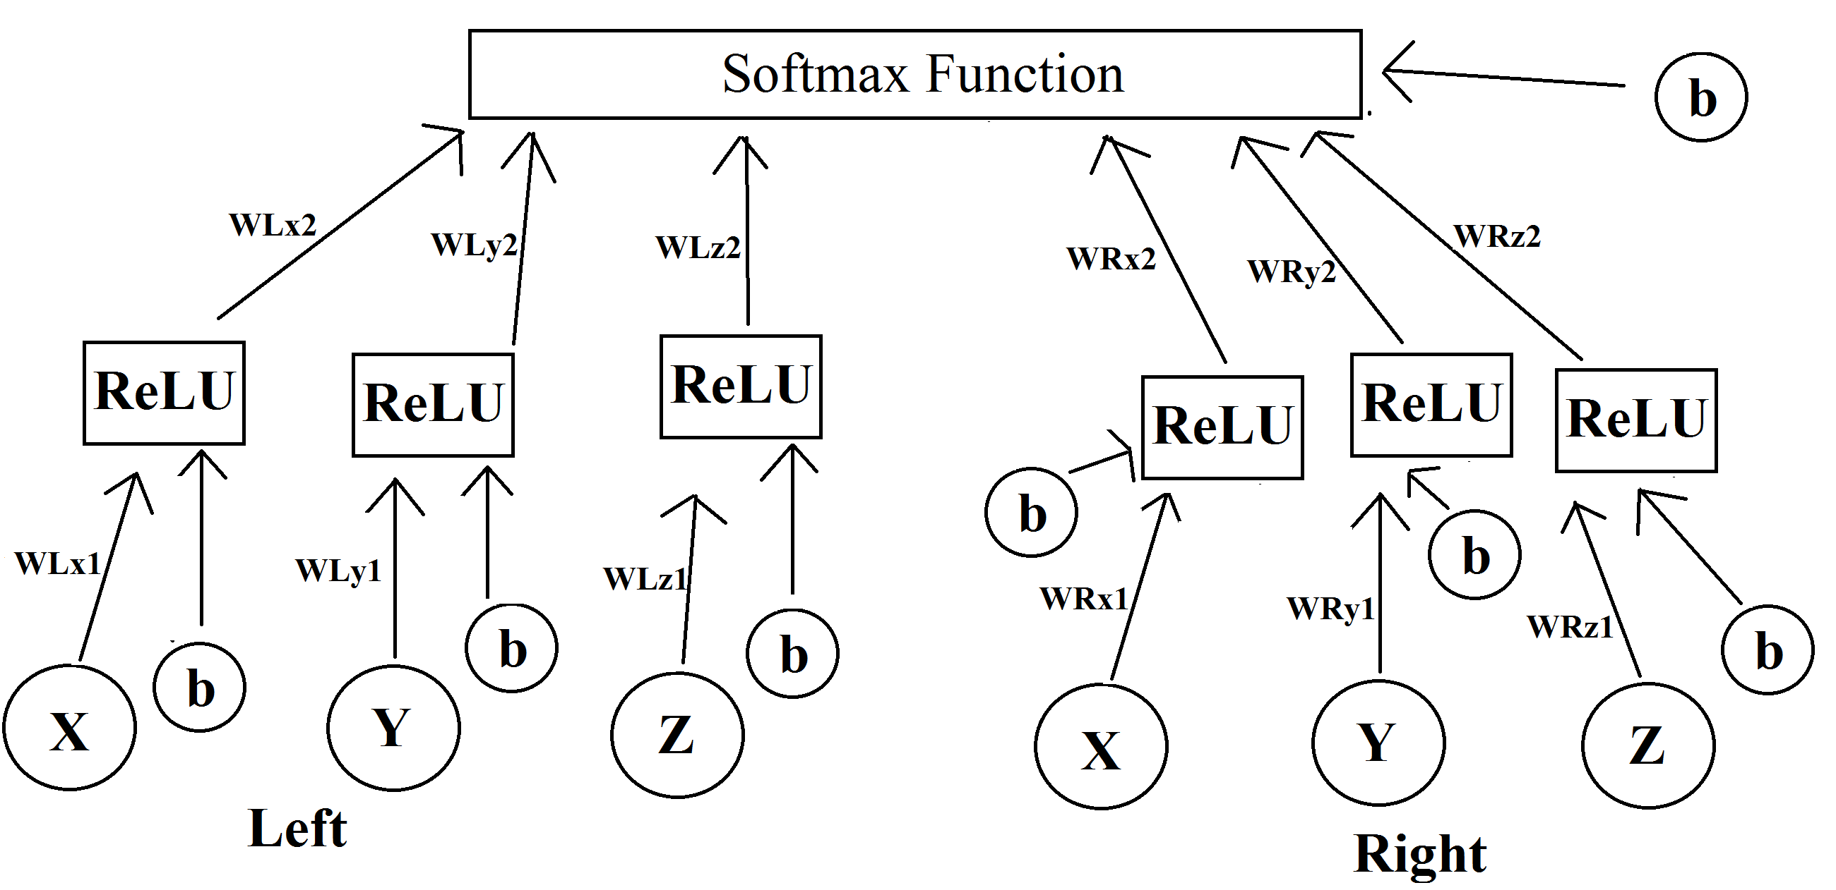
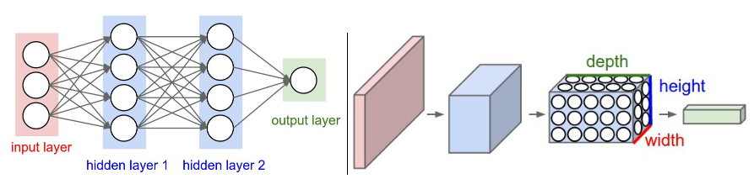
Identifying Hand Hygiene Using Neural Networks James Edwards Advised by Dr. Galluzzi and Dr. Boutell
My Data
My project works with wrist acceleration data, taken from what are essentially custom Fitbits. Healthcare workers washed their hands, tied their shoes, walked around normally, and performed other activities, and the wrist acceleration was captured at 100 Hz.
Pipeline
The final product of my project is to have a Python program which is given a file of time-stamped wrist acceleration data and outputs a list of times corresponding to when the system judges that the user is washing his or her hands.
Results
Overall a shorter window length produced better results. This idea makes sense because longer window lengths may miss certain periodic motions of hand hygiene.
Deep Learning Basics
The object of deep learning is to model complex systems by a series of matrix multiplications.
Models
Selected References
V. Galluzzi, “Automatic Recognition of Healthcare Worker Hand Hygiene,” Ph.D. dissertation, Comput. Sci., University of Iowa, Iowa City, IA, 2015.
Michael A. Nielsen, “Neural Networks and Deep Learning”, Determination Press, 2015.
Andreas Bulling, Ulf Blanke, and Bernt Schiele. A tutorial on human activity recognition using body-worn inertial sensors. ACM Comput. Surv., January 2014.
Ian Goodfellow, Yoshua Bengio, and Aaron Courville. Deep Learning. MIT Press, 2016. http://www.deeplearningbook.org.
Yann LeCun, Yoshua Bengio, and Georey Hinton. Deep learing. Nature, 521:436-444, May 2015.
Michael A. Nielsen. Neural Networks and Deep Learning. Determination Press, 2015.

