Slide 1
Identifying Hand Hygiene with Deep Learning
James Edwards

Slide 2
Motivation
Healthcare
Deep Learning
Wrist Sensor Acceleration Data
Notes:
Way of explaining the pipeline between input and output – diagram (remind more)

Slide 3
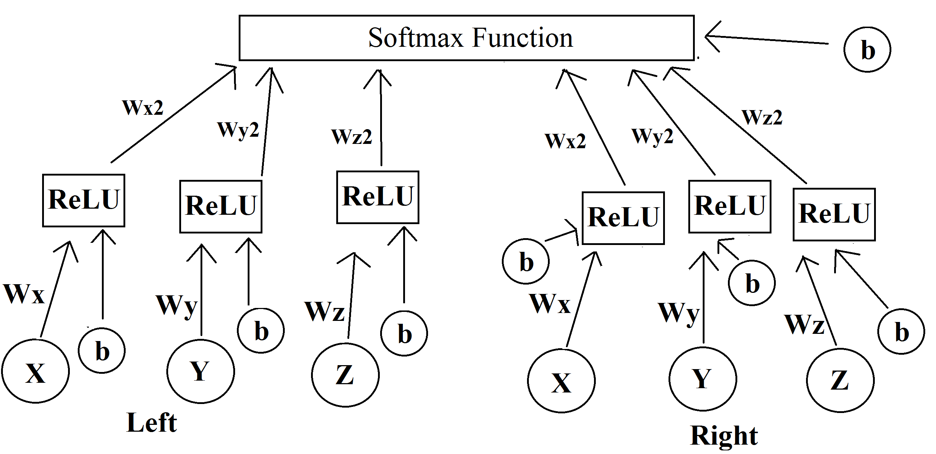
Model
Layered → Layered5
Notes:
--numerical results?

Slide 4
Continuing Steps
Unlabeled Data
Literature Review
Video/Picture
Accelerometer
Healthcare
Notes:
--talk about what I’ve reviewed (Themes, content, identify how it relates to work / (or not) )
--how many

Slide 5
Questions?

