Slide 1
COMPSO: Optimizing Gradient Compression for Distributed Training with Second-Order Optimizers
Luddy School of Informatics, Computing, and Engineering
Baixi Sun¹, Weijin Liu², J. Gregory Pauloski³, Jiannan Tian¹, Jinda Jia¹, Daoce Wang¹, Mingkai Zheng⁴, Sheng Di⁵, Sian Jin⁶, Zhao Zhang⁴, Xiaodong Yu², Guangming Tan⁷, Dingwen Tao⁷
¹Indiana University
²Stevens Institute of Technology
³University of Chicago
⁴Rutgers University
⁵Argonne National Laboratory
⁶Temple University
⁷University of Chinese Academy of Sciences
30th ACM SIGPLAN Annual Symposium on Principles and Practice of Parallel Programming (PPoPP 2025)
Notes:
Collaborating

Slide 2
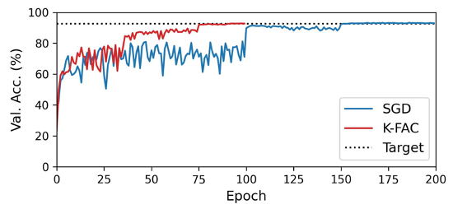
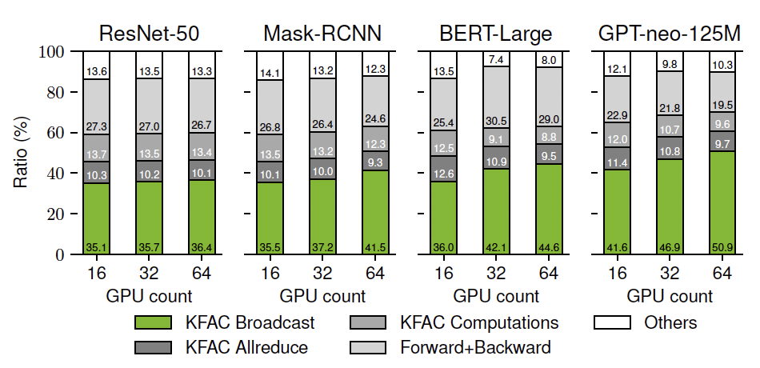
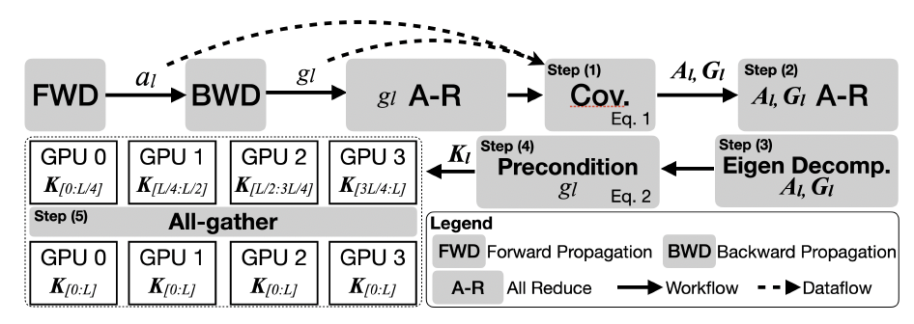
Motivation & Background
Why Second-Order Optimizers and Why Challenging?
Resnet32 on Cifar10, K-FAC uses 50-75 less epochs than SGD-based method
√ Higher validation accuracy.
√ Faster convergence speed (i.e., less training iterations).
× Expensive communication to synchronize second-order gradients.
Distributed Training with Second-Order Optimizers
Computation Parallelism
Distribute large mini-batches via data parallelism.
Layer wise parallel computation via model parallelism.
More accurate weight update via data parallelism.
Broadcast takes up to 50%

Slide 3
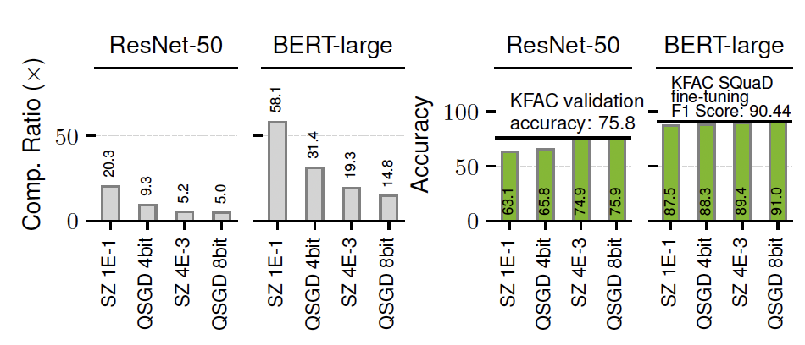
Motivation & Background
Compression-based Communication Optimization
Original Communication Data
Reduces the communication data size, thus improve communication performance.
GPU0
GPU1
Existing Compression Algorithms
Compressed Communication Data
SZ – a lossy compressor that uses rounding-to-the nearest(RN).
QSGD – a first-order gradient compression technique that uses stochastic rounding (SR).
GPU0
GPU1
This is due to the unique error distribution introduced by SR.
Analysis details in next slides.
Either the compression ratio (communication reduction rate) is low or have significant impact on validation accuracy.

Slide 4
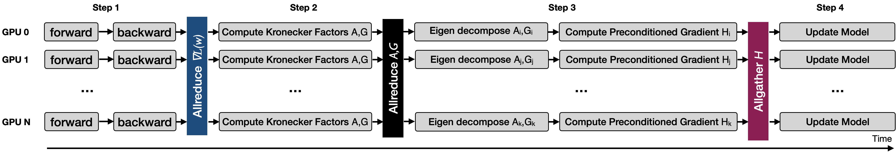
Background – Computation Parallelism in K-FAC
Distributed Training with Second-Order Optimizer
Parallelize expensive computation
Kronecker-factored Approximate Curvature (K-FAC)
Step1: Forward and backward computation, Allreduce gradient ∇𝐿(w).
Step2: For all layers, compute Kronecker factors, Allreduce factors A and G.
Step3: For assigned layer l, eigen decompose A_{l} ,G_{l} and compute preconditioned gradient H_{l} , Allgather H_{l} .
Step4: Update model weights using preconditioned gradient H.
*Note that the Allgather is implemented using Broadcast to pipeline computation and communication for each layer.
Notes:
The broadcast ratio presented in the previous slide is measured after overlapping communication and computation.

Slide 5
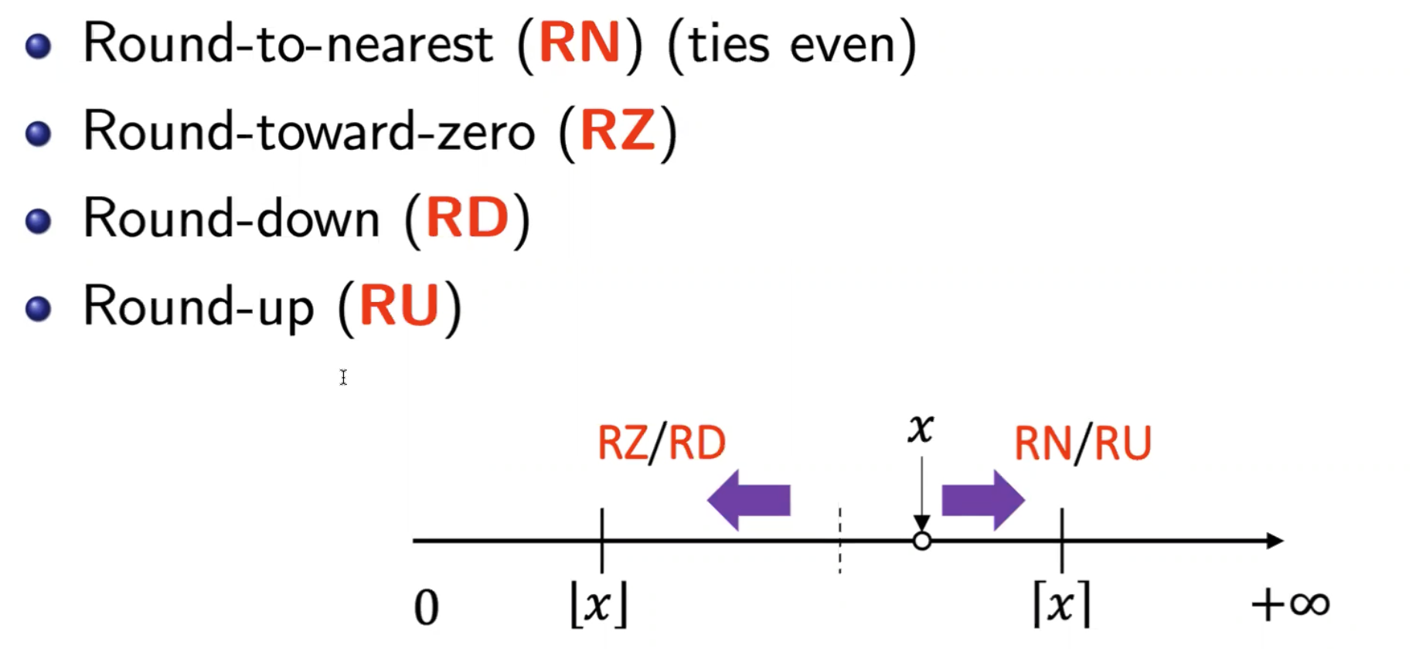
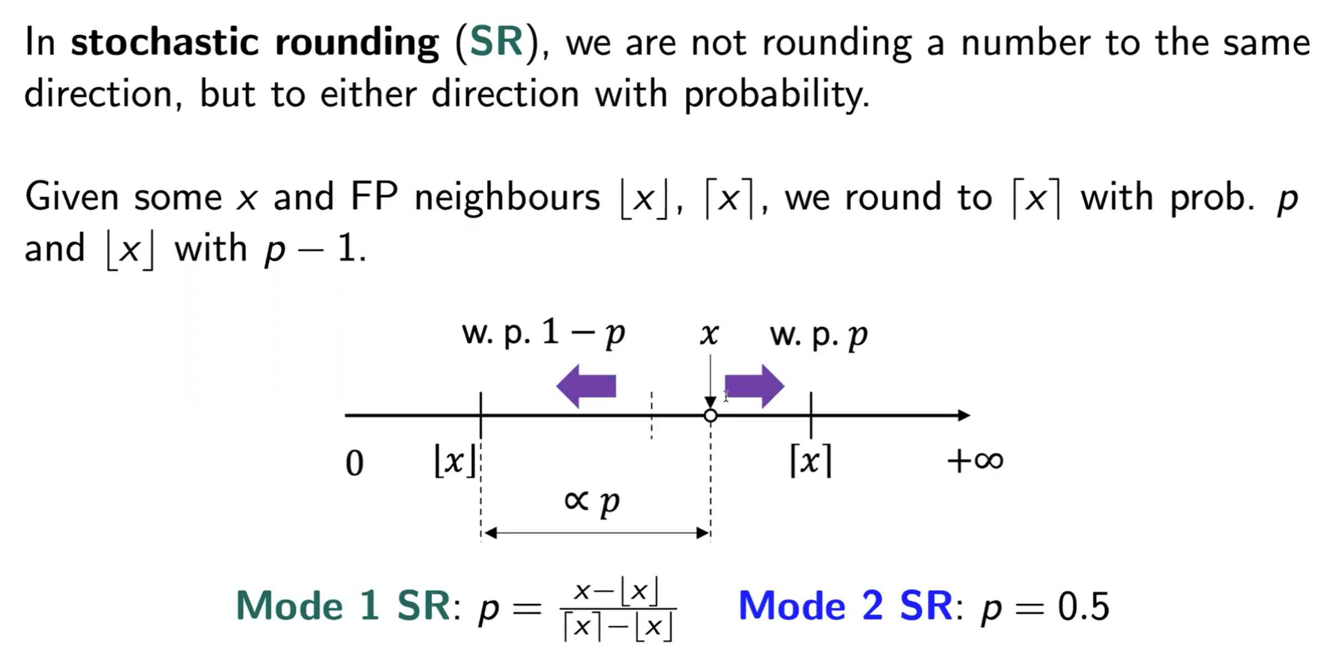
Background – Stochastic Rounding
Comparison Between Conventional Rounding Methods and Stochastic Rounding (SR)
*We focus on Mode 1 SR because it is more effective in preserving accuracy than Mode 2 SR, according to our theoretical and experimental analysis.

Slide 6
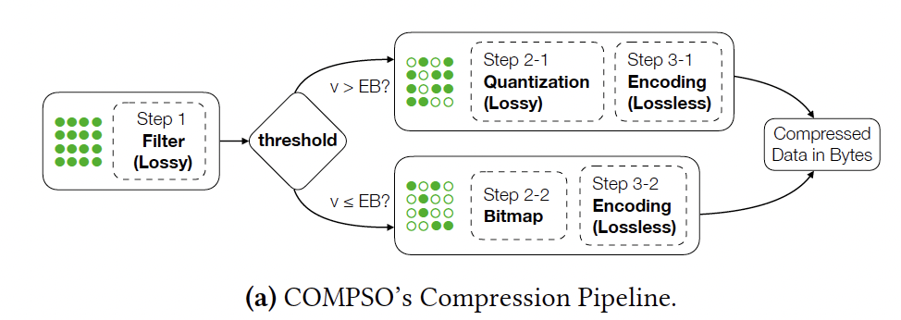
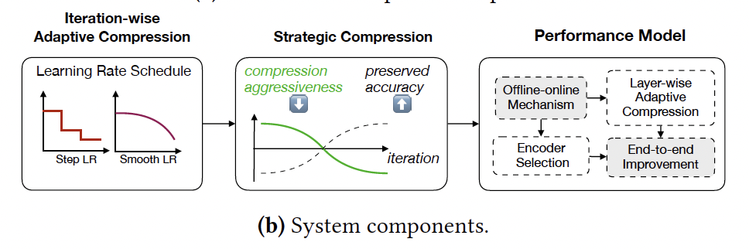
Challenges and Overview of COMPSO
Challenges
1. Compression ratio can be limited by maintaining validation accuracy. This issue is more pronounced for KFAC gradients than SGD gradients.
2.Generalizing the characteristics of a complex system and modeling it is non-trivial due to significant variances.
3. Distributed KFAC mechanism which splits the layers into GPUs for computation makes the gradients vary in sizes and value ranges.
4. GPU implementation for such compression algorithm needs to be carefully done.
Filter: represents small values as bitmap, help improve compression ratio.
SR :random quantization, help preserve validation accuracy.
Iteration-wise: aggressive/conservative compression at prior/latter iterations.
Performance model: ensure end-to-end performance improvement.
Layer-wise: scale values specific for each layer.
Layer and communication aggregation: improve GPU and bandwidth utilization.

Slide 7

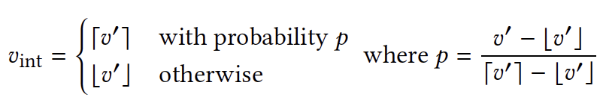
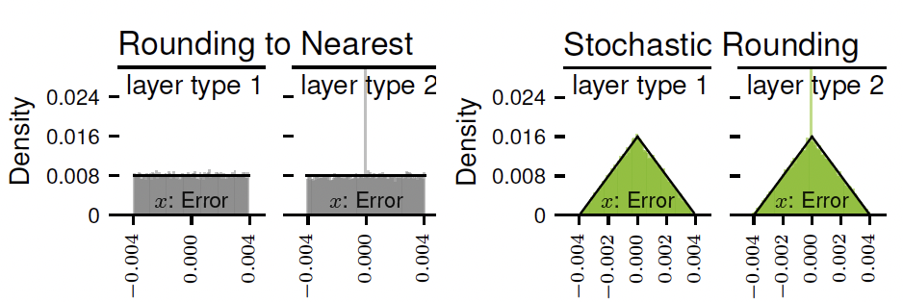
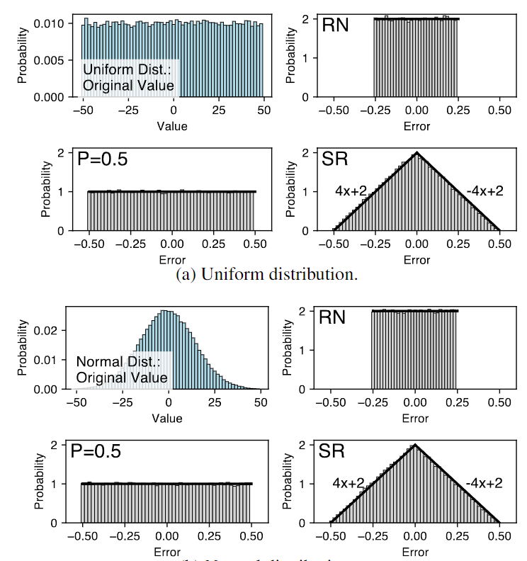
Design of COMPSO
Gradient quantization takes two steps
Normalization
(Stochastic) Rounding
Characterization of Different Quantization Approaches
Rounding to the Nearest (RN) that rounds the float point data to the closest integer.
Stochastic Rouding (SR) that rounds the float point data to floor or ceiling with probability p or 1-p.
Real Data:
Synthetic Data:

Slide 8
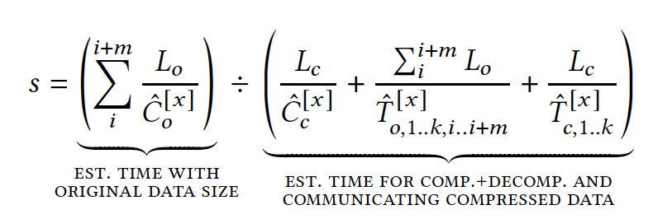
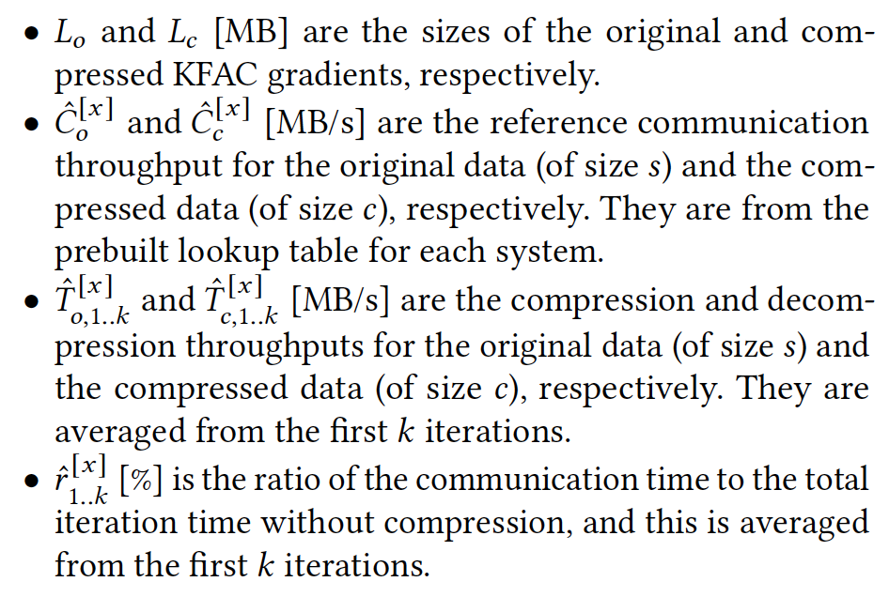

Design of COMPSO
Performance Modeling
Communication Speedup
Variables
End-to-end Speedup
m is the layer aggregation factor, our performance model finds the m such that the end-to-end performance speedup is high

Slide 9
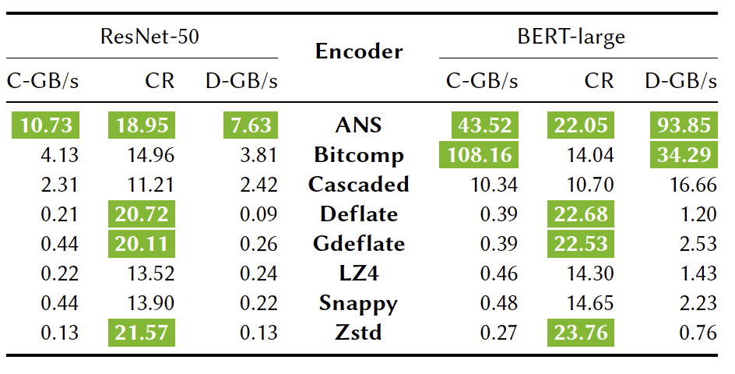
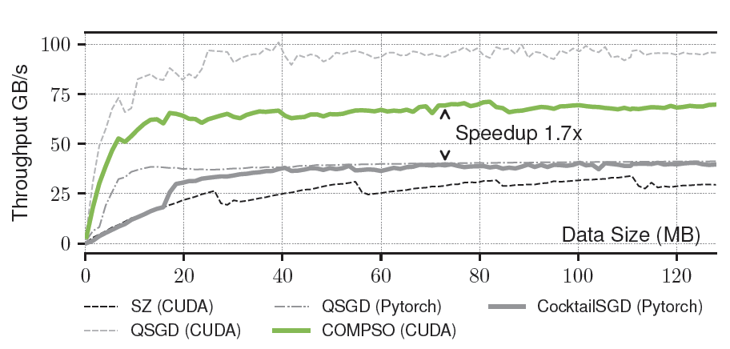
Design of COMPSO
Optimizations in GPU Implementation
Encoder Selection by performance model
Kernel fusion that reduces memory traffic to global memory
Fine-grained range computation (e.g., maxima of each layer) using block reduction and warp-level shuffle.
ANS is the best in this case, that has near-highest compression ratio and throughput.

Slide 10
Evaluation
Platforms
A 16-node cluster, each node equipped with two AMD EPYC 7742 processors, 256 GB of RAM, and four 40GB NV-Link connected NVIDIA A100 GPUs. With Slingshot10 (100Gbps).
A 64-node cluster, each node equipped with the same GPU configuration, one AMD EPYC Milan 7543P processor, and 512 GB of RAM. With Slingshot11 (200Gbps).
Baselines
QSGD: Using SR for quantization and Elias Encoder
cuSZ: Using RN for quantization and Huffman Encoder
CocktailSGD: Using Sparsification and Quantization with manual-tuned sparsity and quantization bits.
DNN Models, Datasets and Benchmark
ResNet-50 on ImageNet
Mask R-CNN on COCO dataset
BERT-large on enwiki and Toronto BookCorpus, with the SQuAD for downstream task evaluation
GPT-3 style model on Pile

Slide 11
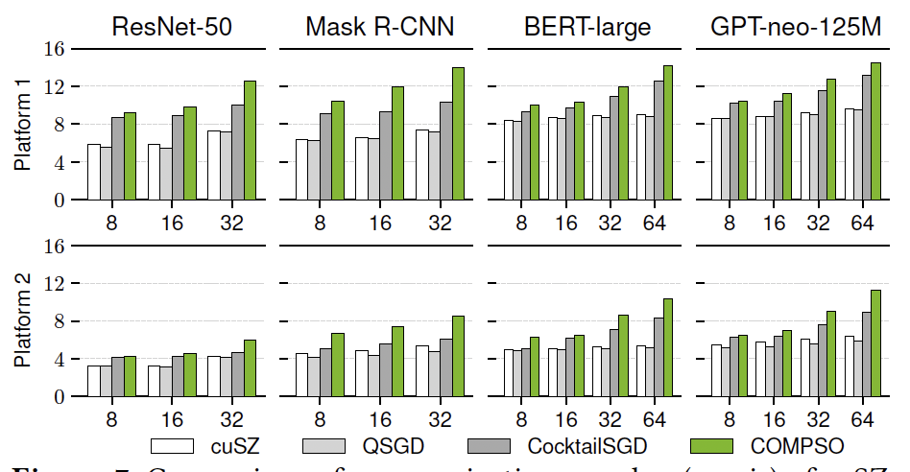
Evaluation
Communication Performance
Up to 14.15x communication speedup
Scale with model size and number of GPUs
COMPSO outperforms baselines because of (1) higher compression ratio, (2) layer aggregation mechanism

Slide 12
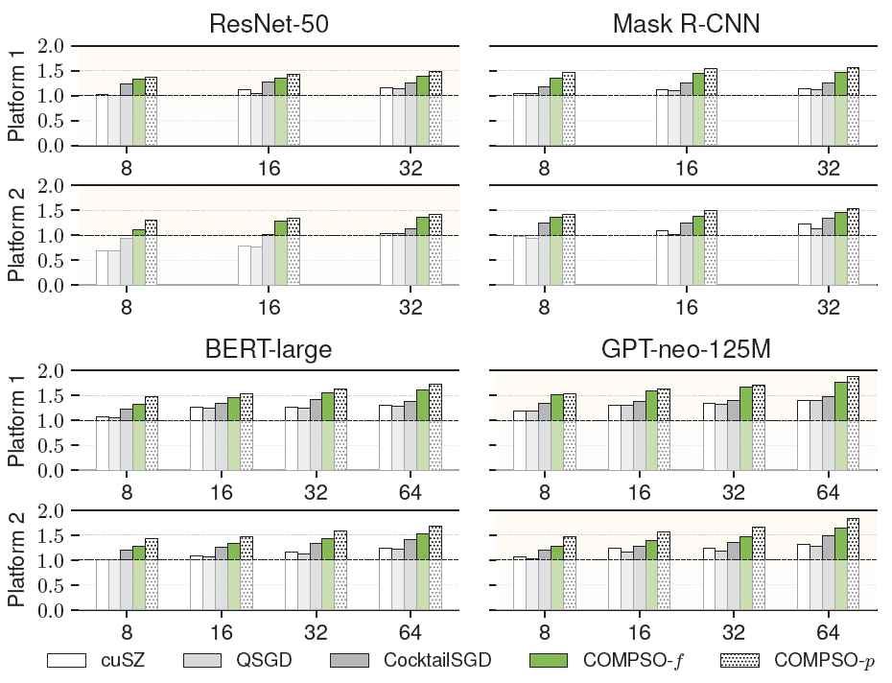
Evaluation
End-to-end Performance
COMPSO-f is the performance without our performance model tuning,
COMPSO-p is the performance with our performance model tuning.
Scales with model size and number of GPUs.
COMPSO outperforms baselines because of (1) higher compression ratio, (2) layer aggregation mechanism, (3) Efficient GPU implementation, and (4) Efficient encoder selection.

Slide 13
Thank You!

