Slide 1
COMPSO: Optimizing Gradient Compression for Distributed Training with Second-Order Optimizers
Luddy School of Informatics, Computing, and Engineering
Baixi Sun¹, Weijin Liu², J. Gregory Pauloski³, Jiannan Tian¹, Jinda Jia¹, Daoce Wang¹, Boyuan Zhang¹, Mingkai Zheng⁴, Sheng Di⁵, Sian Jin⁶, Zhao Zhang⁴, Xiaodong Yu², Kamil A. Iskra⁵, Pete Beckman^{5,7}, Guangming Tan⁸, Dingwen Tao⁸
¹Indiana University
²Stevens Institute of Technology
³University of Chicago
⁴Rutgers University
⁵Argonne National Laboratory
⁶Temple University
⁷Northwestern University
⁸University of Chinese Academy of Sciences
30th ACM SIGPLAN Annual Symposium on Principles and Practice of Parallel Programming (PPoPP 2025)
Notes:
Collaborating

Slide 2
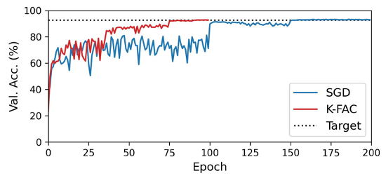
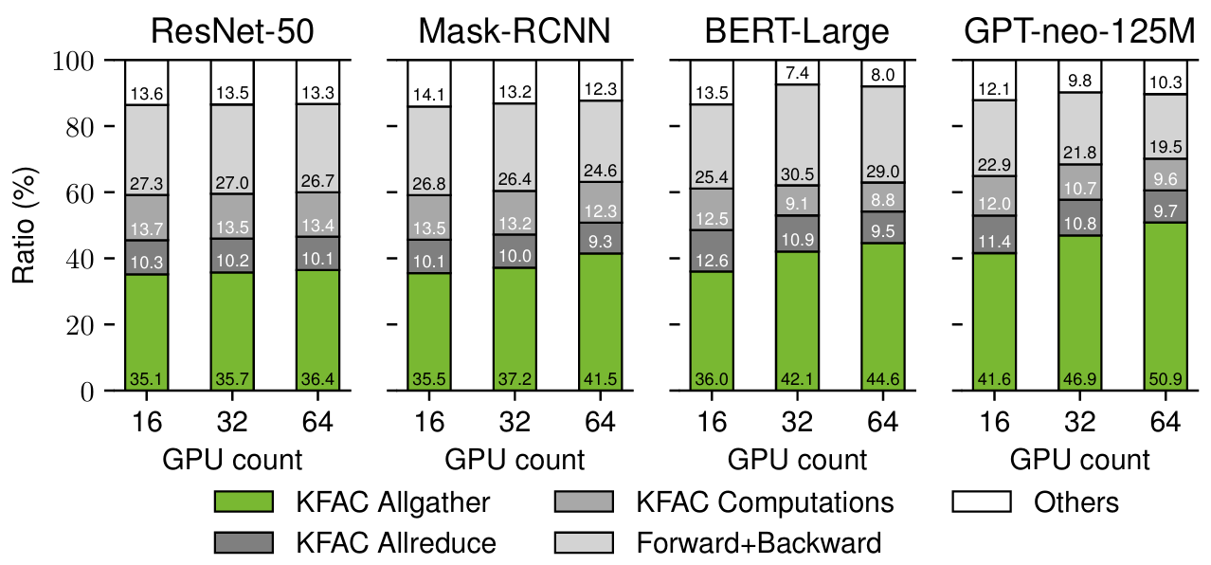
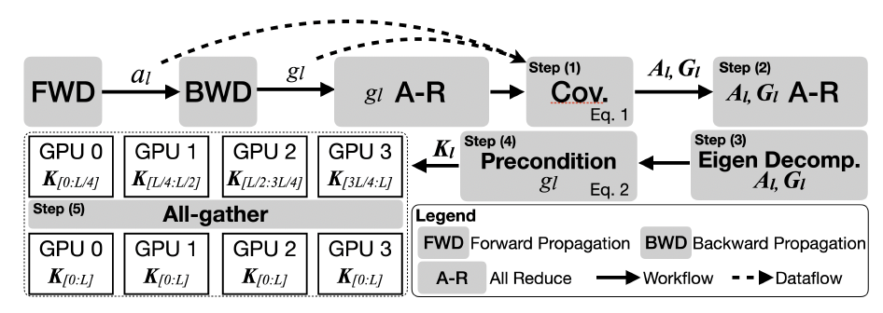
Motivation & Background
Why Using Second-Order Optimizers and What’s Challenging?
Resnet32 on Cifar10, K-FAC uses 50-75 less epochs than SGD-based method
√ Higher validation accuracy.
√ Faster convergence speed (i.e., less training iterations).
× Expensive communication to synchronize second-order gradients.
Distributed Training with Second-Order Optimizers
Distribute large mini-batches via data parallelism.
Layer wise parallel computation via computation parallelism.
More accurate weight update via data parallelism.
Allgather takes 30% to 50%
*Note that the Allgather is implemented using Broadcast to pipeline computation and communication for each layer.
Notes:
The workflow of KFAC is demonstrated as the bottom left figure:
First, Forward and backward computation, Allreduce gradient ∇𝐿(w).this is the same as when using the SGD.
Step1:for all layers, covariance computation, which computes the intermediate data i.e., activation and first order gradient covariance matrix.
Step2: For all layers, compute Kronecker factors, Allreduce factors A and G.
Step3: For assigned layer l, eigen decompose A_{l} ,G_{l} and in Step 4 compute preconditioned gradient H_{l} , in Step 5 Allgather H_{l} .

Slide 3
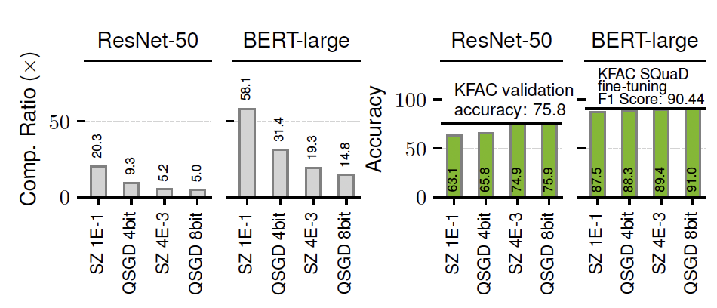
Motivation & Background
Compression-based Communication Optimization
Original Communication Data
Reduces the communication data size, thus improve communication performance.
GPU0
GPU1
Existing Compression Algorithms
Compressed Communication Data
SZ – a lossy compressor that uses rounding-to-the nearest(RN).
QSGD – a first-order gradient compression technique that uses stochastic rounding (SR).
GPU0
GPU1
This is due to the unique error distribution introduced by SR.
Analysis details in next slides.
Either the compression ratio (communication reduction rate) is low or have significant impact on validation accuracy.

Slide 4
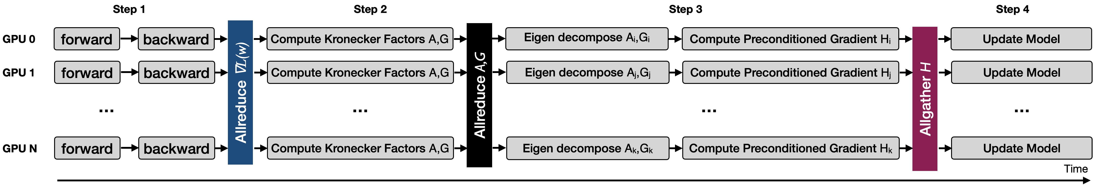
Background – Computation Parallelism in K-FAC
Distributed Training with Second-Order Optimizer
Parallelize expensive computation
Kronecker-factored Approximate Curvature (K-FAC)
Step1: Forward and backward computation, Allreduce gradient ∇𝐿(w).
Step2: For all layers, compute Kronecker factors, Allreduce factors A and G.
Step3: For assigned layer l, eigen decompose A_{l} ,G_{l} and compute preconditioned gradient H_{l} , Allgather H_{l} .
Step4: Update model weights using preconditioned gradient H.
*Note that the Allgather is implemented using Broadcast to pipeline computation and communication for each layer.
Notes:
The broadcast ratio presented in the previous slide is measured after overlapping communication and computation.

Slide 5
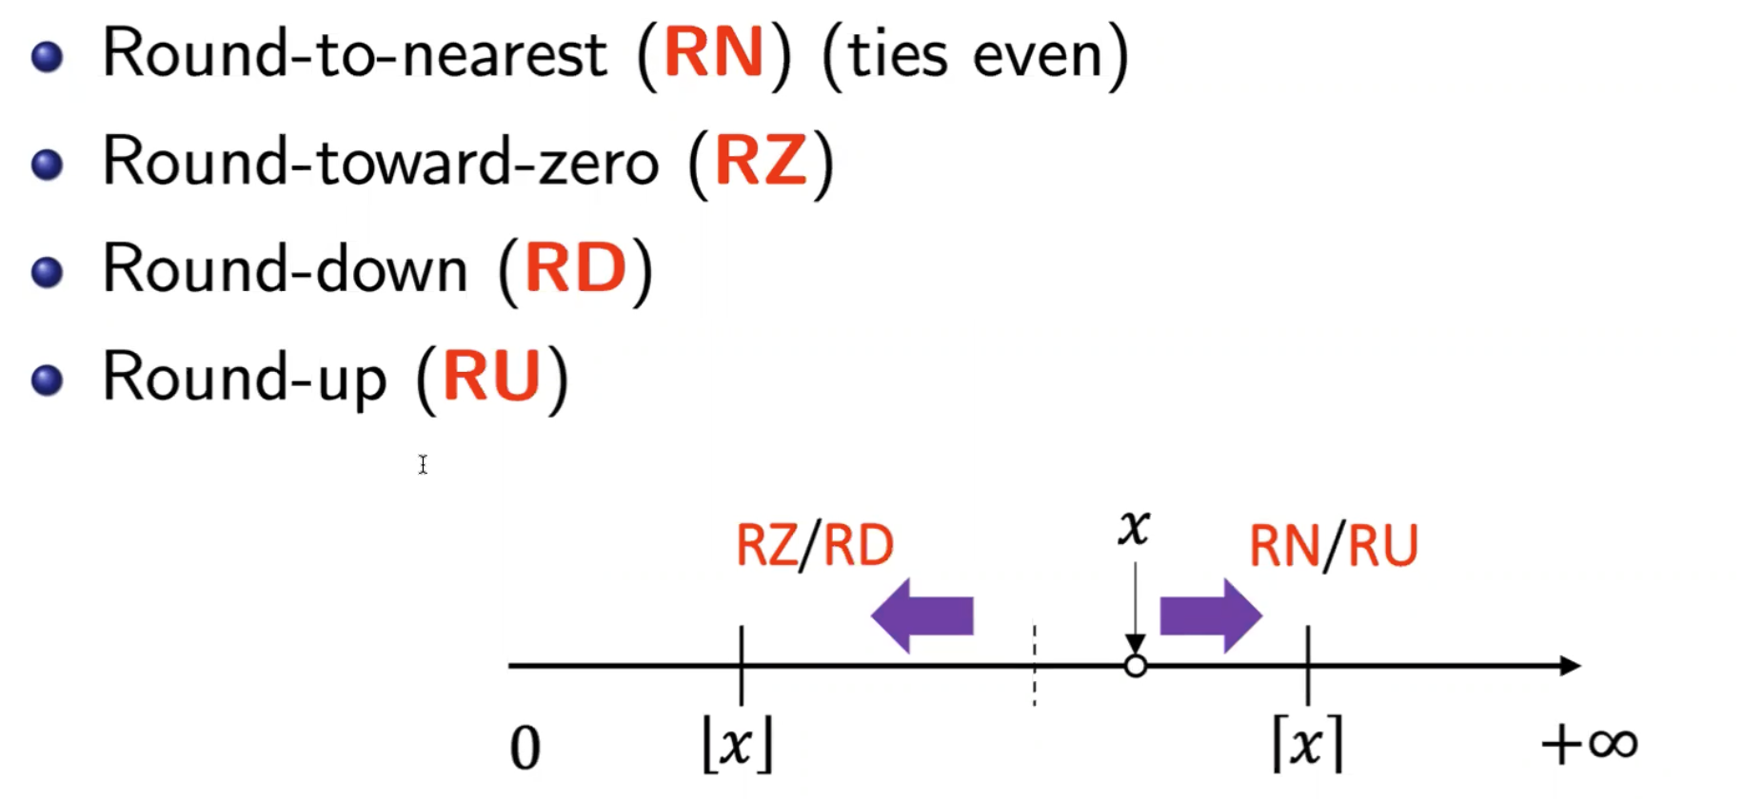
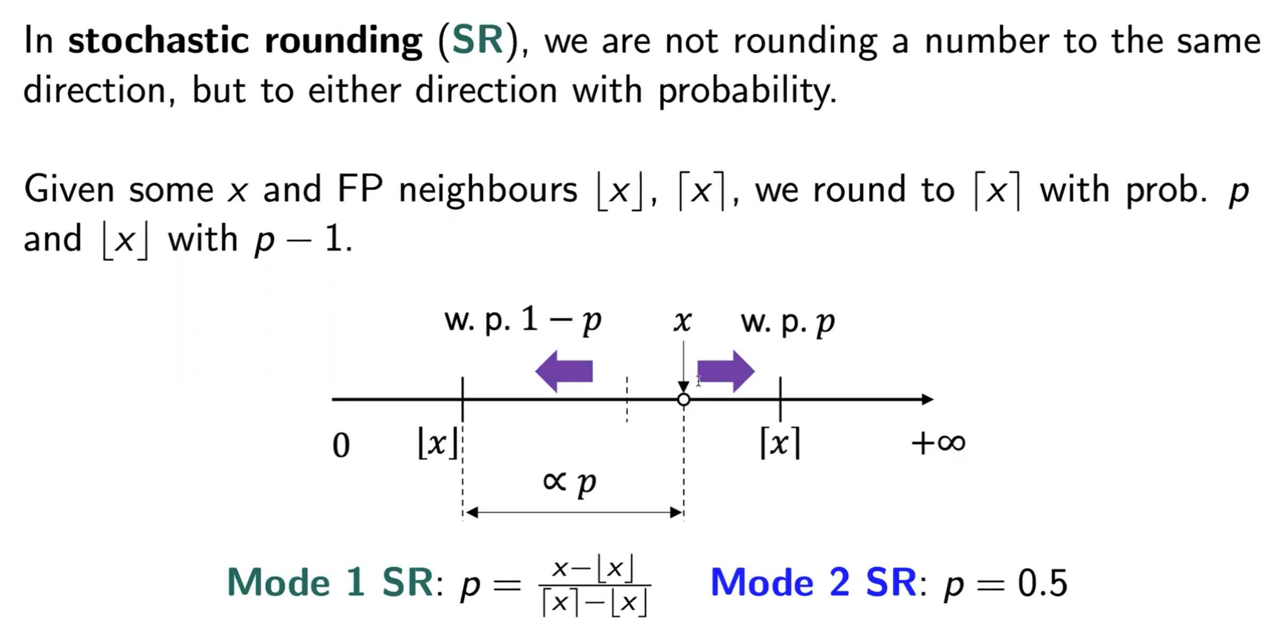
Background – Rounding Methods
Comparison Between Conventional Rounding Methods and Stochastic Rounding (SR)
*We focus on Mode 1 SR because it is more effective in preserving accuracy than Mode 2 SR, according to our theoretical and experimental analysis.

Slide 6
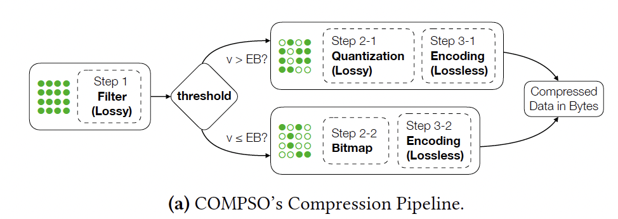
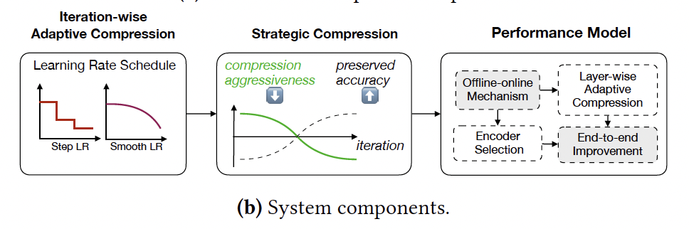
Challenges and Overview of COMPSO
Challenges
1. Compression ratio can be limited by maintaining validation accuracy.
2. Generalizing the characteristics and modeling of this complex system is non-trivial.
3. Varying data sizes across GPUs make multi-GPU parallelism challenging.
4. End-to-end performance gain bounded by the GPU compression throughput in some cases.
Filter: represents small values as bitmap, helps improve compression ratio.
SR :random quantization, help preserve validation accuracy.
Iteration-wise: aggressive/conservative compression at prior/latter iterations.
Performance model: ensure end-to-end performance improvement.
Layer-wise: scale values specific for each layer.
Layer and communication aggregation: improve GPU and bandwidth utilization.
Notes:
1. Compression ratio can be limited by maintaining validation accuracy. This issue is more pronounced for KFAC gradients than SGD gradients.
2. Generalizing the characteristics of a complex system and modeling it is non-trivial due to significant variances.
3. Distributed KFAC mechanism, which splits the layers into GPUs for computation, makes the gradients vary in size and value ranges.
4. GPU implementation for such a compression algorithm needs to be carefully done.

Slide 7

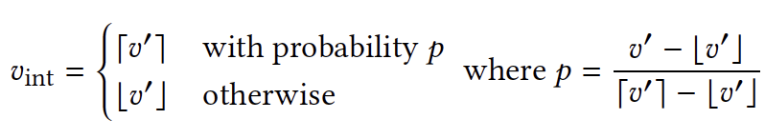
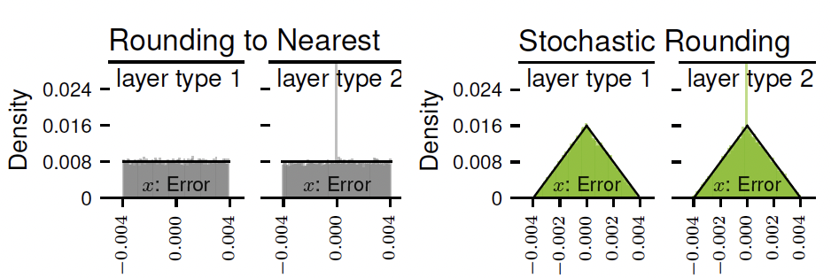
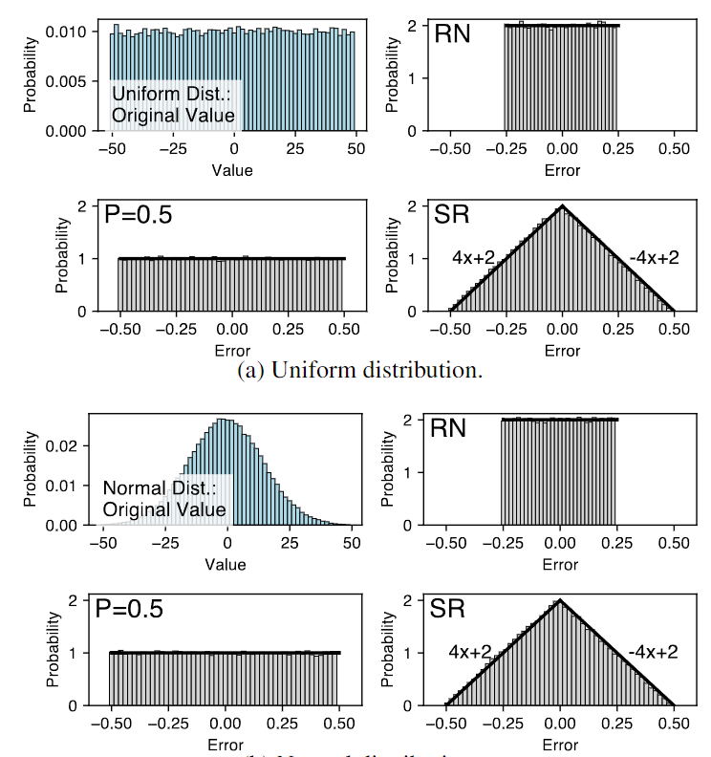
Design of COMPSO
Gradient quantization takes two steps
Normalization
(Stochastic) Rounding
Characterization of Different Quantization Approaches
Rounding to the Nearest (RN) that rounds the float point data to the closest integer.
Stochastic Rouding (SR) that rounds the float point data to floor or ceiling with probability p or 1-p.
Real Data:
Synthetic Data:
Notes:
1 a triangular error distribution is more effective at preserving accuracy than a uniform distribution (SR versus RNand𝑃0.5), 2 within the same class of error distribution, a smaller error bound is more beneficial (§3), and 3 whether the quantization is deterministic (RN) or non-deterministic (𝑃0.5) has no significant impact on accuracy or convergence.

Slide 8
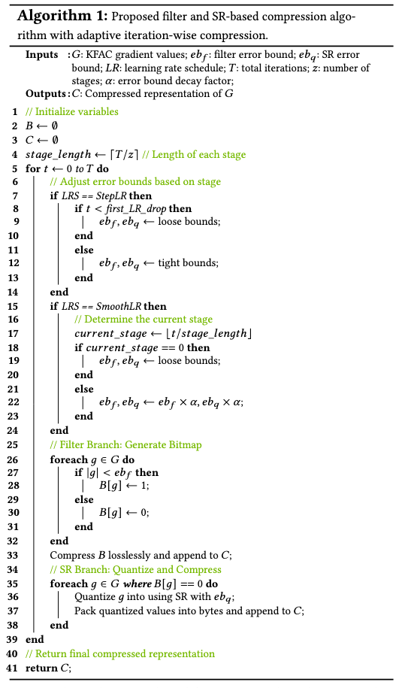
Design of COMPSO
Algorithm Design
Bitmap-based filtering with error bound eb_{f}.
Improves the compression ratio.
SR-based quantization with error bound eb_{q}.
Preserves the convergence.
Iteration-wise adaptive compression.
Based on the learning rate scheduler, adjust the compression mode as aggressive / conservative.
Cont’d

Slide 9
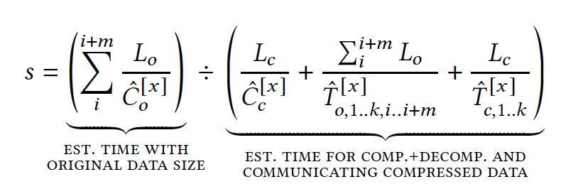
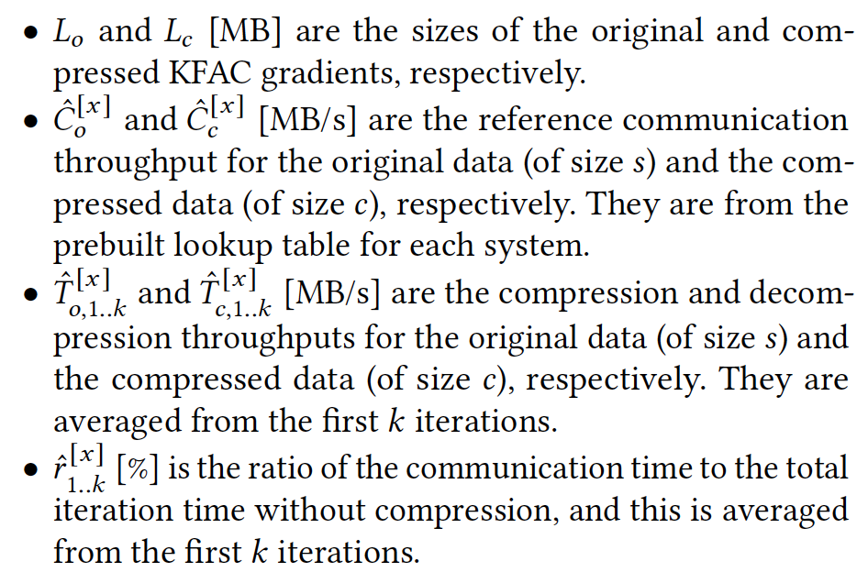

Design of COMPSO
Performance Modeling
Communication Speedup
Variables
End-to-end Speedup
m is the layer aggregation factor, our performance model finds the m such that the end-to-end performance speedup is high
Notes:
Lo and Lc are the sizes of the original and compressed KFAC gradients, respectively
Co hat and Cc hat are the reference communication throughput for the original data (of size s) and the compressed data (of size c), respectively. They are from the prebuilt lookup table for each system.
To 1..k hat and Tc 1..k are the compression and decompression throughputs for the original data (of size s) and the compressed data (of size c), respectively. They are averaged from the first k iterations.
r 1..k hat is the ratio of the communication tie to the total iteration time without compression, and this is averaged from the first k iterations as well.

Slide 10
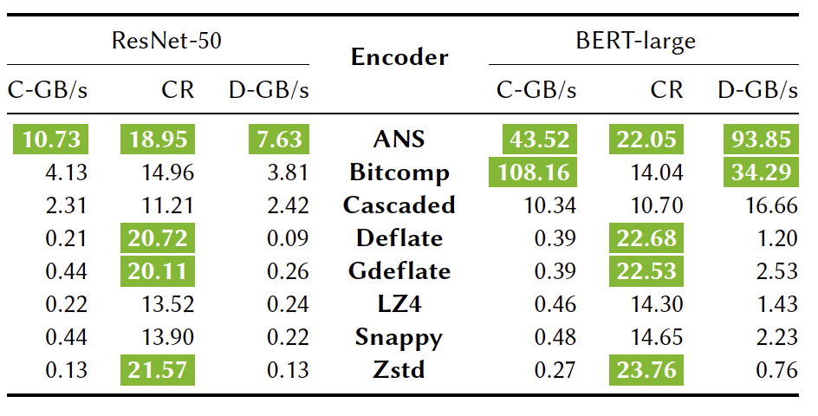
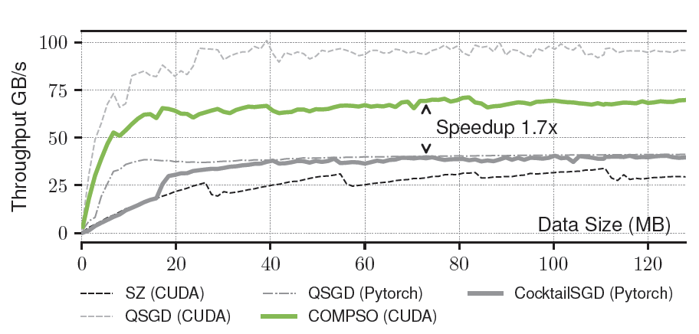
Design of COMPSO
Optimizations in GPU Implementation
Encoder Selection by performance model
Kernel fusion that reduces memory traffic to global memory
Fine-grained range computation (e.g., maxima of each layer) using block reduction and warp-level shuffle.
ANS is the best in this case, that has near-highest compression ratio and throughput.

Slide 11
Evaluation
Platforms
A 16-node cluster, each node equipped with two AMD EPYC 7742 processors, 256 GB of RAM, and four 40GB NV-Link connected NVIDIA A100 GPUs. With Slingshot10 (100Gbps).
A 64-node cluster, each node equipped with the same GPU configuration, one AMD EPYC Milan 7543P processor, and 512 GB of RAM. With Slingshot11 (200Gbps).
Baselines
QSGD: Using SR for quantization and Elias Encoder
cuSZ: Using RN for quantization and Huffman Encoder
CocktailSGD: Using Sparsification and Quantization with manual-tuned sparsity and quantization bits.
DNN Models, Datasets and Benchmark
ResNet-50 on ImageNet
Mask R-CNN on COCO dataset
BERT-large on enwiki and Toronto BookCorpus, with the SQuAD for downstream task evaluation
GPT-3 style model on Pile

Slide 12
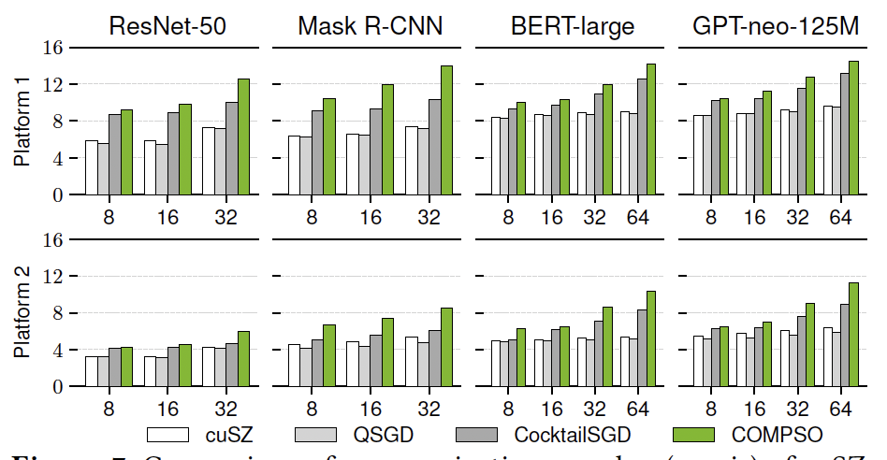
Evaluation
Communication Performance
Up to 14.15x communication speedup by achieving a compression ratio of 22.1x.
Scale with model size and number of GPUs.
COMPSO outperforms baselines because
(1) higher compression ratio,
(2) layer aggregation mechanism.

Slide 13
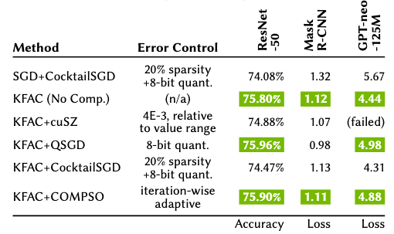
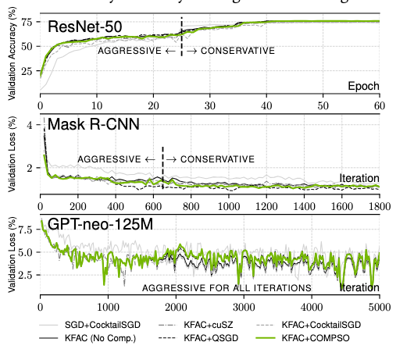
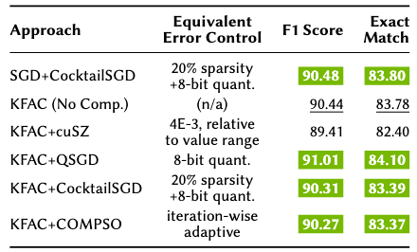
Evaluation
Convergence
Final validation accuracy
COMPSO preserves convergence.
SR preserves convergence better than RN.
BERT-large on SQuAD benchmark
Validation accuracy to iteration curve

Slide 14
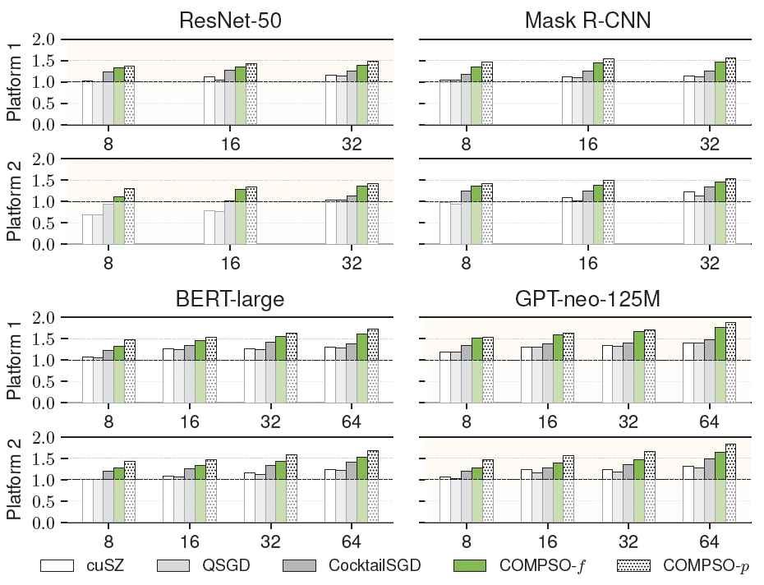
Evaluation
End-to-end Performance
COMPSO-f is the performance without our performance model tuning,
COMPSO-p is the performance with our performance model tuning.
Up to 1.9x speedup over QSGD.
Scales with model size and number of GPUs.
COMPSO outperforms baselines because
(1) Higher compression ratio,
(2) Layer aggregation mechanism,
(3) Efficient GPU implementation,
(4) Selecting the efficient encoder.

Slide 15
Contributions
Analysis on the impact of quantization methods on KFAC convergence and integrate the most suitable in our new compression algorithm.
Design of a novel compression algorithm for KFAC.
Error-bounded scheme.
Adaptive mechanism.
Design of a performance model.
Guarantees end-to-end performance improvement.
Formulates the adaptive compression and layer aggregation mechanism.
Implementation of GPU optimizations to minimize (de-)compression overheads.

Slide 16
Questions and Comments

