Slide 1
Spark Structured Streaming and Spark SQL
Luddy School of Informatics, Computing, and Engineering
Lecturer: Baixi Sun
Notes:
Collaborating

Slide 2

What is Spark Streaming?
Framework for large scale stream processing
Scales to 100s of nodes
Can achieve second scale latencies
Integrates with Spark’s batch and interactive processing
Provides a simple batch-like API for implementing complex algorithm
Can absorb live data streams from Kafka, Flume, ZeroMQ, etc.

Slide 3

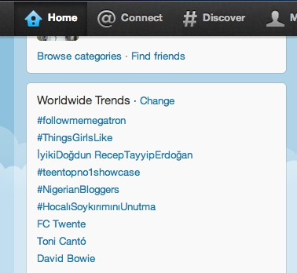

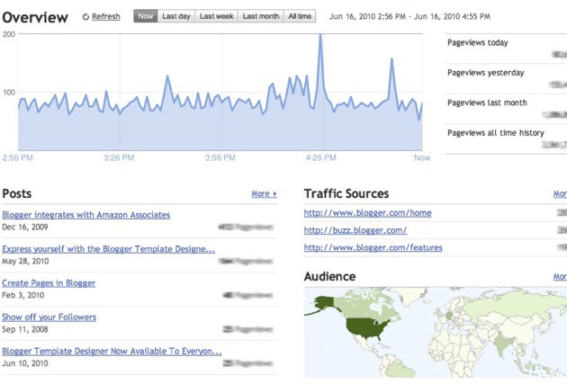

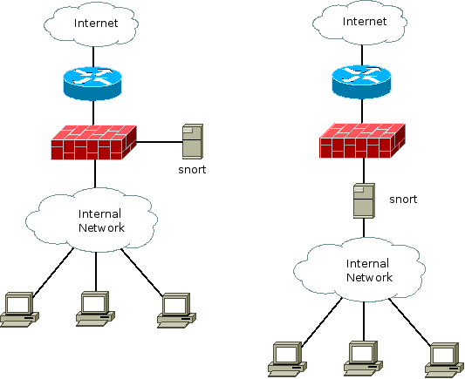
Motivation
Many important applications must process large streams of live data and provide results in near-real-time
Social network trends
Website statistics
Intrusion detection systems
etc.
Require large clusters to handle workloads
Require latencies of few seconds

Slide 4
Need for a framework …
… for building such complex stream processing applications
But what are the requirements from such a framework?

Slide 5
Requirements
Scalable to large clusters
Second-scale latencies
Simple programming model

Slide 6
Case study: XYZ, Inc.
Any company who wants to process live streaming data has this problem
Twice the effort to implement any new function
Twice the number of bugs to solve
Twice the headache
Two processing stacks
Custom-built distributed stream processing system
1000s complex metrics on millions of videos sessions
Requires many dozens of nodes for processing
Hadoop backend for offline analysis
Generating daily and monthly reports
Similar computation as the streaming system

Slide 7


Case study: XYZ, Inc.
Any company who wants to process live streaming data has this problem
Twice the effort to implement any new function
Twice the number of bugs to solve
Twice the headache
Two processing stacks
Custom-built distributed stream processing system
1000s complex metrics on millions of videos sessions
Requires many dozens of nodes for processing
Hadoop backend for offline analysis
Generating daily and monthly reports
Similar computation as the streaming system

Slide 8
Requirements
Scalable to large clusters
Second-scale latencies
Simple programming model
Integrated with batch & interactive processing

Slide 9
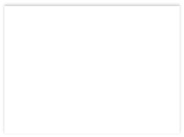


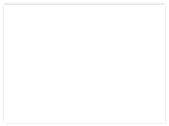

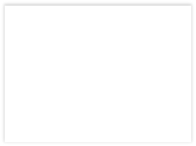

Stateful Stream Processing
Traditional streaming systems have a event-driven
record-at-a-time processing model
input
mutable state
Each node has mutable state
For each record, update state & send new records
records
node 1
State is lost if node dies!
node 3
input records
node 2
Making stateful stream processing be fault-tolerant is challenging

Slide 10
Existing Streaming Systems
Storm
Replays record if not processed by a node
Processes each record at least once
May update mutable state twice!
Mutable state can be lost due to failure!
Trident – Use transactions to update state
Processes each record exactly once
Per state transaction updates slow

Slide 11
Requirements
Scalable to large clusters
Second-scale latencies
Simple programming model
Integrated with batch & interactive processing
Efficient fault-tolerance in stateful computations

Slide 12



















Discretized Stream Processing
Run a streaming computation as a series of very small, deterministic batch jobs
Chop up the live stream into batches of X seconds
Spark treats each batch of data as RDDs and processes them using RDD operations
Finally, the processed results of the RDD operations are returned in batches
live data stream
Spark Streaming
batches of X
seconds
Spark
processed results

Slide 13











Discretized Stream Processing
Run a streaming computation as a series of very small, deterministic batch jobs
live data stream
Spark Streaming
Batch sizes as low as ½ second, latency ~ 1 second
Potential for combining batch processing and streaming processing in the same system
batches of X
seconds
Spark
processed results

Slide 14












Example 1 – Get hashtags from Twitter
1.val tweets = ssc.twitterStream(<Twitter username>, <Twitter password>)
DStream: a sequence of RDD representing a stream of data
Twitter Streaming API
batch @ t
batch @ t+1
batch @ t+2
tweets DStream
stored in memory as an RDD (immutable, distributed)

Slide 15













Example 1 – Get hashtags from Twitter
val tweets = ssc.twitterStream(<Twitter username>, <Twitter password>)
val hashTags = tweets.flatMap (status => getTags(status))
transformation: modify data in one Dstream to create another DStream
new DStream
tweets DStream
batch @ t
batch @ t+1
batch @ t+2
hashTags Dstream [#cat, #dog, … ]
flatMap
flatMap
flatMap
…
new RDDs created for every batch

Slide 16









Example 1 – Get hashtags from Twitter
val tweets = ssc.twitterStream(<Twitter username>, <Twitter password>)
val hashTags = tweets.flatMap (status => getTags(status))
hashTags.saveAsHadoopFiles("hdfs://...")
output operation: to push data to external storage
batch @ t batch @ t+1 batch @ t+2
tweets DStream
flatMap
flatMap
flatMap
hashTags DStream
save
save
save
every batch saved to HDFS

Slide 17
Java Example
Scala
val tweets = ssc.twitterStream(<Twitter username>, <Twitter password>)
val hashTags = tweets.flatMap (status => getTags(status))
hashTags.saveAsHadoopFiles("hdfs://...")
Java
JavaDStream<Status> tweets = ssc.twitterStream(<Twitter username>, <Twitter password>)
JavaDstream<String> hashTags = tweets.flatMap(new Function<...> { })
hashTags.saveAsHadoopFiles("hdfs://...")
Function object to define the transformation

Slide 18












Fault-tolerance
tweets RDD
input data replicated in memory
RDDs are remember the sequence of operations that created it from the original fault-tolerant input data
flatMap
Batches of input data are replicated in memory of multiple worker nodes, therefore fault-tolerant
hashTags RDD
lost partitions recomputed on other workers
Data lost due to worker failure, can be recomputed from input data

Slide 19
Key concepts
DStream – sequence of RDDs representing a stream of data
Twitter, HDFS, Kafka, Flume, ZeroMQ, Akka Actor, TCP sockets
Transformations – modify data from on DStream to another
Standard RDD operations – map, countByValue, reduce, join, …
Stateful operations – window, countByValueAndWindow, …
Output Operations – send data to external entity
saveAsHadoopFiles – saves to HDFS
foreach – do anything with each batch of results

Slide 20










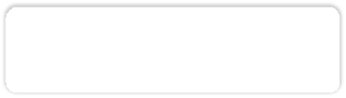



Example 2 – Count the hashtags
val tweets = ssc.twitterStream(<Twitter username>, <Twitter password>)
val hashTags = tweets.flatMap (status => getTags(status))
val tagCounts = hashTags.countByValue()
tweets
batch @ t batch @ t+1 batch @ t+2
flatMap flatMap flatMap
hashTags tagCounts
[(#cat, 10), (#dog, 25),
... ]
map
map
…
map
reduceByKey
reduceByKey
reduceByKey

Slide 21
Example 3 – Count the hashtags over last 10 mins
val tweets = ssc.twitterStream(<Twitter username>, <Twitter password>)
val hashTags = tweets.flatMap (status => getTags(status))
val tagCounts = hashTags.window(Minutes(10), Seconds(1)).countByValue()
sliding window operation
window length
sliding interval
2
0

Slide 22













Example 3 – Count the hashtags over last 10 mins
val tagCounts = hashTags.window(Minutes(10), Seconds(1)).countByValue()
t-1 t t+1 t+2 t+3
hashTags
sliding window
countByValue
tagCounts
count over all the data in the window

Slide 23























Smart window-based countByValue
val tagCounts = hashtags.countByValueAndWindow(Minutes(10), Seconds(1))
t-1 t t+1 t+2 t+3
hashTags
countByValue
add the counts from the new batch in the window
subtract the counts from batch before the window
–
+
tagCounts
+
?

Slide 24
Smart window-based reduce
Technique to incrementally compute count generalizes to many reduce operations
Need a function to “inverse reduce” (“subtract” for counting)
Could have implemented counting as:
hashTags.reduceByKeyAndWindow(_ + _, _ - _, Minutes(1), …)
INDIANA UNIVERSITY BLOOMINGTON
23

Slide 25












Fault-tolerant Stateful Processing
All intermediate data are RDDs, hence can be recomputed if lost
t-1 t t+1 t+2 t+3
hashTags
tagCounts
INDIANA UNIVERSITY BLOOMINGTON

Slide 26
Fault-tolerant Stateful Processing
State data not lost even if a worker node dies
Does not change the value of your result
Exactly once semantics to all transformations
No double counting!
INDIANA UNIVERSITY BLOOMINGTON
25

Slide 27
Other Interesting Operations
Maintaining arbitrary state, track sessions
Maintain per-user mood as state, and update it with his/her tweets
tweets.updateStateByKey(tweet => updateMood(tweet))
Do arbitrary Spark RDD computation within DStream
Join incoming tweets with a spam file to filter out bad tweets
tweets.transform(tweetsRDD => {
tweetsRDD.join(spamHDFSFile).filter(...)
})

Slide 28
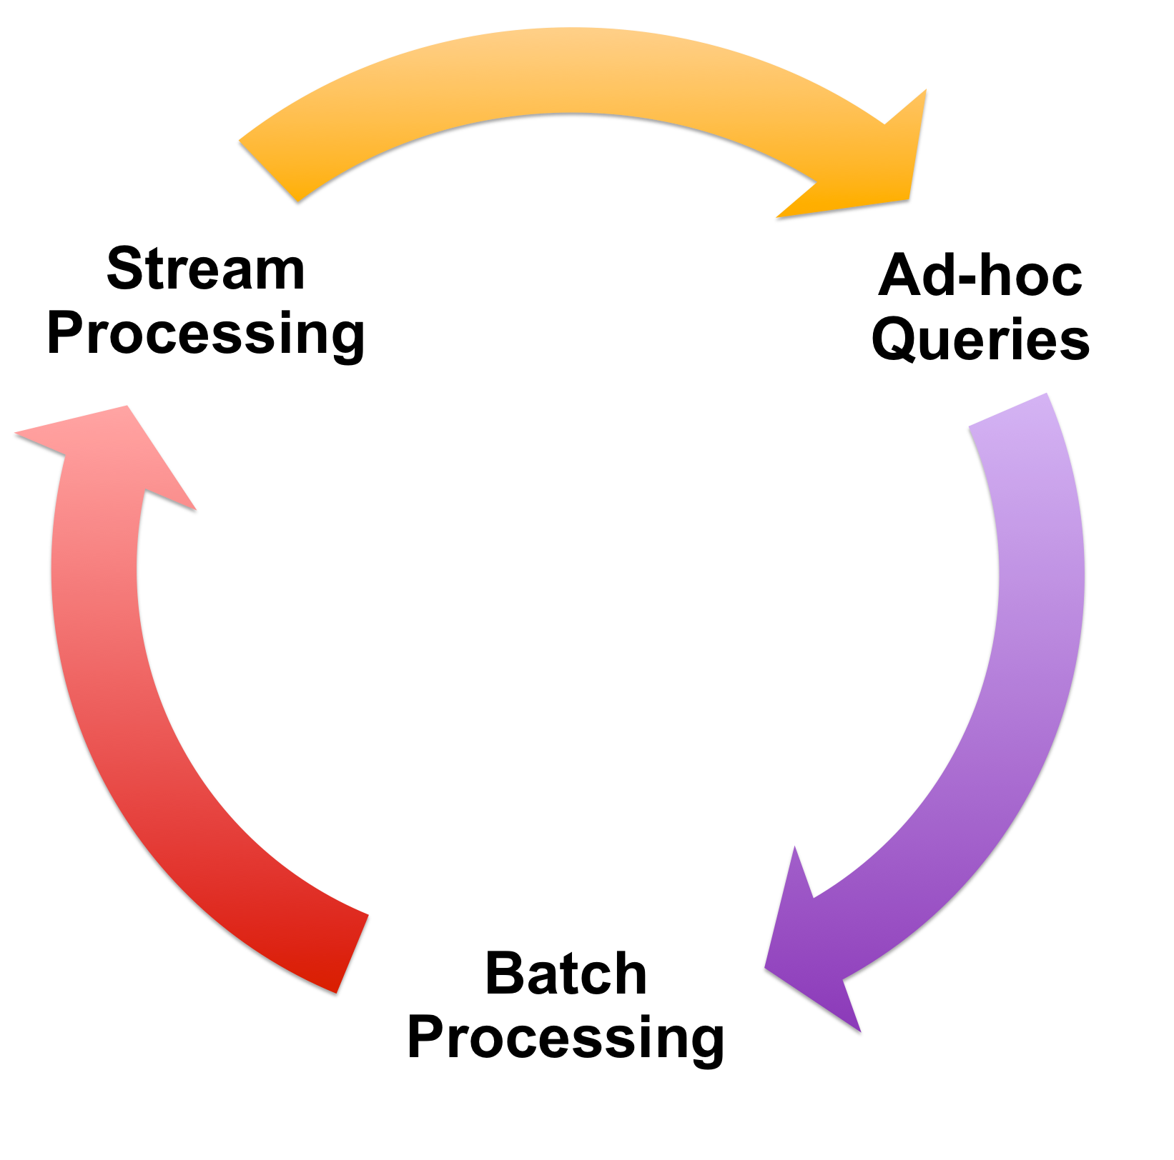
Vision - one stack to rule them all
Spark
+
Spark SQL
+
Spark Streaming

Slide 29
Spark program vs Spark Streaming program
Spark Streaming program on Twitter stream
val tweets = ssc.twitterStream(<Twitter username>, <Twitter password>)
val hashTags = tweets.flatMap (status => getTags(status))
hashTags.saveAsHadoopFiles("hdfs://...")
Spark program on Twitter log file
val tweets = sc.hadoopFile("hdfs://...")
val hashTags = tweets.flatMap (status => getTags(status))
hashTags.saveAsHadoopFile("hdfs://...")

Slide 30




Vision - one stack to rule them all
$ ./spark-shell
scala> val file = sc.hadoopFile(“smallLogs”)
...
scala> val filtered = file.filter(_.contains(“ERROR”))
sc object ProcessProductionData { def main(args: Array[String]) { val sc = new SparkContext(...)
val file = sc.hadoopFile(“productionLogs”)
val filtered = file.filter(_.contains(“ERROR”)) val mapped = file.map(...)
Explore data interactively using Spark Shell / PySpark to identify problems
Use same code in Spark stand-alone programs to identify problems in production logs
Use similar code in Spark Streaming to identify problems in live log streams
...
ala> val mapped = file.map(...)
...
...
}
object ProcessLiveStream { def main(args: Array[String]) {
val sc = new StreamingContext(...) val stream = sc.kafkaStream(...)
val filtered = file.filter(_.contains(“ERROR”)) val mapped = file.map(...)
...
}
}
}

Slide 31
Vision - one stack to rule them all
$ ./spark-shell
scala> val file = sc.hadoopFile(“smallLogs”)
...
scala> val filtered = file.filter(_.contains(“ERROR”))
sc object ProcessProductionData { def main(args: Array[String]) { val sc = new SparkContext(...)
val file = sc.hadoopFile(“productionLogs”)
val filtered = file.filter(_.contains(“ERROR”)) val mapped = file.map(...)
Explore data interactively using Spark Shell / PySpark to identify problems
Use same code in Spark stand-alone programs to identify problems in production logs
Use similar code in Spark Streaming to identify problems in live log streams
Spark
+
Spark SQL
+
Spark Streaming
...
ala> val mapped = file.map(...)
...
...
}
object ProcessLiveStream { def main(args: Array[String]) {
val sc = new StreamingContext(...) val stream = sc.kafkaStream(...)
val filtered = file.filter(_.contains(“ERROR”)) val mapped = file.map(...)
...
}
}
}

Slide 32
Spark SQL and Structured Data Processing
Spark RDD is an object (input/output) for structured data processing in spark
Spark SQL is a “SQL” – like language that manages data in a database style
In other words, Spark SQL is another option for data processing

Slide 33
Review: What is SQL?
Structured Query Language (SQL)
Used for database access and manipulation
SQL is an ANSI/ISO standard
https://www.w3schools.com/sql/sql_intro.asp

Slide 34
Review: What can SQL do?
Execute queries
Insert records
Update records
Delete records
Create new database
Create new tables in a database
…
SQL Code
Database

Slide 35
Review: SQL Examples
Database
SQL Code
Execute queries
Insert records
Update records
Delete records
Create new database
Create new tables in a database
…
Expected data
Customers
SELECT * FROM Customers;
CID
Name
Age
1
Eric
20
Table name
2
John
50
…
Command

Slide 36
Review: SQL Examples
Database
SQL Code
Execute queries
Insert records
Update records
Delete records
Create new database
Create new tables in a database
…
INSERT INTO Customers (3, Gary, 45)
Customers
CID
Name
Age
1
Eric
20
2
John
50
…

Slide 37
Review: SQL Examples
Database
SQL Code
Execute queries
Insert records
Update records
Delete records
Create new database
Create new tables in a database
…
INSERT INTO Customers (3, Gary, 45);
Customers
CID
Name
Age
1
Eric
20
SELECT * FROM Customers;
2
John
50
3
Gary
45
…

Slide 38
Review: SQL Examples
Database
SQL Code
Execute queries
Insert records
Update records
Delete records
Create new database
Create new tables in a database
…
UPDATE Customers
SET Age = ‘50’
WHERE CID = 3;
Customers
CID
Name
Age
1
Eric
20
2
John
50
3
Gary
45
…

Slide 39
Review: SQL Examples
Database
SQL Code
Execute queries
Insert records
Update records
Delete records
Create new database
Create new tables in a database
…
UPDATE Customers
SET Age = ‘50’
WHERE CID = 3;
Customers
CID
Name
Age
1
Eric
20
2
John
50
3
Gary
50
…

Slide 40
Review: SQL Examples
Database
SQL Code
Execute queries
Insert records
Update records
Delete records
Create new database
Create new tables in a database
…
DELETE FROM Customers
WHERE Age = ‘50’;
Customers
CID
Name
Age
1
Eric
20
2
John
50
3
Gary
50
…

Slide 41
Review: SQL Examples
Database
SQL Code
Execute queries
Insert records
Update records
Delete records
Create new database
Create new tables in a database
…
DELETE FROM Customers
WHERE Age = ‘50’;
Customers
CID
Name
Age
1
Eric
20
…

Slide 42
Review: Other SQL Commands
SELECT, UPDATE, DELETE, INSERT, WHERE
Note: All upper case

Slide 43
Spark SQL
Considers Spark query model
Supports all the popular relational operations
Can be intermixed with RDD operations
Enhances the RDD API using the Dataframe API
Dataframe in Spark SQL uses RDD as data structure and manages the data in 2-dimension table format
I.e., Dataframe = RDD + schema
Credits: Ahmed Eldawy

Slide 44
Spark SQL Features
Integrated
Returns the result as RDD, that can be integrate with other RDD operations (Python, Scala and Java APIs)
Unified Data Access
Load and query data from a variety of sources (e.g., JSON, Apache Hive tables, etc.)
Hive Compatibility
Reuses the Hive frontend and MetaStore, thus compact with existing Apache Hive data, queries and UDFs.
Standard Connectivity
Industry standard connectivity - JDBC or ODBC.
Scalability
Easy to scale to long queries.
Using RDD let spark SQL supports mid-query fault tolerance.

Slide 45
Build-in Operations in Spark SQL
Filter (Selection)
Select (Projection)
Join
GroupBy (Aggregation)
Load/Store in various formats
Cache
Conversion between RDD (back and forth)

Slide 46
How to Use Spark SQL?
Option 1: Use the API
Option 2: Integration with SQL-like command strings

Slide 47
How to Use Spark SQL?
Option 1: Use the API
Option 2: Integration with SQL-like command strings

Slide 48
Spark SQL API
Start Spark Session
from pyspark.sql import SparkSession
spark = SparkSession \
.builder \
.appName("Python Spark SQL basic example") \
.config("spark.some.config.option", "some-value") \
.getOrCreate()
https://spark.apache.org/docs/latest/sql-getting-started.html

Slide 49
Spark SQL API
Creating DataFrames
# spark is an existing SparkSession
df = spark.read.json("examples/src/main/resources/people.json")
# Displays the content of the DataFrame to stdout
df.show()
# +----+-------+
# | age| name|
# +----+-------+
# |null|Michael|
# | 30| Andy|
# | 19| Justin|
# +----+-------+
https://spark.apache.org/docs/latest/sql-getting-started.html

Slide 50
Spark SQL API
DataFrame Operations
df.select(df['name'], df['age'] + 1).show()
# +-------+---------+
# | name|(age + 1)|
# +-------+---------+
# |Michael| null|
# | Andy| 31|
# | Justin| 20|
# +-------+---------+
df.filter(df['age'] > 21).show()
# +---+----+
# |age|name|
# +---+----+
# | 30|Andy|
# +---+----+
df.printSchema()
# root
# |-- age: long (nullable = true)
# |-- name: string (nullable = true)
df.select("name").show()
# +-------+
# | name|
# +-------+
# |Michael|
# | Andy|
# | Justin|
# +-------+
df.groupBy("age").count().show()
# +----+-----+
# | age|count|
# +----+-----+
# | 19| 1|
# |null| 1|
# | 30| 1|
# +----+-----+

Slide 51
How to Use Spark SQL?
Option 1: Use the API
Option 2: Integration with SQL-like command strings

Slide 52
Integration with SQL-like command strings
df.createOrReplaceTempView("people")
sqlDF = spark.sql("SELECT * FROM people")
sqlDF.show()
# +----+-------+
# | age| name|
# +----+-------+
# |null|Michael|
# | 30| Andy|
# | 19| Justin|
# +----+-------+
https://spark.apache.org/docs/latest/sql-getting-started.html

Slide 53
Integration with SQL-like command strings
Note: Before operations, register the DataFrame as a SQL temporary view
df.createOrReplaceTempView("people")
sqlDF = spark.sql("SELECT * FROM people")
sqlDF.show()
# +----+-------+
# | age| name|
# +----+-------+
# |null|Michael|
# | 30| Andy|
# | 19| Justin|
# +----+-------+
SQL Code
Expected data
people
CID
Name
Age
SELECT * FROM people;
1
Eric
20
Table name
2
John
50
3
Gary
45
Command
https://spark.apache.org/docs/latest/sql-getting-started.html

Slide 54
Real World Problems as Examples
NBA shot log analysis

Slide 55
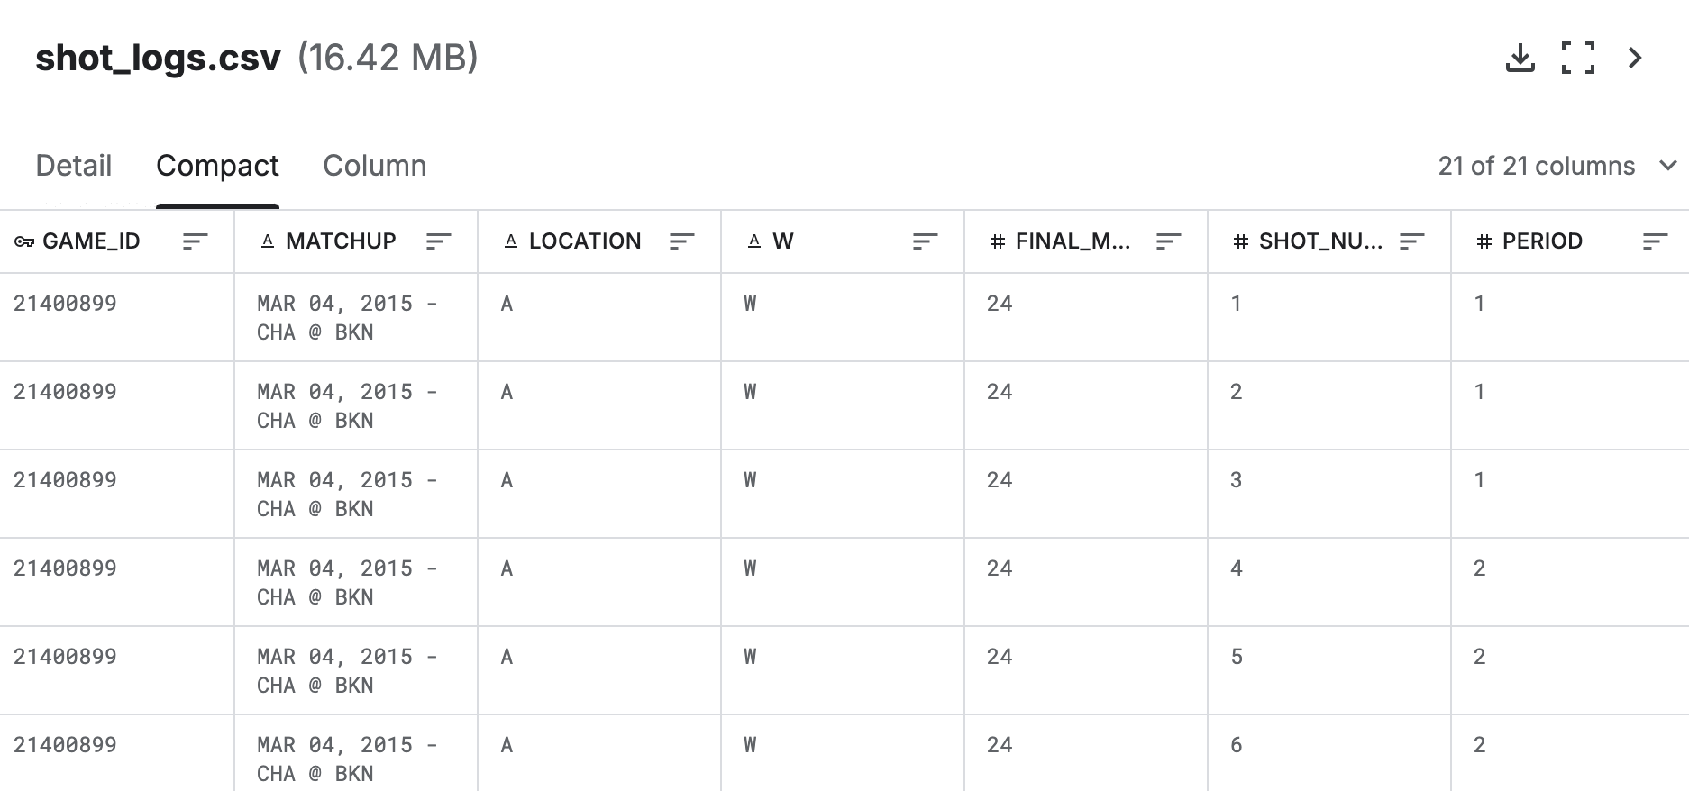
NBA Shot Log Analysis
Raw data is a csv file, each log has 21 properties.
https://www.kaggle.com/datasets/dansbecker/nba-shot-logs

Slide 56
NBA Shot Log Analysis
For each pair of the players (A, B), we define the fear sore of A when facing B is the miss
rate, such that B is closet defender when A is shooting. Based on the fear sore, for each
player, please find out who is his ”most unwanted defender”.
https://www.kaggle.com/datasets/dansbecker/nba-shot-logs

Slide 57
NBA Shot Log Analysis
For each pair of the players (A, B), we define the fear sore of A when facing B is the miss
rate, such that B is closet defender when A is shooting. Based on the fear sore, for each
player, please find out who is his ”most unwanted defender”.
Highest miss rate
https://www.kaggle.com/datasets/dansbecker/nba-shot-logs

Slide 58
NBA Shot Log Analysis
For each pair of the players (A, B), we define the fear sore of A when facing B is the miss
rate, such that B is closet defender when A is shooting. Based on the fear sore, for each
player, please find out who is his ”most unwanted defender”.
Highest miss rate
What info does the csv file has?
GAME_ID
MATCHUP
LOCATION
W
FINAL_MARGIN
SHOT_NUMBER
PERIOD
GAME_CLOCK
SHOT_CLOCK
DRIBBLES
TOUCH_TIME
SHOT_DIST
PTS_TYPE
SHOT_RESULT
CLOSEST_DEFENDER
CLOSEST_DEFENDER_PLAYER_ID
CLOSE_DEF_DIST
FGM
PTS
player_name
player_id

Slide 59
NBA Shot Log Analysis
For each pair of the players (A, B), we define the fear sore of A when facing B is the miss
rate, such that B is closet defender when A is shooting. Based on the fear sore, for each
player, please find out who is his ”most unwanted defender”.
Highest miss rate
For each pair: missed shots / total number of shots
What info do we need?
GAME_ID
MATCHUP
LOCATION
W
FINAL_MARGIN
SHOT_NUMBER
PERIOD
GAME_CLOCK
SHOT_CLOCK
DRIBBLES
TOUCH_TIME
SHOT_DIST
PTS_TYPE
SHOT_RESULT
CLOSEST_DEFENDER
CLOSEST_DEFENDER_PLAYER_ID
CLOSE_DEF_DIST
FGM
PTS
player_name
player_id

Slide 60
NBA Shot Log Analysis
Three tasks:
For each pair of players, compute the total number of shots
For each pair of players, compute the number of missed shots
Aggregate results

Slide 61
NBA Shot Log Analysis
Three tasks:
For each pair of players, compute the total number of shots
For each pair of players, compute the number of missed shots
Aggregate results
How to do the query?
Obtain the player name and defender name
Group the pairs
Obtain the counts of each pair
A-B
B-A
C-D
A-B
C-D
A-B 2
B-A 1
C-D 2

Slide 62
NBA Shot Log Analysis
Three tasks:
For each pair of players, compute the total number of shots
For each pair of players, compute the number of missed shots
Aggregate results
How to do the query?
Obtain the player name, defender name, and the shot result
Filter the shot result where it is ‘missed’
Count the missed results for each pair
A-B ‘missed’
B-A ‘made’
C-D ‘missed’
A-B ‘missed’
C-D ‘made’
A-B ‘missed’
C-D ‘missed’
A-B ‘missed’
A-B 2
C-D 1

Slide 63
NBA Shot Log Analysis
Three tasks:
For each pair of players, compute the total number of shots
For each pair of players, compute the number of missed shots
Aggregate results
Total pairs
Missed
Total pairs
Missed
Miss Rate
A-B 2
B-A 1
C-D 2
A-B 2
C-D 1
A-B 2
B-A 1
C-D 2
A-B 2
B-A 0
C-D 1
A-B 100%
B-A 0%
C-D 50%
Then, for each player, we sort the defenders‘ miss rate and find the defender with highest miss rate.

Slide 64
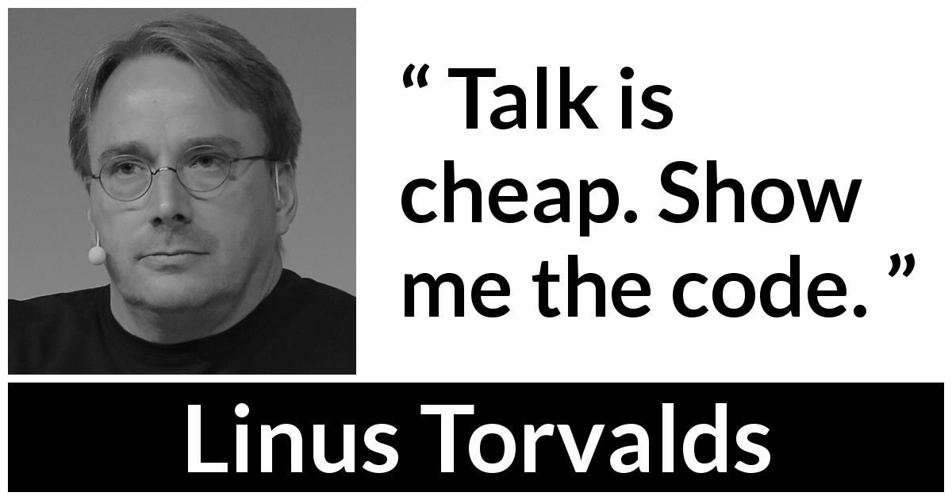
NBA Shot Log Analysis
Three tasks:
For each pair of players, compute the total number of shots
For each pair of players, compute the number of missed shots
Aggregate results
Total pairs
Missed
Total pairs
Missed
Miss Rate
A-B 2
B-A 1
C-D 2
A-B 2
C-D 1
A-B 2
B-A 1
C-D 2
A-B 2
B-A 0
C-D 1
A-B 100%
B-A 0%
C-D 50%
Then, for each player, we sort the defenders‘ miss rate and find the defender with highest miss rate.

Slide 65

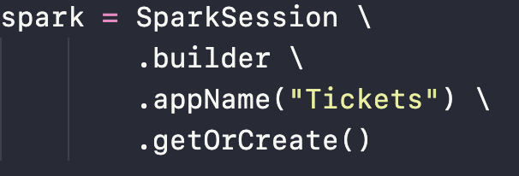
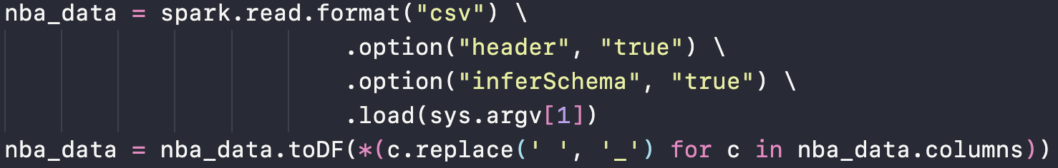
NBA Shot Log Analysis
Setup spark session:
Read raw data and create a temp view:

Slide 66
NBA Shot Log Analysis
Three tasks:
For each pair of players, compute the total number of shots
For each pair of players, compute the number of missed shots
Aggregate results
Obtain the player name and defender name
Group the pairs
Obtain the counts of each pair

Slide 67
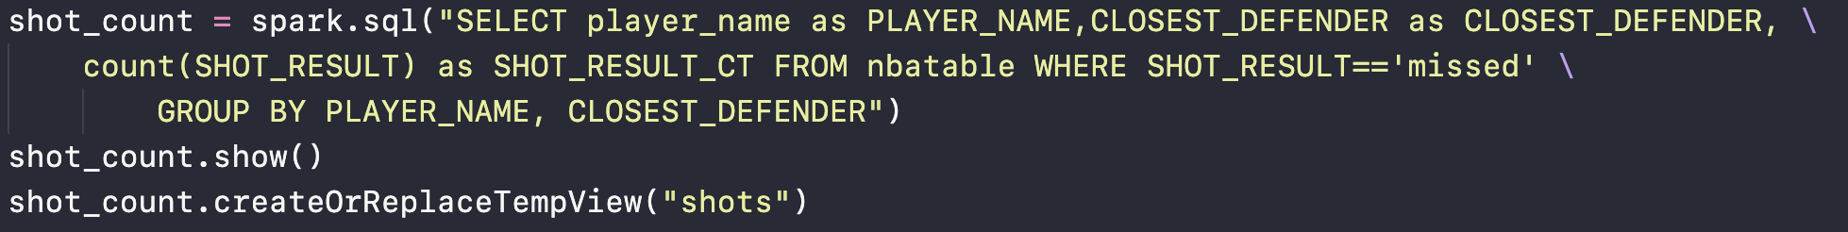
NBA Shot Log Analysis
Three tasks:
For each pair of players, compute the total number of shots
For each pair of players, compute the number of missed shots
Aggregate results
Obtain the player name, defender name, and the shot result
Filter the shot result where it is ‘missed’
Count the missed results for each pair

Slide 68
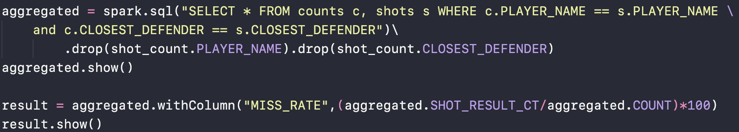
NBA Shot Log Analysis
Three tasks:
For each pair of players, compute the total number of shots
For each pair of players, compute the number of missed shots
Aggregate results

Slide 69
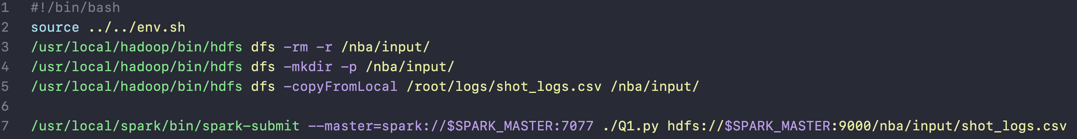
NBA Shot Log Analysis
How to run this code?

Slide 70
Mllib
Machine Learning Algorithms
Supervised learning
Given a set of features and labels
Builds a model that predicts the label from the features
E.g., Classification and regression
Unsupervised learning
Given a set of features without labels
Finds interesting patterns or underlying structure
E.g., clustering and association mining
Credits: Ahmed Eldawy

Slide 71
Mllib
Overview
Simple primitives
Basic Statistics
Extractors, transformations
Estimators
Evaluators
Model tuning

Slide 72
Mllib
Simple primitives
Local vector
To represent features (e.g., {1.2, 0.0, 5.5, 2.1})
Dense form (e.g., [1.2, 0.0, 5.5, 2.1])
Sparse form (e.g., [0,2,3], [1.2, 5.5, 2.1])
Local matrix
Dense and sparse form representations
Dataframe.randomSplit
Splits an input dataset randomly
Useful in dataset train / test split

Slide 73

Mllib
Basic Statistics
Column statistics
Minimum, maximum, count, etc.
Correlation
Pearson’s and Spearman’s correlation
Hypothesis testing
Chi-square Test

Slide 74
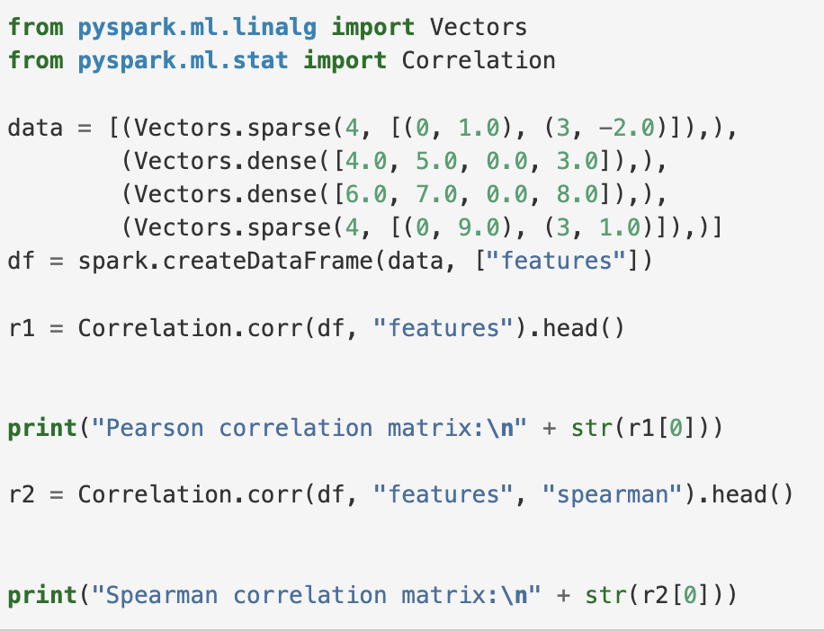
Mllib
Basic Statistics
Column statistics
Minimum, maximum, count, etc.
Correlation
Pearson’s and Spearman’s correlation
Hypothesis testing
Chi-square Test
https://spark.apache.org/docs/latest/ml-statistics.html

Slide 75
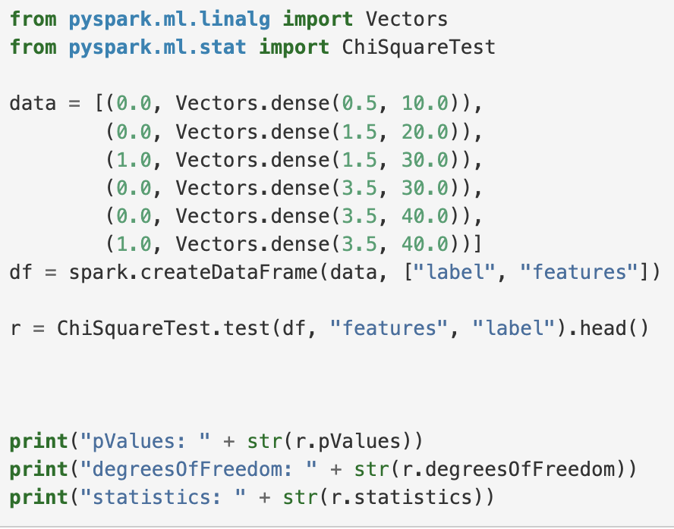
Mllib
Basic Statistics
Column statistics
Minimum, maximum, count, etc.
Correlation
Pearson’s and Spearman’s correlation
Hypothesis testing
Chi-square Test
https://spark.apache.org/docs/latest/ml-statistics.html

Slide 76
Mllib
Parameters
ML Stages
Input
Data Loading
Data Cleaning
Feature extraction and transformation
Estimator
Prediction
Final Model
Evaluator
Model
Test Data

Slide 77
Mllib
Transformations
Used in feature extraction, dimensionality reduction, or schema transformation
Text transformations
Encoding
Normalization
Hashing

Slide 78
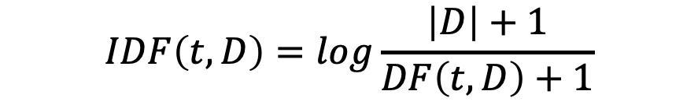
Mllib
Transformations
TF-IDF
Term frequency-inverse document frequency
Measures the importance of a term in a document
TF: Count of a term in a document
DF: Number of documents that contain a term
$$IDF\left(t,D\right)=log\frac{\left|D\right|+1}{DF\left(t,D\right)+1}$$
$$TFIDF\left(t,D\right)=TF\left(t,d\right)∙IDF(t,D)$$

Slide 79
Mllib
Transformations
Word2Vec
Converts each sequence of words to a fixed-size vector
In this model, similar sequences of words are supposed to be mapped to nearby vectors

Slide 80
Mllib
Transformations
Other text transformers
Tokenizer: used by most of today’s large language model (LLM)
Stop word remover: Removes common but less important word in the context, e.g., a, an, the.
StringIndexer: Converts each unique string to a numeric value
IndexToString: Converts each integer value to a string value using a lookup table (pre-defined or trained)

Slide 81
Mllib
Encoders
PCA (Principal Component Analysis)
Reduces number of dimensions to a set of uncorrelated dimensions (components)
DiscreteCosineTransform (DCT)
Frequency analysis
OneHotEncoder: Converts categorical values to a vector with one bit set for the category

Slide 82
Mllib
Estimators
An estimator is a machine learning algorithm that fits a model on the data
Classification
Classifies data points into discrete points (categories)
Regression
Estimates a continuous numeric
Clustering
Groups similar records together into clusters
Collaborative filtering (Recommendation)
Predicts (missing) user ratings for items
Frequent Pattern Mining

Slide 83
Mllib
Clustering
Unsupervised learning method
K-means clustering. Clustering based on distance between vectors
Latent Dirichlet allocation (LDA). Groups vectors based on some latent (hidden) variables
Bisecting k-means. Hierarchical clustering
Gaussian Mixture Model (GMM). Breaks down data distribution into multiple Gaussian distributions

Slide 84
Mllib
Evaluator
An Evaluator takes a model and produces numeric values that measure the goodness of the model for a specific dataset
BinaryClassificationEvaluator evaluates binary classifiers using precision, recall, F- measure, area under ROC curve, … etc.
MulticlassClassificationEvaluator evaluates multiclass classifiers using confusion matrix, accuracy, precision, recall … etc.

Slide 85
Mllib
Validator
Each model has its own parameters that are usually no intuitive to tune
A validator takes a pipeline, an evaluator, and a set of parameters and it tries all possible combinations of parameters to find the best model, i.e., the model that gives the best numeric evaluation metric
Examples, CrossValidator and TrainValidationSplit

Slide 86
Thank You!

