Slide 1
Compression for Communication in Large-Scale Distributed Training
Luddy School of Informatics, Computing, and Engineering
Baixi Sun
Indiana University Bloomington
Notes:
Collaborating

Slide 2
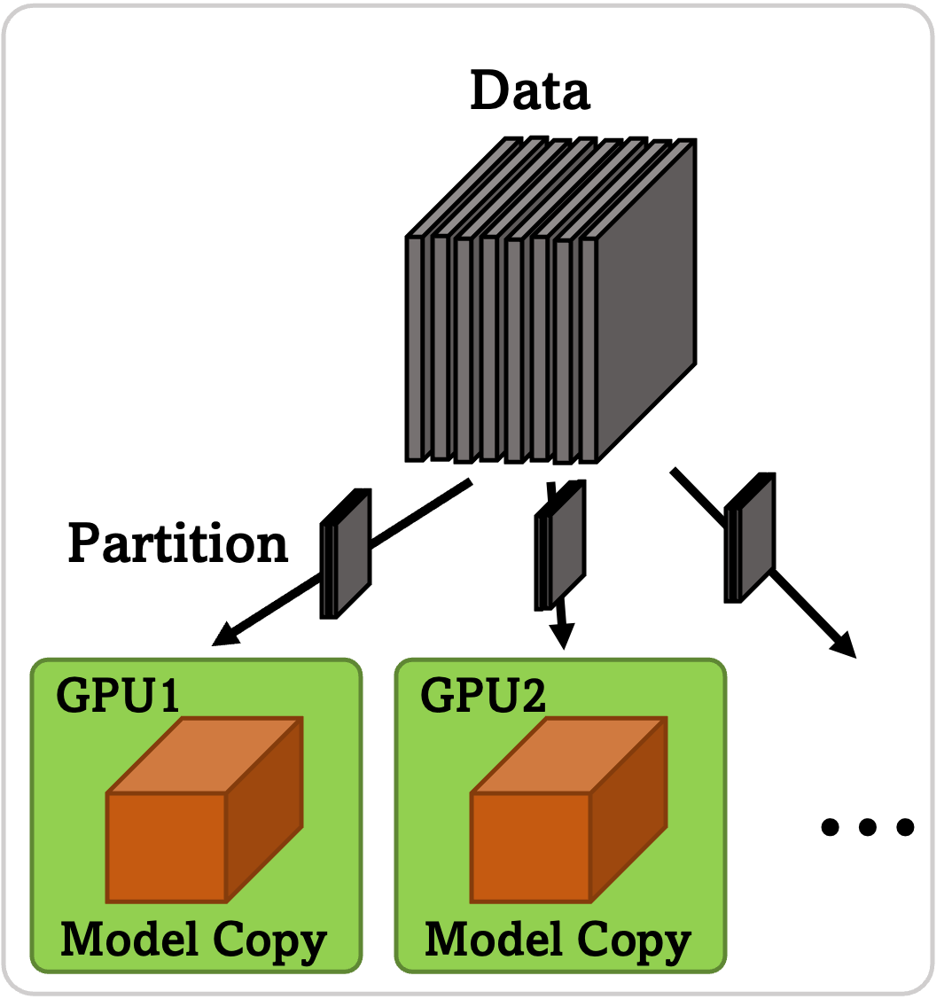
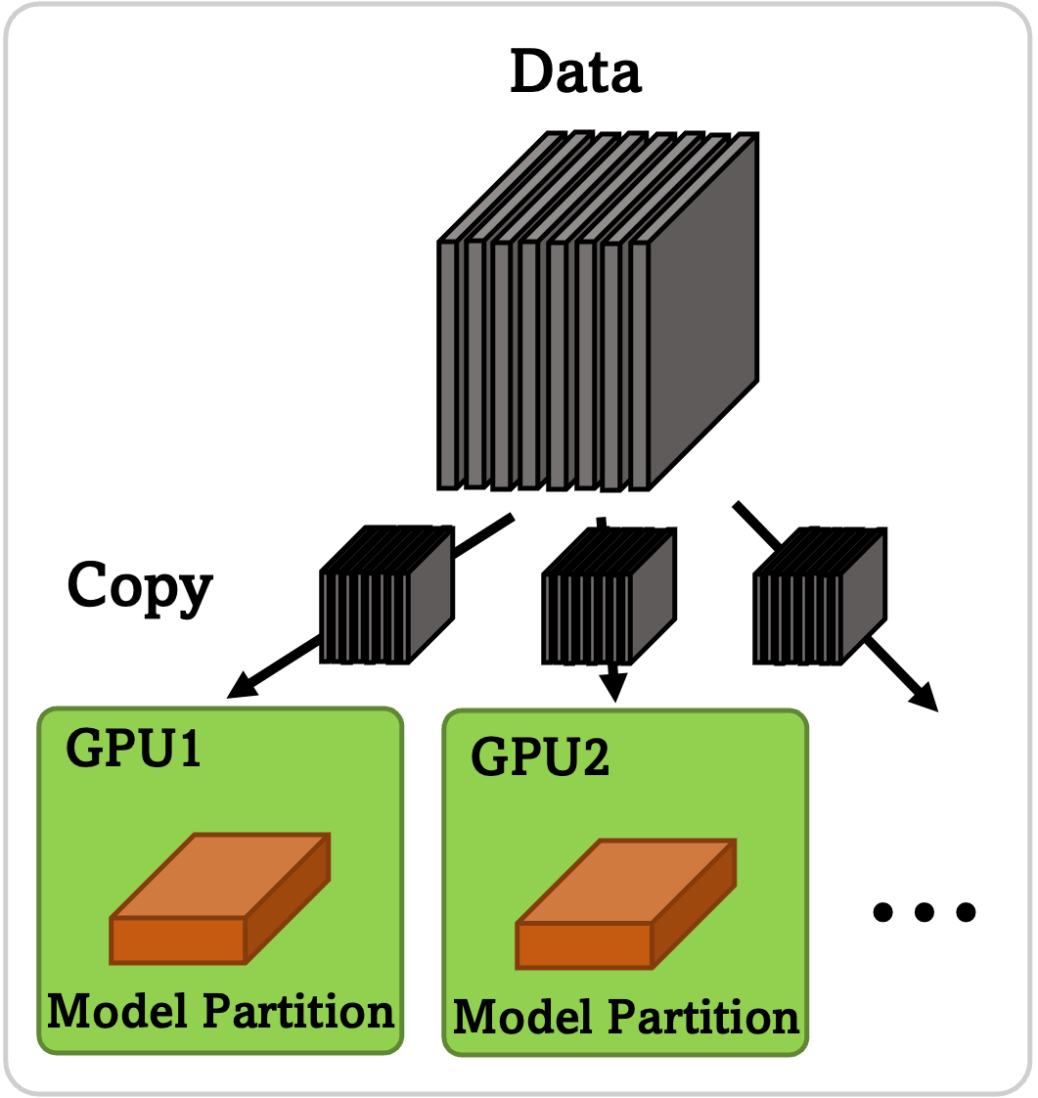
Background & Motivation
Distributed Training Enables AI with Large Dataset/Model
DNN training heavily depends on large datasets. Data parallelism where each device trains the entire model on a partition of the dataset.
DNN models are too large to fit to a single device. Model parallelism where each device train the partitioned model on the entire dataset.
DNN models require intensive computation and depends on large datasets. Pipeline parallelism
Data parallelism
Model parallelism
e.g.,
Data Parallelism
Model Parallelism
Data Parallelism
Load Input Data
Communications For Types Of Parallelism
Forward pass
Data parallelism requires gradient synchronization. Typically, all-reduce
Model parallelism requires activation data propagation in forward and backward pass. Typically, point-to-point
Pipeline parallelism extensively requires gradient gathering and synchronization.
Typically, all-gather
Backward pass
Gradient Synchronization
Model Update

Slide 3
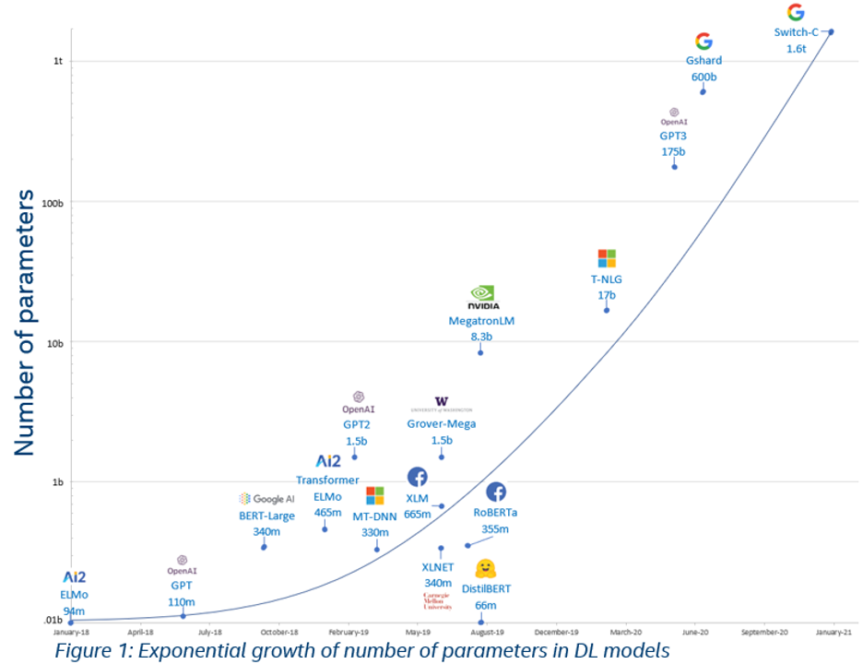
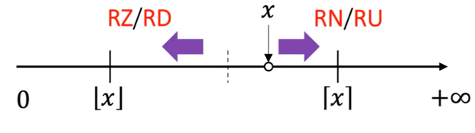
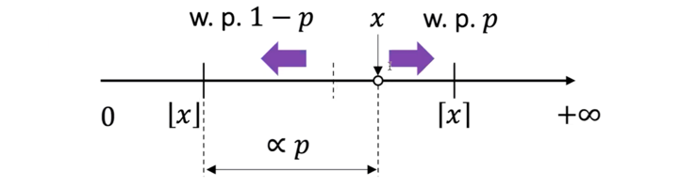
Background & Motivation
Compression For Communication
Today’s DNN model size are exponentially increasing
Distributed training techniques play a more important role
Communication is more intensive considering the number of workers (e.g., GPU) used and the communication data size.
Reducing the communication data size via compression improves the scalability and overall training performance.
Types Of Compression Algorithms
e.g.,
w/ Predictor
w/o Predictor
RN
SZ3
Modified SZ3
SR
QSGD
Rounding to nearest (RN)
Stochastic Rounding (SR)
QSGD quantizes the L-2 Normalized gradients and controls the error via number of quantization bins

Slide 4
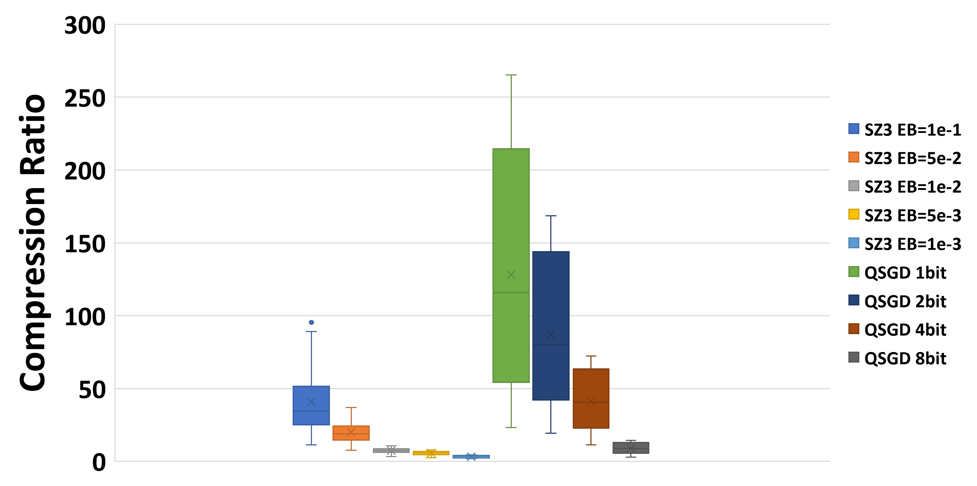
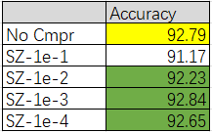
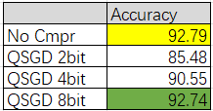
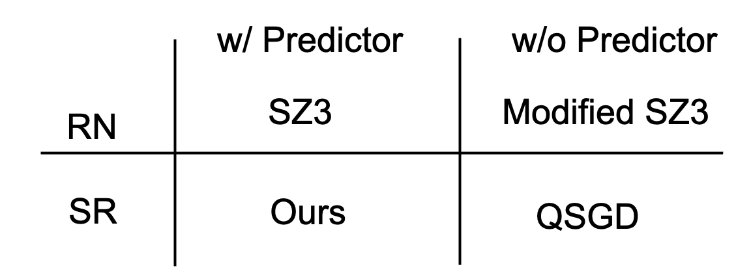
Challenges
= No compression
= No significant accuracy drop
Preserving Test Accuracy While Achieving High Compression Ratio
When the compression ratio is high, the test accuracy is significantly degraded
When the test accuracy has no significant drop, the compression ratio is low
Achieving End-to-end Performance Improvement
The incurred computation overhead in compression and decompression can neutralize the improved communication performance

Slide 5
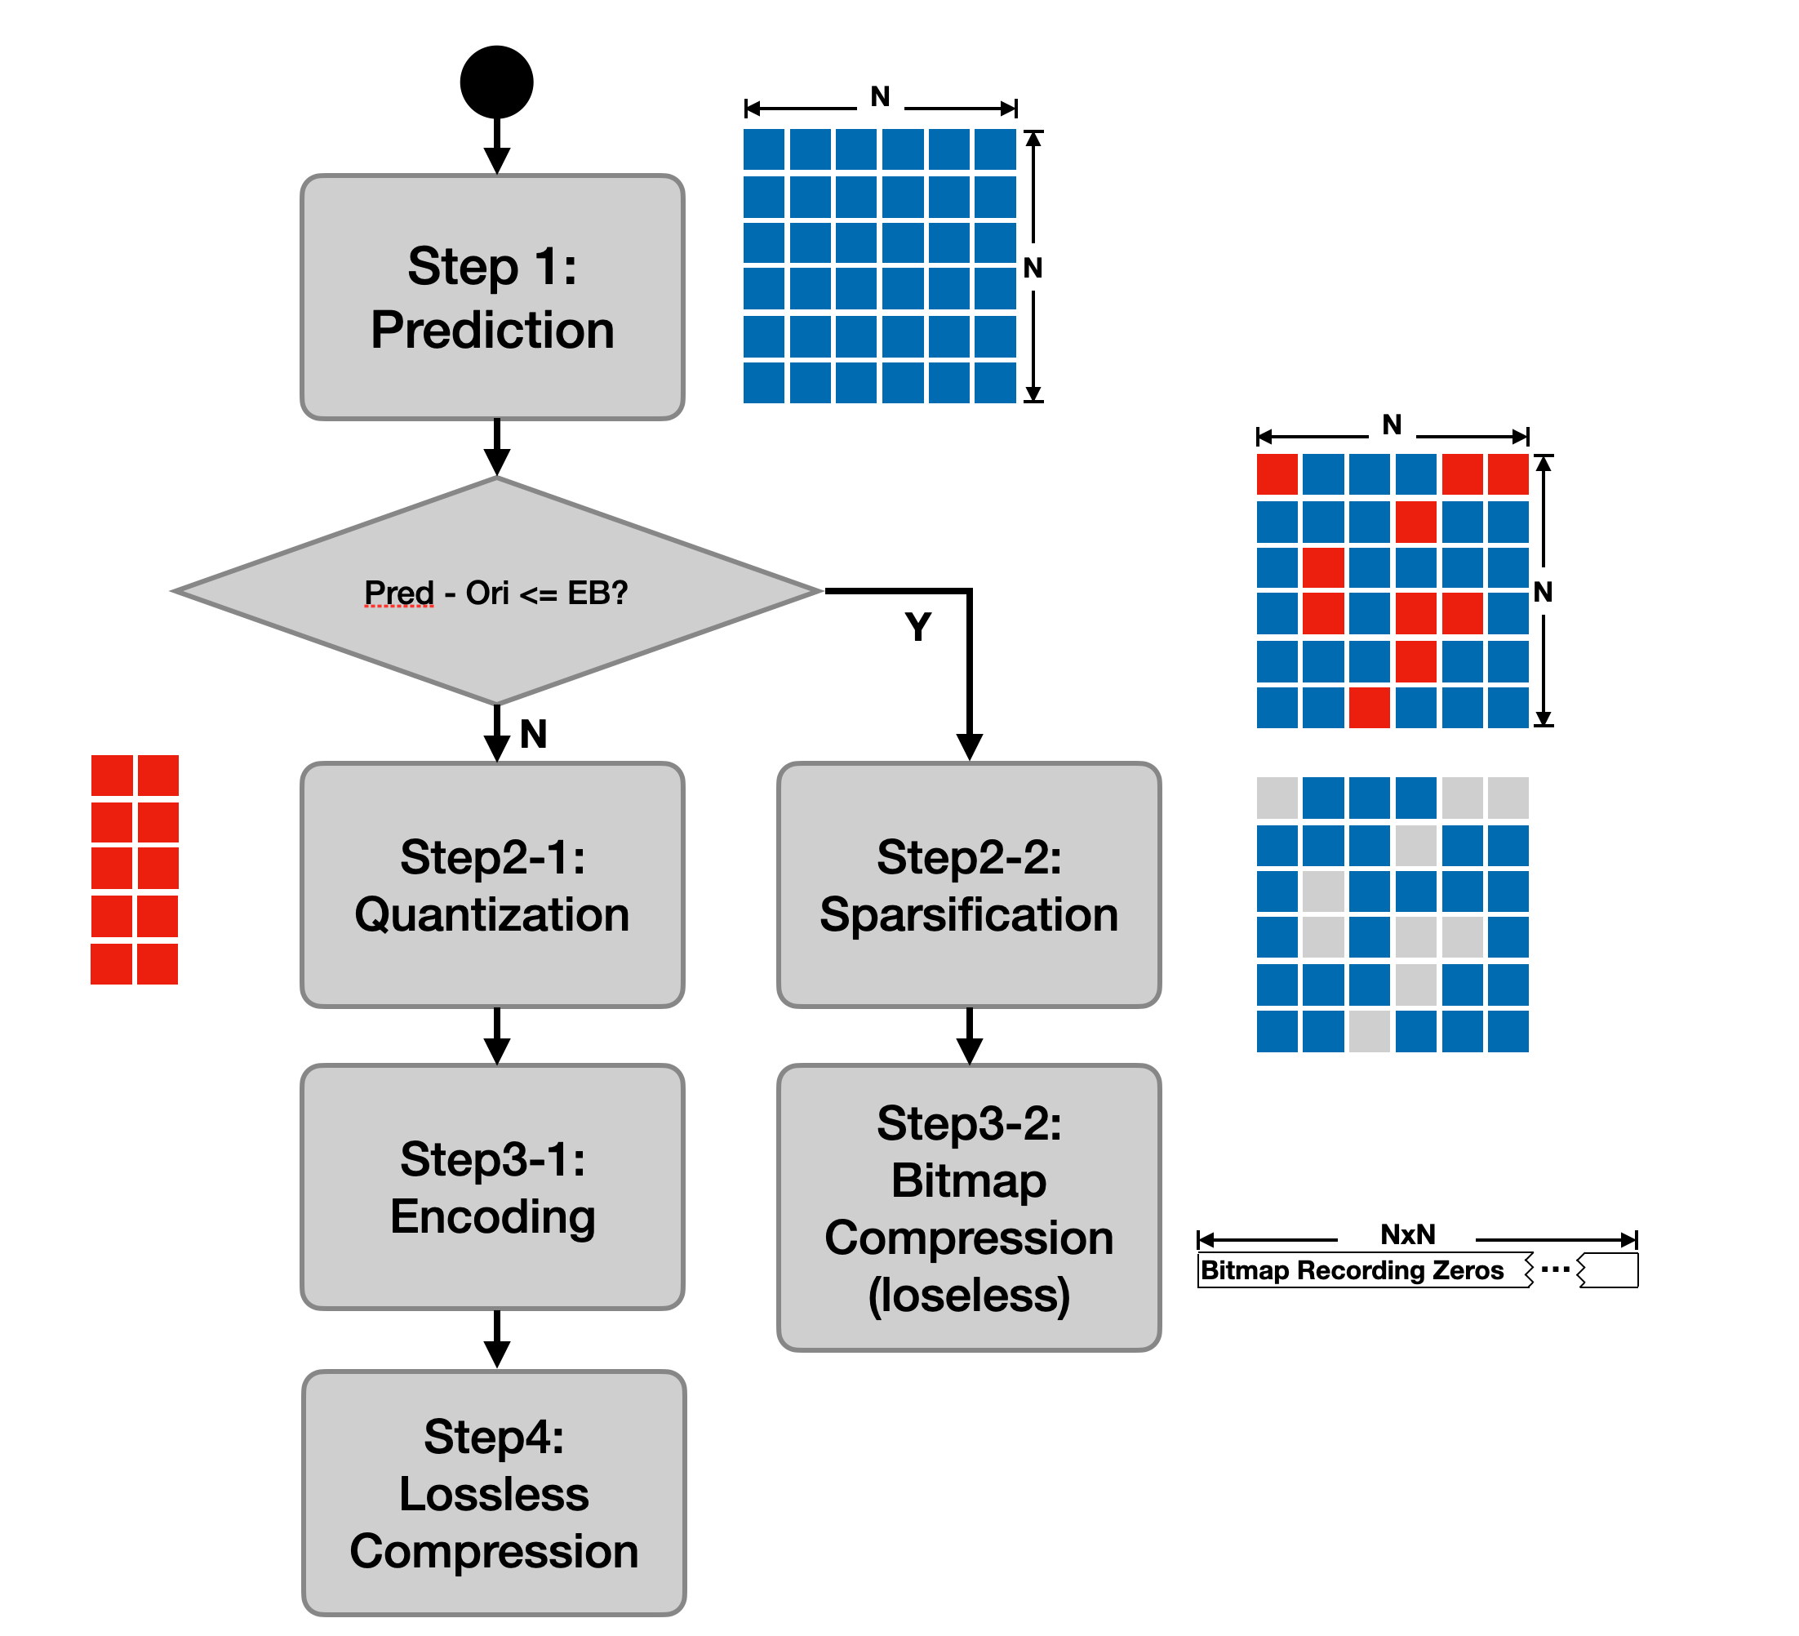
Proposed Method
Preserving Test Accuracy While Achieving High Compression Ratio
Compression:
Sparsify the data using predictor
Quantize the unpredictable data points with SR
Decompression:
Reverse the steps
Achieving End-to-end Performance Improvement
Aggregate multiple layer’s data
Share codebook
Aggregate multiple communications into one
Optimize the algorithm on GPUs

Slide 6
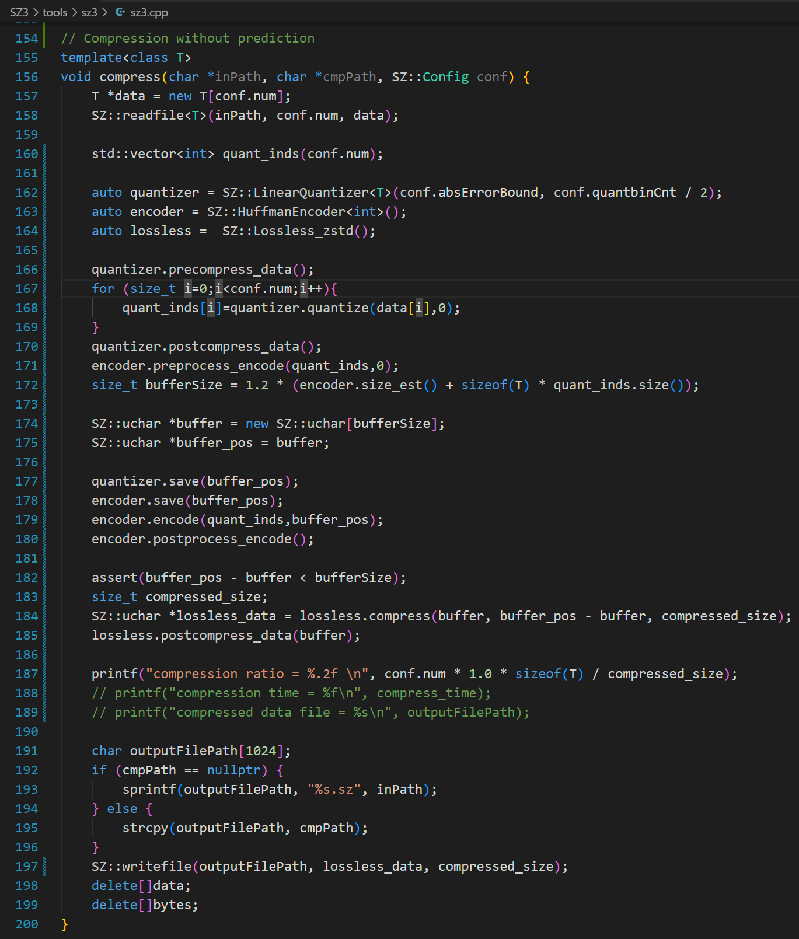
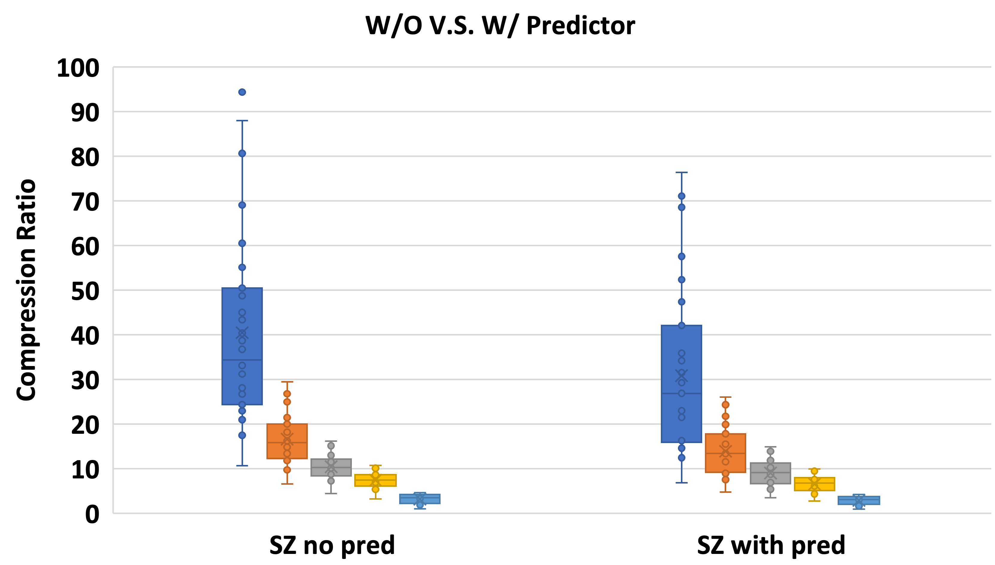
Exploring the SZ3 Platform
SZ3 is a Modularized Platform
Select the needed module
Customize algorithms in each module
Case 1: Using SZ3 without predictor
Gradient compression algorithms does not apply prediction algorithms, why?
sz3.cpp
Quantizer
Encoder
Loseless

Slide 7
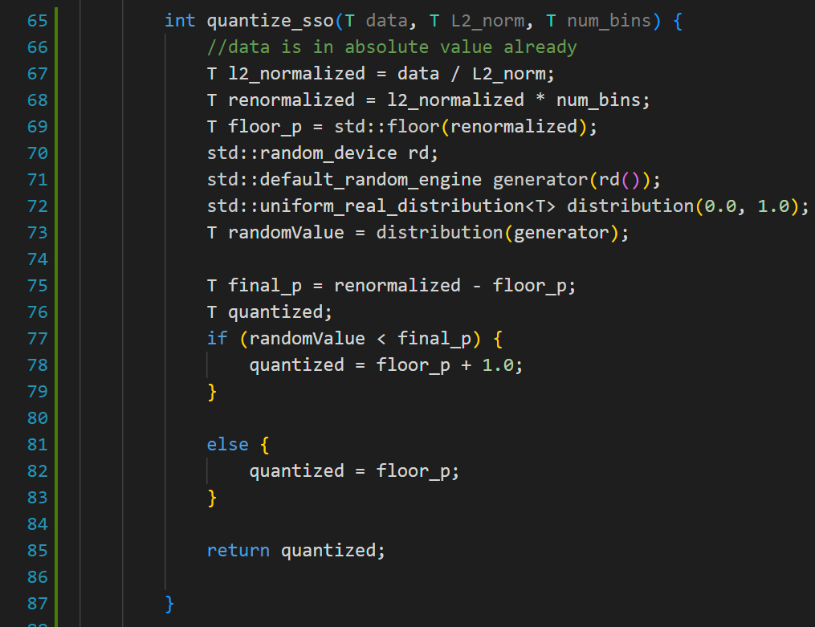
Exploring the SZ3 Platform
Case 2: Customize Quantization Methods
IntegerQuantizer.hpp
Use SR instead of RN
Steps
1. L2 Normalization.
2. Renormalize using number of bins.
3. Generate a random number.
4. Compare the distance and the random number.
5. If the random number is larger, round down, else round up.

Slide 8
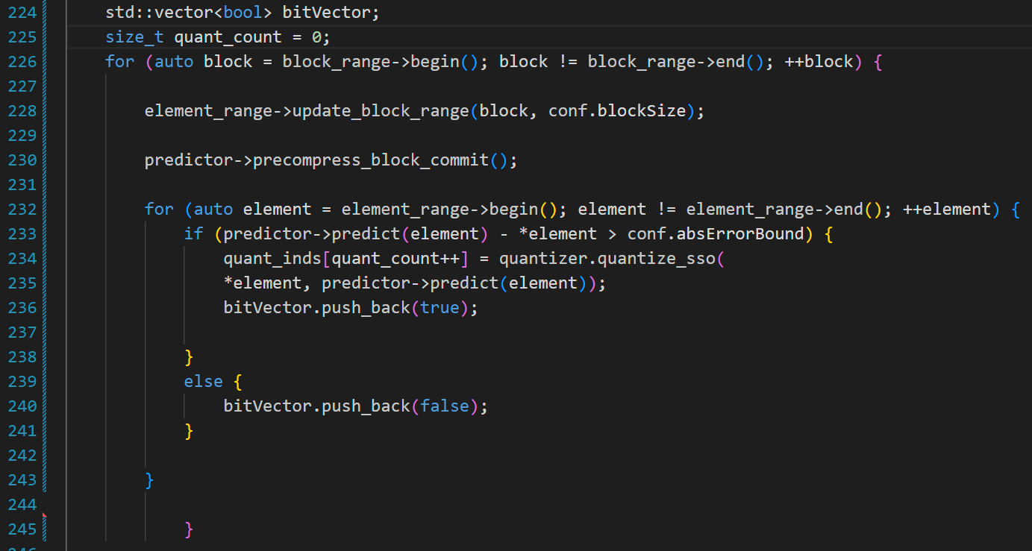
Exploring the SZ3 Platform
Case 3: Use Predictor for Sparsification
sz3.cpp
Use the predictor as filter
Suggestions for SZ3 / 4
Separate the predictor and quantization module to improve code reuse.
More documents or tutorials are appreciated.

