Slide 1
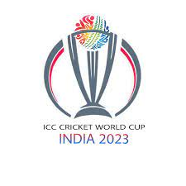
WORLD CUP 2023 ANALYSIS
Mentorness Internship Program
Asibecheh Precious Omechamba
MIP-ML-02

Slide 2
Project Objectives
The goal of this project is to perform an Exploratory Data Analysis (EDA) on the World Cup 2023 dataset by uncovering patterns, trends and a notable statistics that provide a delicate understanding of the team and player’s performance.

Slide 3

Dataset Description
team: Teams that participated in the tournament.
Player: Name of the players that participated in the tournament.
bat_or_bowl: Role of the player.
bb_bf: Balls bowled by the bowler or balls faced by the batsman.
runs: Runs scored by player in a match.
wkts: Wickets taken by the bowler.
wicketball_prob: Wickets taken per bb_bf.
runs_per_ball: runs / bb_bf.
opposition: Opposition team the player played against.
ground: The place where the match will take place.
start_date: Date of the match.
overs: Number of overs made by the bowler.
mdns: Number of maiden overs bowled.
econ: The average number of runs the bowler conceded per over bowled.
inns: innings.
4s: Number of fours scored by the batsman.
6s: Number of sixes scored by the batsman.
sr: Strike rate of the batsman.
not_out: The batsman was not out.
mins: Time period the batsman lasted on the field (minutes).

Slide 4
Exploratory Data Analysis

Slide 5
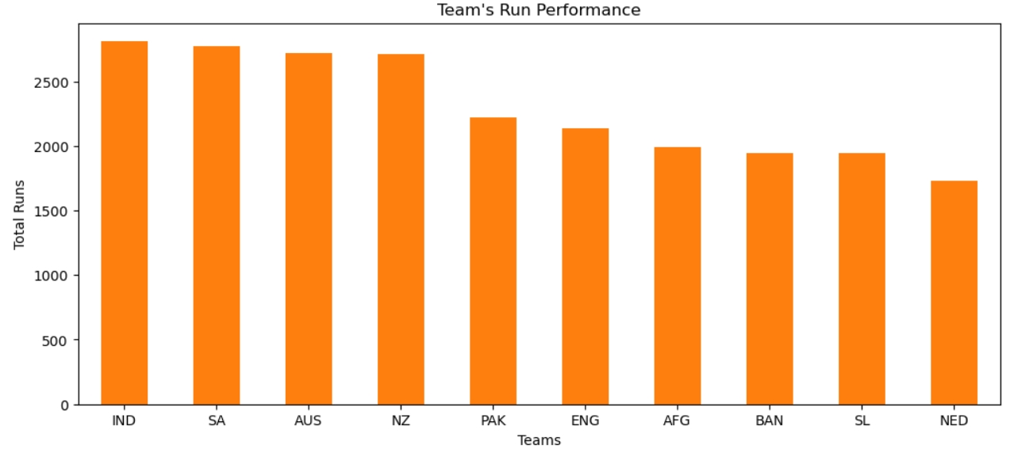
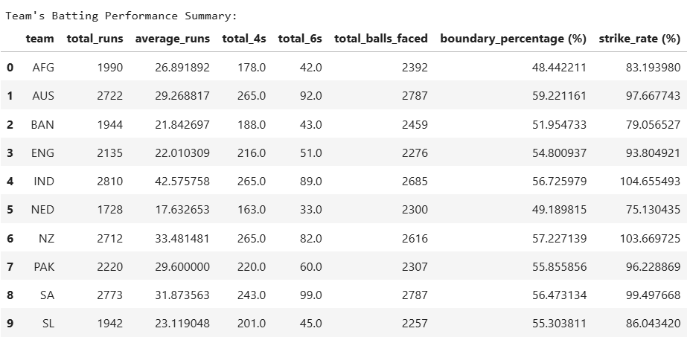
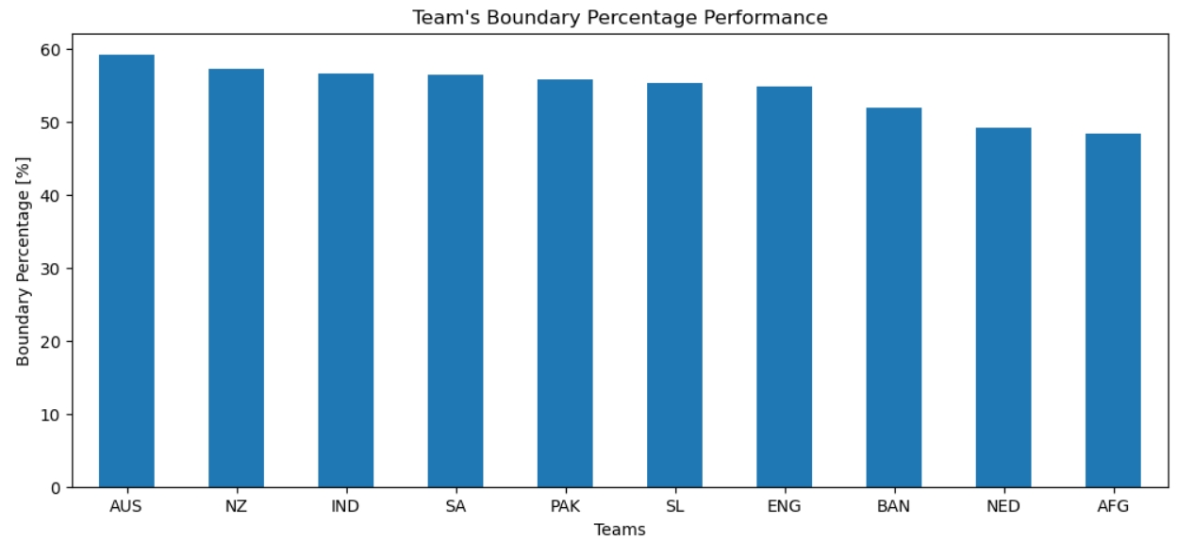
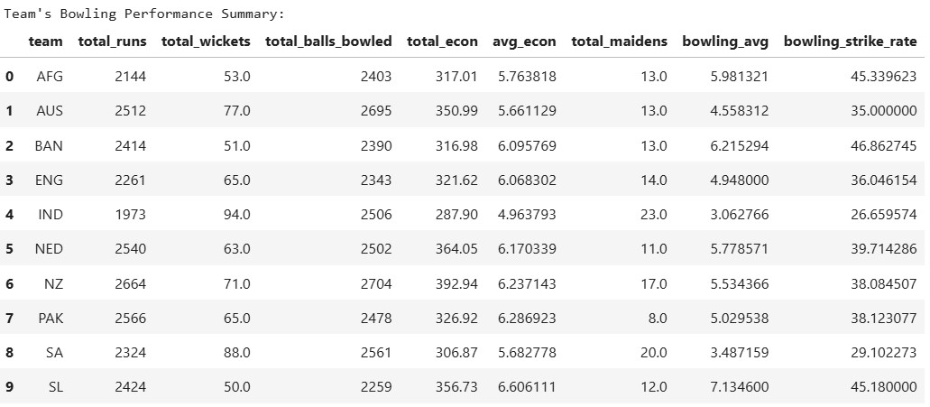
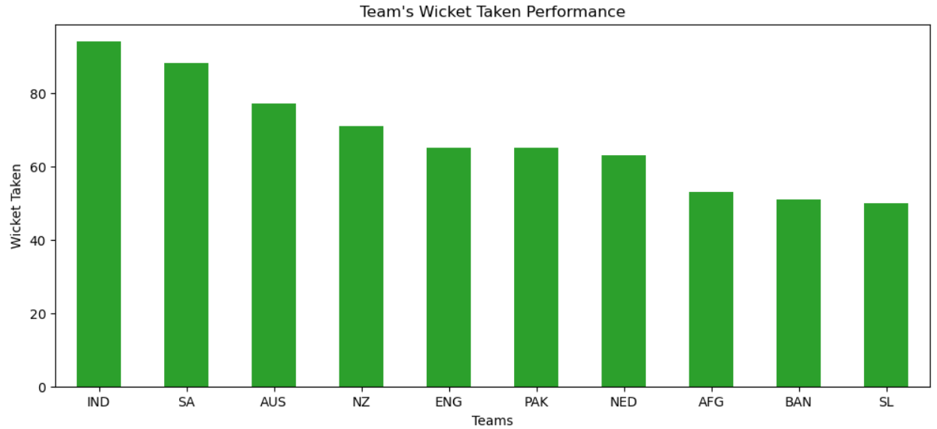
Team Performance Analysis

Slide 6
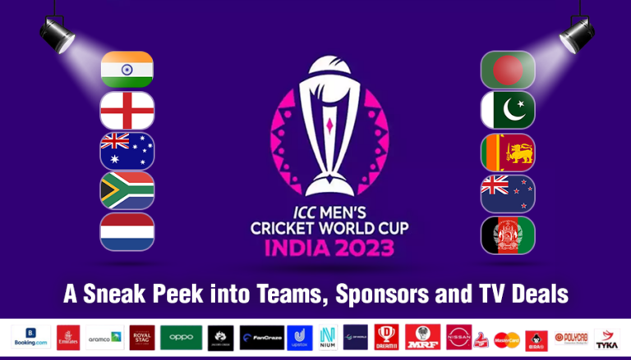
Findings
“IND” scored more runs during the tournament. Second by “SA”, third by “AUS” and fourth by “NZ”. Similarly, “IND” has the highest number of wickets in the tournament with “SA” being the second, “AUS” being the third and “NZ” the fourth.
The top performing teams during the tournament are “IND”, “SA”, “AUS” and “NZ”.
With these four teams being the top performers in runs scored and wickets taken, they possess both competent batting and bowling capabilities.
With “AUS” possessing the highest boundary percentage of about 59.22%, this implies that it scored 59.22% of its run by fours and sixes.

Slide 7
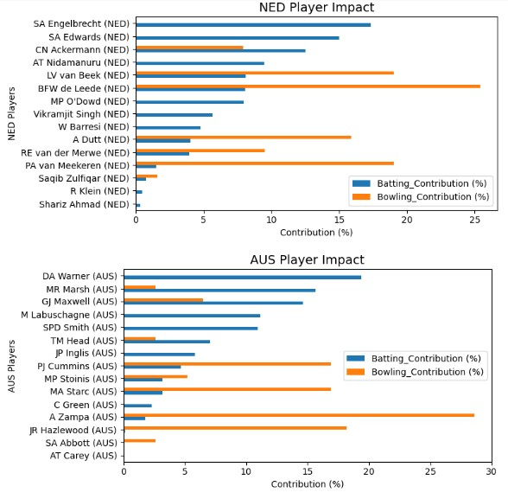
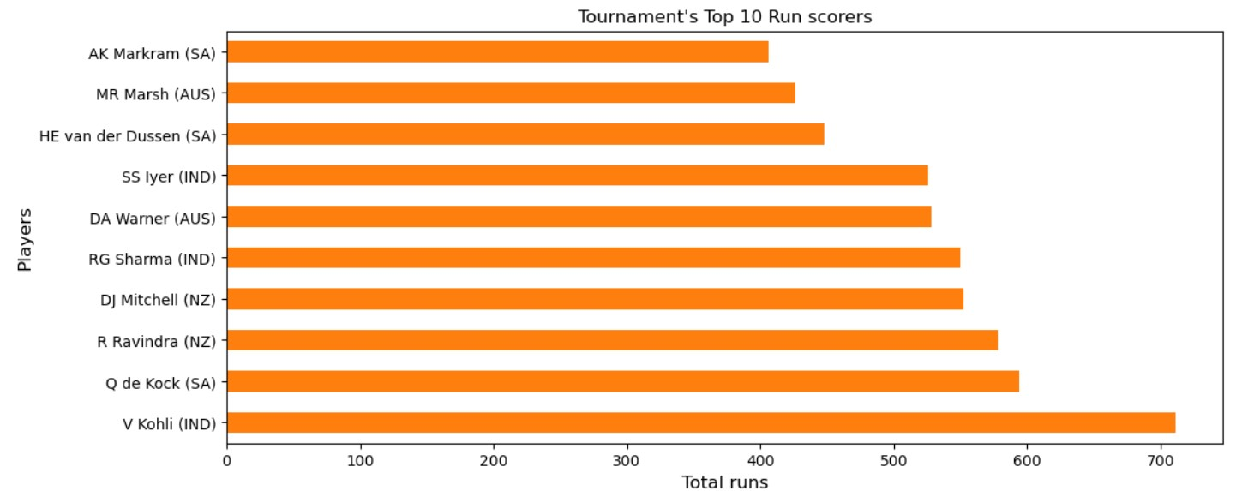
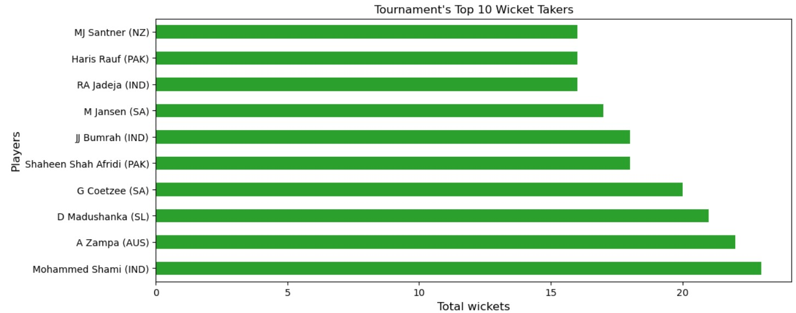
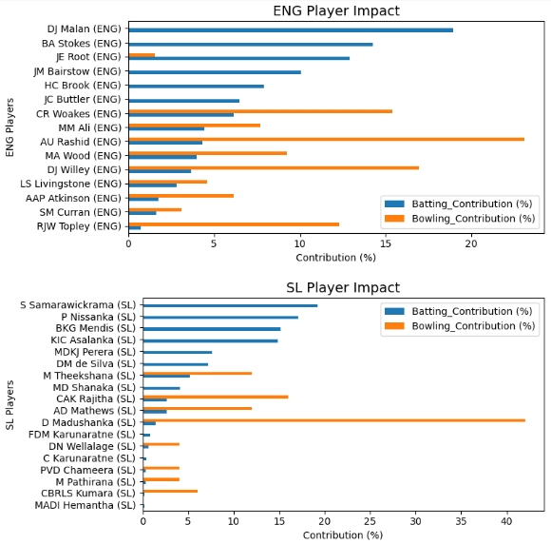
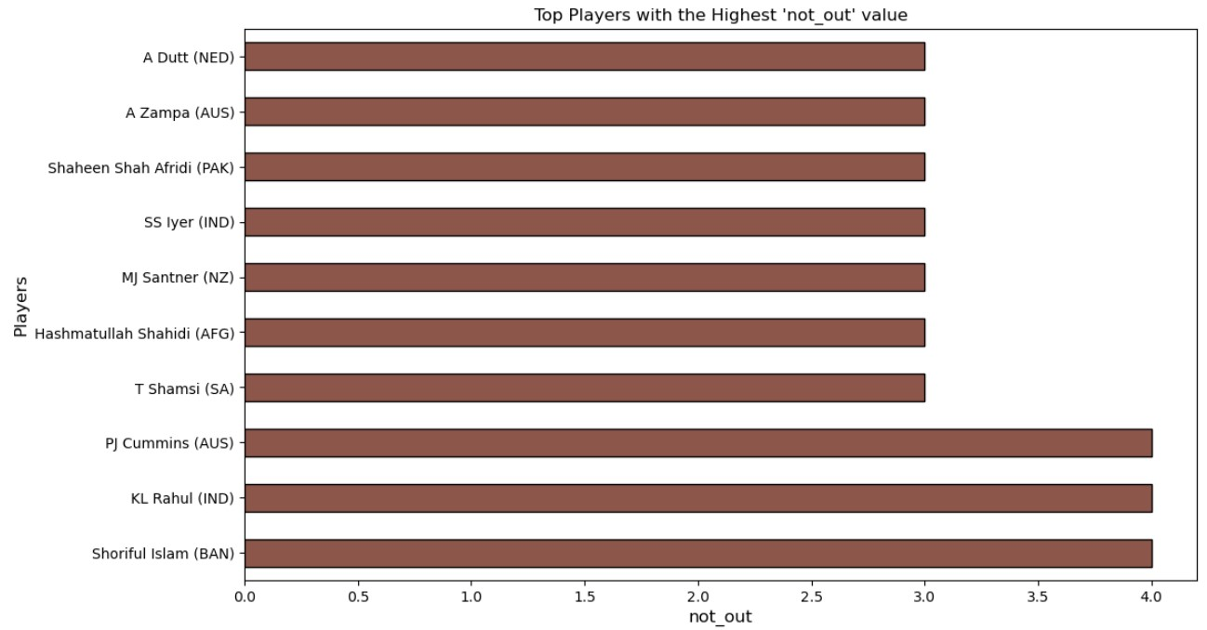
Player Performance Analysis

Slide 8
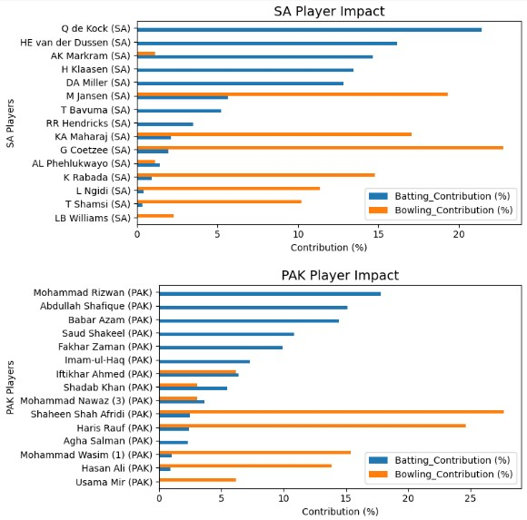
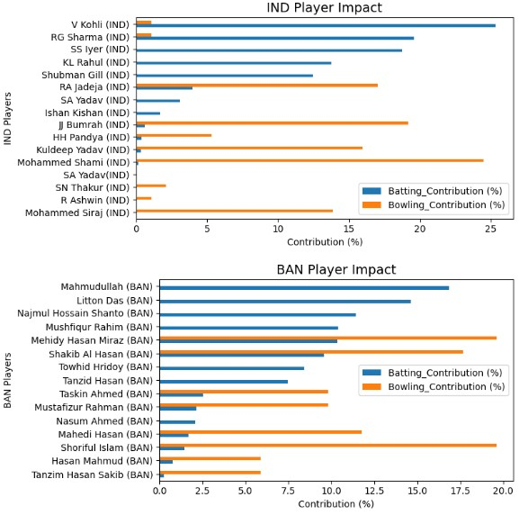
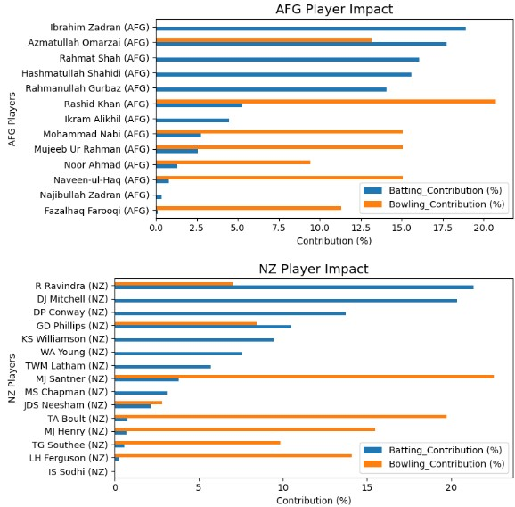

Slide 9
Findings
The leading run scorer of the World Cup 2023 tournament was “V Kohli” from “IND” team with a total run score of more than 700. Second by “Q de Kock” from “SA” team and third by “R Ravindra” from “NZ” team.
The leading wicket takers of the World Cup 2023 tournament was “Mohammed Shami” from “IND” team with a total number of wicket greater than 20. Second by “A Zampa” from “AUS” team and third by “D Madushanka” from “SL” team.
Player with the most not_out value was “Shoriful Islam” from “BAN” team.
Players of each teams that participated in the tournament contributed not more than 23% of their team's total runs, except for the team “IND” with just a player that contributed more than 25% (“V Kohli”) of the team's total run.
There are six teams with players that contributed less than 25% of the wickets taken (i.e bowling contribution) and for the rest of the teams, that is “NED”, “AUS”, “SL”, and “PAK” have just a single player with a contribution value of more than 25%of the wickets taken.
The team "SL" has a player (D. Madushanka) with the greatest bowling contribution of around 42% compared with any other player that participated during the tournament. This means that this player has a huge impact on the team's performance (i.e total wickets taken).

Slide 10
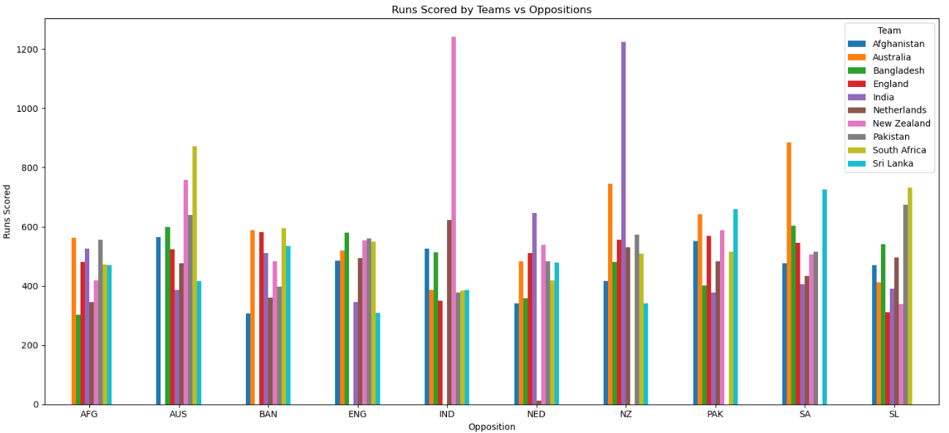
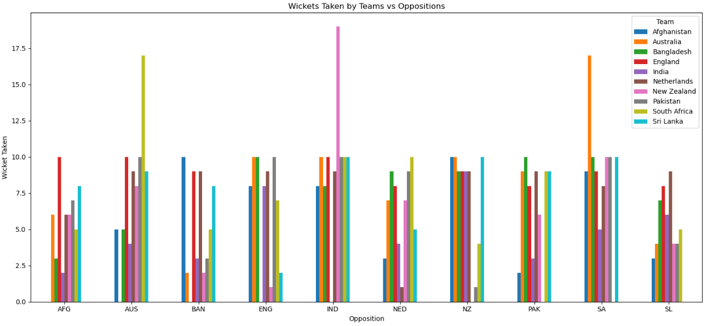
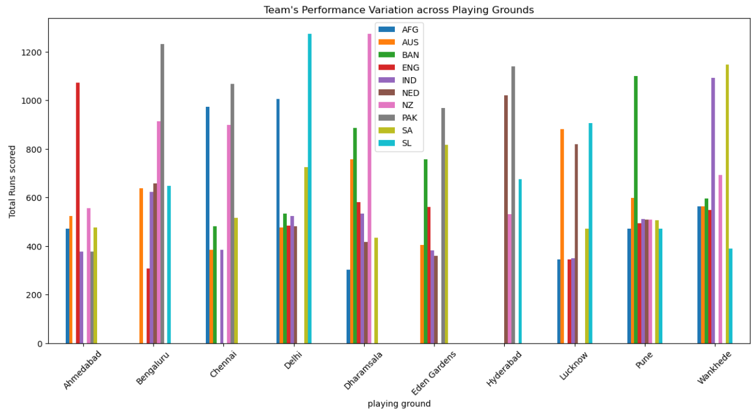
Opposition and Ground Analysis

Slide 11
Findings
The teams “AFG”, “BAN” and “ENG” scored a maximum number of runs less than 600 against each opposition team in the entire tournament.
The teams “IND” and “NZ” team scored a maximum number of runs far greater than 1000 when played against each other.
Among all the teams, the teams “AUS”, “IND” and “SA” have a maximum wicket value far greater than 10 when played against each opposition team compared to the maximum wicket value of the rest of the teams (which is equal to 10).
The teams “NZ” and “SL” scored more runs in “Delhi” and “Dharamsala” playing ground respectively compared to the other playing grounds.

Slide 12
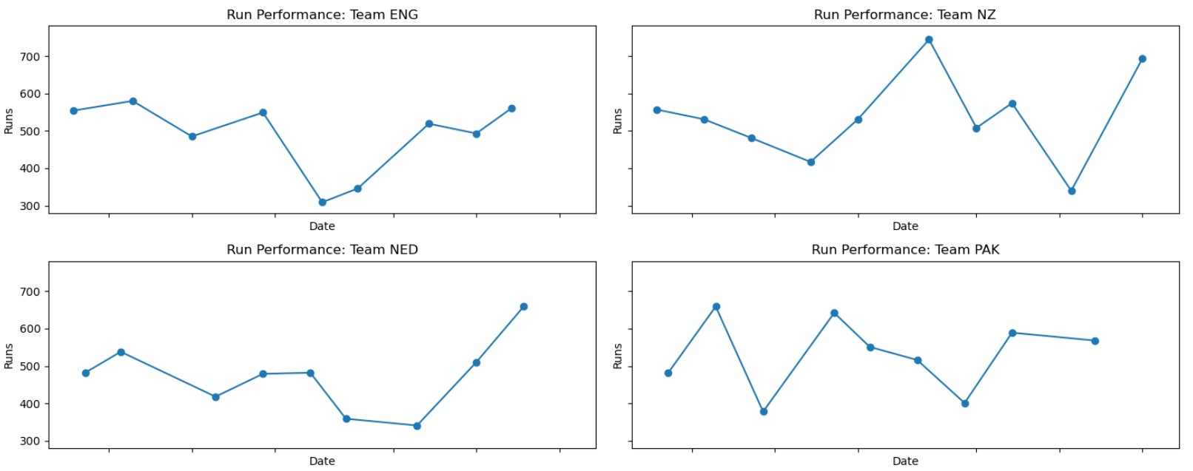
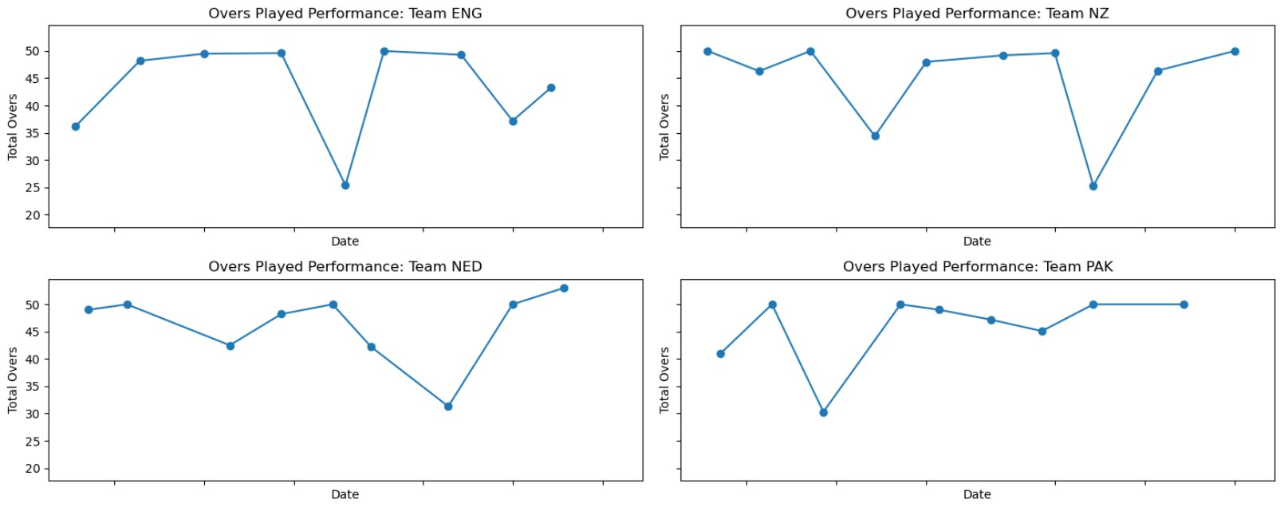
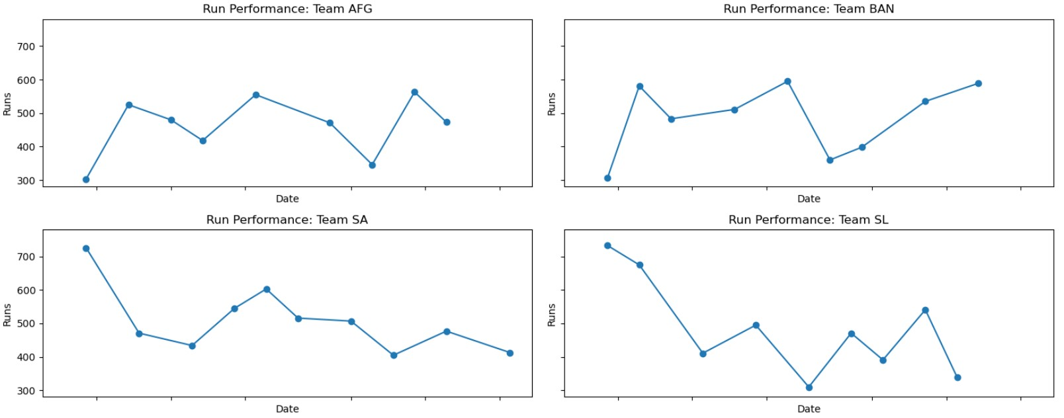
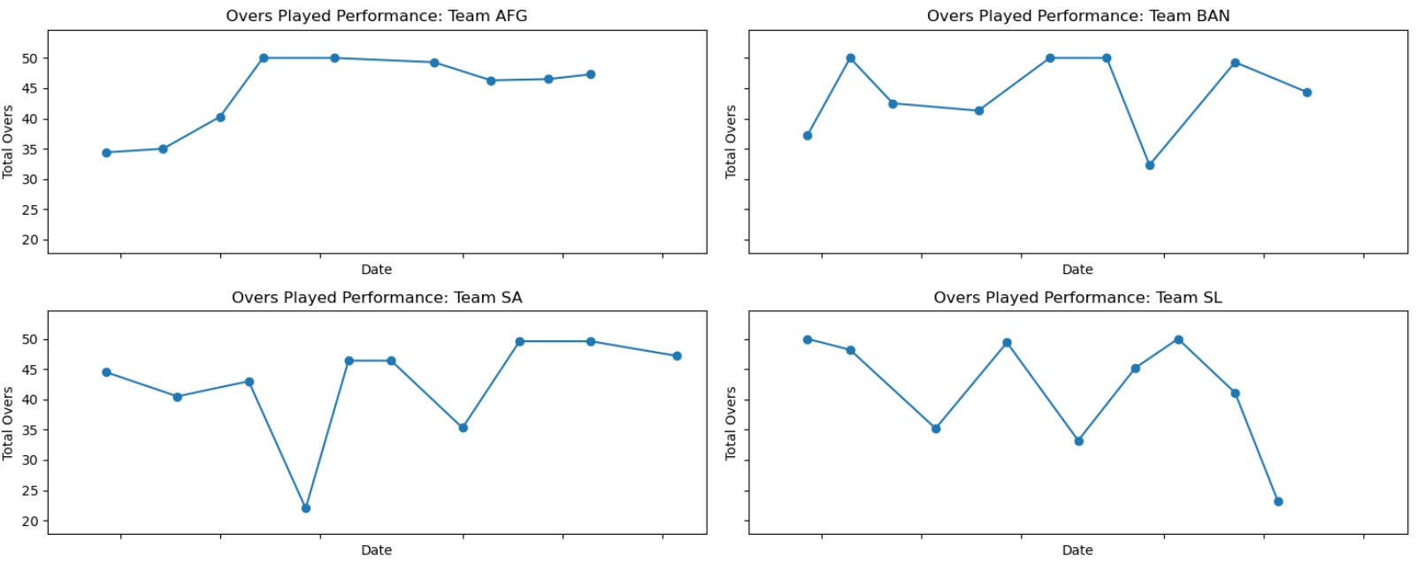
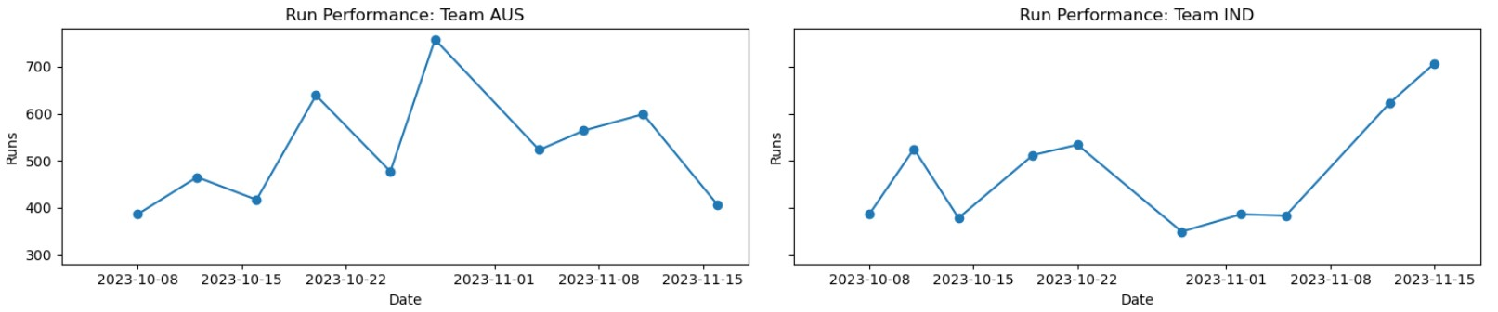
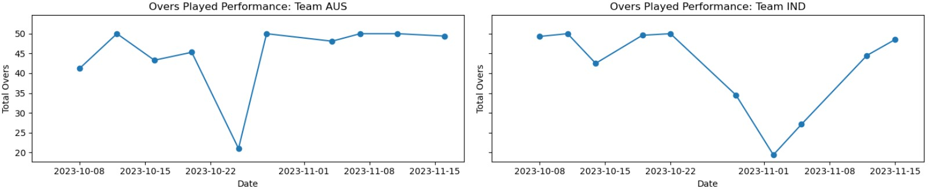
Temporal Analysis
Team’s Run Performance
Team’s Over Performance

Slide 13
Findings
In the month of October, around 07 teams scored more runs during that period and 03 teams scored the highest number of runs in the month of November.
In the month of October, around 07 teams possessed more overs and 03 teams possessed more overs in the Month of November.

Slide 14
Conclusions
The analysis was undertaken to evaluate and optimize players and team performance during a tournament, focusing specifically on key metrics across different oppositions and play grounds. The key finding is that team Sri Lanka exhibits a high dependency on specific play grounds, resulting to a decrease in runs when playing outside Delhi. Conversely, team India demonstrates superior consistency over time, with a steady increasing run rate.
We recommend the coaching staff investigate Player D's high single-innings score variability to determine if performance is linked to specific venues. Furthermore, prioritize match strategies that exploit the opposition's known weakness against high run-rates identified in the recent matches."

